Slide 1
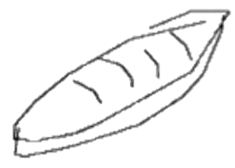

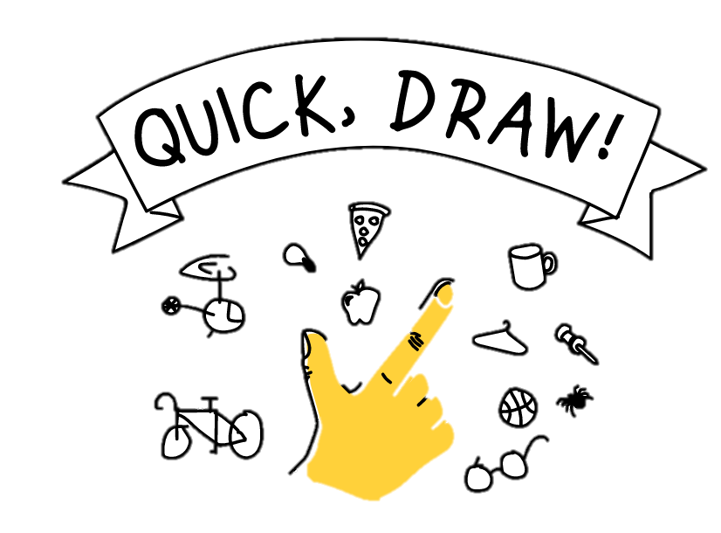
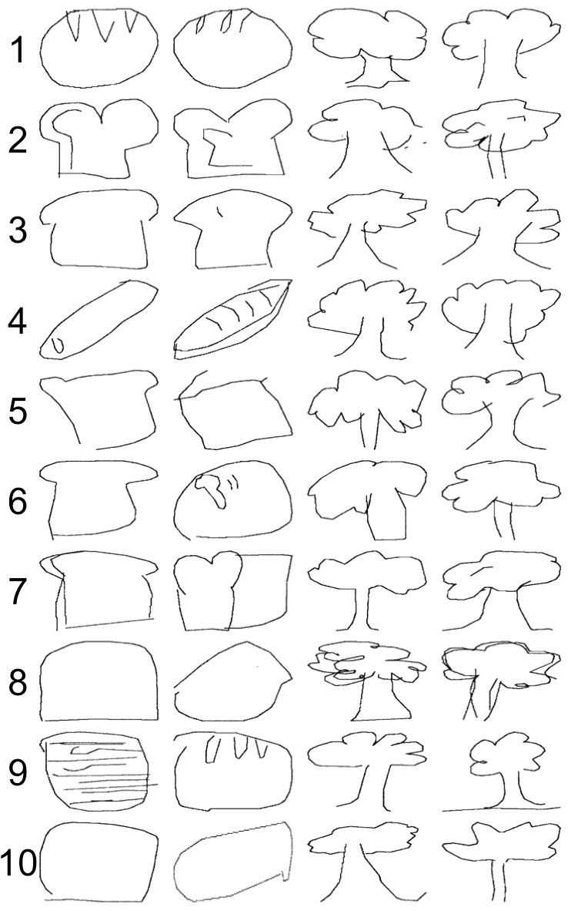
What 50 Million Drawings Can Tell Us About Shared Meaning
Molly Lewis and Gary Lupyan, University of Wisconsin-Madison
=
How to interrogate shared meaning?
Cross-Cultural Variability in Drawings
“bread”
Drawings as a window into meaning
50M drawings across 345 categories (N = 15M)
quickdraw.withgoogle.com
Quantifying Similarity
Hausdorff Distance — drawing similarity as the minimum Euclidean distance between two sets of points (Huttenlocher, Klanderman, & Rucklidge, 1993).
Predicting Variability with Language
Drawing Similarity:
50 drawings from each of 39 countries
Items from 4 categories: food (e.g., “cake”), weather (“cloud”), artifact (e.g. “key”), place (e.g. “jail”)
For each country pair, calculated mean drawing similarity for each category.
Independent Cultural Similarity Measures:
Lexical semantics – Alignment from word embedding models (Bojanowski et al., 2016)
Lexical forms – ASJP distance (Bakker, et al., 2009, Dediu, in press)
Grammar – WALS distance (Dediu, in press)
Physical distance
Japanese-Arabic
Measure Validation:
1500 drawing pairs from two categories
20 pairs from each decile of similarity/item
Rated for similarity on 7-pt. Likert Scale
Each participant (N =100) rated 50 drawing pairs
Human judgements highly correlated with Hausdorff Distance (r = .29; p < .001)
Danish-
Norwegian
Hausdorff Distance Quintile
Lexical semantics predicts independence variance in drawing distances, suggesting speakers of languages with more similar semantics have more similar non-linguistic representations.

Slide 2

Notes:
For tree – cosine similairites
Grouped by similarity
Hight of cluster -> degree of similarity

Slide 3
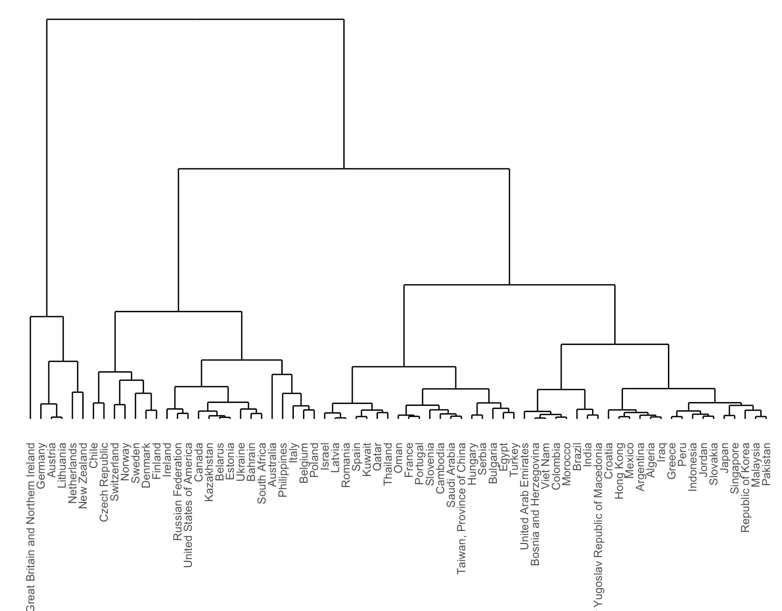
Notes:
For tree – cosine similairites
Grouped by similarity
Hight of cluster -> degree of similarity

