Slide 1
Getting Started with R
17 January 2020
Molly Lewis
Lab
Course Website: https://cumulativescience.netlify.com/

Slide 2
Rstudio.cloud logistics

Slide 3
How to get help
Tips for asking questions:
Format your questions nicely using markdown and code formatting.
Where appropriate, provide links to specific files, or even lines within them, in the body of your issue. This will help your helper understand your question
Give your question context from course concepts not couse assignments.
Good context: "I have a question on filtering"
Bad context: "I have a question on HW 1 question 4"
Be precise in your description:
Good description: "I am getting the following error and I'm not sure how to resolve it - Error: could not find function "ggplot""
Bad description: "R giving errors, help me! Aaaarrrrrgh!”
You can edit a question after posting it.

Slide 4
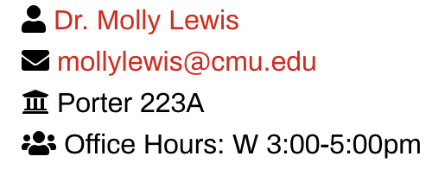
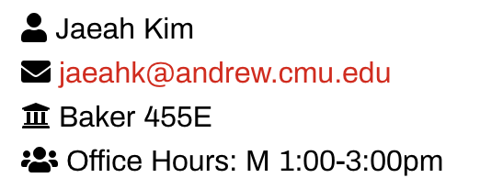
How to contact us
Email is best

Slide 5
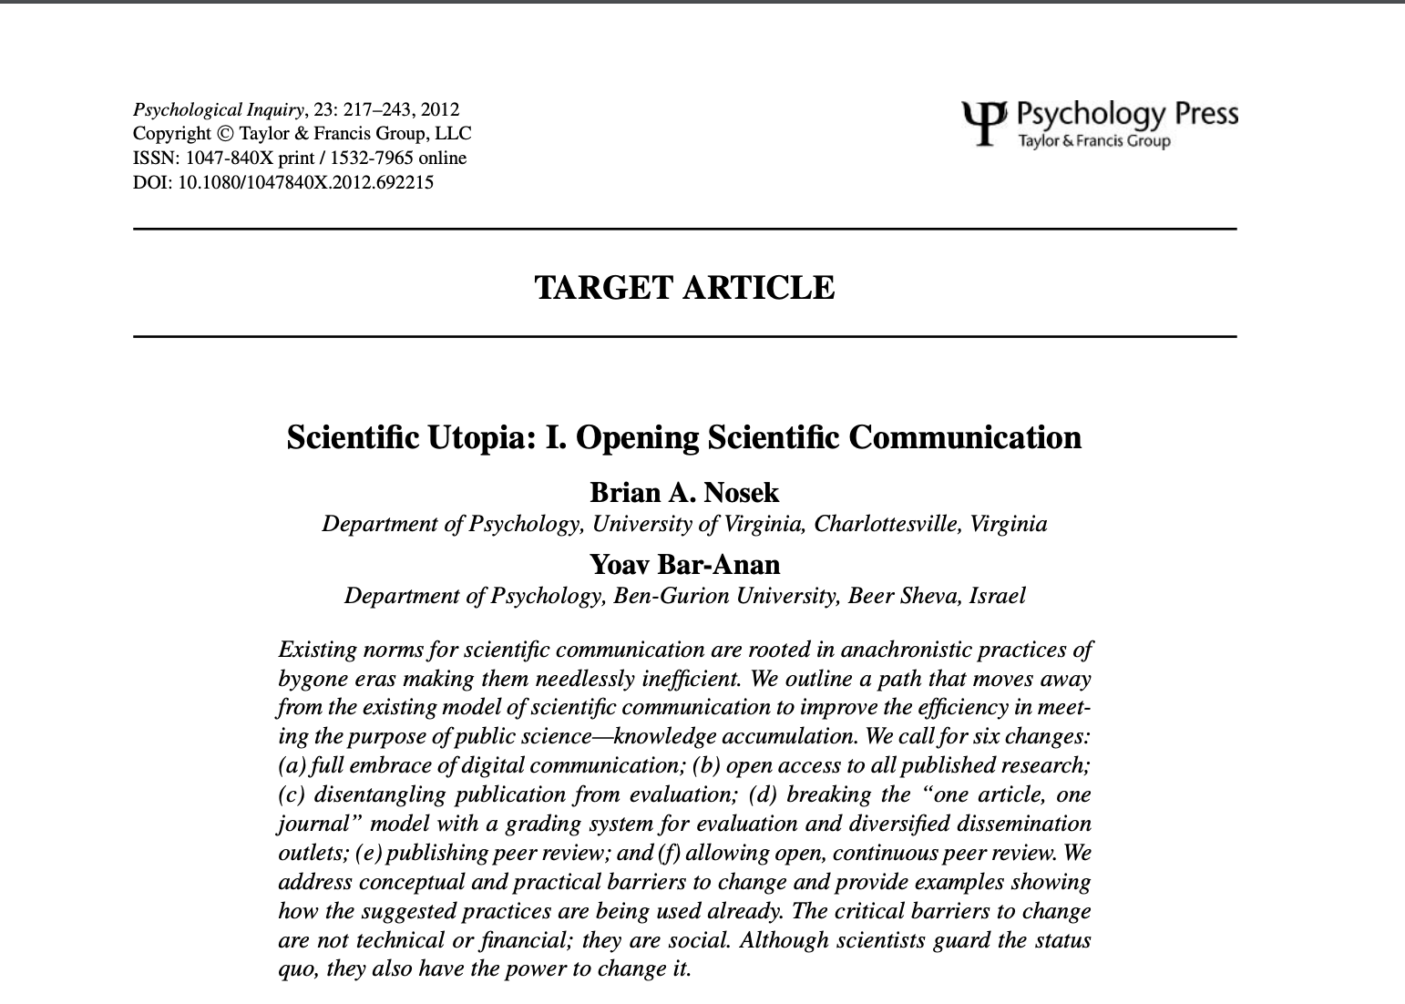
Next Time: What does doing science in psychology actually look like?
Imagine you’re a researcher and you get a cool finding – what do you do next?
The reading – only pages 217 - 225
Question to think about: In what sense do you think science is/is not a ”utopia”?

