Slide 1
The scientific process as cumulative
15 January 2020
Modern Research Methods
Molly Lewis
Course Website: https://cumulativescience.netlify.com/

Slide 2
Last Time:

Slide 3

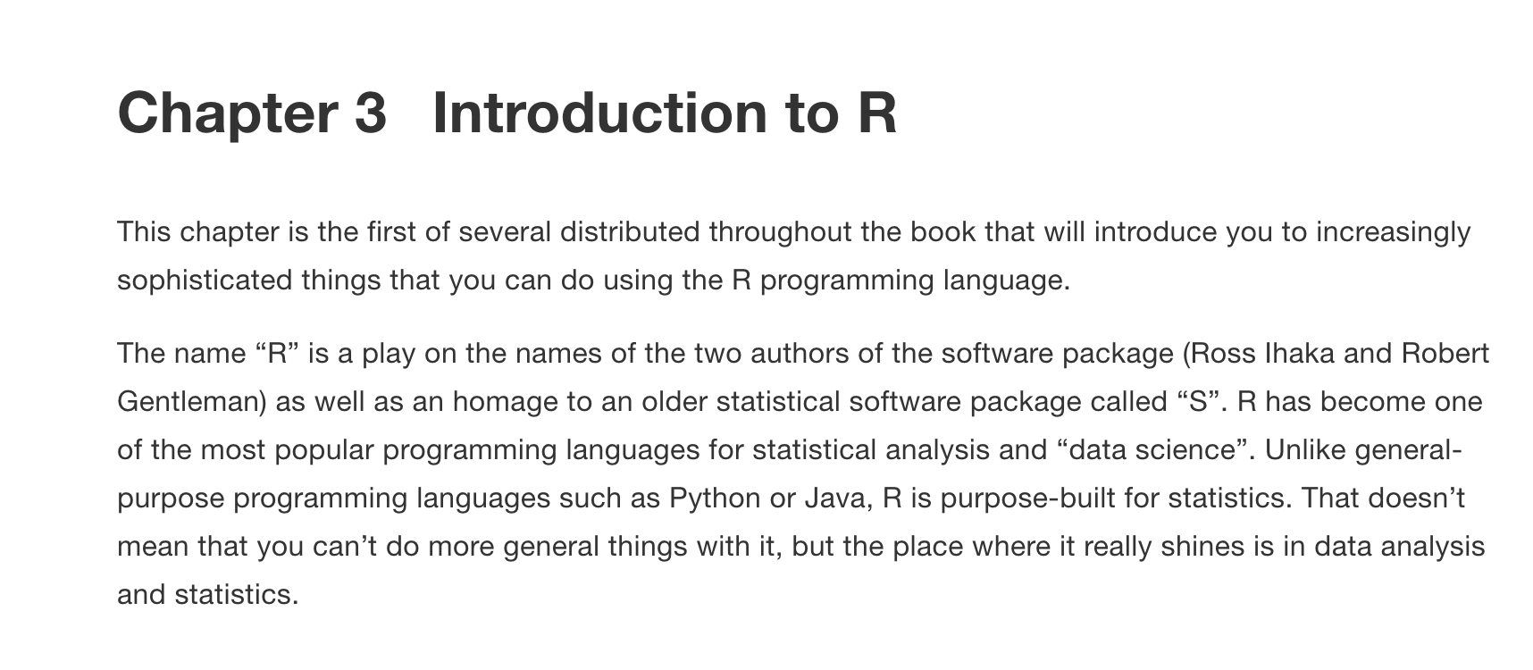
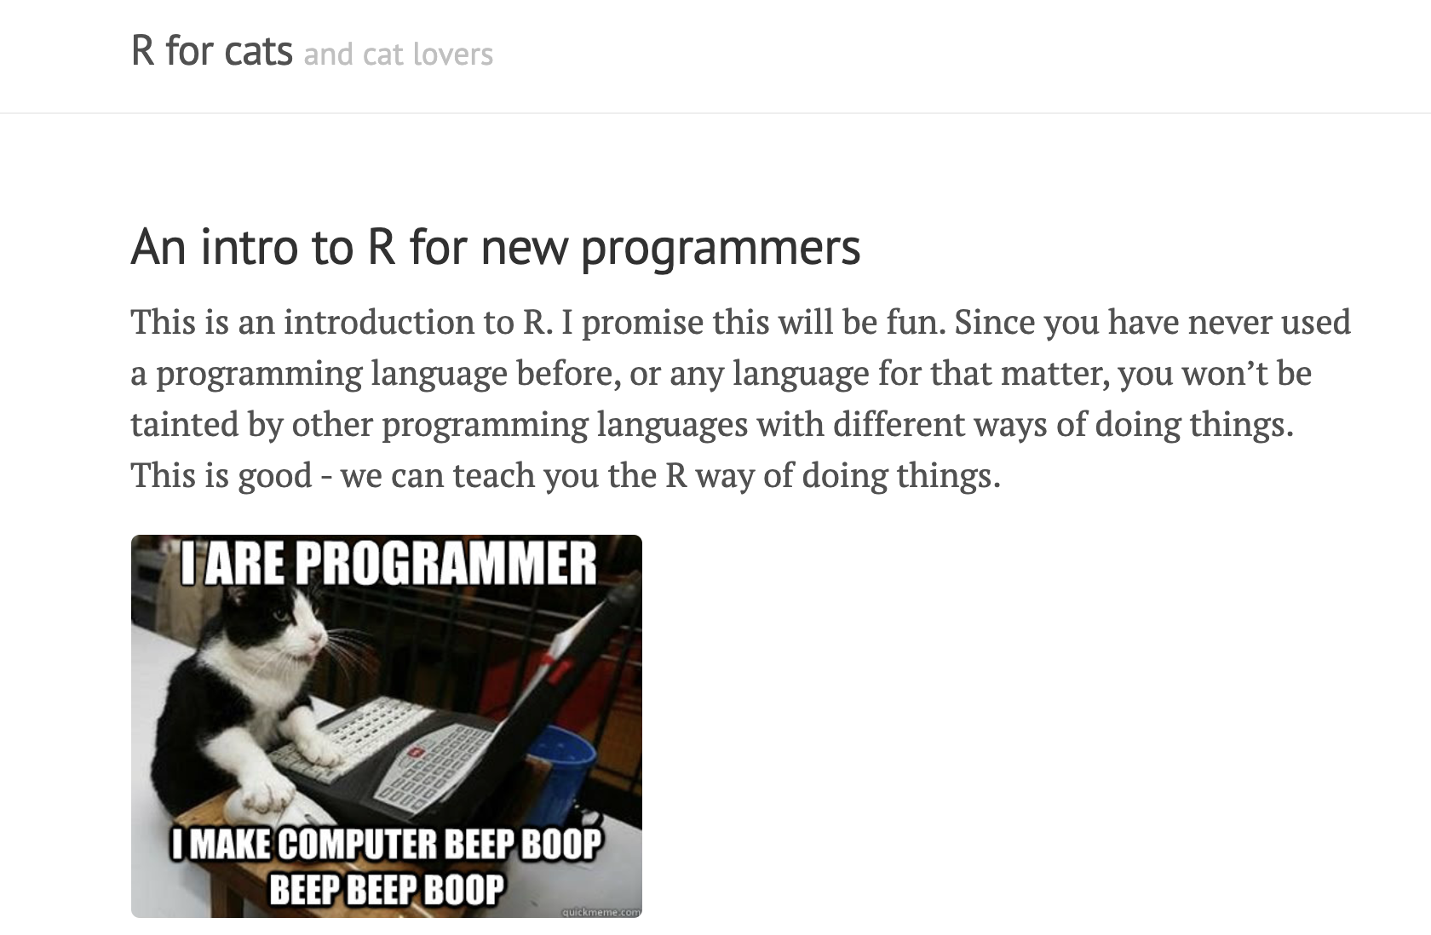
Next Time: Introduction to R (Lab)
Bring your computer if you prefer to use it
Porter 232P
Reading:

