Slide 1
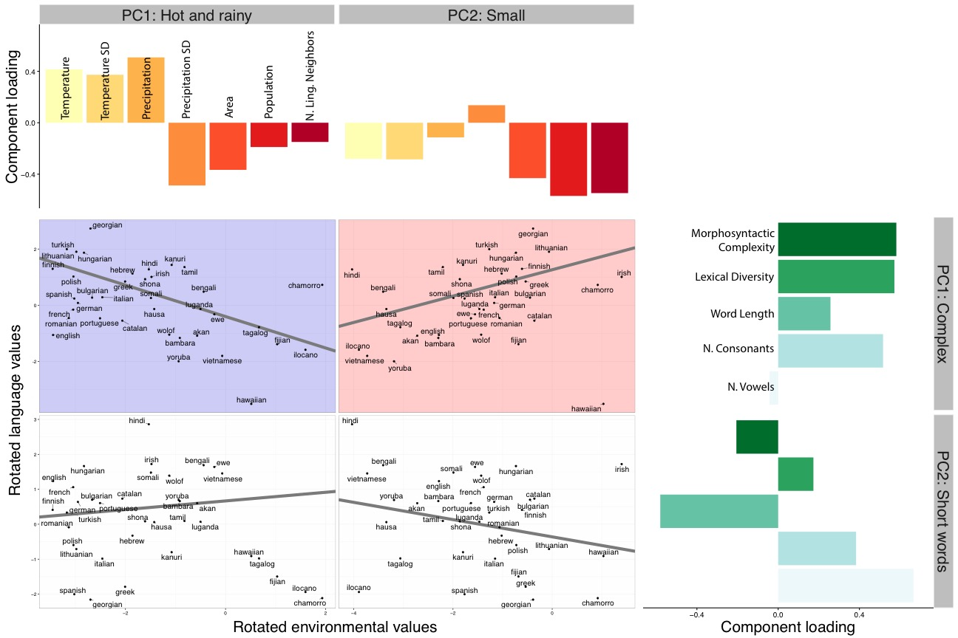
Synthesizing Evidence for the Linguistic Niche Hypothesis
Molly Lewis and Michael C. Frank, Stanford University
=
Linguistic Niche Hypothesis: Languages adapt to pressures in their environment.
(Lupyan & Dale, 2010; Wray & Grace, 2007)
Explore data: https://mlewis.shinyapps.io/lhnn/
Analysis 2: Principle component analysis
Two principle components for environmental variables (69% of variance) and linguistic variables (70%)
Predict ling. principle components with env. principle components
Analysis 1: Predicting each language variable with each environment variable
Aggregate datasets with environmental (n = 8) and linguistic variables (n = 6).
Linear mixed-effects regression (Jaeger, et al., 2011)
Languages in cold, small communities are more complex.
Notes:
language.variable ∼ environmental.variable + (environmental.variable | language.family) + (1 | origin.country)

