Slide 1
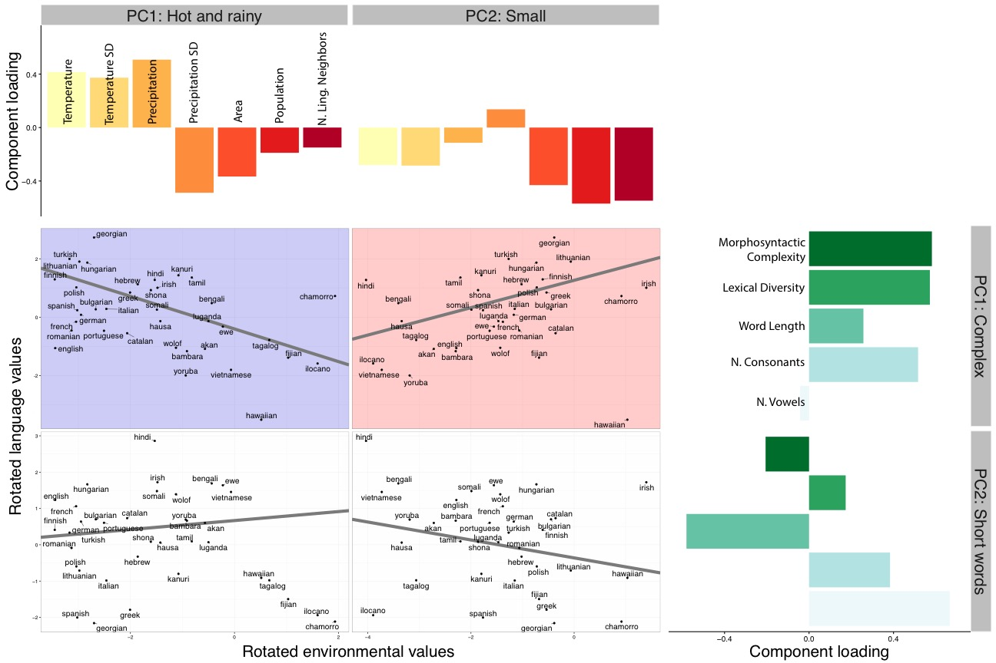
Synthesizing Evidence for the Linguistic Niche Hypothesis
Molly Lewis and Michael C. Frank, Stanford University
=
Linguistic Niche Hypothesis: Languages adapt to pressures in their environment.
(Lupyan & Dale, 2010; Wray & Grace, 2007).
Explore data: https://mlewis.shinyapps.io/lhnn/
Analysis 2: Principal component analysis
Two principle components for environmental variables (69% of variance) and linguistic variables (70%)
Predict ling. principle components with env. principle components
Analysis 1: Predicting each language variable with each environment variable
Aggregate datasets with environmental (n = 8) and linguistic variables (n = 6).
Linear mixed-effects regression (Jaeger, et al., 2011)
1
2
1
1
1
1
1
1
Languages in cold, small communities are more complex.
(1)
4
Linguistic variables
2
5
4
Environment variables
4
DATA SOURCES: 1. Lupyan & Dale (2010). 2. Bentz et al. (2015). 3. Moran, McCloy & Wright (2012). 4. Lewis & Frank (2016). 5. Wichmann, Rama, & Holman (2014).
Notes:
language.variable ∼ environmental.variable + (environmental.variable | language.family) + (1 | origin.country)

