Slide 1
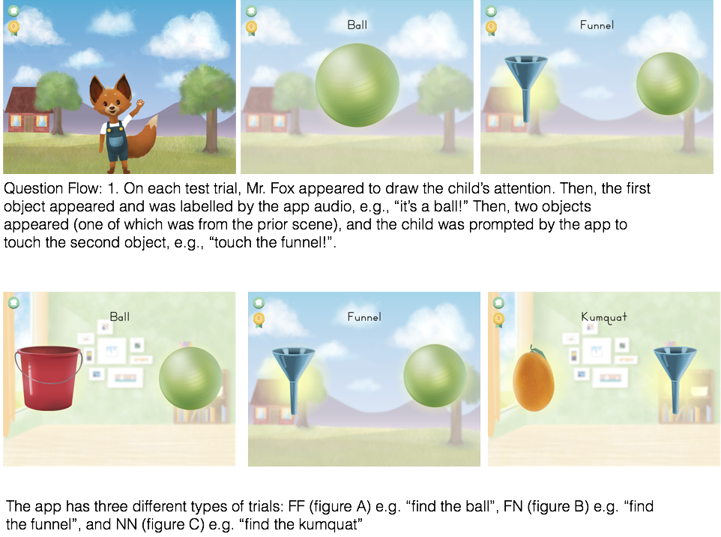
a
b
c
a
b
c

Slide 2
Trial Type
Display
Audio
Experimental-NF
Control-NF

