Slide 1
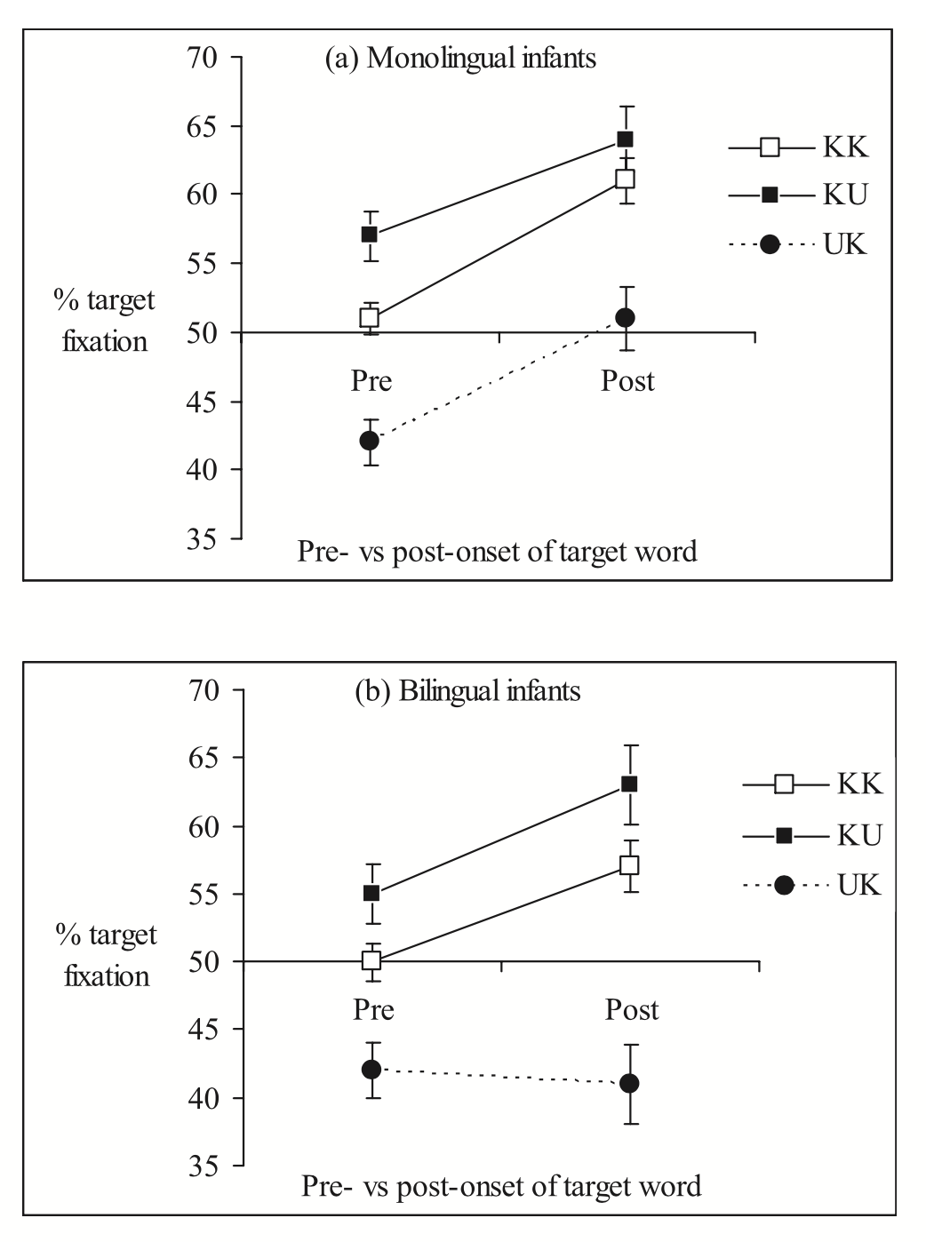
Height = 2.93 (35)
Y1 = .6
Y2 = 1.33
Y1SE = .13
Y2SE = .19
Y1 = .58
Y1SE = .15
Y2SE = .23
Y2 = .49

Slide 2
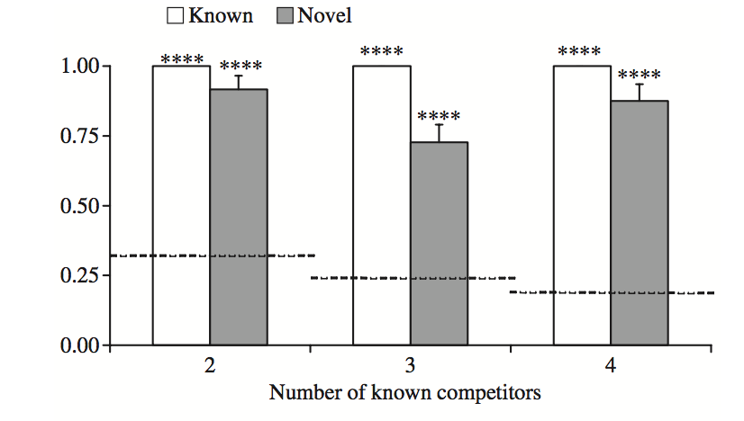
H = 3.17
Y2 = 2.91
Y2se = .16
Y3 = 2.3
Y3se = .19
Y4 = 2.77

Slide 3
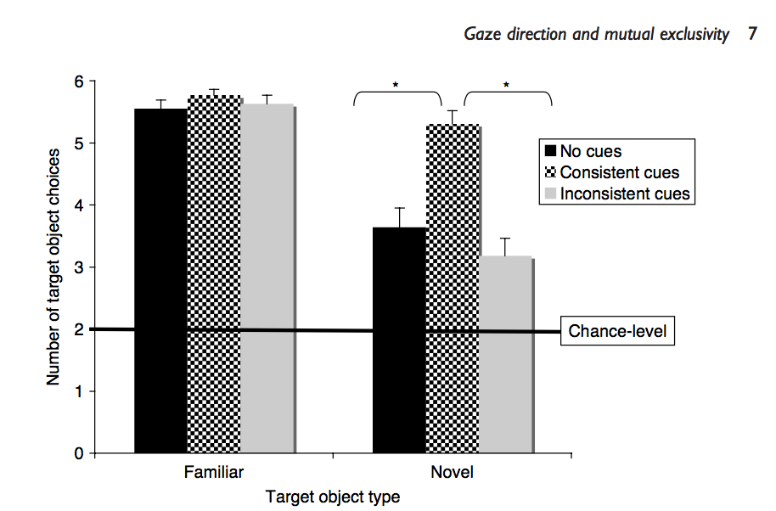
Graham (2010)
Y_nocues = 1.85
Y_consistent = 2.7
Se_nocues = .16
Se_consistent = .12
H = 3.05

