Slide 1
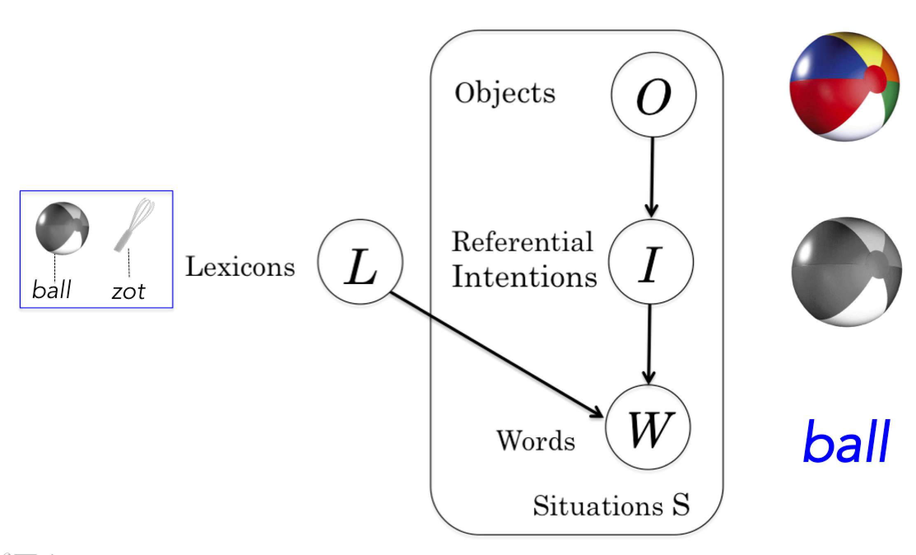


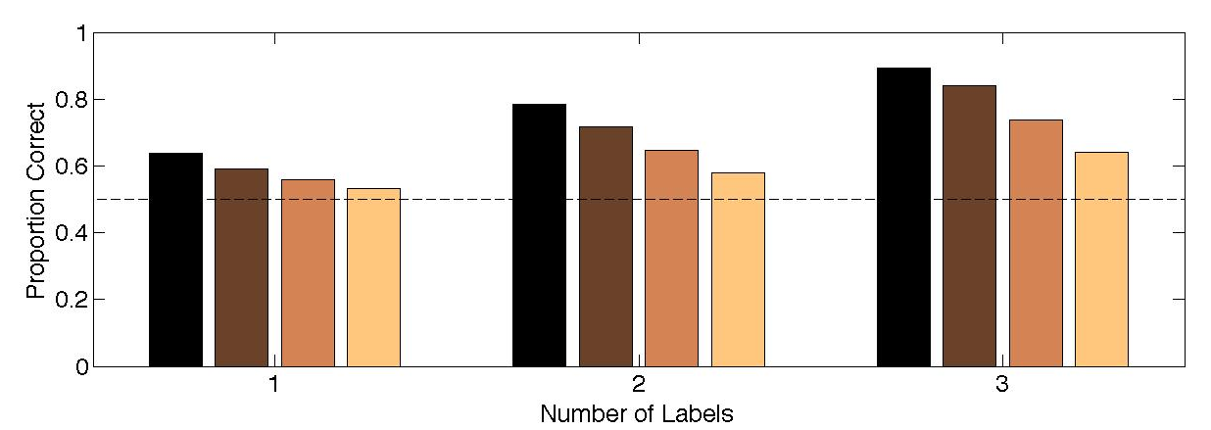
Modeling disambiguation in word learning via multiple probabilistic constraints
Molly Lewis and Michael C. Frank
Stanford University
Background
Method
Results
Mapping a word to its referent is an under-constrained learning problem.
One of the mechanisms hypothesized to constrain the problem is a bias to map novel words to novel objects –
termed the “Disambiguation effect”.
Two broad classes of theories exist to account for this effect.
Mutual-Exclusivity Constraint (e.g., Markman & Wachtel, 1988)
Bias to consider only those lexicons that have a 1-1 mapping between words and objects.
Pragmatic inference account (e.g., Clark, 1987)
Learners infer the speaker’s intent in the referential context, using basic principles of communication.
Empirical tests of these theories reveal inconsistencies (e.g. Diesendruck & Markson, 2001; Preissler & Carey, 2005).
Proposal:
Multiple classes of theories may be describing distinct, but complementary mechanisms, that jointly contribute to the disambiguation effect.
Hierarchical Bayesian Model
Simulation #1: Disambiguation at multiple levels
zot
Modeling the Disambiguation Task
Define space of lexicons, assuming world with 2 words and 2 objects
Observe situations
Determine the most likely lexicons, given situations (using Bayesian inference by exact enumeration)
Known-Word Training
Disambiguation Test
w1
w2
o1
o1
o2
Simulation #2: Hierarchical Constraint as modified by experience
Simulation #3: Simple Probabilistic
Route as modified by experience
Instantiating a hierarchical constraint
Impose 4 different constraints on lexicons:
(1) 1 word to 1 object
(2) 1 word to many objects
(3) many words to 1object
(4) null
Discussion
References
Neither disambiguation mechanism, as instantiated, is necessary to create a bias, but either is sufficient.
Disambiguation is strongest when both mechanisms jointly contribute.
May be difficult to tease apart these two aspects empirically (weights may vary across tasks/individuals).
Model provides a means to make precise quantitative predictions, with potential to resolve inconsistencies in the literature.
Clark, E. (1987). The principle of contrast: A constraint on
language acquisition. Mechanisms of Language Acquisition. Hillsdale, NJ: Erlbaum.
Diesendruck, G., & Markson, L. (2001). Children’s avoidance of lexical overlap: A pragmatic account. Developmental Psychology, 37, 630.
Markman, E., & Wachtel, G. (1988). Children’s use of mutual exclusivity to constrain the meanings of words. Cognitive Psychology, 20, 121–157.
Preissler, M., & Carey, S. (2005). The role of inferences about referential intent in word learning: Evidence from autism. Cognition, 97, B13–B23.

