Slide 1


Pragmatic Reasoning about Novel Words: The Effect of Context and Speaker
Elise Sugarman
December 3, 2013
Final Project: Computation and Cognition

Slide 2


Pragmatic Reasoning about a Novel Word’s Meaning
[ 0 0 ]
[ 1 0 ]
[ 0 1 ]
[ 1 1 ]
What is a wug?
- a flower with uniquely this rare feature?
-a flower with at least this rare feature?
Notes:
I want to start by asking you to imagine that this flower on the left can have two rare mutations.
It might have blue petals, and, independently of this feature, it might have thorns. It also might be unlucky enough to have both mutations.
Now imagine I showed you a flower with thorns and told you that it was a wug.
With this information, what could you tell me about the definition of wug?
Both a narrow and a broad definition seem logically consistent. Wug could refer to flowers with just this one special feature, or it could refer to flowers with at least this special feature
at this point, the meaning of “wug” is ambiguous: we’re not sure if the flower with blue petals and thorns would count as a wug.

Slide 3
With a speaker:
Without a speaker:
Sampling process important : how is observed data generated?
Shafto and Goodman 2012
Xu and Tenenbaum 2007
Notes:
Now imagine that I showed you these TWO flowers, and told you that the one on the left was a wug
Here, learning about the flower’s name in the context of the both feature flower seems to allow for extra information about the definition: after all, if I was trying to teach you that the definition of wug was inclusive, why wouldn’t I have just said that “both these flowers are wugs?”
Assuming that I’m an informative speaker, then, you might reason that wugs are flowers with uniquely thorns.
This situation might be understood as a type of specificity implicature: because I used the narrower possible definition of wug, you are licensed to reason that the broader definition of wug isn’t true.
Notice that this line of reasoning seems to crucially depend on the source of the context. If instead you you picked at random, and then picked one of those to learn that it was called a “wug,” we still wouldn’t know anything about the both feature flower. Without an informative speaker, the pragmatic reasoning does not go through, because without a speaker, there’s no reasoning about alternative utterances.
All of this amounts to basically pointing out that the sampling process is important for pragmatic reasoning.
Shafto and Goodman’s 2012 study focused on how purposeful pedagogical sampling effects learner’s guesses of rectangle concepts
Along similar lines, Xu and Tenenbaum’s 2007 “Sensitivity to sampling in Bayesian word learning” discusses the difference between observations in word learning drawn from the probability distribution by the learner, called weak sampling, and observations drawn from the extension of the word by a teacher, called strong sampling

Slide 4
Hypothesis: Word learners who receive information about speaker-given context will be more likely to guess in line with the more conservation definition
Notes:
These learners will be more inclined to think that wugs are flowers with only one special feature

Slide 5
Experimental Design
Two by two between subjects design
Varying presence of context and of an informative speaker
Coded in JavaScript, HTML, CSS environment
responses solicited through email and social media
Data logged to lab server through a PHP script
langcog.stanford.edu/expts/MLL/ES_contextandspeaker/final204.html
Notes:
In order to test this hypothesis, my experiment relied on a two by two between subjects design
If you’re curious the study is hosted at this site
Each experiment consisted of three main slides

Slide 6
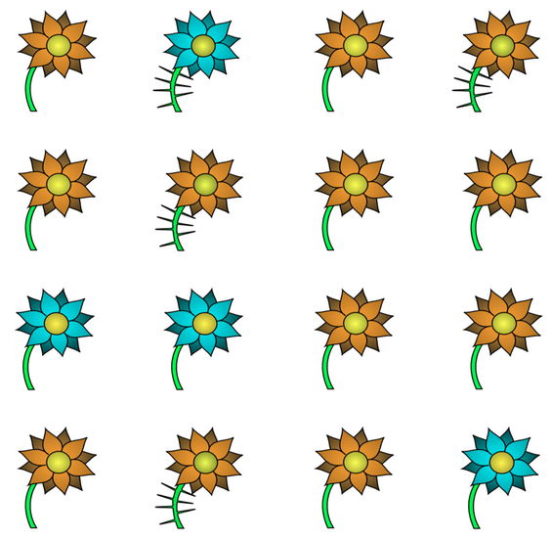

1) Exposure to base rate probabilities of features
P = 0.25 for both blue petal feature and thorn feature
Notes:
Same slide for everyone

Slide 7
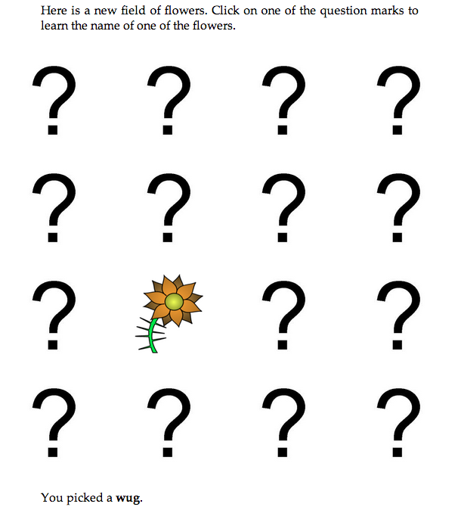
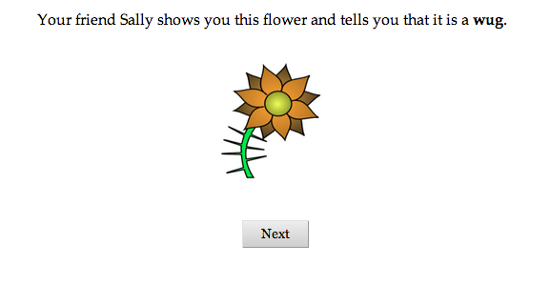
2) Word learning varied across conditions: No Context Cases
Speaker
No Speaker
Notes:
Participants learned the meaning of the novel word in various ways.
Worth mentioning that the novel word is randomized, and feature – whether the “wug” has just thorns or just blue petals -- is also randomized

Slide 8
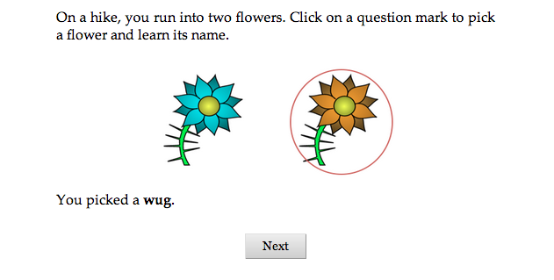
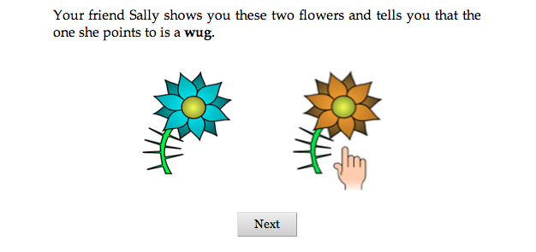
2) Word learning varied across conditions: Context Cases
No Speaker
Speaker
Notes:
-In the no speaker case, the cover story implies that the two flowers were found at random, and the participant is led to believe that they’ve click on one of these two flowers to learn what it’s called
-In the speaker case, a friend shows the participant both flowers and then tells them that one of them is the novel word

Slide 9
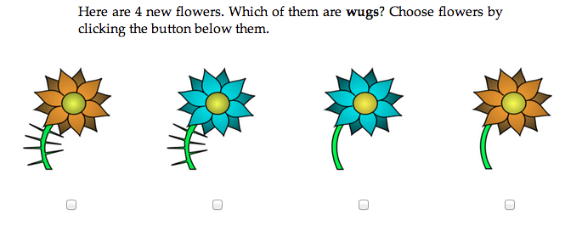
3) Query
Notes:
Finally, participants were shown a scrambled array of all four flower types and asked which of these four flowers the novel word they learned refers to

Slide 10
Hypothesis: Word learners who receive information about speaker-given context will be more likely to guess in line with the more conservation definition
Notes:
Summarized in a graph: We might expect that generalizations to the flower with both features will be lower for a group that has an informative speaker and context than for any other group

Slide 11
Results
N = 302
Notes:
Here are the results. Sadly enough none of these four conditions, nor context or speaker isolated, turned out to be statistically significant.

Slide 12
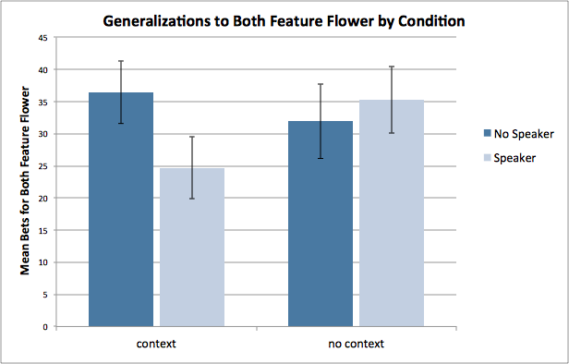
Results with bet measure

Slide 13
Context/No Speaker the same as Context/ Speaker
No Context/Speaker the same as Context/Speaker
Notes:
There are two main ways in which these results differ from the expected results.
First: Neither of the context cases differed
Second: Neither of the speaker cases differed
I will briefly speculate possible reasons for each

Slide 14
Context/No Speaker the same as Context/ Speaker
No Context/Speaker the same as Context/Speaker
Difficult to separate speaker and non-speaker cases in an experimental paradigm
Even in no context condition, speaker is assumed to be maximally informative
Notes:
First of all, participants weren’t sensitive to the sampling difference between No Speaker and Speaker trials in the Context cases.
This might be because it is difficult to set the origin of the sample in an experimental paradigm, where participants will assume that there is some “experimenter” with intentionality. Unlike in the real world, where someone could roll a die and see it turn up as green, it is difficult to convince a participant that something is truly randomly picked in a study.

Slide 15
Context/No Speaker the same as Context/ Speaker
No Context/Speaker the same as Context/Speaker
Difficult to separate speaker and non-speaker cases in an experimental paradigm
Even in no context condition, speaker is assumed to be maximally informative
Notes:
First of all, participants weren’t sensitive to the sampling difference between No Speaker and Speaker trials in the Context cases.
This might be because it is difficult to set the origin of the sample in an experimental paradigm, where participants will assume that there is some “experimenter” with intentionality. Unlike in the real world, where someone could roll a die and see it turn up as green, it is difficult to convince a participant that something is truly randomly picked in a study.

Slide 16
Context/No Speaker the same as Context/ Speaker
No Context/Speaker the same as Context/Speaker
Difficult to separate speaker and non-speaker cases in an experimental paradigm
Even in no context condition, speaker is assumed to be maximally informative
Notes:
First of all, participants weren’t sensitive to the sampling difference between No Speaker and Speaker trials in the Context cases.
This might be because it is difficult to set the origin of the sample in an experimental paradigm, where participants will assume that there is some “experimenter” with intentionality. Unlike in the real world, where someone could roll a die and see it turn up as green, it is difficult to convince a participant that something is truly randomly picked in a study.

Slide 17
Context/No Speaker the same as Context/ Speaker
No Context/Speaker the same as Context/Speaker
Difficult to separate speaker and non-speaker cases in an experimental paradigm
Even in no context condition, speaker is assumed to be maximally informative
Notes:
Second of all, regardless of context, participants werejust as likely to guess that the meaning of the word is restricted to flowers with uniquely one feature.
This might be because even in the no context condition, the speaker is also assumed to be maximally informative. Counterfactuals about which flowers the speaker decides to show the listener might be treated as just as relevant to the reasoning process as a speaker’s utterance. Maybe, then, the fact that a speaker only shows the listener one flower in the no context case as opposed to another flower, or more than one flower, gives the listener information that allows them to reason to the narrower definition just as successfully.

Slide 18
Context/No Speaker the same as Context/ Speaker
No Context/Speaker the same as Context/Speaker
Difficult to separate speaker and non-speaker cases in an experimental paradigm
Even in no context condition, speaker is assumed to be maximally informative
Notes:
Second of all, and more puzzlingly, regardless of context, participants were just as likely to guess that the meaning of the word is restricted to flowers with uniquely one feature.
This might be because even in the no context condition, the speaker is also assumed to be maximally informative. Counterfactuals about which flowers the speaker decides to show the listener might be treated as just as relevant to the reasoning process as a speaker’s utterance. Maybe, then, the fact that a speaker only shows the listener one flower in the no context case as opposed to another flower, or more than one flower, gives the listener information that allows them to reason to the narrower definition just as successfully.

Slide 19
Context/No Speaker the same as Context/ Speaker
No Context/Speaker the same as Context/Speaker
Difficult to separate speaker and non-speaker cases in an experimental paradigm
Even in no context condition, speaker is assumed to be maximally informative
Notes:
Second of all, regardless of context, participants were just as likely to guess that the meaning of the word is restricted to flowers with uniquely one feature.
This might be because even in the no context condition, the speaker is also assumed to be maximally informative. Counterfactuals about which flowers the speaker decides to show the listener might be treated as just as relevant to the reasoning process as a speaker’s utterance. Maybe, then, the fact that a speaker only shows the listener one flower in the no context case as opposed to another flower, or more than one flower, gives the listener information that allows them to reason to the narrower definition just as successfully.

Slide 20
Directions Forward
Allow participants opportunity to express uncertainty
Graded responses (betting from 0 to 100) instead of binary variable from checkboxes
Notes:
-The lack of conclusive results in this study might have also had something to do simply with how the query slide was set up. Checkboxes only allow for participants to answer “yes” or “no” to whether objects are wugs. Clicking a box to commit to the fact that something is actually a wug, when only one positive example has been offered, might be too demanding.
-to better accommodate uncertainty and make guesses less intimidating, a future version of the study could use textboxes where participants bet which flowers were wugs on a numeric scale

Slide 21
Special Thanks to:
Molly Lewis and Professor Michael Frank
PSYCH204 Teaching team: Professor Noah Goodman and TAs
Erin for the awesome stimuli

