Slide 1
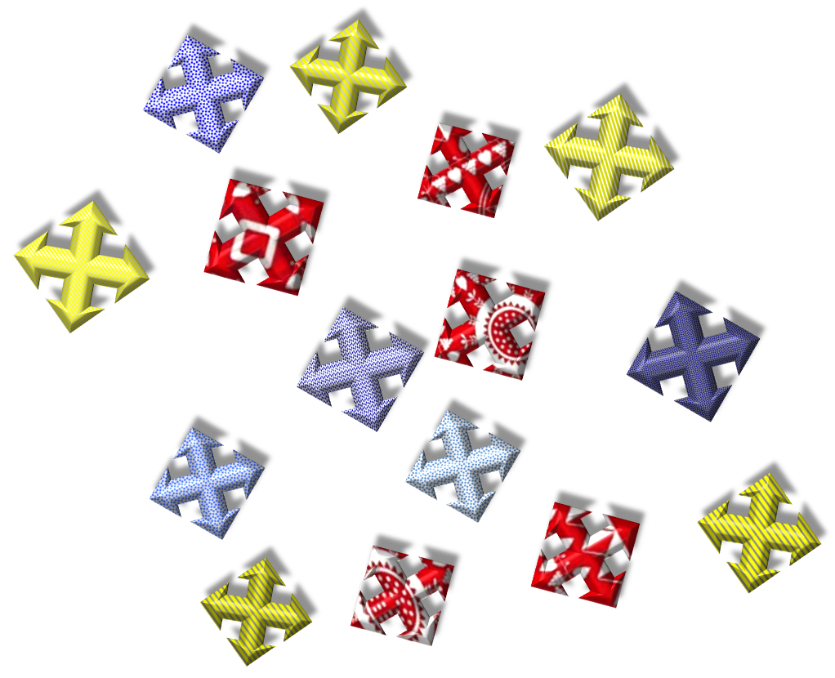
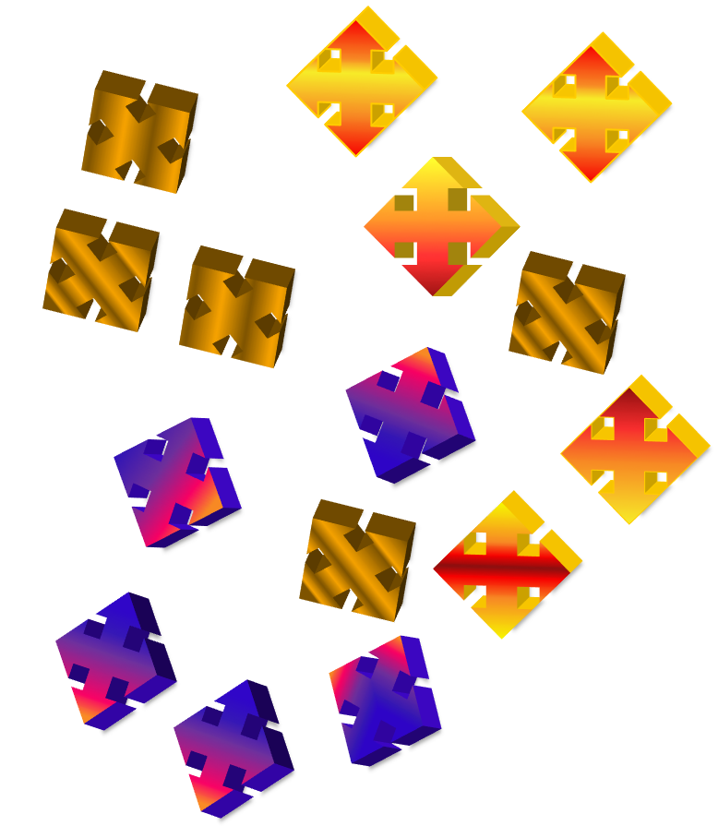


Experiments 1-3
Experiments 4-5
Notes:
mollyllewis[at]gmail[dot]com

Slide 6
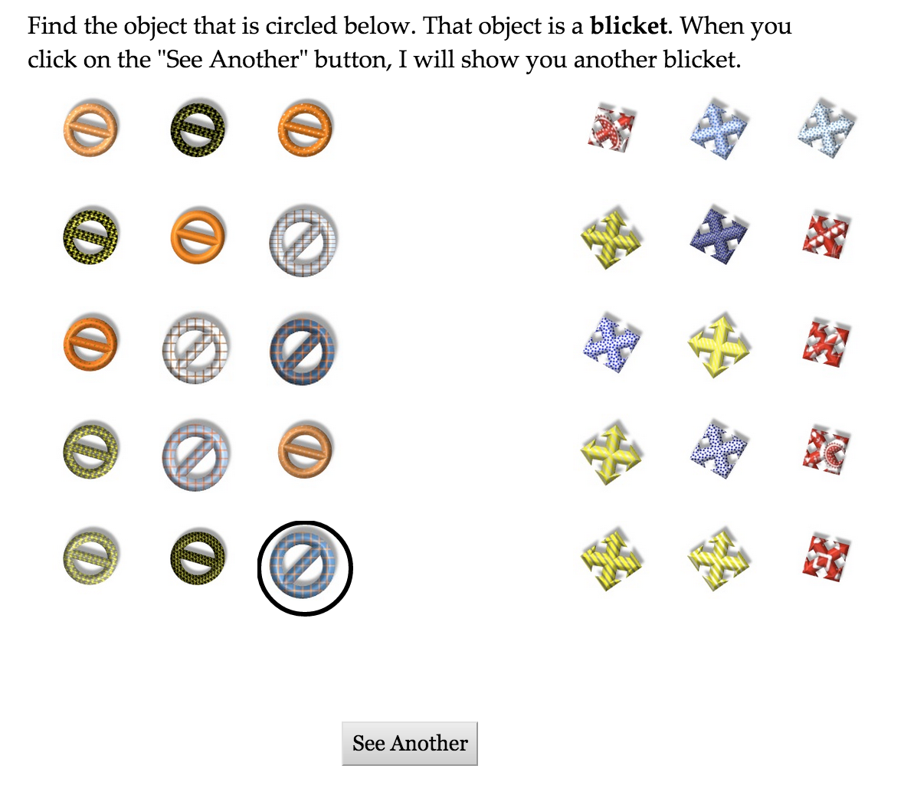

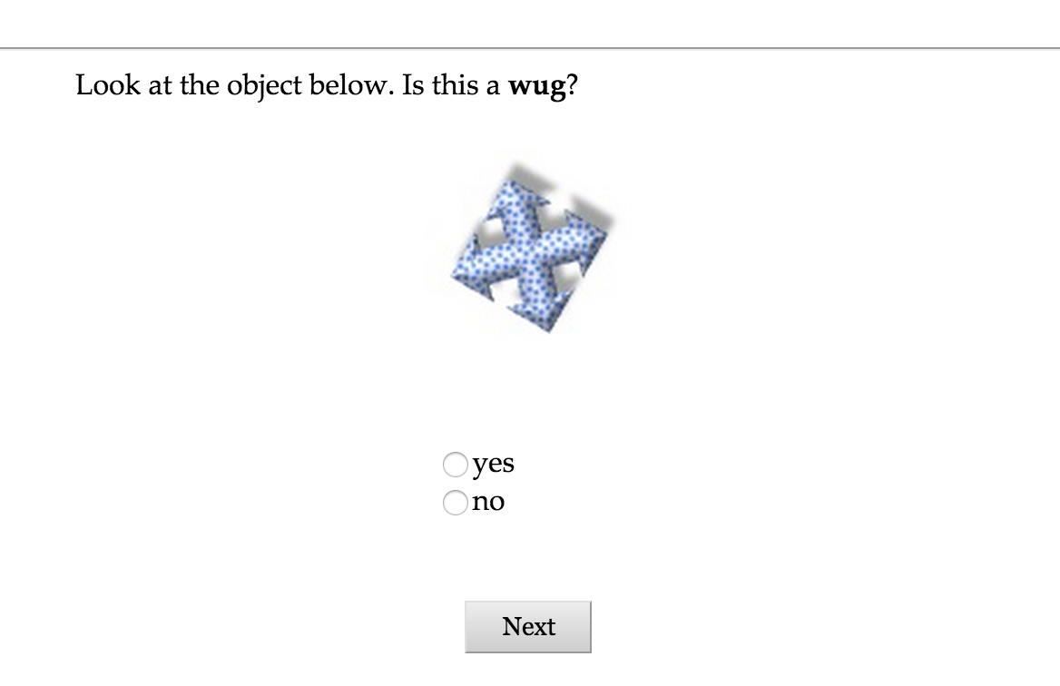

Training
Testing

Slide 7
Training
Testing

