Slide 1
Machine Learning Models Deployment using Sklearn2SQL framework
Technical Presentation
Antoine CARME (2022)
Antoine.CARME@outlook.com
https://github.com/antoinecarme/sklearn2sql-demo

Slide 2
What is Sklearn2SQL ?
sklearn2sql is a “development tool” for generating deployment SQL code from scikit-learn objects.
  https://github.com/antoinecarme/sklearn2sql-demo
Using sklearn2sql, it is possible to predict values from an already-fitted classifier or a regressor simply by executing some SQL code.
It can be seen as an alternative to PMML-based methods to perform In-database processing.
It performs the deployment where the data are : in the database !!!
  No data transfer is needed
  An asset for performance and security.
  SQL can also be validated and adapted before execution.
  SQL is software : it can be integrated easily in large systems.
  Easily distributable : one can generate SQL codes for all databases at the enterprise level and execute the same model with locally-adapted SQL codes.

Slide 3
Supported Machine Learning Models
It is designed to support all classification and regression methods in scikit-learn
  SVMs, linear models, naive-bayes. decision trees, MLP, etc
  Transformers (PCA, imputers, scalers)
  Feature selection
  Outlier detection
  Derived models (random forests, meta-estimators, pipelines, feature unions, ensembles, etc).

Slide 4
Supported Databases
Support for most popular relational databases has been added progressively. Now, sklearn2sql supports almost all the leading relational databases referenced on DB-Engines.
  https://db-engines.com/en/ranking/relational+dbms
Open source databases : PostgreSQL (Just perfect !!!, most derived database), MariaDB (contributed some CTE-related bugs for this project. Very reactive team. All bugs were fixed !!!!
Commercial databases : Oracle, MS SQL Server, IBM DB2, Teradata (to cover 95% of the market and get real-world tests)
Embedded databases : SQLite (even in-memory ;). Nice for prototyping, documentation and development. Zero config. Available everywhere (on Android and iOS devices and inside jupyter notebooks ;).
Hadoop databases : Hive and Impala
Other : Firebird (low memory footprint. A stress test ;) , Monetdb (columnar, a SQL quality reminder ;)

Slide 5
Sample Codes 1/4
-- This SQL code was generated by sklearn2sql (development version).
-- Copyright 2018
-- Model : DecisionTreeClassifier
-- Dataset : iris
-- Database : mysql
-- This SQL code can contain one or more statements, to be executed in the order they appear in this file.
-- Model deployment code
WITH `DT_node_lookup` AS
(SELECT `ADS`.`KEY` AS `KEY`, CASE WHEN (`ADS`.`Feature_3` <= 0.800000011920929) THEN 1 ELSE CASE WHEN (`ADS`.`Feature_2` <= 4.850000381469727) THEN CASE WHEN (`ADS`.`Feature_3` <= 1.6500000953674316) THEN 4 ELSE CASE WHEN (`ADS`.`Feature_1` <= 3.0999999046325684) THEN 6 ELSE 7 END END ELSE CASE WHEN (`ADS`.`Feature_3` <= 1.75) THEN CASE WHEN (`ADS`.`Feature_2` <= 5.050000190734863) THEN CASE WHEN (`ADS`.`Feature_1` <= 2.3499999046325684) THEN 11 ELSE 12 END ELSE 13 END ELSE 14 END END END AS node_id_2
FROM iris AS `ADS`),
`DT_node_data` AS
(SELECT `Values`.node_id AS node_id, `Values`.feature AS feature, `Values`.threshold AS threshold, `Values`.count AS count, `Values`.depth AS depth, `Values`.parent_id AS parent_id, `Values`.`Proba_0` AS `Proba_0`, `Values`.`LogProba_0` AS `LogProba_0`, `Values`.`Proba_1` AS `Proba_1`, `Values`.`LogProba_1` AS `LogProba_1`, `Values`.`Proba_2` AS `Proba_2`, `Values`.`LogProba_2` AS `LogProba_2`, `Values`.`Decision` AS `Decision`, `Values`.`DecisionProba` AS `DecisionProba`
FROM (SELECT 1 AS node_id, CAST(NULL AS CHAR(256)) AS feature, NULL AS threshold, 37 AS count, 1 AS depth, 0 AS parent_id, 1.0 AS `Proba_0`, 0.0 AS `LogProba_0`, 0.0 AS `Proba_1`, -1.79769313486231e+308 AS `LogProba_1`, 0.0 AS `Proba_2`, -1.79769313486231e+308 AS `LogProba_2`, 0 AS `Decision`, 1.0 AS `DecisionProba` UNION ALL SELECT 4 AS node_id, CAST(NULL AS CHAR(256)) AS feature, NULL AS threshold, 36 AS count, 3 AS depth, 3 AS parent_id, 0.0 AS `Proba_0`, -1.79769313486231e+308 AS `LogProba_0`, 1.0 AS `Proba_1`, 0.0 AS `LogProba_1`, 0.0 AS `Proba_2`, -1.79769313486231e+308 AS `LogProba_2`, 1 AS `Decision`, 1.0 AS `DecisionProba` UNION ALL SELECT 6 AS node_id, CAST(NULL AS CHAR(256)) AS feature, NULL AS threshold, 2 AS count, 4 AS depth, 5 AS parent_id, 0.0 AS `Proba_0`, -1.79769313486231e+308 AS `LogProba_0`, 0.0 AS `Proba_1`, -1.79769313486231e+308 AS `LogProba_1`, 1.0 AS `Proba_2`, 0.0 AS `LogProba_2`, 2 AS `Decision`, 1.0 AS `DecisionProba` UNION ALL SELECT 7 AS node_id, CAST(NULL AS CHAR(256)) AS feature, NULL AS threshold, 1 AS count, 4 AS depth, 5 AS parent_id, 0.0 AS `Proba_0`, -1.79769313486231e+308 AS `LogProba_0`, 1.0 AS `Proba_1`, 0.0 AS `LogProba_1`, 0.0 AS `Proba_2`, -1.79769313486231e+308 AS `LogProba_2`, 1 AS `Decision`, 1.0 AS `DecisionProba` UNION ALL SELECT 11 AS node_id, CAST(NULL AS CHAR(256)) AS feature, NULL AS threshold, 1 AS count, 5 AS depth, 10 AS parent_id, 0.0 AS `Proba_0`, -1.79769313486231e+308 AS `LogProba_0`, 0.0 AS `Proba_1`, -1.79769313486231e+308 AS `LogProba_1`, 1.0 AS `Proba_2`, 0.0 AS `LogProba_2`, 2 AS `Decision`, 1.0 AS `DecisionProba` UNION ALL SELECT 12 AS node_id, CAST(NULL AS CHAR(256)) AS feature, NULL AS threshold, 3 AS count, 5 AS depth, 10 AS parent_id, 0.0 AS `Proba_0`, -1.79769313486231e+308 AS `LogProba_0`, 1.0 AS `Proba_1`, 0.0 AS `LogProba_1`, 0.0 AS `Proba_2`, -1.79769313486231e+308 AS `LogProba_2`, 1 AS `Decision`, 1.0 AS `DecisionProba` UNION ALL SELECT 13 AS node_id, CAST(NULL AS CHAR(256)) AS feature, NULL AS threshold, 3 AS count, 4 AS depth, 9 AS parent_id, 0.0 AS `Proba_0`, -1.79769313486231e+308 AS `LogProba_0`, 0.0 AS `Proba_1`, -1.79769313486231e+308 AS `LogProba_1`, 1.0 AS `Proba_2`, 0.0 AS `LogProba_2`, 2 AS `Decision`, 1.0 AS `DecisionProba` UNION ALL SELECT 14 AS node_id, CAST(NULL AS CHAR(256)) AS feature, NULL AS threshold, 37 AS count, 3 AS depth, 8 AS parent_id, 0.0 AS `Proba_0`, -1.79769313486231e+308 AS `LogProba_0`, 0.0 AS `Proba_1`, -1.79769313486231e+308 AS `LogProba_1`, 1.0 AS `Proba_2`, 0.0 AS `LogProba_2`, 2 AS `Decision`, 1.0 AS `DecisionProba`) AS `Values`),
`DT_Output` AS
(SELECT `DT_node_lookup`.`KEY` AS `KEY`, `DT_node_lookup`.node_id_2 AS node_id_2, `DT_node_data`.node_id AS node_id, `DT_node_data`.feature AS feature, `DT_node_data`.threshold AS threshold, `DT_node_data`.count AS count, `DT_node_data`.depth AS depth, `DT_node_data`.parent_id AS parent_id, `DT_node_data`.`Proba_0` AS `Proba_0`, `DT_node_data`.`LogProba_0` AS `LogProba_0`, `DT_node_data`.`Proba_1` AS `Proba_1`, `DT_node_data`.`LogProba_1` AS `LogProba_1`, `DT_node_data`.`Proba_2` AS `Proba_2`, `DT_node_data`.`LogProba_2` AS `LogProba_2`, `DT_node_data`.`Decision` AS `Decision`, `DT_node_data`.`DecisionProba` AS `DecisionProba`
FROM `DT_node_lookup` LEFT OUTER JOIN `DT_node_data` ON `DT_node_lookup`.node_id_2 = `DT_node_data`.node_id)
SELECT `DT_Output`.`KEY` AS `KEY`, NULL AS `Score_0`, NULL AS `Score_1`, NULL AS `Score_2`, `DT_Output`.`Proba_0` AS `Proba_0`, `DT_Output`.`Proba_1` AS `Proba_1`, `DT_Output`.`Proba_2` AS `Proba_2`, `DT_Output`.`LogProba_0` AS `LogProba_0`, `DT_Output`.`LogProba_1` AS `LogProba_1`, `DT_Output`.`LogProba_2` AS `LogProba_2`, `DT_Output`.`Decision` AS `Decision`, `DT_Output`.`DecisionProba` AS `DecisionProba`
FROM `DT_Output`

Slide 6
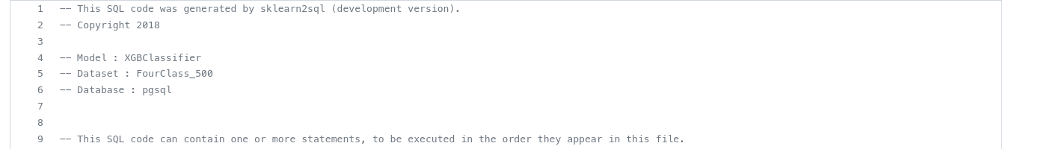
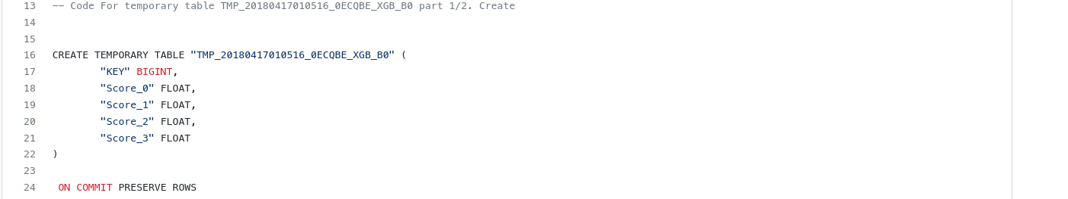
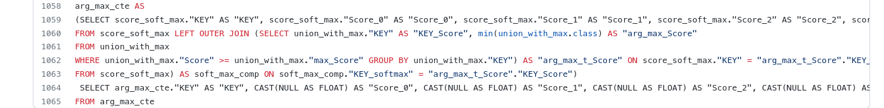
Sample Codes 2/4
https://github.com/antoinecarme/sklearn2sql-demo/blob/master/VeryLargeModelsSupport_temp_tables/XGBClassifier/FourClass_500/pgsql/demo3_XGBClassifier_pgsql.sql

Slide 7
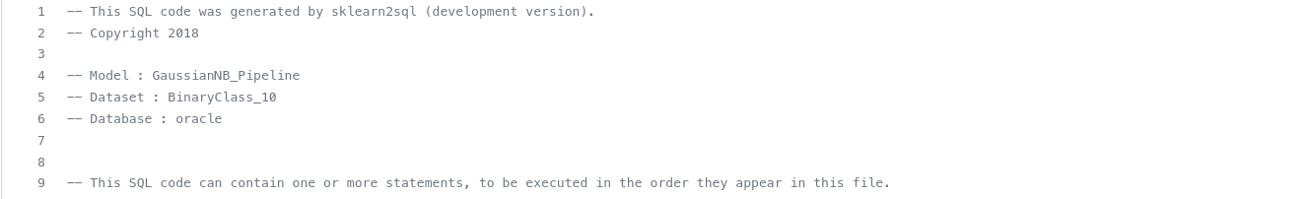
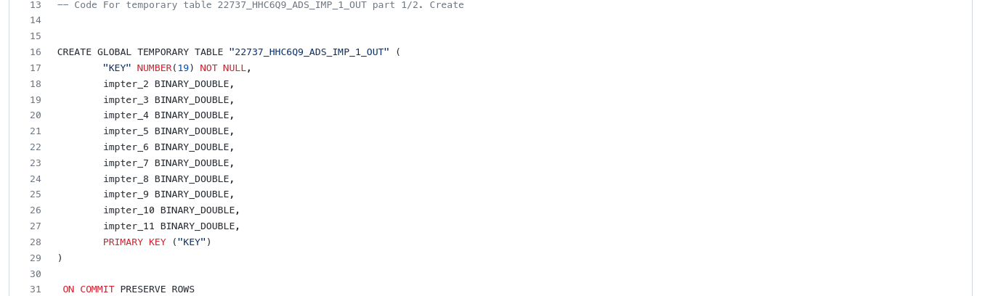
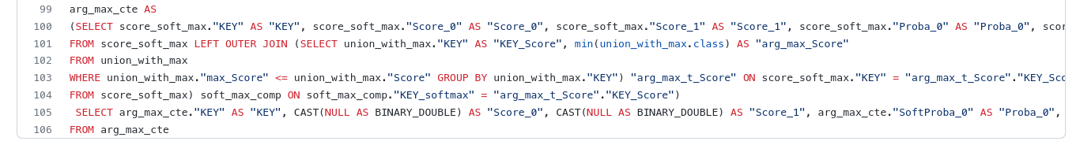
Sample Codes 3/4

Slide 8
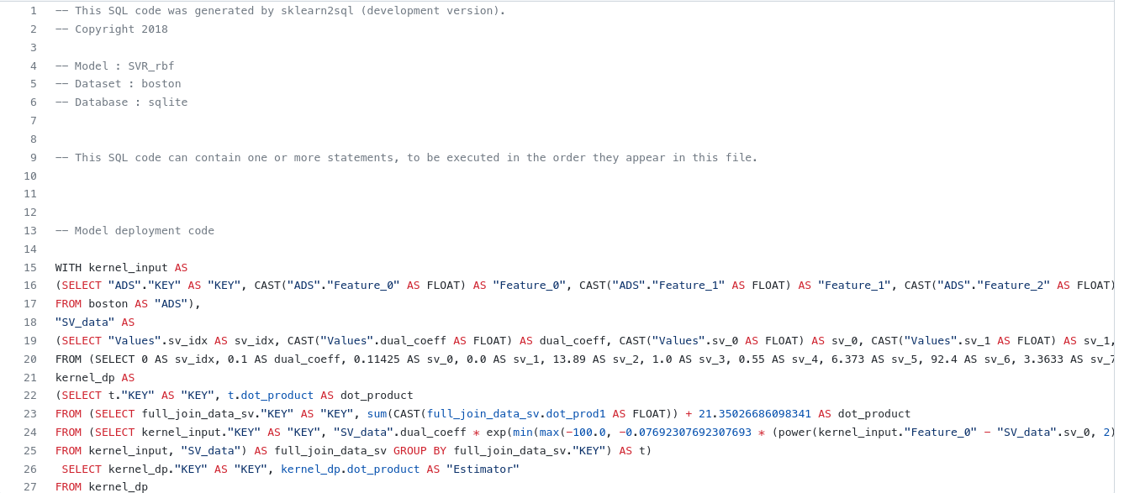
Sample Codes 4/4

Slide 9
Framework Description
Model Abstraction (.json ?)
Relational Translation
(Flexible : Model as dataset transformations)
Finalized ML Model (.pkl)
SQL
Code Generation

Slide 10
System Input
The system generates SQL code from already trained models.
The gory details of the training process are not significant.
Almost all public interfaces and web services take a serialized model as input (pickle is your friend here).

Slide 11
Model Abstraction
In this step, the system performs a complete formal abstraction of the underlying algorithm of the model.
  For a linear Model :
    {“Type” : “linear”, “coefficients” : [8.88, 8888e-8], “intercept” : 888888}
More complex formal abstractions are available for each model/algorithm type (DT, XGB, SVM, RF, Pipeline, ...).
The abstraction must be complete, For a random forest (RF) model, the abstraction contains the individual abstractions of all the forest decision trees.
Adding a new mathematical model requires designing/authoring these abstractions.
  The math behind scikit-learn algorithms (and machine learning in general) is evolving slowly (need many years to “invent” a new model). Almost all of these models date back to 19xx.
    Scikit-learn has a lot of requirements on what model can be added (popularity, publications, citations, impact, ), and that’s really good. https://scikit-learn.org/stable/faq.html
  The current version of the sklearn2sql framework has designed ( > 40) abstractions of almost all scikit-learn models known before 2020.
    https://scikit-learn.org/stable/modules/classes.html
These abstractions are deduced from a reloaded/living model. We only use model metadata. The original dataset is not needed even if the model can help generating/simulating one.
The formal abstraction is expressed in JSON format.
  Almost all python objects have a __dict__ member. Python object introspection is easy.
  Scikit Learn Models are aggregates of numpy python objects.
  XGB models already have a to_json method. Easy.
  JSON code is debuggable.

Slide 12
Relational Model Representation
All machine learning data processing can be performed using sequences of simple dataset/columns transformations (dataset→dataset mapping).
This translation is performed only using the “Complete” Model Abstraction (JSON format is enough).
These dataset transformations can be translated into relations (as in a relational algebra / SQL).
For a given model, The number of these transformations depends on the complexity of the model.
  Think of these as the layers of a sequential neural network (Scikit MLP), but at a lower level.
Individual transformations are developed using specialized python classes, with the most tasks done at the abstract level.
  The transformation does not take into account the type of model it is part of.
  Groups of transformations used to compute the predicted values (arg-max of probabilities) are shared across all model representations (the same SQL code between DTs and pipelines of SVMs).
A scikit-learn machine learning model can be mapped this way.
  A decision tree score computation can be performed by hand using ~4 excel sheets, and these sheets can be mapped to SQL tables/views. The first table contains the input and the last contains the scores and class probabilities as columns.
  A random forest with 500 trees, will be translated as ~4*500 separate relations. An additional relation is used to compute the RF class probabilities (means of 500 individual class probabilities).
    Seems too mechanical. There are some technical limitations but SQL allows the usage of views or temporary tables to deal with this kind of complexity.

Slide 13
SQL Code Generation 1/4
SQL Code generation is about translation the model representation into a valid SQL code for a target database dialect.
We use the excellent Python SQLAlchemy as a framework for handling relational model representions internal transformations.
  https://www.sqlalchemy.org/
SQLAlchemy allows mapping each transformation to a set of SQLAlchemy objects (table, expression, column, function, join, literal values, case, union, ...)
SQLAlchemy Expressions can generate their SQL Code for a target database which has a python SQLAlchemy driver.
SQLAlchemy has a set of internally supported database drivers (psql, sqlite, mssql, oracle, …)
Almost all database vendors maintain a python SQLAlchemy driver for their database (teradata, ...).
  Easy to add a new database.
  For teradata : https://github.com/Teradata/sqlalchemy-teradata
SQLAlchemy plays nicely with pandas
  One can create a pandas dataframe using a SQLAlchemy connection and a SQL select statement to be executed.
    https://pandas.pydata.org/docs/reference/api/pandas.read_sql.html#pandas.read_sql
  One can save a dataframe as a table through a SQLAlchemy database connection.
    https://pandas.pydata.org/docs/reference/api/pandas.DataFrame.to_sql.html#pandas.DataFrame.to_sql

Slide 14
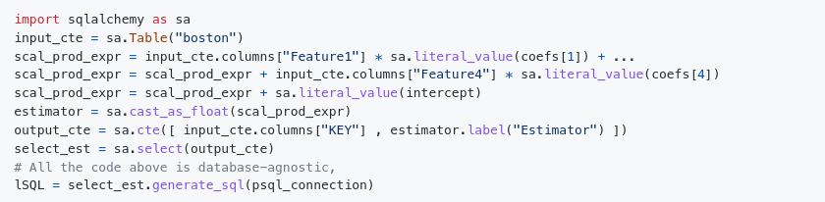
SQL Code Generation 2/4
Sketch of a linear regression model SQL code generation

Slide 15
SQL Code Generation 3/4
By default , each transformation is generated as a CTE through an sa.CTE object (WITH clause)
  https://modern-sql.com/feature/with
For a simple model, a single select statement which contains one or many CTEs is generated.
  SQL Code = [With Clauses + compute_scores_select]
Some databases do not support too many WITH clauses in the same select
  MariaDB, number of CTEs > 64.
    https://jira.mariadb.org/browse/MDEV-13730
For complex models (number of CTEs > 64), the SQL generator materializes some CTEs
  For a RF model with 500 trees, each tree is generated as temporary table instead of a CTE. These temporary tables are populated on each code execution and automatically dropped by internal database mechanisms.
    SQL Codes = [500*create_temp_tables , 500*populate_temp_tables , 1*aggregate_scores_select]

Slide 16
SQL Code Generation 4/4
For the SQL code design, the author tried when possible to use meaningful aliases in the SQL code. The names are intention revealing according to the excellent Modern SQL.
  http://modern-sql.com/use-case/literate-sql
For example, a SQL generated from a decision tree contains three common table expressions (CTEs) whose names are : "DT_node_lookup", "DT_node_data" and "DT_Output.
  https://github.com/antoinecarme/sklearn2sql-demo/blob/master/sample_outputs_tuning_round_1/DecisionTreeClassifier/iris/pgsql/demo2_DecisionTreeClassifier_pgsql.sql
This design has a significant impact on the performance. All SQL codes are tested to execute in less than 2-3 minutes on the various databases, even for very complex models.

Slide 17
Quality Assessment 1/2
A test framework has been put in place.
The framework works on all supported databases instances simultaneously.
For each scikit-learn model class, we perform the following tests:
  Train different models on datasets of various sizes (nrows, ncols). These datasets are transferred
  For each trained model :
    save it,
    Predict all the possible values for all the training dataset in python scikit-learn (sklearn_output_python_df)
    generate the SQL,
    Execute the SQL code on each database => pandas dataframes (gen_sql_output_mssql_df , ...).
    Compare the relevant output columns between sklearn_output_python_df and each database output dataframe.
    Add some reporting for success/failures each model/database combination.

Slide 18
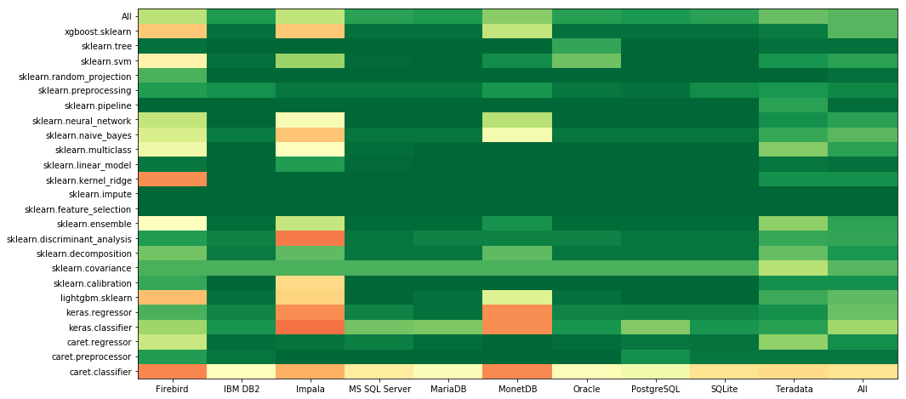
Quality Assessment 2/2
Sample report :
  https://github.com/antoinecarme/sklearn2sql_heroku/blob/master/Quality/extensive_tests-debrief.ipynb

Slide 19
Extensions
The system has been designed to been extended to support additional types of models:
  Gradient Boosting Models : XGBoost and LightGBM
    Have a scikit-learn API.
    These can be exported in a json format.
  Keras and PyTorch Deep Learning Models
    Both share the same abstraction layers.
      https://github.com/antoinecarme/keras2sql
      https://github.com/antoinecarme/pytorch2sql
    Defined new transformations for NN Layers and transfer functions (ReLU, ...).
    Basically he same as sklearn.MLP
    Support Convolutional networks (partial) and recursive models (RNN, LSTM, GRU)
  R Models, through Caret.
    Basically, these are the same as the existing scikit-learn models
      https://github.com/antoinecarme/caret2sql
    We chose to generate code for “equivalent” abstractions for scikit-learn models.
    Abstract models are generated by running custom R model introspection scripts.
  The four NN dense layer implementations (sklearn.MLP, Keras.Dense, PyTorch.Dense, Caret.nnet) share the same abstraction and the model transformations.
  These models have been included in the Quality Assessment test framework.
    R models output (using R) is compared with the generated SQL output for each database.

Slide 20
谢谢 !!!!

