Slide 1
Machine Learning for Micro-controllers
Technical Presentation
Antoine CARME (202? - WIP)
Antoine.CARME@outlook.com
https://github.com/antoinecarme/

Slide 2
Outline
History
Goals
Task Definition
Prototyping

Slide 3
History
Had some projects on industrializing machine learning models in various environments
  Databases : generate SQL code from already trained scikit-learn/pytorch/keras/caret models.
    Very standardized authoring, algebraic/tabular/columnar.
    Almost unlimited resources,
    Small variations between database providers. Need to manage a small set of exceptions for each database.
  Micro-controllers : generate hardware-level C++ code from already trained models.
    Very constrained
    slow cpu,
    power/watts : can run on battery.
    Memory ( < 256KB for some).
    The generated C++ code should work for all platforms. Some platforms do not have numerical libraries. KISS.
Only for model deployment and scoring : predict API calls.
A lot of time reading/inspecting/ scikit-learn/caret/keras/pytorch code and other mathematical libraries (numpy. Scipy, ) and pandas/SQL etc.
  A lot of things in common. The same abstractions are finally used to generate SQL/C++ code for four different NN layers implementations (keras/pytorch/scikit-learn/caret).
  Code reading in this case is very special !!!
  Can be time-consuming. Limited time per model/feature. Define more priority for default settings and use cases.
Software QA / Evaluation is based on the reference python version : SQL/C++ codes should give the same result (up to 12 decimal points) on a fixed set of models and datasets.
  Process in place.
  The same validation process for all models and databases.

Slide 4
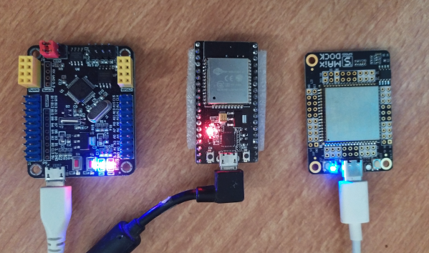
Goals
Provide some advanced machine-learning capabilities to the most frequent platforms.
  ESP32 micro-controller on battery needs to analyze sensors data for months, build a decision tree model on the fly twice a day and send a weekly summary report as JSON.
  A TinyML system.
Do more than just predicting values from an existing model.
  Training capabilities on small datasets (tens of columns).
    Out-Of-Memory error is sometimes allowed.
  Support the 4 most-used scikit-learn models.
    Decision Tree (prototyping), Ridge, SVM, MLP
    Classifications and regressions.
    More models if need.
  Allow building (fit), deploying (predict) and saving models.
  In a portable, uniform, reliable and transparent way (next 4 slides).

Slide 5
Portable
Portability : Good old C++.
  Works as well on a huge Xeon server, a VPN Openwrt router, an Android mobile or a laptop.
  GCC everywhere !!!
Allows all possible data formats (dtypes) : INT8, FP16 etc.
  Can be optimized to use less memory at no additional cost.
Can be used in other languages through their respective CFFI
  scikit-learn models for Common Lisp, Julia and R.
Can be used in database as a UDF code.
KISS. No use of external libraries.
STL is allowed.
Header only, No binary.
Can be faster than scikit-learn and its python layers (cython, GIL) on the same hardware.
Can be written/authored in a micro-controller friendly way:
  Optimize for firmware size. Do it the embedded way !!!
  Separate implementations for regressions and classifications. No need for AUC or GINI code when building a regression model.
  More context-based analysis, depending on the model.

Slide 6
Uniform
Uniform : Scikit-learn like API.
Doc and training is not needed.
Fit, predict, predict-proba.
Can be used in existing reporting software : Jupyter notebooks, etc.
  Python allows duck-typing.

Slide 7
Reliable
Computations are validated against an existing software reference.
Weights are similar to those given by scikit-learn or keras for the same model, dataset, settings.

Slide 8
Transparent
The built model must be human-readable, auditable, debuggable.
Text-based serialization.
JSON import/export.
  The model is built in a ESP32 and can be sent through the USB/Bluetooth interface, to be later loaded and analyzed in a more user-friendly environment.
The implementation itself is transparent:
  Reproducible. Source will be available under an open source license.
  Header-only, no binary blobs.
  Versioned.

Slide 9
谢谢 !!!!

