Slide 1
Machine Learning Models Deployment
Hardware or Software ?
Antoine CARME (2022)
Antoine.CARME@outlook.com

Slide 2
Software vs Hardware Deployment ?
Software is easy to maintain, update, correct…
  Only when released as Open Source, by experience.
Specialized Hardware is not reusable
The following slides will (try to) give an overview of the past and present systems for deploying analytic/data processes
Some hardware systems are listed here only to keep track of the “Hall of Fame of bad Ideas in Hardware Analytics” !!!
Some Lobbying arguments for “Software Supremacy”:
  https://github.com/antoinecarme/sklearn2sql-demo/blob/master/notebooks/sql_rationale.md

Slide 3
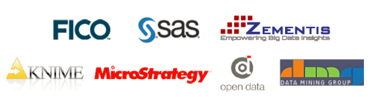
Software Deployment Systems 1/4
Predictive Model Markup Language (PMML)
  https://en.wikipedia.org/wiki/Predictive_Model_Markup_Language
  XML Schema developed by the Data Mining Group, A consortium of proprietary data mining software companies (SAS, SPSS, ...)
  Deployment is made through specialized vendor-independent software (PMML runtime).

Slide 4
Software Deployment Systems 2/4
Java PMML API
  Open Source PMML software.
    https://github.com/jpmml
    Developed by https://openscoring.io
    Very Actively Developed.
    Works with R and Scikit-Learn Models

Slide 5
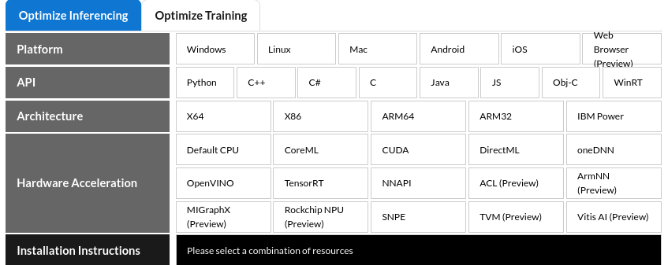
Software Deployment Systems 3/4
Open Neural Network Exchange (ONNX)
  https://onnx.ai/index.html
  The open standard for machine learning interoperability
  Allows building and Deploying models.
  Supports many ML/DL frameworks (Scikit-Learn TensorFlow, PyTorch, Caffe2, …)
  Needs a runtime for deploying models
    One runtime for each target environmet/(programming language).
    Not all environments are equal ...
  Actively Developed.
    https://github.com/onnx/sklearn-onnx

Slide 6
Software Deployment Systems 4/4
Vendor Specific Systems
  The software used to train ML models can be used to deploy these models.
  SAS and SPSS have some kind of in-Database Scoring (SQL-based)
    https://github.com/antoinecarme/sklearn2sql-demo/blob/master/notebooks/limitations.md
    Often limited in the supported models and databases.
  TFLite : Deploy TF models on mobile and edge devices
    Google : https://www.tensorflow.org/lite?hl=fr
    TensorFlow Lite for Micro-controllers currently supports a limited subset of TensorFlow operations
  PyTorch Mobile
    Allow building apps to deploy PyTorch models on iOS and Android devices.
    https://pytorch.org/mobile/home/

Slide 7
Hardware Deployment Systems 1/5
History
  The use of hardware systems to deploy Machine Learning systems is a very old idea.
  Experimental Fax + OCR + Speech.
    Apple. Mimetics (199x)
    https://techmonitor.ai/technology/mimetics_shows_fax_into_voice_product_at_comdex_98
    https://www.manualsdir.com/manuals/548581/apple-fax.html?page=101
  Defense systems.
  Many categories:
    Database Accelerators / Data Caching
    Deep Learning GPUs / TPUs / ASICs / FPGAs
    New trends. NPUs

Slide 8
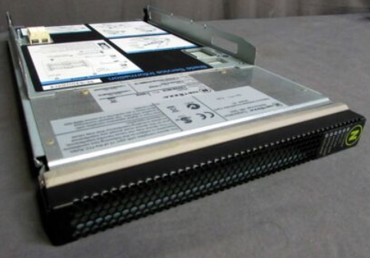
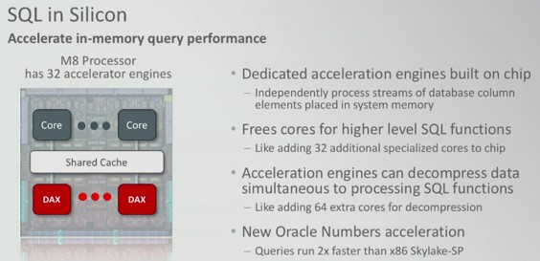
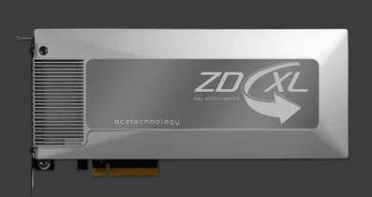
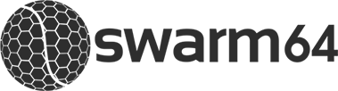

Hardware Deployment Systems 2/5
Database Appliances
  Netezza, etc …
Database Analytics Accelerators
    Oracle DAX, T7 and M8 Sparc CPUs
    ZD-XL SQL Server Accelerator
Database + GPU/FPGA/…
  Kinetica, swarm64, …

Slide 9
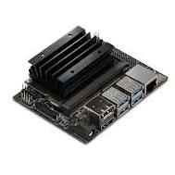
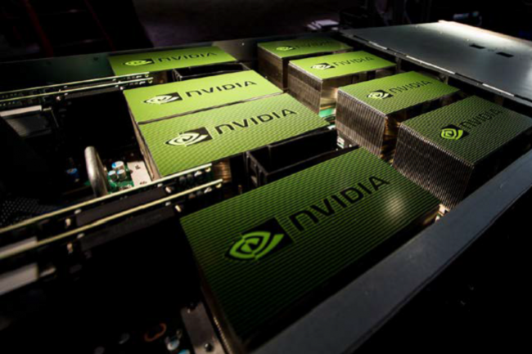
Hardware Deployment Systems 3/5
The Use of GPUs
  The use of GPUs in Deep Learning training and deployment follows years of use of GPUs as a tool for accelerating video graphics and scientific computing.
    https://en.wikipedia.org/wiki/General-purpose_computing_on_graphics_processing_units
  The main DL frameworks (Theano, TF, PyTorch) allow using GPUs to speed up computations otherwise using system CPUs.
  Nvidia is the main hardware manufacturer in this area.
    Nvidia provides embedded systems (Jetson) dedicated to ML/DL.
      https://www.nvidia.com/en-us/autonomous-machines/embedded-systems/
  The main Cloud providers (AWS, IBM, …) have specialized instances with GPUs

Slide 10
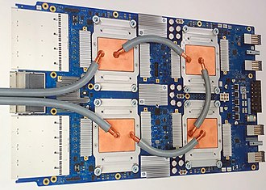
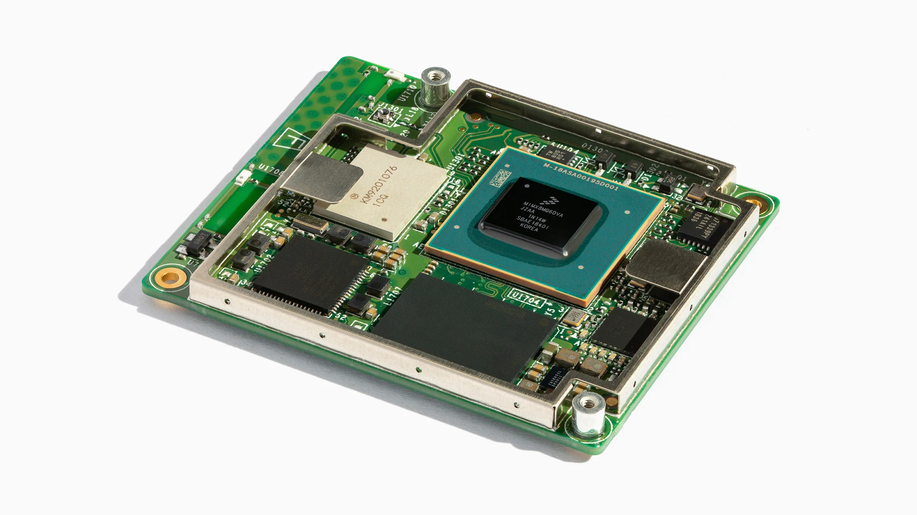
Hardware Deployment Systems 4/5
The Use of Specialized Hardware (ASICs)
  A current trend is to build application-specific integrated circuit (ASIC) for DL data (tensor-processing units)
    https://en.wikipedia.org/wiki/Tensor_Processing_Unit
  Google Uses its own TPUs instead of GPUs for training and deploying DL/TF Models
    https://cloud.google.com/tpu
  Google Edge TPUs are available for microcontrollers.
    https://coral.ai/products/
    Uses TFLite. Limited.

Slide 11
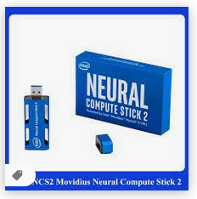
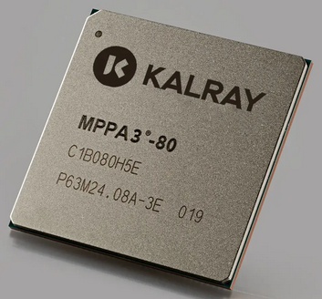
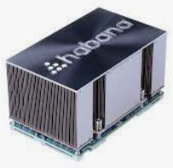
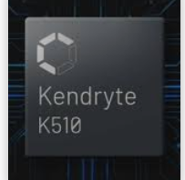
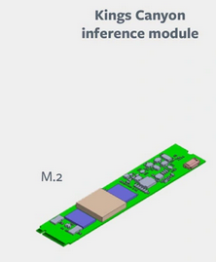
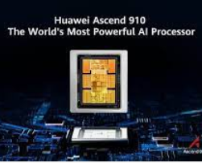
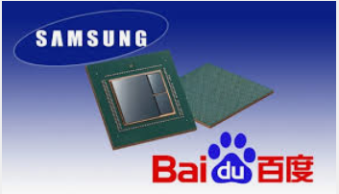
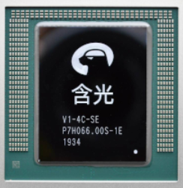
Hardware Deployment Systems 5/5
Deep learning hardware accelerators (+NPUs)
  GAFAM and BATX race to AI chips.
  https://syncedreview.com/2019/03/14/facebook-releases-a-trio-of-new-ai-hardware-designs/

Slide 12
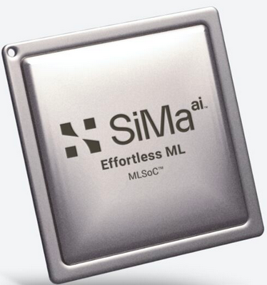
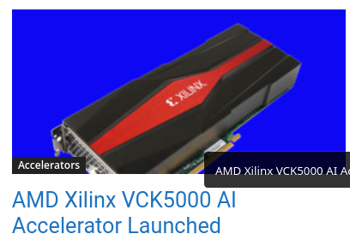
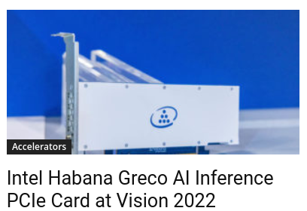
https://en.wikipedia.org/wiki/AI_accelerator

Slide 13
谢谢 !!!!

