Slide 1
Machine Learning Models Deployment using ML2CPP framework
Technical Presentation
Antoine CARME (2022)
Antoine.CARME@outlook.com
https://github.com/antoinecarme/ml2cpp

Slide 2
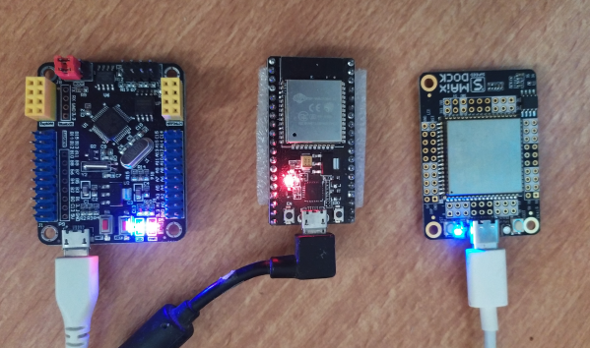
What is ML2CPP ?
ML2CPP is a “development tool” for generating deployment C++ code from Machine Learning models.
  https://github.com/antoinecarme/ml2cpp
Using ML2CPP, it is possible to predict values from an already-fitted classifier or a regressor on cheap widely-available hardware simply by executing some compiled C++ code.
C++ is the most hardware-friendly programming language. Compilers are available on most platforms (GCC).
ML2CPP allows for example to deploy an XGBoost, scikit-learn or a caret model
It generates binary executables for
  Small Edge controllers like STM32 or esp32,
  Android, iOS, Linux, Windows devices,
  But also for standard cloud virtual machines at the highest possible speed.

Slide 3
Supported Machine Learning Models
ML2CPP shares the same low-level framework as Sklearn2SQL , a SQL generator for machine learning models used for in-database deployment.
  It is written in python.
  https://github.com/antoinecarme/sklearn2sql-demo
  Some of these slides are copies of the same presentation for Sklearn2SQL (module SQL => C++)
It is designed to support all classification and regression methods in scikit-learn
  SVMs, linear models, naive-bayes. decision trees, MLP, etc
  Transformers (PCA, imputers, scalers, ...)
  Feature selection
  Outlier detection
  Derived models (random forests, meta-estimators, pipelines, feature unions, ensembles, etc).

Slide 4
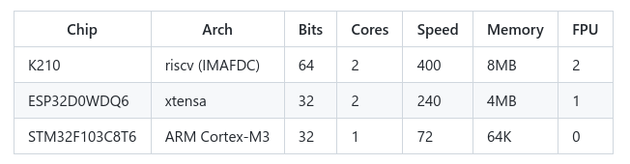
Some supported Hardware

Slide 5
Generated C++ Code
The C++ code contains everything needed to compute the predicted values of the model,
No external library is needed,
Can be compiled for any target hardware platform using any standard C++ compiler on the market (GCC).
The automatically generated code is plain STL C++-17,
Designed to maintain a strong semantic mapping with the model and allows auditing , debugging, benchmarking and reporting.
The generated code does/will not rely on any kind of external library (not use BLAS or tensorflow or ...) and will not need compiler specific flags.
It is generated such that any C++ code can integrate it without specific change (the model code is a namespace).

Slide 6
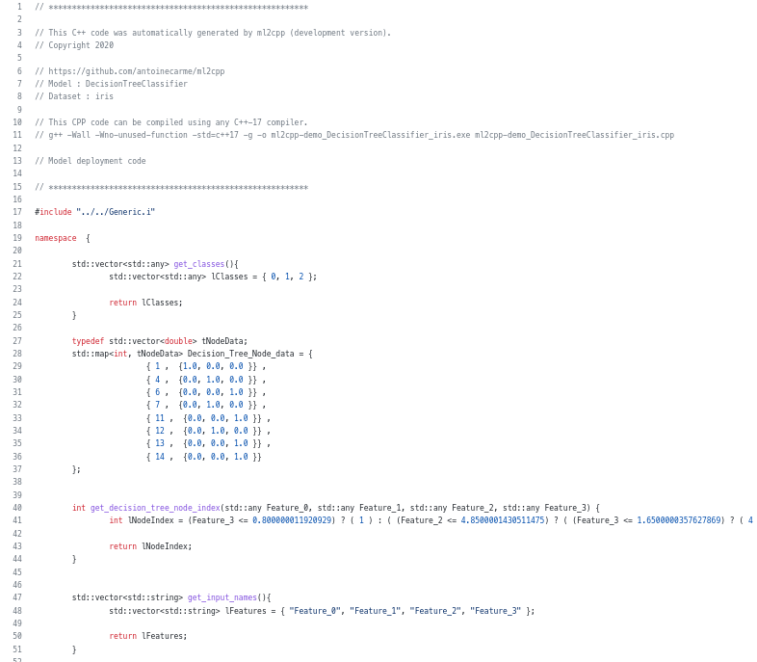
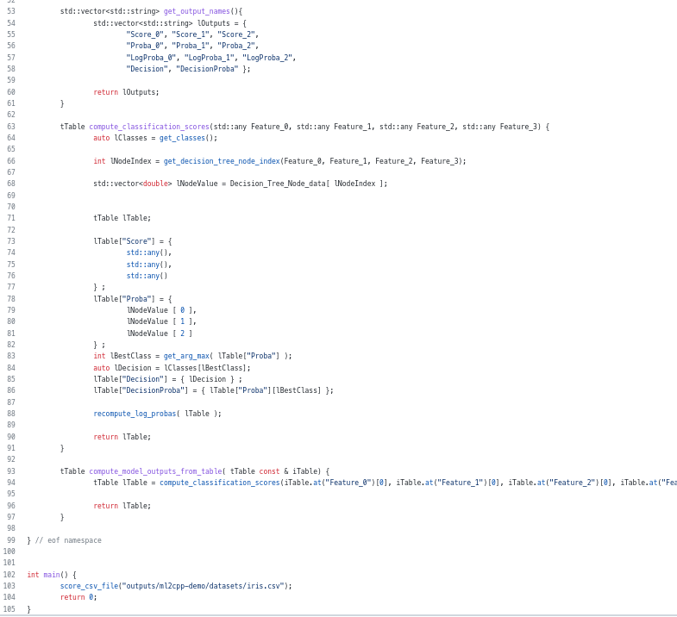
Sample Codes 1/2

Slide 7
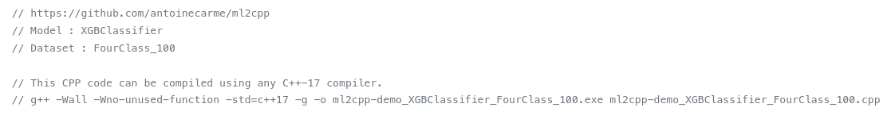
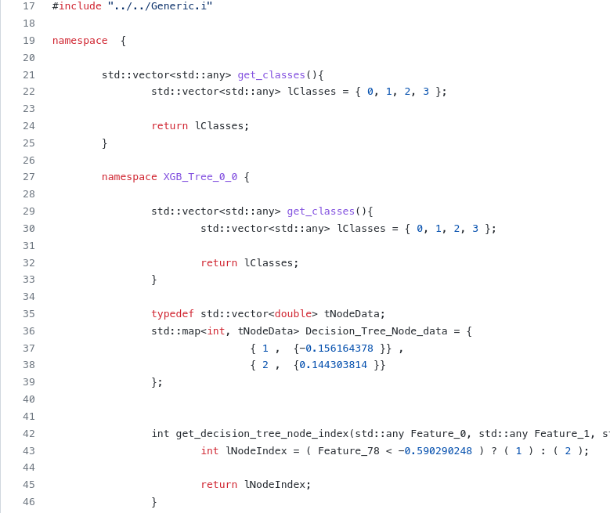
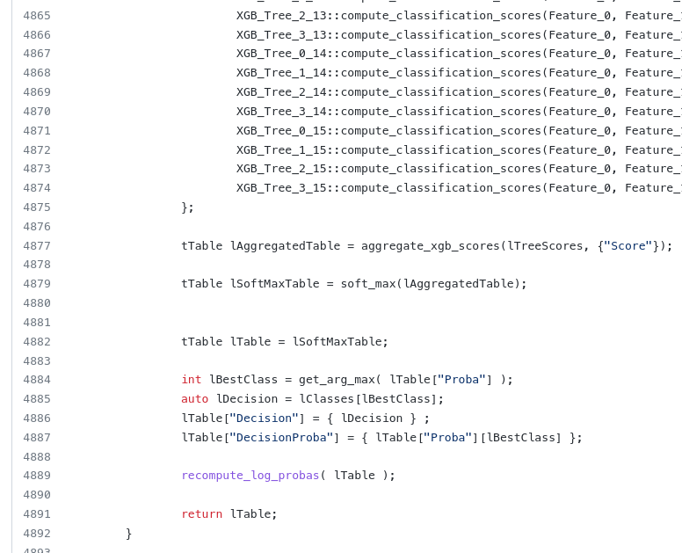
Sample Codes 2/2
https://github.com/antoinecarme/ml2cpp/tree/master/bench/ml2cpp-demo/XGBClassifier/FourClass_100

Slide 8
Framework Description
Model Abstraction (.json ?)
Relational Translation
(Flexible : Model as dataset transformations)
Finalized ML Model (.pkl)
C++
Code Generation

Slide 9
System Input
The system generates C++ code from already trained models.
The gory details of the training process are not significant.
Almost all public interfaces and web services take a serialized model as input (pickle is your friend here).

Slide 10
Model Abstraction
In this step, the system performs a complete formal abstraction of the underlying algorithm of the model.
  For a linear Model :
    {“Type” : “linear”, “coefficients” : [8.88, 8888e-8], “intercept” : 888888}
More complex formal abstractions are available for each model/algorithm type (DT, XGB, SVM, RF, Pipeline, ...).
The abstraction must be complete, For a random forest (RF) model, the abstraction contains the individual abstractions of all the forest decision trees.
Adding a new mathematical model requires designing/authoring these abstractions.
  The math behind scikit-learn algorithms (and machine learning in general) is evolving slowly (need many years to “invent” a new model). Almost all of these models date back to 19xx.
    Scikit-learn has a lot of requirements on what model can be added (popularity, publications, citations, impact, ), and that’s really good. https://scikit-learn.org/stable/faq.html
  The current version of the sklearn2sql framework has designed ( > 40) abstractions of almost all scikit-learn models known before 2020.
    https://scikit-learn.org/stable/modules/classes.html
These abstractions are deduced from a reloaded/living model. We only use model metadata. The original dataset is not needed even if the model can help generating/simulating one.
The formal abstraction is expressed in JSON format.
  Almost all python objects have a __dict__ member. Python object introspection is easy.
  Scikit Learn Models are aggregates of numpy python objects.
  XGB models already have a to_json method. Easy.
  JSON code is debuggable.

Slide 11
Relational Model Representation
All machine learning data processing can be performed using sequences of simple dataset/columns transformations (dataset→dataset mapping).
This translation is performed only using the “Complete” Model Abstraction (JSON format is enough).
These dataset transformations can be translated into relations (as in a relational algebra / SQL).
For a given model, The number of these transformations depends on the complexity of the model.
  Think of these as the layers of a sequential neural network (Scikit MLP), but at a lower level.
Individual transformations are developed using specialized python classes, with the most tasks done at the abstract level.
  The transformation does not take into account the type of model it is part of.
  Groups of transformations used to compute the predicted values (arg-max of probabilities) are shared across all model representations (the same C++ code between DTs and pipelines of SVMs).
A scikit-learn machine learning model can be mapped this way.
  A decision tree score computation can be performed by hand using ~4 excel sheets, and these sheets can be mapped to C++ classes.
  A random forest with 500 trees, will be translated as ~4*500 separate relations. An additional relation is used to compute the RF class probabilities (means of 500 individual class probabilities).
    Seems too mechanical. There are some technical C++ limitations but the usage of namespaces solves these code complexity issues.

Slide 12
C++ Code Generation 1/4
C++ Code generation is about translation the model representation into a valid C++ code for a target compiler on the target platform.
We use a symbolic hand-crafted generator as a framework for handling relational model representations internal transformations.
Relations are generated in C++ as maps. It is common for holding all types of data (classifier inputs/outputs, regression inputs/outputs, transformer inputs/outputs, etc). A specific class is used
  typedef std::vector<std::any> tAnyVector;
  typedef std::map<std::string, tAnyVector> tTable;
Generic methods are used to get the outputs of a model
  tTable compute_model_outputs_from_table( tTable const & iTable)
For controlling scopes, namespaces are used. A random forest model with 500 trees is generated as namespaces with 500 sub-namespaces.
  For code readability, each internal namespace reflects the tree that is generated.
  The use of namespaces makes life easier for the compiler/parser.

Slide 13
Extensions
ML2CPP can be used to generate C++ code that is compiled to as part of a java or python project.
We tested generating python module out of a Machine learning model using Boost. Python with a few extra lines of code.
  https://www.boost.org/doc/libs/1_63_0/libs/python/doc/html/index.html
  https://github.com/antoinecarme/ml2cpp/issues/35
The model was trained using scikit-learn/numpy and has been deployed on a tiny micropython environment (where no scikit-learn numpy is available)
  https://micropython.org/

Slide 14
Quality Assessment 1/2
A test framework has been put in place.
For each scikit-learn model class, we perform the following tests:
  Train different models on datasets of various sizes (nrows, ncols). These datasets are stored as CSV files.
  For each trained model :
    save it,
    Predict all the possible values for all the training dataset in python scikit-learn (sklearn_output_python_df)
    generate the C++ code,
    Compile and Execute the C++ code on the test platform (sparc debian T3-1) => CSV => pandas dataframes (gen_cpp_output_df).
    Compare the relevant output columns between sklearn_output_python_df the output dataframe.
    Add some reporting for success/failures each model.

Slide 15
谢谢 !!!!

