Slide 1


Capstone Project - AAA Northeast Member Analysis
Reinaldo Mozart
Contact: rmozart@halliburton.com

Slide 2
Agenda
Background
Objectives
Applied Methodology
Framework
Data Processing
Predictions
Clustering
Market Segementation
Segment Labels
Segment Analysis
Recomendations
Sources

Slide 3


Background

Slide 4
Background
American Automobile Association (AAA) is a North American federation motor clubs:
117 years old
Over 60 millions members
Not-for-Profit Organization
Several types of service (Travel Insurance, Mortgage, Roadside Assistance, etc)
34 motor clubs (Grand areas)
1.100 branch offices
Each club is independent
Main club for this presentation: AAA- Northeast

Slide 5
Objectives

Slide 6
Project Objectives
Segmentation of AAA members (Household Level):
Types of Households
Target Products
Behavioral Analysis (last 3 years)
Associated Probabilities:
Product Aqcuisition
Usage of provided services
Higher Revenue Household Groups
Associated Household Groups Cost

Slide 7
Applied Methodology

Slide 8

Framework
Data-Processing
Predictions
Clustering
Market Segmentation
Data
Grouping (by households)
Variable Ranking
Variable Influence Evaluation
Filtering and Sorting (separation by data type and outlier removal)
Purchase Product
Optimum Group Number
Roadside Services
Missing Values (prediction or removal)
Other New Variables

Slide 9
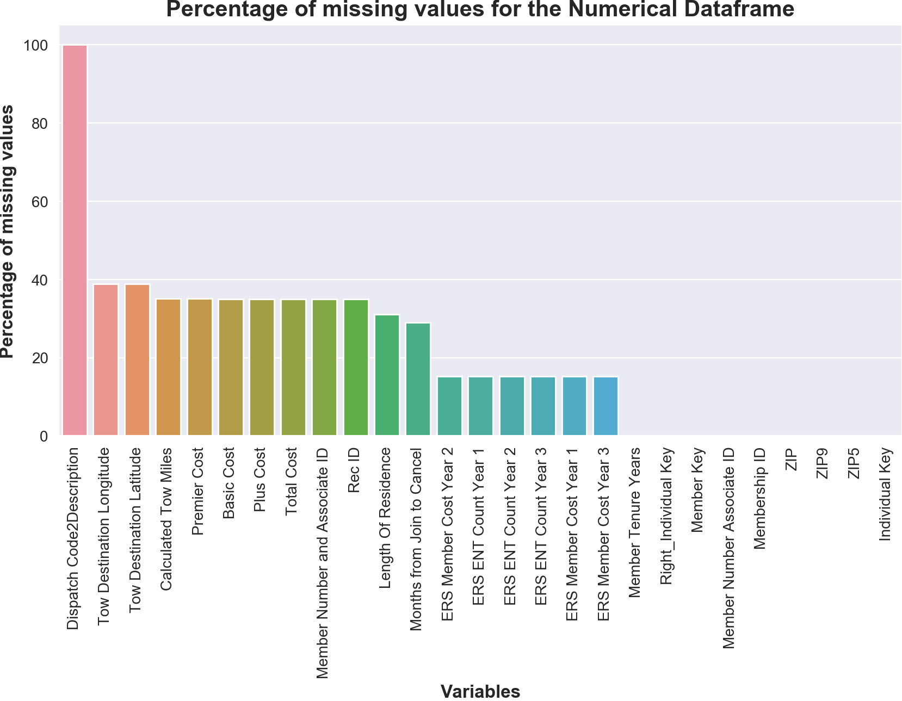
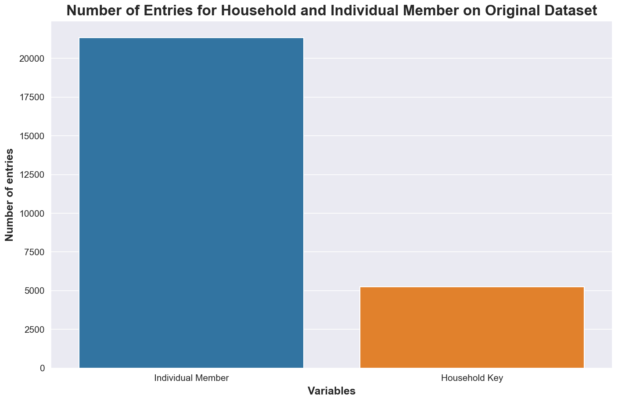
Data-Processing
Grouping data by Household:
Spreadsheet originally sorted by Individual Members
Filtering and Sorting:
Outliers Removal
Separation per Data Type
Missing Values:
Prediction (when possible)
Removal

Slide 10
Predictions
Chosen Model:
Logistic-Regression
Motivation: Direct output of probability for target variable
Variable Ranking (Feature Selection) Methods:
Pearson Correlation
Recursive Feature Elimination
Test using several possible number of variables (3 to 10)
Monitors:
Accuracy
Precision
Recall
F1-Score
Build:
30% for training data
70% for validation (score calculation)

Slide 11
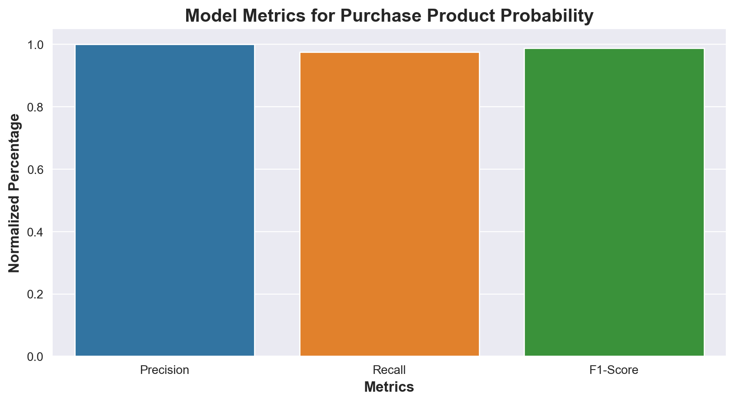
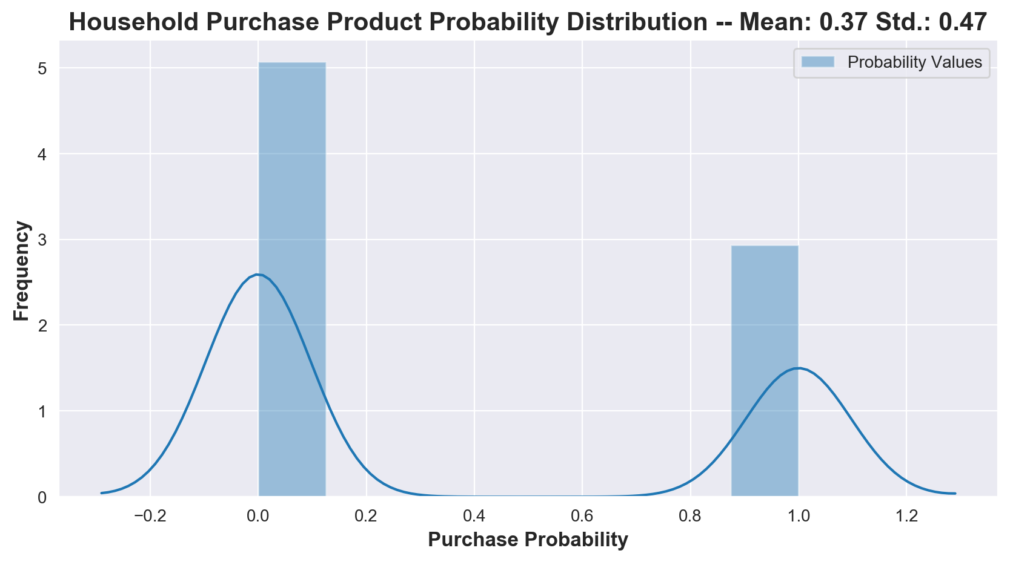
Predictions - Purchase Product Probability
Variable Ranking (Importance):
Total Number of Purchase Products (new variable predicted)
AAA Travel (TRV Globalware Flag)
AAA Insurance (INS Client Flag)
AAA Credit Card (FSV Credit Card Flag)
AAA Financial Services (FSV CMSI Flag)
Method of Variable Ranking chosen:
Recursive Feature Elimination
Absolute Value of Metrics:
Accuracy: 98%
Precision: 100%
Recall: 98%
F1-Score: 99%

Slide 12
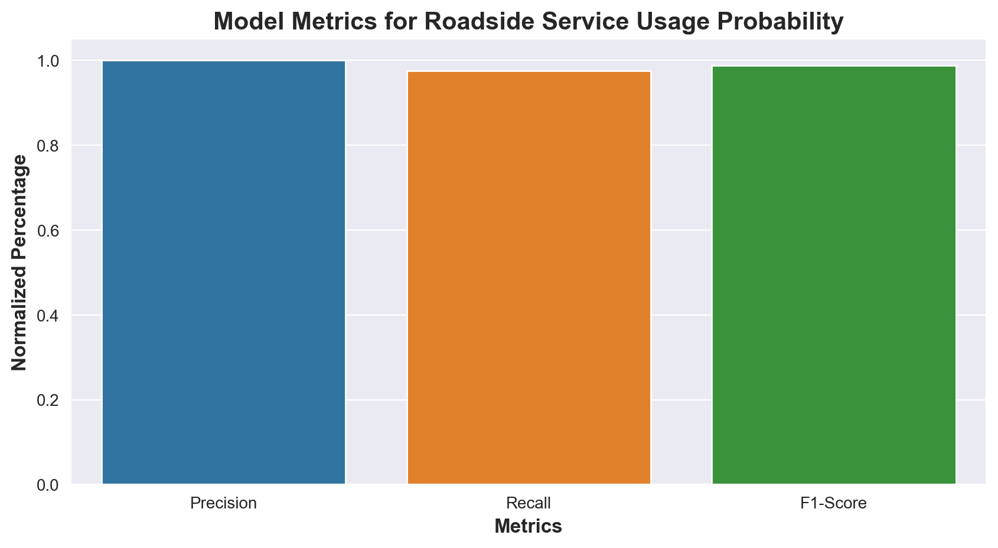
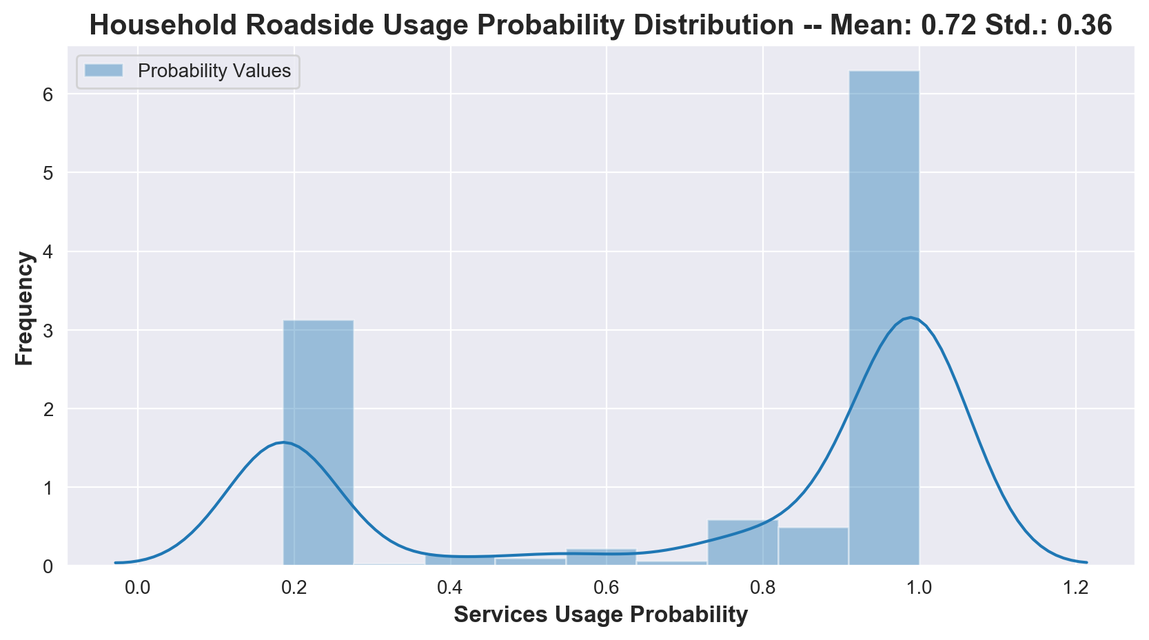
Predictions – Roadside Service Usage Probability
Variable Ranking (Importance):
Frequency of Roadside Services Use (new variable predicted)
Total Number of Roadside Calls (new variable predicted)
Number of Roadside Calls for Year 3 (ERS ENT Count Year 3)
Number of Roadside Calls for Year 2 (ERS ENT Count Year 2)
Method of Variable Ranking chosen:
Recursive Feature Elimination
Absolute Value of Metrics:
Accuracy: 98%
Precision: 94%
Recall: 100%
F1-Score: 97%

Slide 13
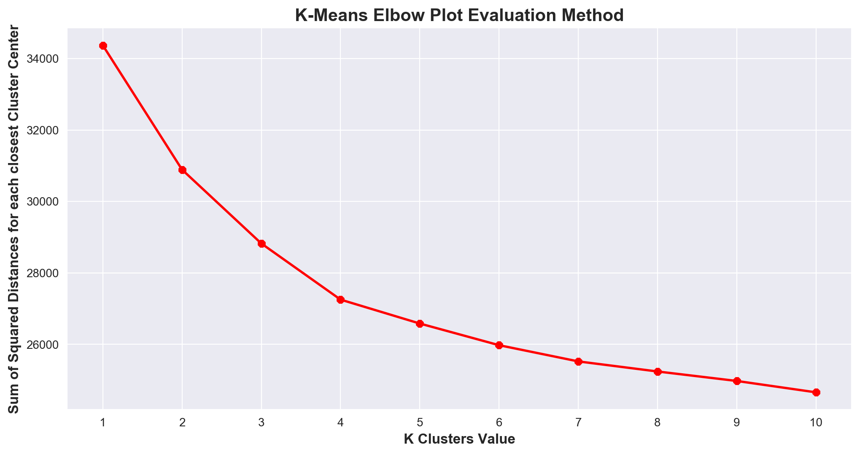
Clustering
Multiple Variable Selection:
Combination of different set of variables:
Features most related to cost
Features most related to profit
Cultural Information
Test on entire post-processed data
Optimum Number of Clusters:
Several Numbers of clusters tested (1 tp 10)
Elbow Method:
Plot based Method
Monitors the Sum of Squared Distances of each sample to their closest cluster center
Build:
Using entire post-processed database restrained on selected features
‘Elbow’ on Plot for K=4

Slide 14
Market Segmentation

Slide 15
Segment Labels
Household were grouped into 4 different clusters:
Cluster 1:
Labeled as “No Home - No Mortgage”
Group Highlights:
No home ownership info or mainly Renters
Did not purchase Mortgage Product (FSV Mortgage Flag)
Cluster 2:
Labeled as “The Big Problem”
Group Highlights:
Have not purchased any type of product in the last three years
Total Cost for AAA above average
Cluster 3:
Labeled as “Stick to the Basics”
Group Highlights:
All Basic Membership
They buy, but also cost
Cluster 4:
Labeled as “The Big Target”
Group Highlights:
98% of Purchase Probability
Open for Email Approach (lower cost associated)

Slide 16
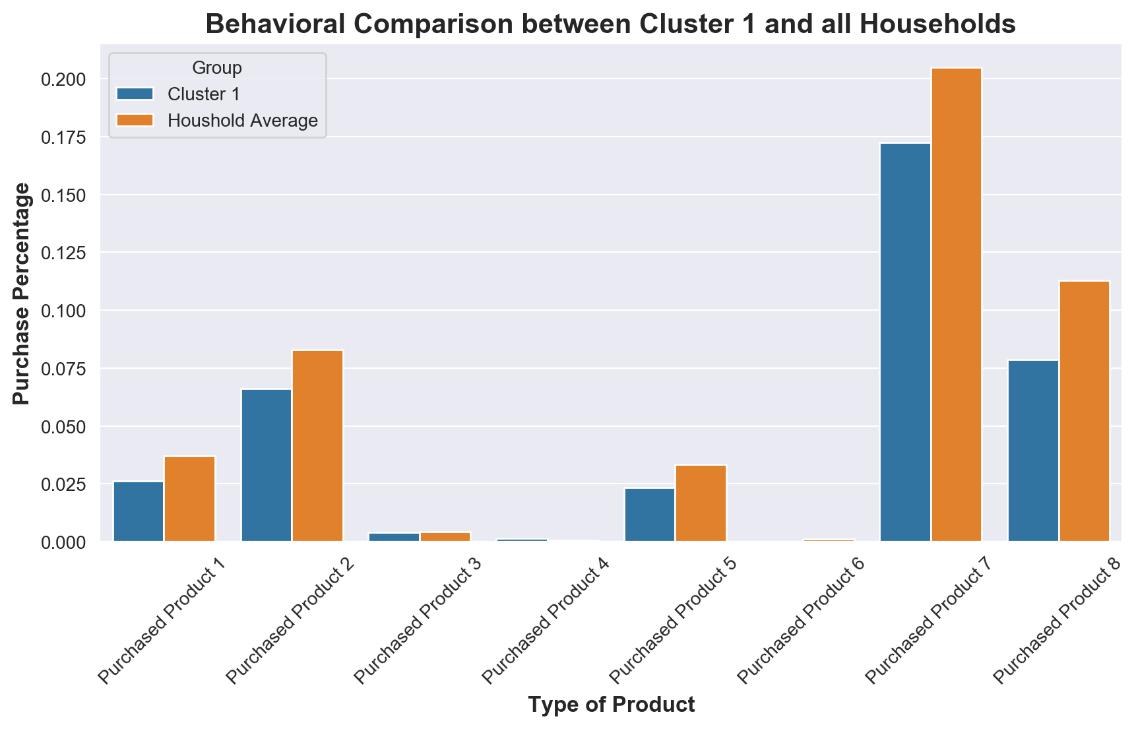
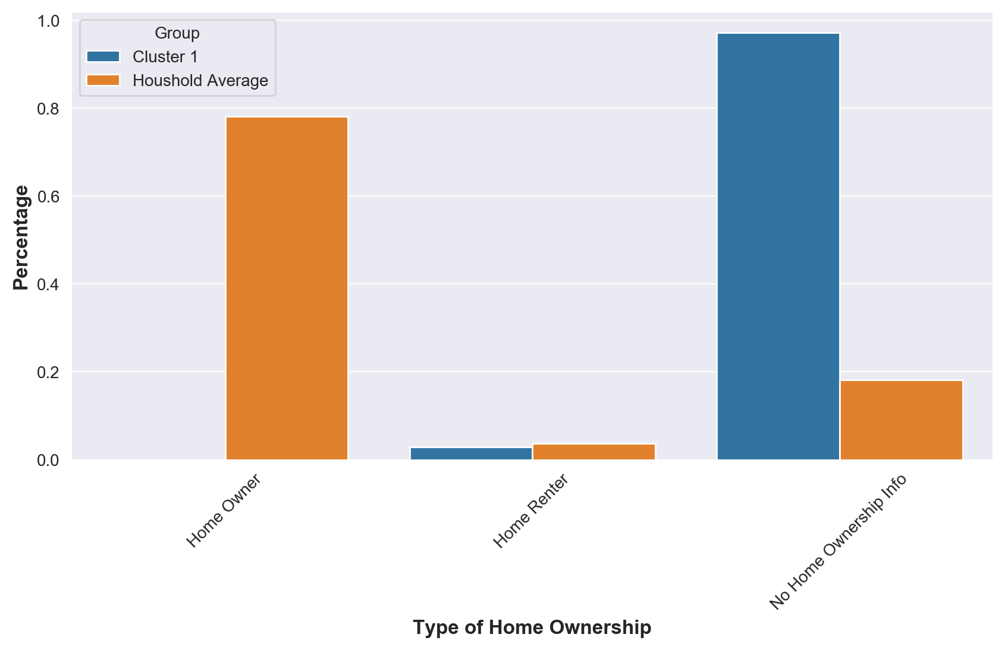
Segment Analysis - “No Home - No Mortgage”
Household group main characteristics:
Number of Household within: 725
Below Average on cost (Approximately USD 918.13) [Avg. = USD 991.48]
Average Mean Member Tenure Years (Approximately 369 Years) [Avg. = 362 Years]
They havent purchased any Mortgage Service (FSV Mortgage Flag)
They still purchase other products, but with a low percentage of probability (30 %)
None of them are Home Owners
2% are Renters, however 98% have no record of Home Ownership status
They prefer comunication via e-mail and respond to contacts made by the same
Average users of the Roadside Services (73% of chance for usage)
Product associated with Mortgage

Slide 17
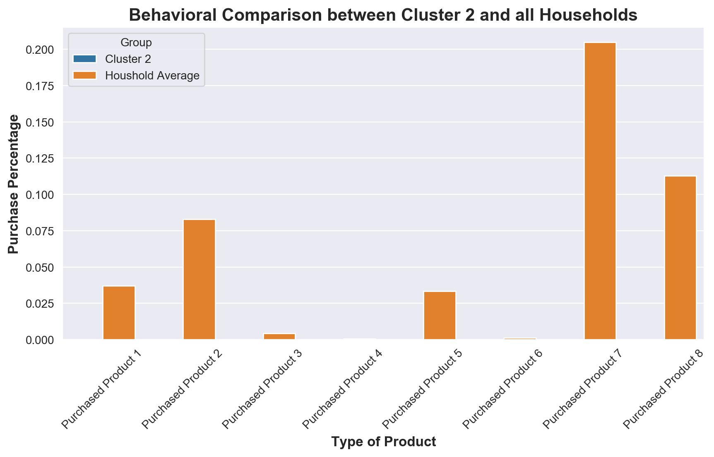
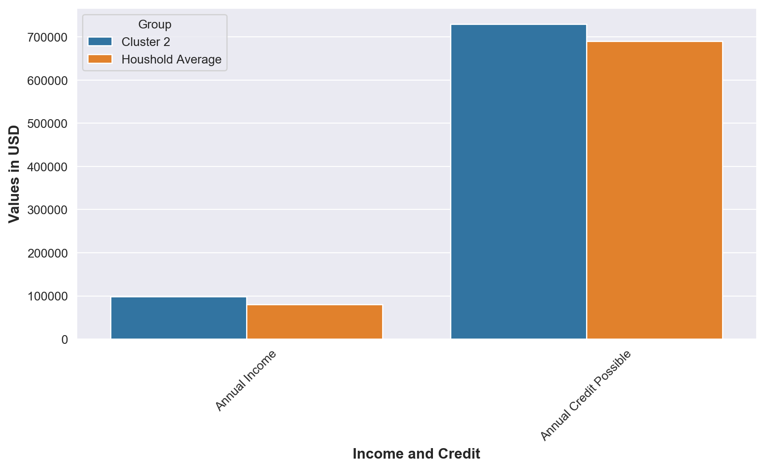
Segment Analysis - “The Big Problem”
Household group main characteristics:
Number of Households within: 1653
Above Average on cost (Approximately USD 1004.00)
Average Mean Member Tenure Years (Approximately 360 Years)
They havent purchased any product on the register
70% have their e-mails available and 97% respond AAA e-mails (Reachable Clients)
High Annual Income and Possible Credit (Households with purchasing power)
They prefer comunication via e-mail and respond to contacts made by the same
Average users of the Roadside Services (73% of chance for usage)
No Product Purchased

Slide 18
Segment Analysis - “The Big Problem”
Household group main characteristics:
Number of Households within: 1653
Above Average on cost (Approximately USD 1004.00)
Average Mean Member Tenure Years (Approximately 360 Years)
They havent purchased any product on the register
70% have their e-mails available and 97% respond AAA e-mails (Reachable Clients)
High Annual Income and Possible Credit (Households with purchasing power)
They prefer comunication via e-mail and respond to contacts made by the same
Average users of the Roadside Services (73% of chance for usage)
No Product Purchased

