Slide 1
Project Assignment
Applied Bioinformatics
Mario L. Martin

Slide 2
Data information

Slide 3
Roscovitine: CdK inhibitor → modifies the cell cycle
Important during somitogenesis → How regulates the process?
Chicken embryos samples treated and untreated with roscovitine x4 replicates
Expression levels for all gens measured using:
Affymetrix Microarray → .CEL files for each sample
RNA-Sequencing → .txt file with all the expression values

Slide 4
Overview

Slide 5
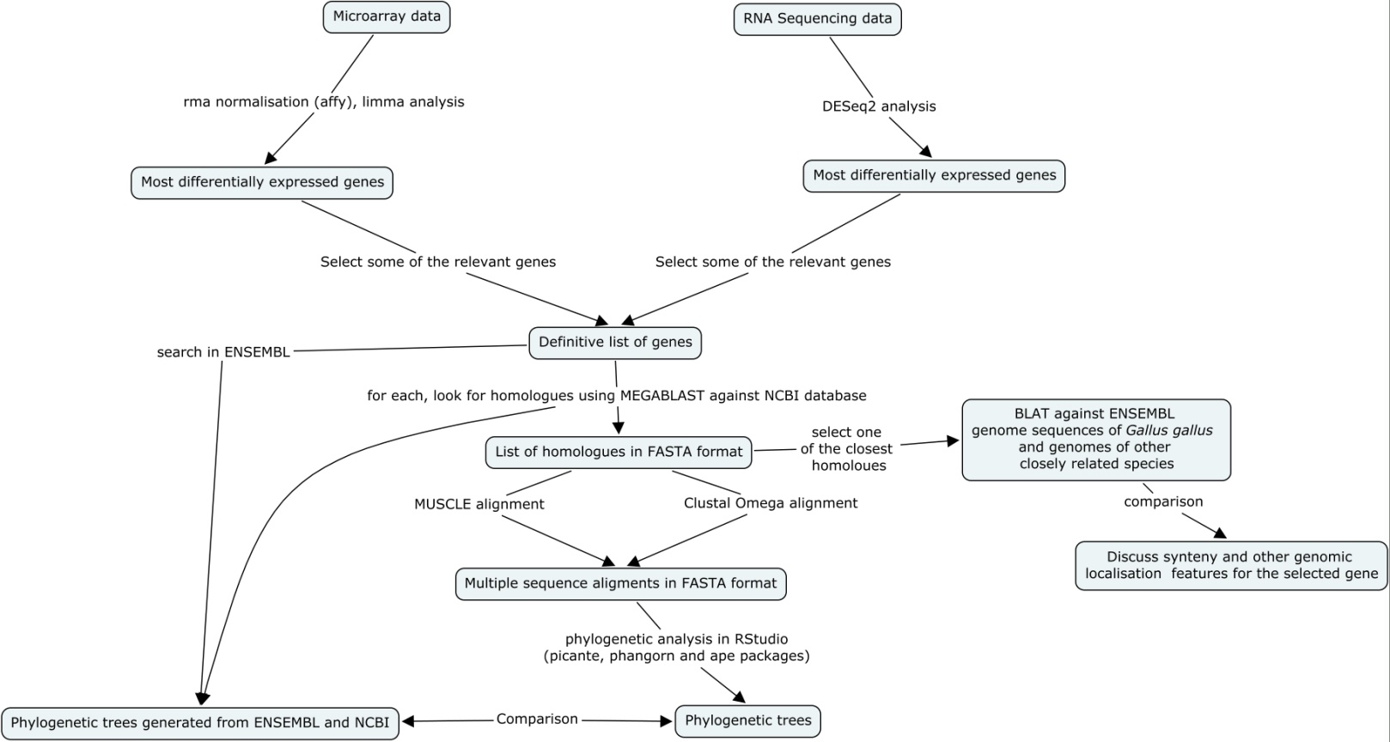

Slide 6
Identification of the most differentially expressed genes

Slide 7
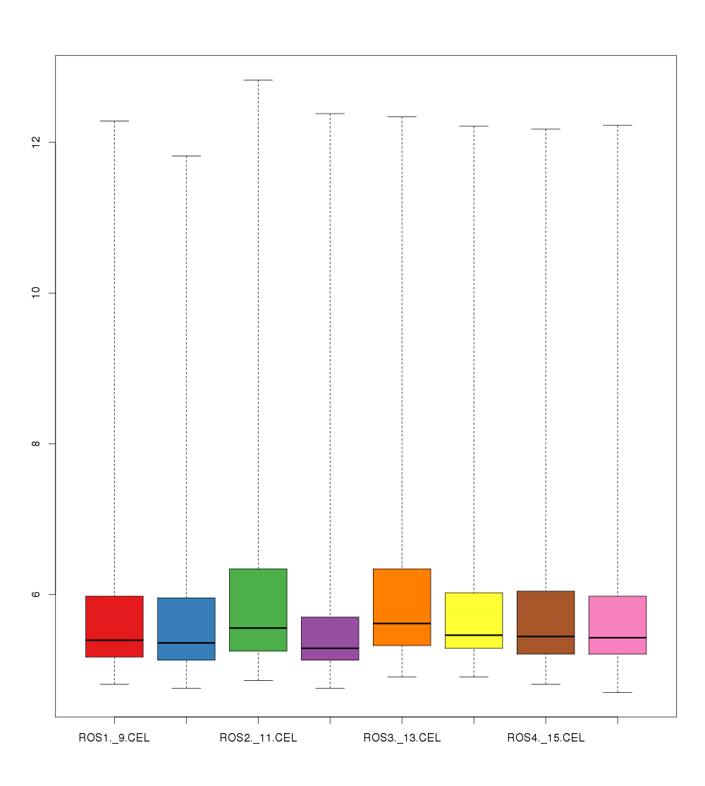
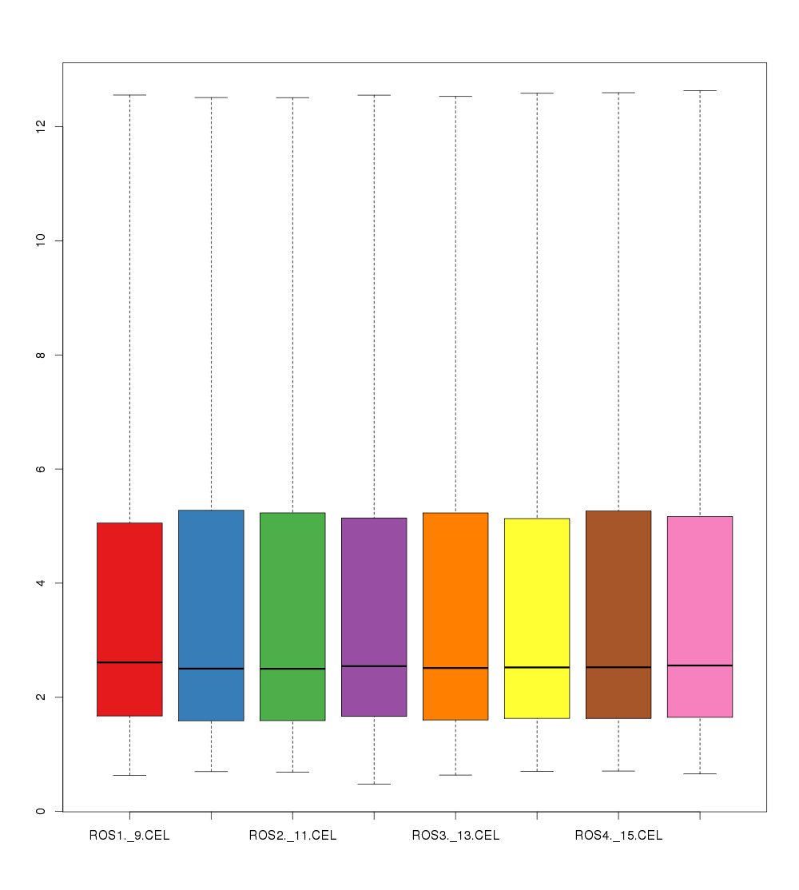
Microarray
RMA Normalization using affy
Limma analysis to find the most differentially expressed genes
DESeq2 analysis to find the most differentialle expressed genes
RNA Sequencing

Slide 8
List of genes
Microarray RNA-Sequencing
GNAZ RIMBP2
???? MMEL1
???? NABP1
???? MUC6

Slide 9
Homologues search and multiple sequence alignment

Slide 10
Too long
No real gene homology
Nucleotide loci sequences
ENSEMBL sequences
Nucleotide mRNA sequences
Uncompleted

Slide 11
Find the mRNA sequence of MMEL1 and MUC6
Search homologues
(MEGABLAST against Nucleotide)
Download the sequences in FASTA file
MSA using Clustal Omega and MUSCLE
MUSCLE alignment and Clustal alignment for each gene

Slide 12
Tree building and phylogenetic analysis

Slide 13
Distance matrix using K80
NJ tree building
Model testing
Tree fitting with the new more suitable model and plotting
Bootstrapping

Slide 14
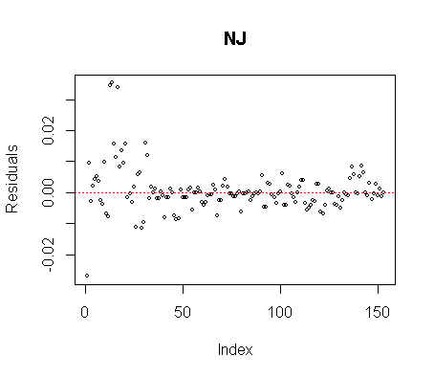
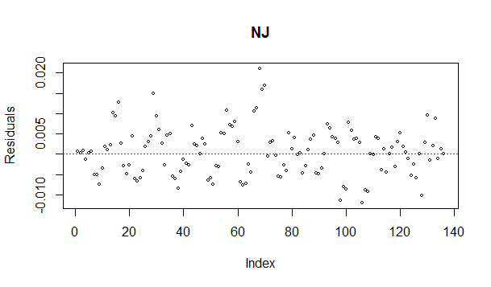
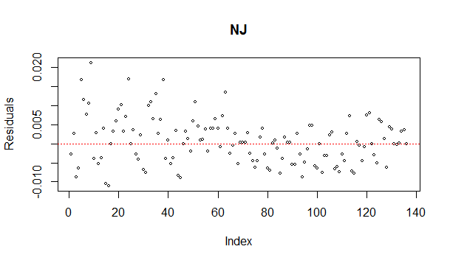
Distorsion
MUC6 MUSCLE
MMEL1 CLUSTAL
MMEL MUSCLE

Slide 15
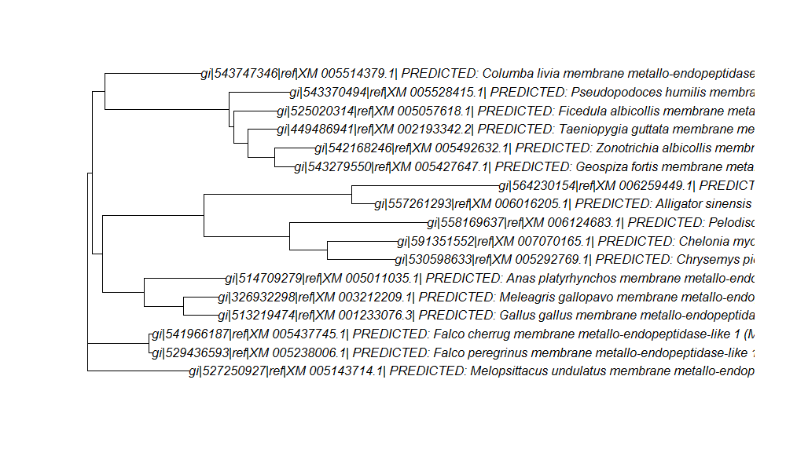
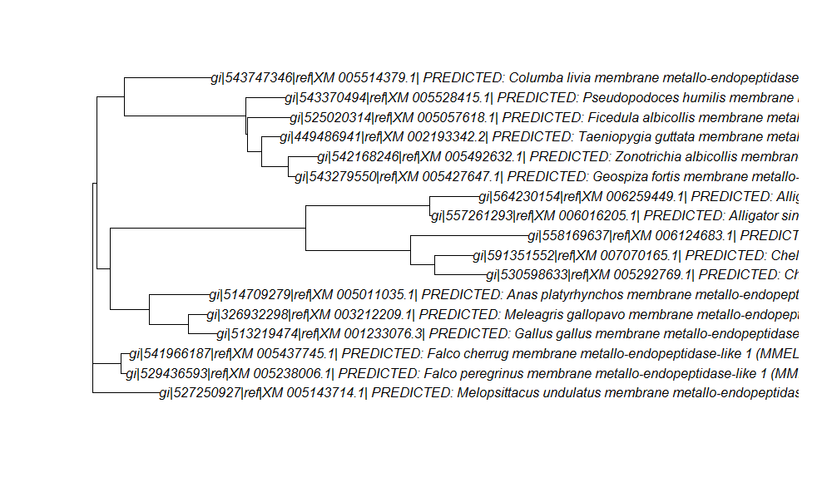
Unfitted vs fitted

Slide 16
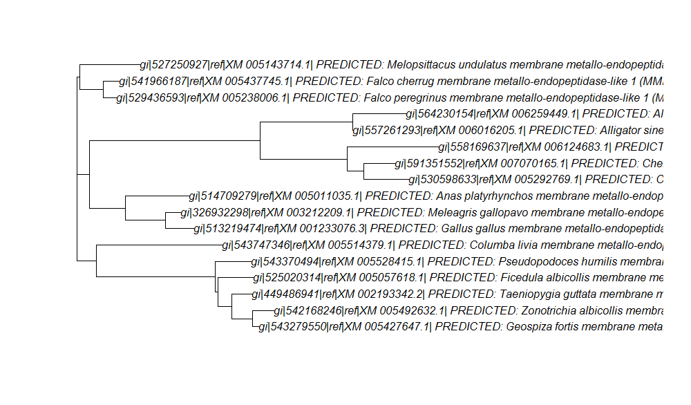
MUSCLE vs Clustal OMEGA

Slide 17
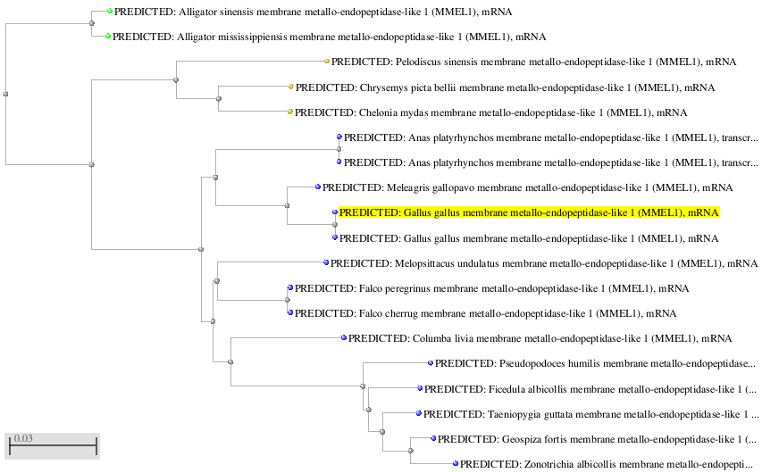
NCBI vs own treee

Slide 18
Genomic analysis

Slide 19
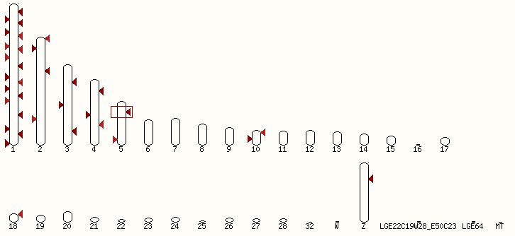
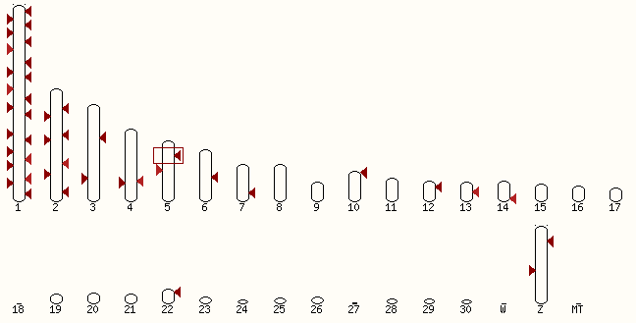
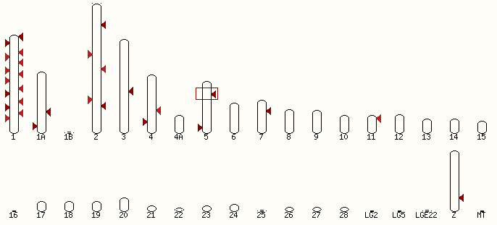
MUC6
Chicken
Turkey
Zebra finch

Slide 20
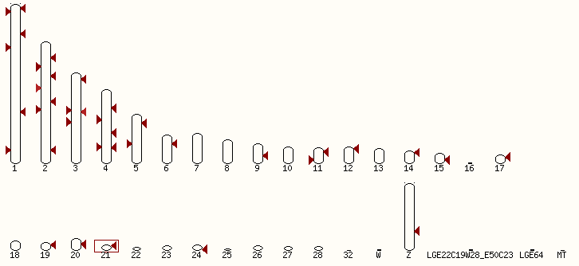
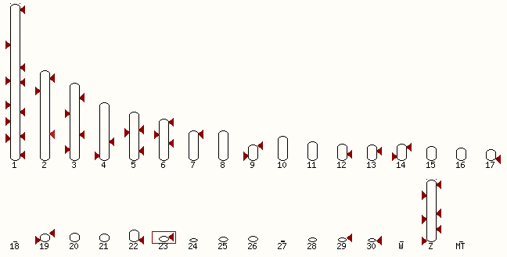
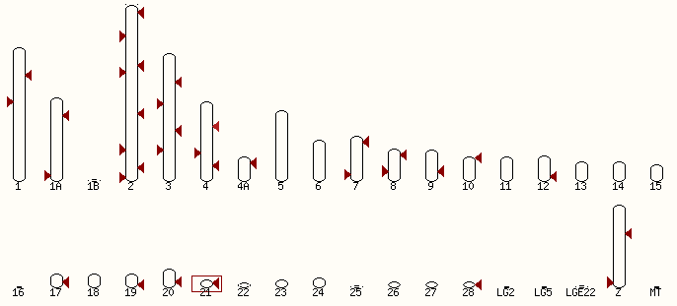
MMEL1
Chicken
Turkey
Zebra finch

Slide 21
Conclusions
Using different techniques, methodologies and algorithms change the final results
Microarray vs RNA-Sequencing
MUSCLE vs Clustal OMEGA
K80 vs GTR
Close relationship between chicken, turkey and duck homologues
Genes location are well conserved between the different species

Slide 22
Things to be considered/improved
Deeper genomic analysis
Protein alignment + tree
Solving problems:
Unplotted tres

Slide 23

Thanks for you attention!

