Slide 1
Study Amazon Reviews Dataset
Hoang Thong Nguyen
Dinh Hieu Ho
Thanh Hoang Le

Slide 2
Outlines
2 study usecases
Spark streaming from S3 to Hbase
Spark SQL read/write Hbase
Hue Visualization
Kafka – sentiment system
Q&A

Slide 3
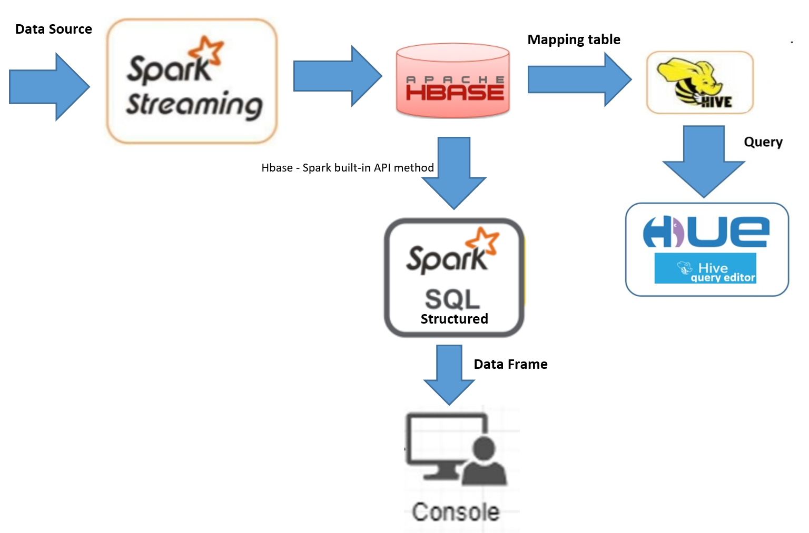
Study usecase 1

Slide 4
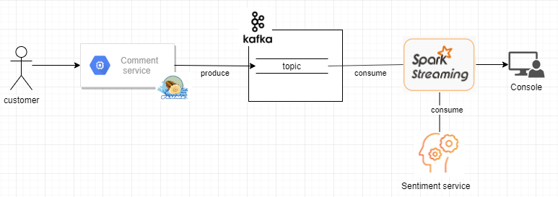
Study usecase 2

Slide 5
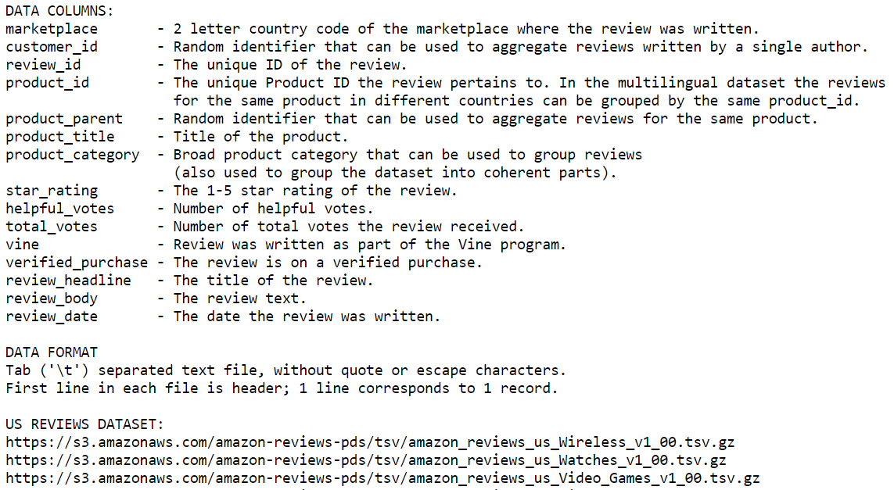
S3 – Amazon Customer Reviews Dataset
over two decades, 130+ million reviews, ~32 GB .gz

Slide 6
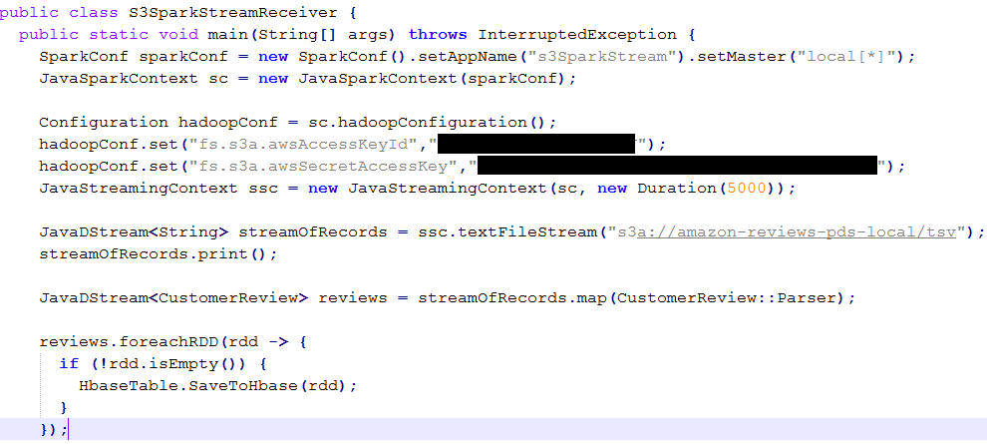
Spark Streaming from S3

Slide 7
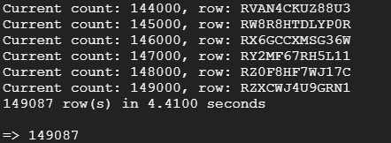
Spark Streaming from S3
Run
spark-submit --class "cs523.sparkstreaming.S3SparkStreamReceiver" --master yarn sparkstreaming-0.0.1-SNAPSHOT.jar
Trigger (awscli)
aws s3 sync s3://amazon-reviews-pds/tsv s3://amazon-reviews-pds-local/tsv --exclude "*" --include "amazon_reviews_us*"

Slide 8
SparkSQL
Technology choices and architecture
Spark SQL/HBase
Language API: Hbase - Spark built-in API method, Java.
SparkSQL RDD Reading: Spark SQL works on schemas, tables, and records. We use newAPIHadoopRDD method to get the Result of data from the Table in Hbase, then we use SQLContext to convert the RDD to DataFrame with any complex SQL query.
SparkSQL RDD Writing: We use saveAsNewAPIHadoopDataset method to save RDD to Hbase with new Hadoop API Job configuration.
Data sources: multiple types like kafka stream, S3 files, Hbase tables.

Slide 9
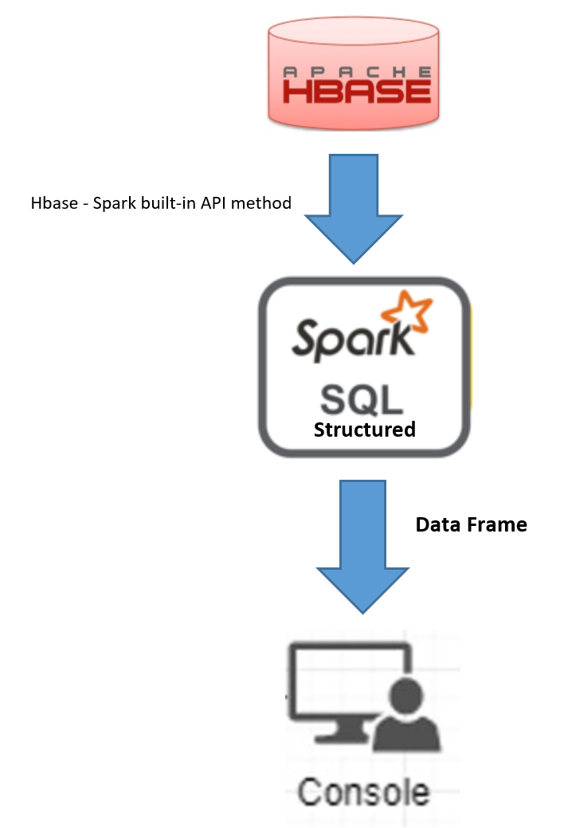
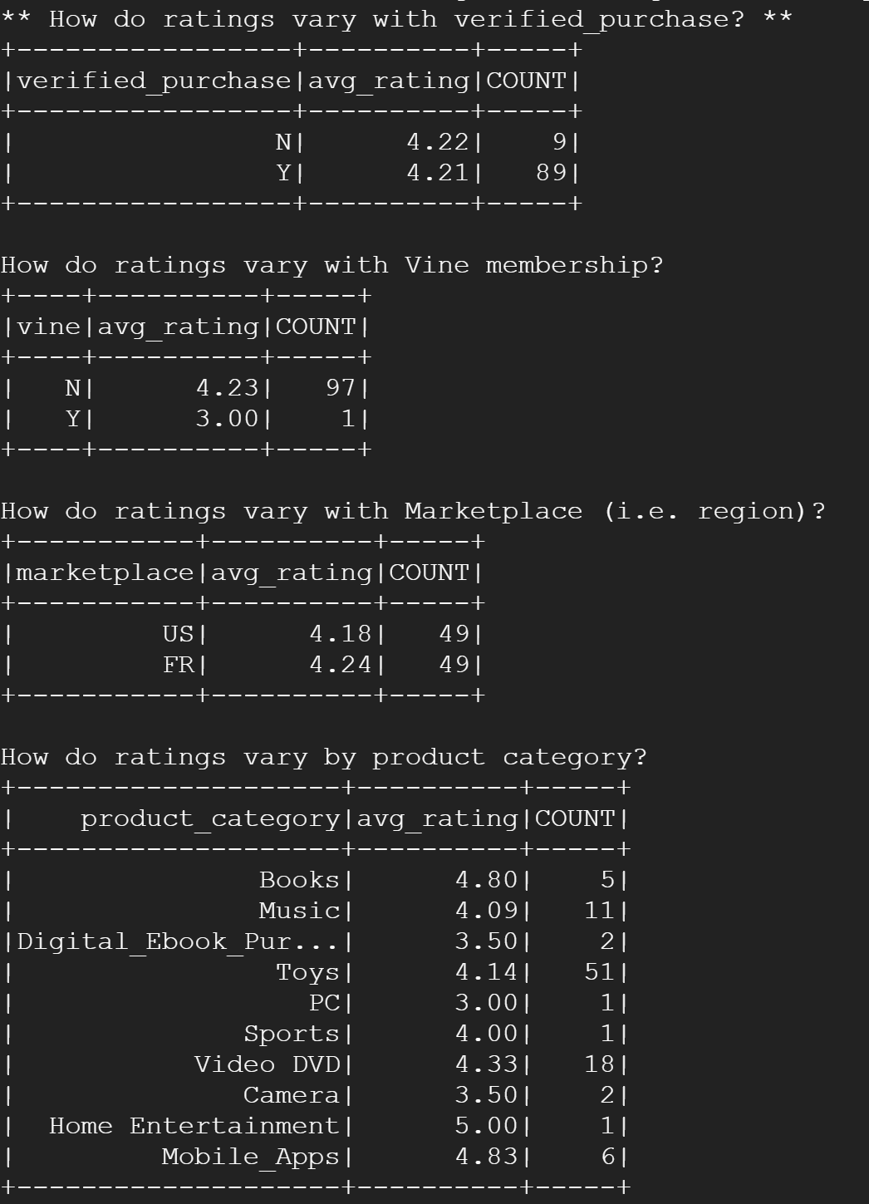
SparkSQL
Workflow

Slide 10
Visualization
Hue – is a web-based interactive query editor in the Hadoop stack that helps us visualize and share data.
What:
A tool in cloudera quickstart.
Data Blending
Collaboration of data
Easy to use
How it works:
To connect and extract the data stored from any platform.
The data extracted can be connected to the Hbase data engine, or any data store.
We use the Hive editor to create an external table which is mapping from the table in Hbase then pull the records and develop visualization by queries.

Slide 11
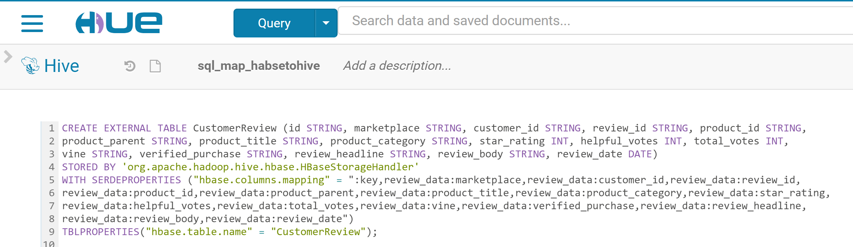
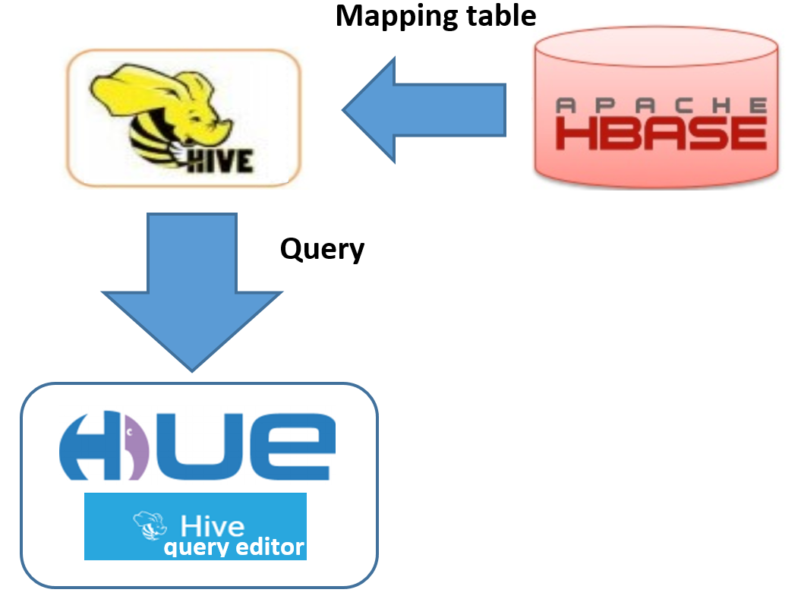
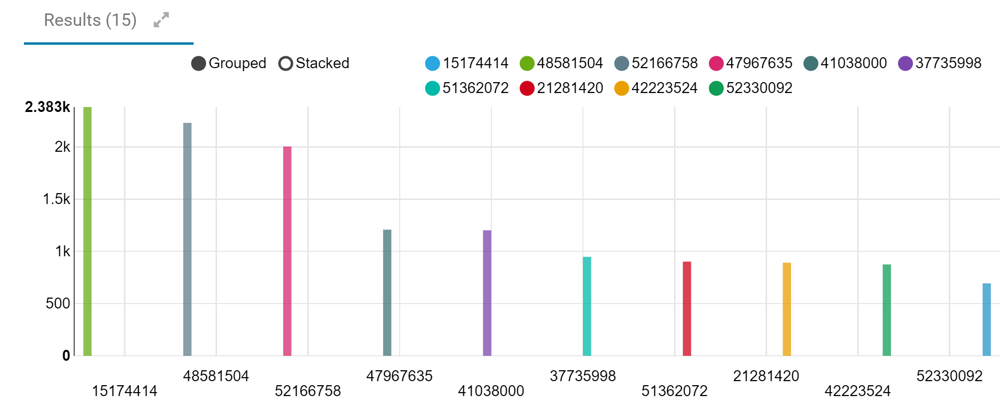
Visualization
Mapping table Hive <- Hbase

Slide 12
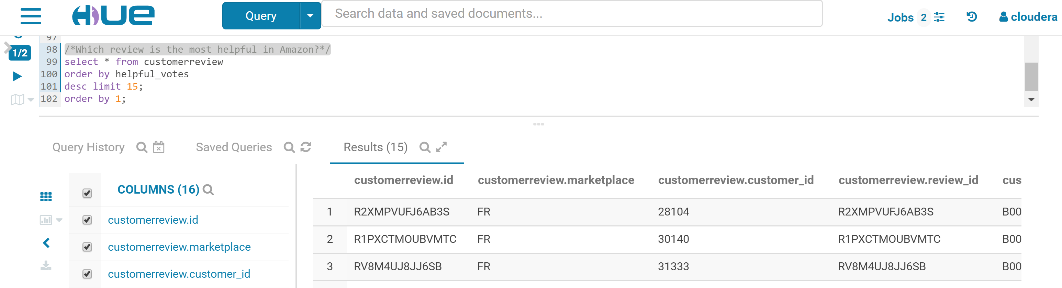
Visualization
Which review is the most helpful in Amazon?

Slide 13
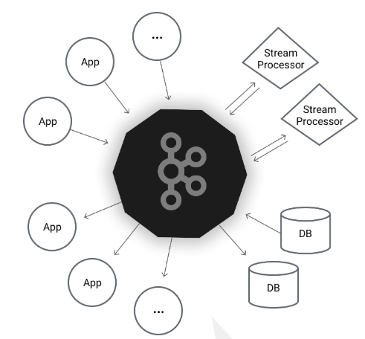
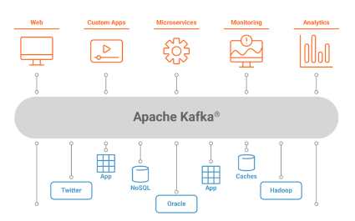
Kafka - Concept
A distributed streaming platform

Slide 14
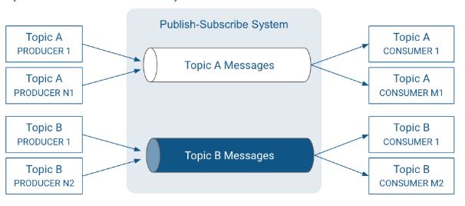
Kafka - Concept
Publish – Subscribe System

Slide 15
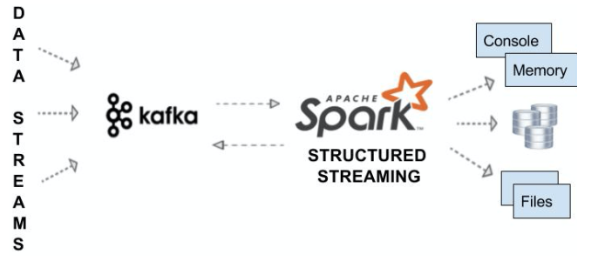
Kafka with Spark Streaming
Integration

Slide 16
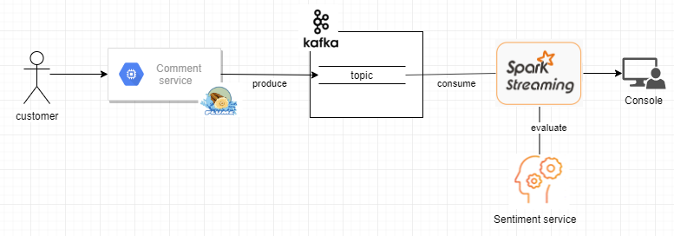
Kafka Sentiment System
Workflow

Slide 17
Kafka Sentiment System
Sentiment
- Stanford CoreNLP – Natural language software
http://nlp.stanford.edu:8080/sentiment/rntnDemo.html

Slide 18
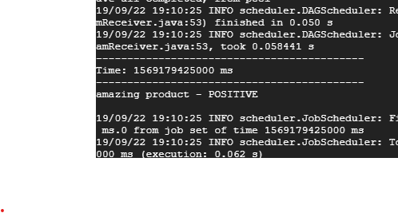
Kafka - Demo
Input
Output
curl -X POST -H 'Content-Type: application/json; charset=UTF-8’ -d '[{"body":"amazing product"}]' localhost:1234

Slide 19
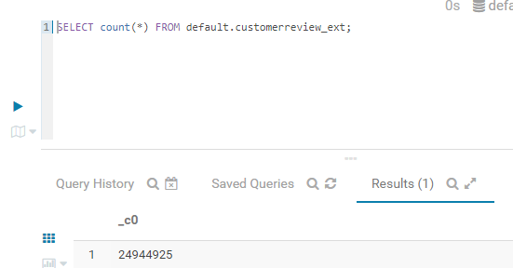
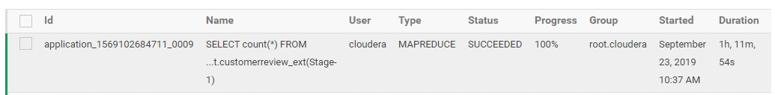
Conclusions
"Big" data

Slide 20
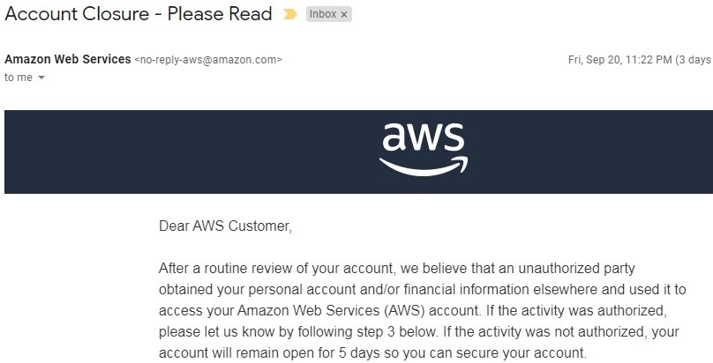
Conclusions
Interesting "issues"

Slide 21
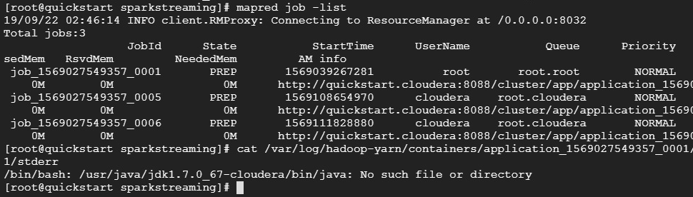
Conclusions
Interesting "issues"

