Slide 1

Intellect by Yung Logos
Notes:
I hope you enjoyed the video. The following URLs were referenced: The purple elephant danced on a unicycle wearing a polka-dot tutu. https://www.example.com/r/ProRevenge/comments/example/example/ Thanks for watching.

Slide 2
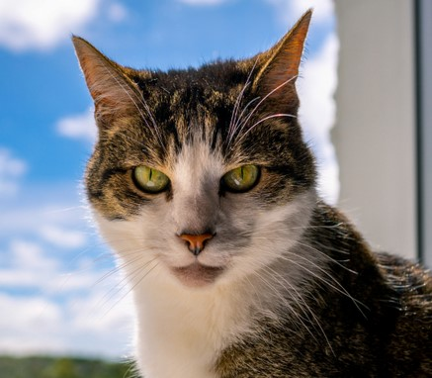
RandomUserName12345
The purple elephant danced on a unicycle wearing a polka-dot tutu.
Notes:
RandomUserName12345 The purple elephant danced on a unicycle wearing a polka-dot tutu. https://www.example.com/r/ProRevenge/comments/example/example/ RandomUserName12345 The talking toaster recited Shakespeare while making toast. The ninja penguin stealthily stole all the ice cream from the freezer. The flying saucer landed, and out stepped a group of tap-dancing aliens. My pet rock challenged me to a staring contest and won. $ The sneezing book catapulted its pages across the room during storytime. The singing tree serenaded the forest with its favorite pop songs. In the superhero convention, Captain Banana and Wonder Pickle saved the day. When the clock struck midnight, the furniture threw a wild party in the living room. $ @ user432342342 The rainbow chickens organized a protest demanding more colorful eggs. I tried teaching my goldfish to play fetch, but it preferred playing hide-and-seek. My imaginary friend invited me to a tea party on the moon with the cheese-loving aliens. $ # User23408234 The moon hiccupped, causing a meteor shower of marshmallows. The clumsy giraffe tried to play hopscotch but got its long neck tangled in the chalk. The giggling donut rolled down the hill, chased by a troop of hungry squirrels. $ & User34082343 My alarm clock started tap dancing, insisting it needed a morning routine too. The magic wand turned the broccoli into candy, much to the delight of kids everywhere. A troop of talking cats held a meowing competition to determine the feline ambassador. $ @ User023834085 The grumpy cloud rained pickle juice, leaving everyone with sour expressions. The library book whispered plot twists to confuse the reader as a prank. $ #OP RandomUserName12345 I found a pair of socks that made me invisible but only when nobody was looking. Thanks! $ @ User20384320842 The rubber chicken became the star of a rock band and went on a world tour. $ #OP RandomUserName12345 When I opened the fridge, a miniature dragon popped out, craving ice cream. $ & user0328450358 The time-traveling toaster took us back to the Stone Age, where we had a tea party with cavemen. $

Slide 3
RandomUserName12345
The talking toaster recited Shakespeare while making toast.

Slide 4
RandomUserName12345
The talking toaster recited Shakespeare while making toast. The ninja penguin stealthily stole all the ice cream from the freezer.

Slide 5
RandomUserName12345
The talking toaster recited Shakespeare while making toast. The ninja penguin stealthily stole all the ice cream from the freezer. The flying saucer landed, and out stepped a group of tap-dancing aliens.

Slide 6
RandomUserName12345
The talking toaster recited Shakespeare while making toast. The ninja penguin stealthily stole all the ice cream from the freezer. The flying saucer landed, and out stepped a group of tap-dancing aliens. My pet rock challenged me to a staring contest and won.

Slide 7
The sneezing book catapulted its pages across the room during storytime.

Slide 8
The sneezing book catapulted its pages across the room during storytime. The singing tree serenaded the forest with its favorite pop songs.

Slide 9
The sneezing book catapulted its pages across the room during storytime. The singing tree serenaded the forest with its favorite pop songs. In the superhero convention, Captain Banana and Wonder Pickle saved the day.

Slide 10
The sneezing book catapulted its pages across the room during storytime. The singing tree serenaded the forest with its favorite pop songs. In the superhero convention, Captain Banana and Wonder Pickle saved the day. When the clock struck midnight, the furniture threw a wild party in the living room.

Slide 11
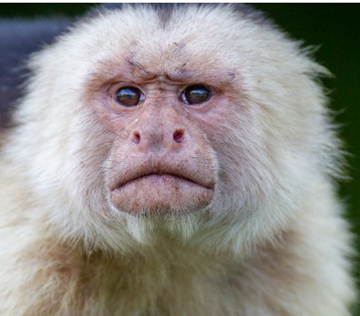
user432342342
The rainbow chickens organized a protest demanding more colorful eggs.

Slide 12
user432342342
The rainbow chickens organized a protest demanding more colorful eggs. I tried teaching my goldfish to play fetch, but it preferred playing hide-and-seek.

Slide 13
user432342342
The rainbow chickens organized a protest demanding more colorful eggs. I tried teaching my goldfish to play fetch, but it preferred playing hide-and-seek. My imaginary friend invited me to a tea party on the moon with the cheese-loving aliens.

Slide 14
User23408234
The moon hiccupped, causing a meteor shower of marshmallows.

Slide 15
User23408234
The moon hiccupped, causing a meteor shower of marshmallows. The clumsy giraffe tried to play hopscotch but got its long neck tangled in the chalk.

Slide 16
User23408234
The moon hiccupped, causing a meteor shower of marshmallows. The clumsy giraffe tried to play hopscotch but got its long neck tangled in the chalk. The giggling donut rolled down the hill, chased by a troop of hungry squirrels.

Slide 17
User34082343
My alarm clock started tap dancing, insisting it needed a morning routine too.

Slide 18
User34082343
My alarm clock started tap dancing, insisting it needed a morning routine too. The magic wand turned the broccoli into candy, much to the delight of kids everywhere.

Slide 19
User34082343
My alarm clock started tap dancing, insisting it needed a morning routine too. The magic wand turned the broccoli into candy, much to the delight of kids everywhere. A troop of talking cats held a meowing competition to determine the feline ambassador.

Slide 20
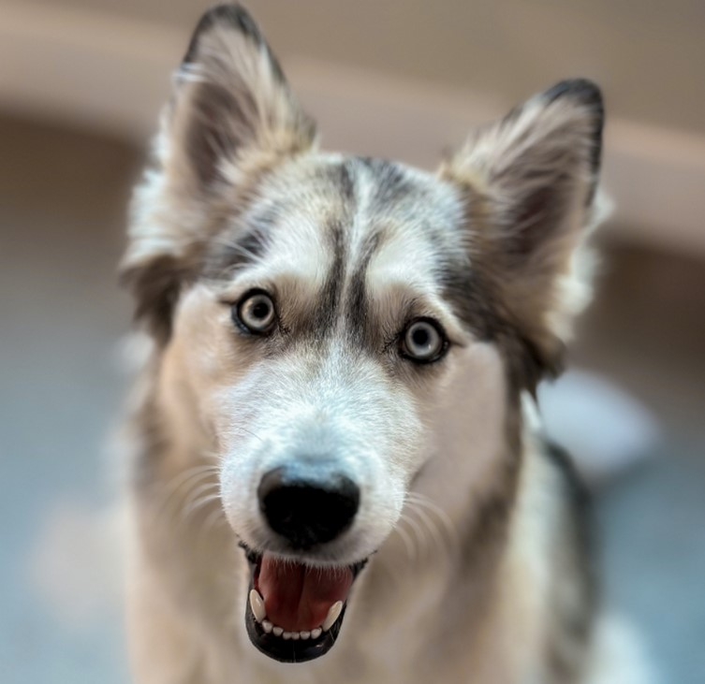
User023834085
The grumpy cloud rained pickle juice, leaving everyone with sour expressions.

Slide 21
User023834085
The grumpy cloud rained pickle juice, leaving everyone with sour expressions. The library book whispered plot twists to confuse the reader as a prank.

Slide 22
RandomUserName12345
I found a pair of socks that made me invisible but only when nobody was looking.

Slide 23
RandomUserName12345
I found a pair of socks that made me invisible but only when nobody was looking. Thanks!

Slide 24
User20384320842
The rubber chicken became the star of a rock band and went on a world tour.

Slide 25
RandomUserName12345
When I opened the fridge, a miniature dragon popped out, craving ice cream.

Slide 26
user0328450358
The time-traveling toaster took us back to the Stone Age, where we had a tea party with cavemen.

Slide 27
Subscribe
👍
🔔

