Slide 1

End-Semester Dissertation Evaluation Phase II 2021-22
Presented By: Anindya Ghosal
Roll No: 2020PSP3007
Branch: MTech (Signal Processing)
Supervisor: Prof. (Dr.) Jyotsna Singh
Division of Electronics & Communication Engineering NETAJI SUBHAS UNIVERSITY OFTECHNOLOGY
(Formerly NSIT) NEW DELHI-110078

Slide 2
Dissertation Topic : Bounding Box Refinement Agent for Overlapping Objects

Slide 3
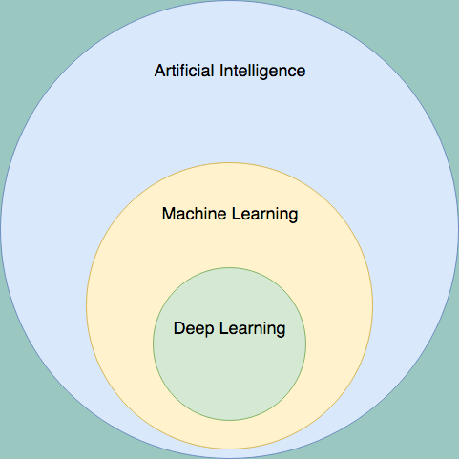
What is Machine Learning?
Machine Learning is an application of Artificial Intelligence (AI) it gives devices the ability to learn from their experiences and improve their self without doing any coding.
For Example, when you shop from any website it’s shows related search like:- People who bought also saw this.
Arthur Samuel coined the term Machine Learning in the year 1959.
He defined Machine Learning as “Field of study that gives computers the capability to learn without being explicitly programmed”.

Slide 4
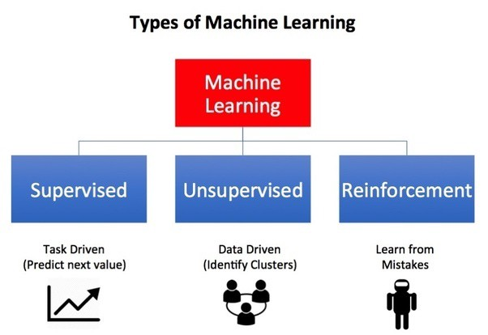
Types of Machine Learning

Slide 5
Supervised Machine Learning
Supervised learning is one of the most basic types of machine learning. In this type, the machine learning algorithm is trained on labeled data. Even though the data needs to be labeled accurately for this method to work, supervised learning is extremely powerful when used in the right circumstances.
In supervised learning, the ML algorithm is given a small training dataset to work with. This training dataset is a smaller part of the bigger dataset and serves to give the algorithm a basic idea of the problem, solution, and data points to be dealt with. The training dataset is also very similar to the final dataset in its characteristics and provides the algorithm with the labeled parameters required for the problem.
The algorithm then finds relationships between the parameters given, essentially establishing a cause and effect relationship between the variables in the dataset. At the end of the training, the algorithm has an idea of how the data works and the relationship between the input and the output.
This solution is then deployed for use with the final dataset, which it learns from in the same way as the training dataset. This means that supervised machine learning algorithms will continue to improve even after being deployed, discovering new patterns and relationships as it trains itself on new data.
Regarding this a conference publication is accepted and presented in Com-IT-Con, help from 26-27 May 2022 at Manav Rachna International Institute of Research and Studies, Faridabad.
The work done was in the field of using various machine learning techniques to predict the footfall in tourism of Bali.

Slide 6
Unsupervised Machine Learning
Unsupervised machine learning holds the advantage of being able to work with unlabeled data. This means that human labor is not required to make the dataset machine-readable, allowing much larger datasets to be worked on by the program.
In supervised learning, the labels allow the algorithm to find the exact nature of the relationship between any two data points.
However, unsupervised learning does not have labels to work off of, resulting in the creation of hidden structures. Relationships between data points are perceived by the algorithm in an abstract manner, with no input required from human beings.
The creation of these hidden structures is what makes unsupervised learning algorithms versatile. Instead of a defined and set problem statement, unsupervised learning algorithms can adapt to the data by dynamically changing hidden structures.

Slide 7
Reinforcement Learning
Reinforcement learning directly takes inspiration from how human beings learn from data in their lives. It features an algorithm that improves upon itself and learns from new situations using a trial-and-error method. Favorable outputs are encouraged or ‘reinforced’, and non-favorable outputs are discouraged or ‘punished’.
Based on the psychological concept of conditioning, reinforcement learning works by putting the algorithm in a work environment with an interpreter and a reward system. In every iteration of the algorithm, the output result is given to the interpreter, which decides whether the outcome is favorable or not.
In case of the program finding the correct solution, the interpreter reinforces the solution by providing a reward to the algorithm. If the outcome is not favorable, the algorithm is forced to reiterate until it finds a better result. In most cases, the reward system is directly tied to the effectiveness of the result.
In typical reinforcement learning use-cases, such as finding the shortest route between two points on a map, the solution is not an absolute value. Instead, it takes on a score of effectiveness, expressed in a percentage value. The higher this percentage value is, the more reward is given to the algorithm. Thus, the program is trained to give the best possible solution for the best possible reward.

Slide 8
Some Terminologies:
Model: Also known as “hypothesis”, a machine learning model is the mathematical representation of a real-world process. A machine learning algorithm along with the training data builds a machine learning model.
Feature: A feature is a measurable property or parameter of the data-set.
Feature Vector: It is a set of multiple numeric features. We use it as an input to the machine learning model for training and prediction purposes.
Training: An algorithm takes a set of data known as “training data” as input. The learning algorithm finds patterns in the input data and trains the model for expected results (target). The output of the training process is the machine learning model.
Prediction: Once the machine learning model is ready, it can be fed with input data to provide a predicted output.
Target (Label): The value that the machine learning model has to predict is called the target or label.
Overfitting: When a massive amount of data trains a machine learning model, it tends to learn from the noise and inaccurate data entries. Here the model fails to characterize the data correctly.
Underfitting: It is the scenario when the model fails to decipher the underlying trend in the input data. It destroys the accuracy of the machine learning model. In simple terms, the model or the algorithm does not fit the data well enough.

Slide 9
How is Reinforcement Learning different from traditional machine learning algorithms?
Unsupervised learning is a geometric problem. Meaning, it tries to understand the structure of the problem in order to discover how to partition the data meaningfully.
Supervised learning is all about how to partition the data based on labels. In a sense, the structure is much less important, and the labels are the critical hints of how we should partition the data.
Reinforcement learning (RL) is something different. It involves feedback from the environment, depend on the previous states. It doesn’t necessarily involves labels, and you may get the reward well after the actions were taken. Whenever we want to model any algorithm as a sequential decision process, then reinforcement learning is used.
These points differentiate reinforcement learning totally from run of the mill supervised and unsupervised learning:
It works on interacting with the environment, no predefined data, Exploration V/s Exploitation, no supervision, with the aim of learning a series of action.

Slide 10
Reinforcement Learning:
Reinforcement learning (RL) is learning what to do—how to map situations to actions—so as to maximize a numerical reward signal.
The learner is not told which actions to take, but instead must discover which actions yield the most reward by trying them.
Though both supervised and reinforcement learning use mapping between input and output, unlike supervised learning where the feedback provided to the agent is correct set of actions for performing a task, reinforcement learning uses rewards and punishments as signals for positive and negative behavior.
As compared to unsupervised learning, reinforcement learning is different in terms of goals. While the goal in unsupervised learning is to find similarities and differences between data points, in the case of reinforcement learning the goal is to find a suitable action model that would maximize the total cumulative reward of the agent.

Slide 11

The following are couple of terminologies when it comes to Reinforcement Learning:
Environment — Physical world in which the agent operates
State — Current situation of the agent
Reward — Feedback from the environment
Policy — Method to map agent’s state to actions
Value — Future reward that an agent would receive by taking an action in a particular state
Agent — The main working entity of the reinforcement learning paradigm

Slide 12
Markov Decision Process
The standard theory of RL is defined by a Markov Decision Process (MDP), which is an extension of the Markov process (also known as the Markov chain).
Mathematically, the Markov process is a discrete-time stochastic process whose conditional probability distribution of the future states only depends upon the present state and it provides a framework to model decision-making situations.
An MDP is typically defined by five elements as follows:
• S: a set of state or observation space of an environment. s₀ is starting state.
• A: set of actions the agent can choose.
• T: a transition probability function T(s_{t+1}|s_{t}; a_{t}), specifying the probability that the environment will transition to state s_{t+1} ∈ S if the agent takes action a_{t} ∈ A in state s_{t} ∈ S.
• R: a reward function where r_{t+1} = R(s_{t} , s_{t+1}) is a reward received for taking action at a_{t} state s_{t} and transfer to the next state s_{t+1}.
γ : a discount factor.

Slide 13

Considering MDP($S, A, γ , T, R$), the agent chooses an action according to the policy $π$(a_{t}|s_{t}) at state s_{t}. Notably, agent's algorithm for choosing action a, given current state s, which in general can be viewed as distribution $π$(a|s), is called a policy (strategy). The environment receives the action, produces a reward r_{t+1} and transfers to the next state s_{t+1} according to the transition probability T(s_{t+1}|s_{t}, a_{t}).
The process continues until the agent reaches a terminal state or a maximum time step.

Slide 14
Q Learning
Q-learning is a simple yet very powerful algorithm to create a table for our reinforcement learning agent. This helps the agent figure out exactly which action to perform.
But what if this table is way too long? Just give a thought on an environment with 10,000 states and 1,000 actions per state. This would create a table of 10 million cells.
Well if the table has 10 million cells, good luck trying to find the best action when landing on a state.
Now it became pretty clear that we can under no way the agent can infer the Q-value of new states from already explored states. This presents two problems:
First, the amount of memory required to save and update that table would increase as the number of states increases, in other words logarithmically
Second, the amount of time required to explore each state to create the required Q-table would be unrealistic
Now what would happen if we are able approximate these Q-values with machine learning models such as a neural network? This was the idea behind DeepMind’s algorithm which dropped like a bombshell on the world opening new possibilities for reinforcement learning paradigm.

Slide 15
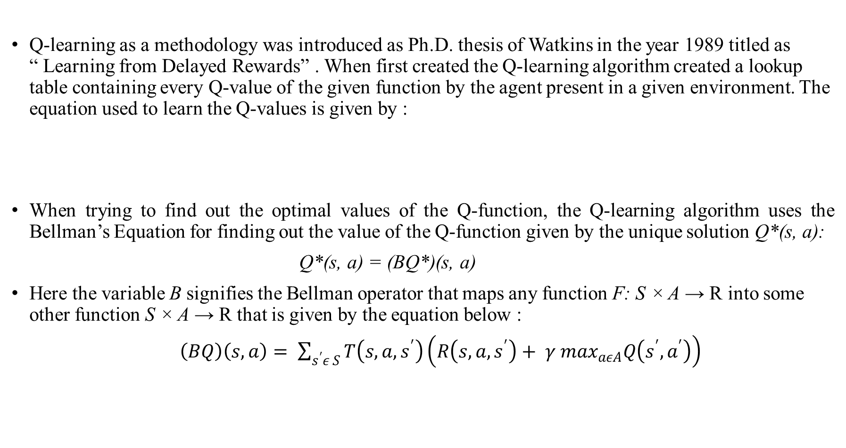
Q-Learning
Q-learning as a methodology was introduced as Ph.D. thesis of Watkins in the year 1989 titled as “ Learning from Delayed Rewards” . When first created the Q-learning algorithm created a lookup table containing every Q-value of the given function by the agent present in a given environment. The equation used to learn the Q-values is given by :
When trying to find out the optimal values of the Q-function, the Q-learning algorithm uses the Bellman’s Equation for finding out the value of the Q-function given by the unique solution Q*(s, a):
Q*(s, a) = (BQ*)(s, a)
Here the variable B signifies the Bellman operator that maps any function F: S × A → R into some other function S × A → R that is given by the equation below :
$\left(BQ\right)\left(s,a\right)= \sum_{s^{′}ε S}{T\left(s,a,s^{′}\right)\left(R\left(s,a,s^{′}\right)+ γ \max_{aεA}Q\left(s^{′}, a^{′}\right)\right) }$

Slide 17
Category
In general, RL can be divided into either model-free or model-based methods. Here, "model“ is defined by the two quantity: transition probability function T(s_{t+1}|s_{t ,} a_{t}) and the reward function R(s_{t} , s_{t+1}).
Model-based RL is an approach that uses a learnt model, i.e. T(s_{t+1}|s_{t ,} a_{t}) and reward function R(s_{t} , s_{t+1}) to predict the future action. There are four main model-based techniques as follows:
Value Function: The objective of value function methods is to obtain the best policy by maximizing the value functions in each state.
Transition Models: Transition models decide how to map from a state s, taking action a to the next state (s') and it strongly affects the performance of model-based RL algorithms. Based on whether predicting the future state s' is based on the probability distribution of a random variable or not, there are two main approaches in this group: stochastic and deterministic.
Policy Search: Policy search approach directly searches for the optimal policy by modifying its parameters, whereas the value function methods indirectly find the actions that maximize the value function at each state.
Return Functions: Return functions decide how to aggregate rewards or punishments over an episode. They affect both the convergence and the feasibility of the model. There are two main approaches in this group: discounted returns functions and averaged returns functions

Slide 18
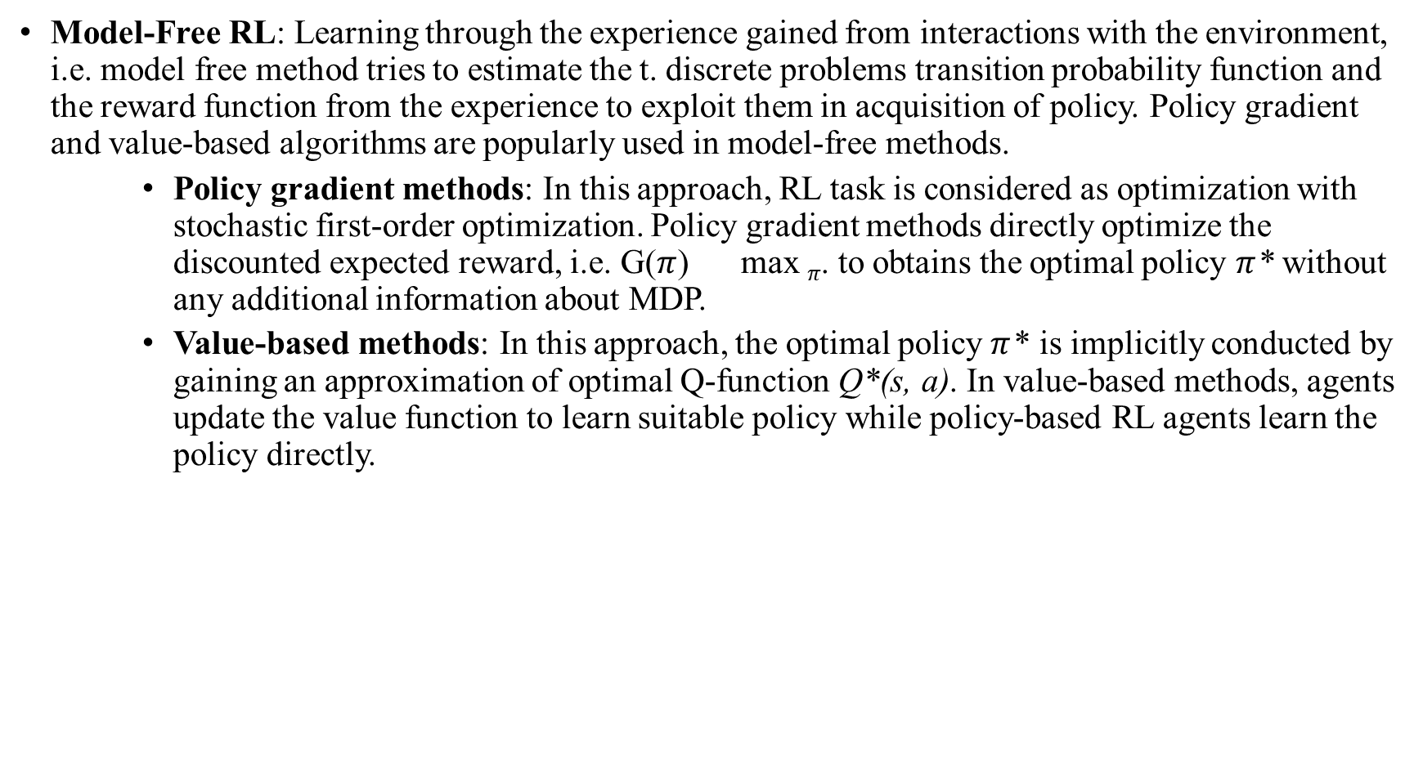
Model-Free RL: Learning through the experience gained from interactions with the environment, i.e. model free method tries to estimate the t. discrete problems transition probability function and the reward function from the experience to exploit them in acquisition of policy. Policy gradient and value-based algorithms are popularly used in model-free methods.
Policy gradient methods: In this approach, RL task is considered as optimization with stochastic first-order optimization. Policy gradient methods directly optimize the discounted expected reward, i.e. G($π$) max $π$. to obtains the optimal policy $π$* without any additional information about MDP.
Value-based methods: In this approach, the optimal policy $π$* is implicitly conducted by gaining an approximation of optimal Q-function Q*(s, a). In value-based methods, agents update the value function to learn suitable policy while policy-based RL agents learn the policy directly.

Slide 19
Deep Reinforcement Learning (DRL)
Deep Reinforcement Learning (DRL) is the combination of Reinforcement Learning and Deep Learning (DL) and it has become one of the most intriguing areas of artificial intelligence today.
DRL has been successfully applied into many domains including games, robotics, autonomous driving, healthcare, natural language processing, and computer vision. In contrast to supervised learning which requires large labeled training data, DRL samples training data from an environment.
Far from supervised learning, DRL-based approaches focus on solving sequential decision making problems. They aim at deciding, based on a set of experiences collected by interacting with the environment, the sequence of actions in an uncertain environment to achieve some targets.
Different from supervised learning where the feedback is available after each system action, it is simply a scalar value that may be delayed in time in the DRL framework.
For example, the success or failure of the entire system is reflected after a sequence of actions. Furthermore, the supervised learning model is updated based on the loss/error of the output and there is no mechanism to get the correct value when it is wrong.
This is addressed by policy gradients in DRL by assigning gradients without a differentiable loss function. This aims at teaching a model to try things out randomly and learn to do correct things more.

Slide 20
DQN in application
DQN as a first was introduced by authors in 2 papers namely “ Playing Atari with Deep Reinforcement Learning” in the year 2013 at NIPS and “Human-level control through deep reinforcement learning” in the year 2015 in Nature.
The idea to use deep learning as a mapping paradigm which lead the researcher to the creation of the field of deep reinforcement learning.
The main reason to use deep learning was if the number of q values corresponding to an exploration problem happened and the number of action and states corresponding to the problem comes out at a magnitude of thousand or millions, it was not at all feasible to create a Q-Table for containing such a large number of parameters.
So DQN was used to map the states to specific actions.
The image shown here is from [4] denoting how a DQN
works.

Slide 21
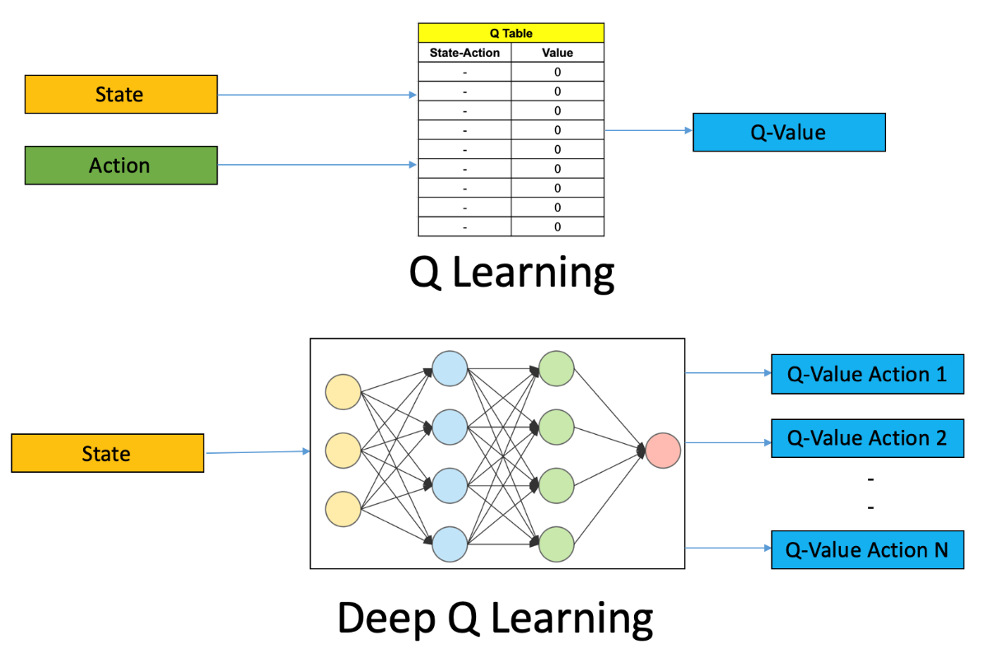
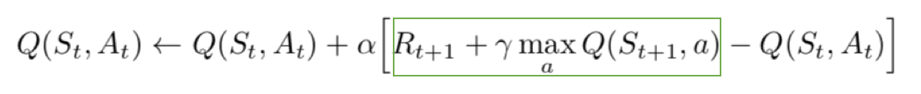
Deep Q Network
In deep Q-learning, we use a neural network to approximate the Q-value function. The state is given as the input and the Q-value of all possible actions is generated as the output.
So, let’s understand what are the steps involved in reinforcement learning using deep Q-learning networks (DQNs)?
All the past experience is stored by the user in memory
The next action is determined by the maximum output of the Q-network
The loss function here is mean squared error of the predicted Q-value and the target Q-value – Q* so basically it becomes a regression problem.
The target for DQN is denoted by the green rectangle. We can argue that it is predicting its own value, but since R is the unbiased true reward, the network is going to update its gradient using backpropagation to finally converge

Slide 22
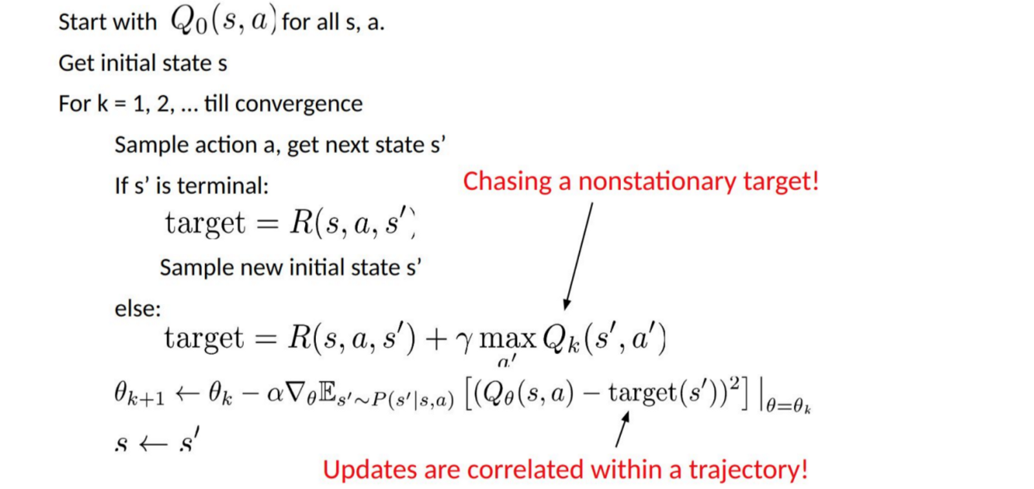
Biggest Challenge in Deep Reinforcement Learning
As we can see in the pseudo code, the target is continuously changing with each iteration. Generally in deep learning, the target variable does not change and hence the training is stable, but when it comes to reinforcement learning it is just not true.
Now what are trajectories? In RL framework, the tuple (s_{t}; a_{t}; r_{t+1}; s_{t+1}) is called transition. Several sequential transitions are usually referred to as roll-out. Full sequence (s₀; a₀; r₁; s₁; a₁; r₂; ..) is called a trajectory.

Slide 23
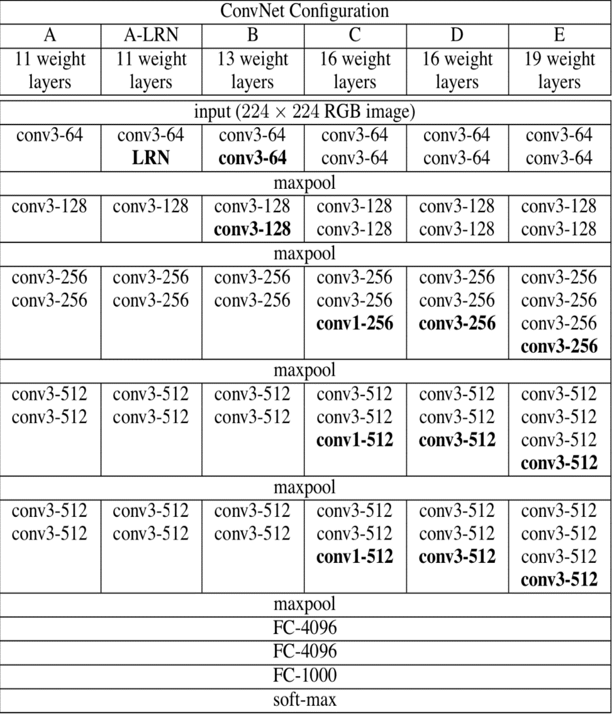
VGG
The runner-up architecture in ILSVRC 2014 was VGG [5] by a group of researchers from University of Oxford. This architecture hired its idea from AlexNet.
Input: The input to the network is a 224x224 pixel RGB image. For the ImageNet competition, the authors cropped out the center 224x224 patch in each image to keep the input image size consistent.
Convolutional Layers. The convolutional layers in VGG use a very small receptive field (3x3, the smallest possible size that still captures left/right and up/down). There are also 1x1 convolution filters which act as a linear transformation of the input. The convolution stride is fixed to 1 pixel so that the spatial resolution is preserved after convolution.
Fully-Connected Layers: VGG has three fully-connected layers: the first two have 4096 channels each and the third has 1000 channels, 1 for each class.
Hidden Layers: VGG’s hidden layers use ReLU (a huge innovation from AlexNet that cut training time).

Slide 24
ResNet-50
ResNet50 is a variant of ResNet [6] Model which has 48 Convolution layers along with 1 MaxPool and 1 Average Pool layer. It has 3.8 x 10^9 Floating points operations. It is a widely used ResNet model.
Deep Convolutional neural networks are really great at identifying low, mid and high level features from the images and stacking more layers generally was expected to give us better accuracy so a question arose that stacking more layers help us with getting better model performance?
The answer was not really. It rather displayed the problem of vanishing/exploding gradients which were largely handled in ways like normalization and enabled networks with tens of layers to converge but when deep neural networks start to converge another problem of the accuracy getting saturated and then degrading rapidly showed up
This was not caused by overfitting and adding more layers to a suitable deep model just increased the training error.
This problem was rectified by taking a shallower model and a deep model that was constructed with the layers from the shallow model and added identity layers to it and accordingly the deeper model shouldn't have produced any higher training error than its counterpart as the added layers were just the identity layers.

Slide 25
Fig. Network Architecture of varied length ResNet Architectures

Slide 26
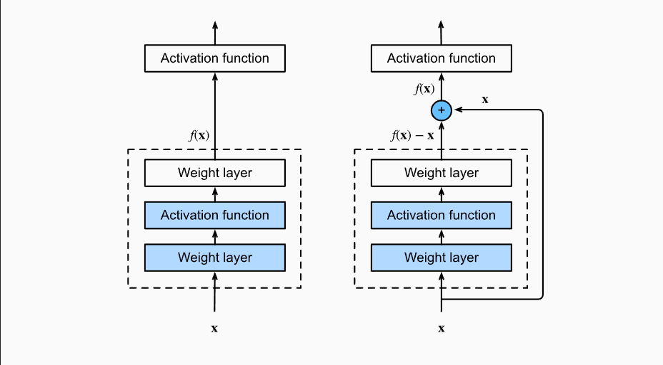
Residual Connections
The input is denoted by x .
The desired underlying mapping we want to obtain by learning is f(x) to be used as input for the activation function for the next input going layer.
On the left picture the layers within the dotted lines needs to learn the actual mapping thus taking huge amount of time.
Whereas on the right the portion within the dotted line just need to learn the residual mapping i.e. f(x)-x .
If the identity mapping f(x)=x is what we desire then adjusting the weights for the block would be easier because we are trying to make the difference zero thus helping the layer learn quickly

Slide 27
Faster R-CNN
The R-CNN family of object detectors maintained and worked towards moving on from computationally expensive models towards computationally less expensive models of CNN and object detection. So in comes Faster R-CNN which uses a collection of RPN and Fast R-CNN
The making of these networks is generally two folds. One of the things in these detectors are a region proposal network to generate bounding boxes, a feature generation stage, a classification layer to classify object detected and a regression layer to make the bounding box more precise.
The whole approach is even better computationally because it uses shared layers between the RPN and the detector. These are the 4 steps it takes:
The RPN is trained independently with the backbone CNN being initialized by ImageNet weights and then fine tunes for region proposal tasks.
Then the Fast R-CNN take in input from the above regions and uses ImageNet again to fine tune itself.
Now the Fast R-CNN trained is used to initialize the RPN, freeze the shared convolution layers and finely tune the fully connected RPN layers unique to RPN
Finally they freeze the shared convolution layers and finally tune the fully connected layers of Fast R-CNN.
The above is the implementation methodology of Faster R-CNN [7]

Slide 28
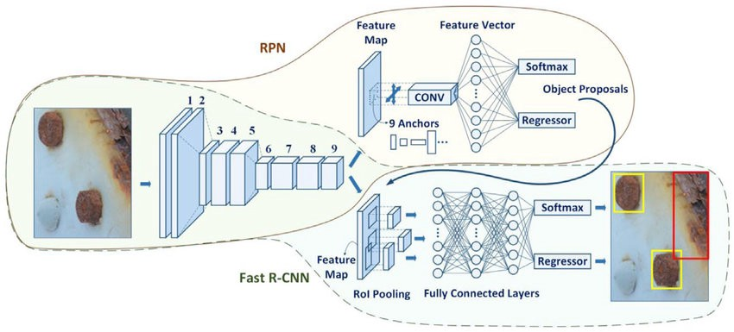
RPN takes in input image fed into the backbone convolutional neural network. The resizing done is short side not less that 600px and longer one not more than 1000px.
The feature map sizes from the backbone network is quite less and stride signifies that. Generally stride signifies that.
Every output feature map puts on anchors on the input image for every location on the output feature map from backbone networks. The anchors are 128^{2,} 256², 512² and aspect ratio of 1:1, 1:2, 2:1 giving 9 possible anchors.
First, a 3 x 3 convolution with 512 units is applied to the backbone feature map as shown in figure, to give a 512-d feature map for every location. This is followed by two sibling layers: a 1 x 1 convolution layer with 18 units for object classification, and a 1 x 1 convolution with 36 units for bounding box regression.
The 18 units output is used to give probabilities of whether or not each point in the backbone feature contains an object within all 9 of the anchors at that point.
The 36 units output is used to give the 4 regression coefficients of each of the 9 anchors & are used to improve the coordinates of the anchors that contain objects.

Slide 29
Problem Statement
All the existing literature just tends to create bounding boxes around the image but no approach has been taken to actually improve those bounding boxes. Bounding boxes might be very important in a industrial setting or even medical field. Incorrect bounding boxes might hamper the goal that we are trying to reach.
It might happen that in a business setting a particular object detection algorithm is already running. It is generally not feasible and recommended to scrap off the complete algorithm, retrain the complete algorithm on a new object and then use it on the new dataset.
So my main literature [3] tends to solve that problem of correcting the bounding boxes by using a DRL agent save time, effort, and money to re-annotate the images, train the images from scratch and then deploy the object detection model.
The criteria used for evaluating the ability of the agent to actually correct those bounding boxes is Average precision.

Slide 30
Methodology
For work done, the following progress was done as mentioned in the said paper.
The initial paper is trained on a private dataset. So a workaround that is done my replacing the initial private dataset by just one class with overlapping objects in the image from the PACAL VOC 2007 dataset.
200 images of “Person” class were chosen at random. The initial annotations were provided in the PASCAL dataset and the Faster R-CNN detection was used to produce the annotation for the detection methodology.
The DQN is a simple 4 layer fully connected architecture containing 2000 nodes each for the first 2 layers and 500 nodes each for the other too layers and a 9 node output layer for 9 actions namely up, down, left, right, wider, taller, fatter, thinner and stop.
The work done in this is an extension of a future work mentioned by the authors in paper [3].

Slide 31
Contribution done towards the existing work
A modified version of Faster R-CNN was used as the object detection algorithm because of OOM error that kept on appearing when running on the machine.
So instead of the fully connected layers as 4096 in the original VGG architecture was changed to 1024 units but the number of layers where increased to 3 and for regularization dropout with 0.50 was used.
For the DQN network the reward movement and the reward trigger was changed. An extremely high negative reward was imposed for the DQN agent so that having the better bounding box it should not get degraded.
The DQN agent was changed into a 4 layer fully connected network with 2000 neuron each for the first 2 layers and 500 neurons each for the last 2 layers and penultimate layer of 9 action states.

Slide 32
Load feature extraction method (ResNet-50)
Initialize DQN agent
Load image names
Load the ground truth and skewed boxes
Based on ground truth skim through the images
and find the objects
Based on that calculate the initial IoU
Create a history vector taking all the actions (0 if it is the first image)
Then start adjusting the skewed annotations based on the ground truth
Run till terminal action (10 steps/image)
Update history and state vector
Make the agent remember
Save the model weights

Slide 33
Action Steps | Corresponding Equation | Action Steps | Corresponding Equation
right | y_{min} + a₁ × width y_{max} + a₁ × width | left | y_{min} – a₁ × width y_{max} – a₁ × width
up | x_{min} – a₁ × height x_{max} – a₁ × height | down | x_{min} + a₁ × height x_{max} + a₁ × height
fat | x_{min} + a₂ × height x_{max} – a₂ × height | thin | y_{min} + a₂ × width y_{max} – a₂ × width
wide | y_{min} – a₂ × width y_{max} + a₂× width | tall | x_{min} – a₂ × height x_{max} + a₂ × height
a₁ is the percentile of bounding boxes that have been changed or modified from its present coordinates, a₂ = a₁/2

Slide 34
Results
Table 1. mAP values corresponding to modified implementation of Faster R-CNN
Model Architecture | mAP (PASCAL VOC 2007)
2 FC Layers, 1024, 8 Epochs, Shuffling | 34.6
2 FC Layers, 1024, 8 Epochs | 34.8
6 FC Layers, 1024, 50% Dropout | 38.6
3 FC Layers, 1024, 50% Dropout | 62.4

Slide 35
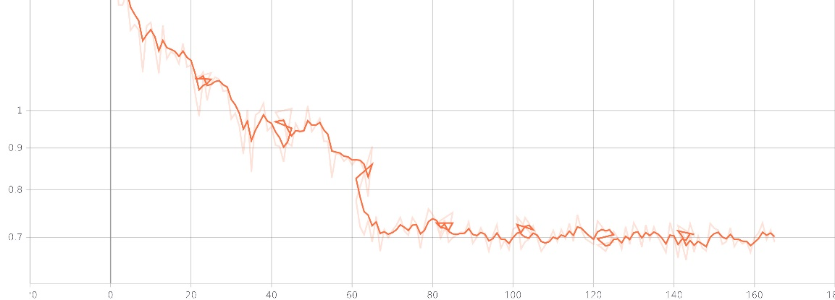
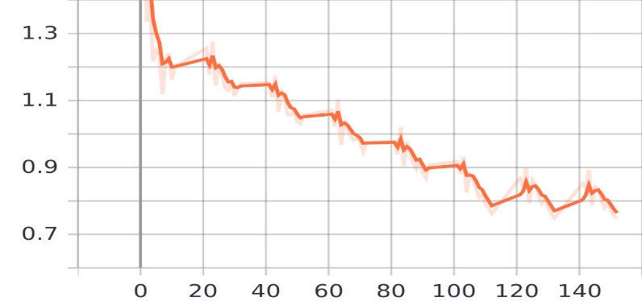
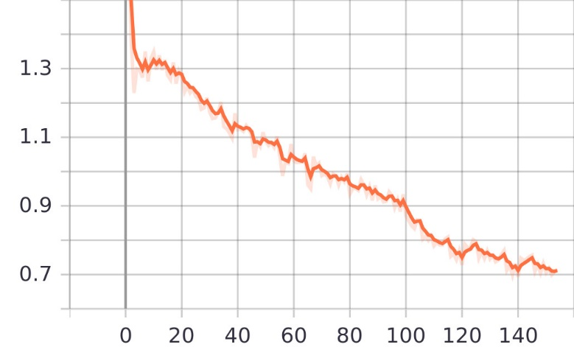
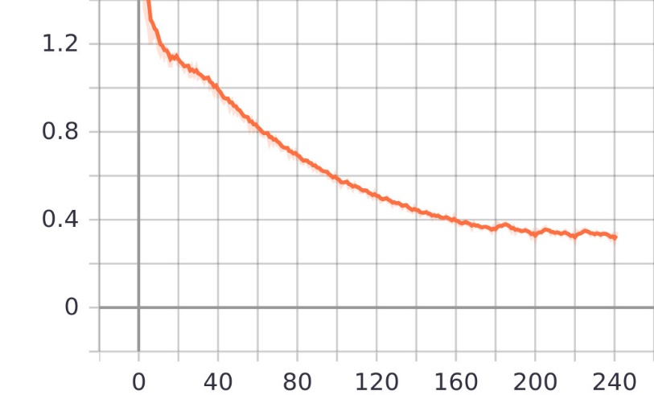
Fig. 1 1024 in 2 FC Layers, with shuffling 8 Epochs
Fig. 2 1024 in 2 FC Layers, with no shuffling 8 Epochs
Fig. 3 1024 in 6 FC Layers, with shuffling 8 Epochs, dropout of 0.50
Fig. 4 1024 in 3 FC Layers, with shuffling 12 Epochs, dropout of 0.50

Slide 36
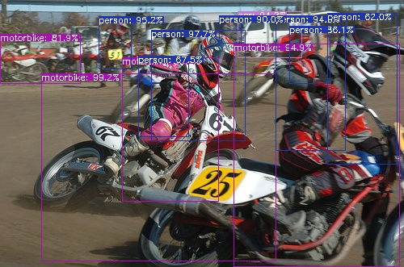
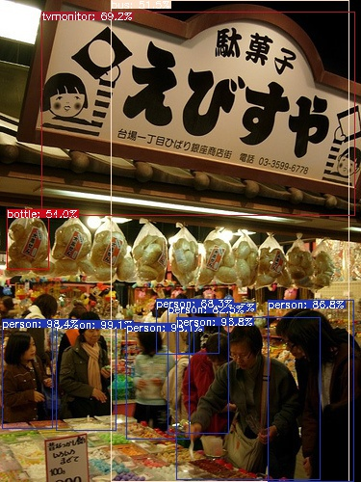
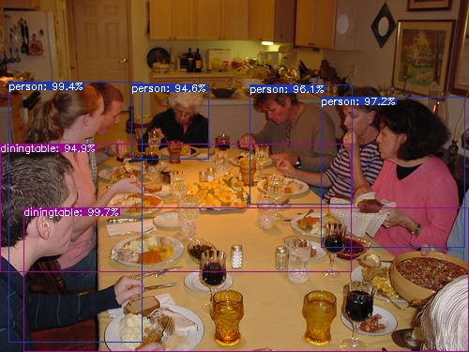

Slide 37
Table 2. AP values corresponding to DQN agent refinement
Model Architecture | Initial AP@50 | Final AP@50
VGG19, 50 Epoch, IoU@50 | 69.93 | 70.12
VGG19, 50 Epoch, IoU@80 | 69.93 | 65.23
ResNet50, 80 Epoch, IoU@50 | 69.93 | 72.22

Slide 38
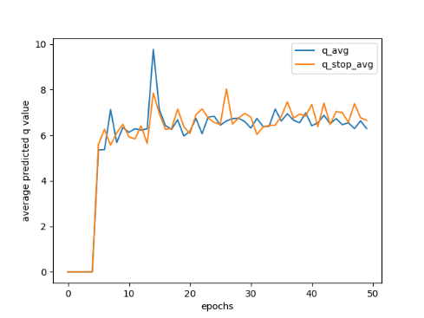
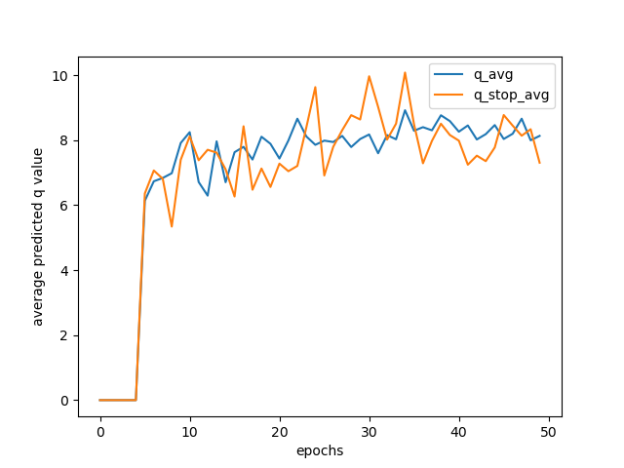
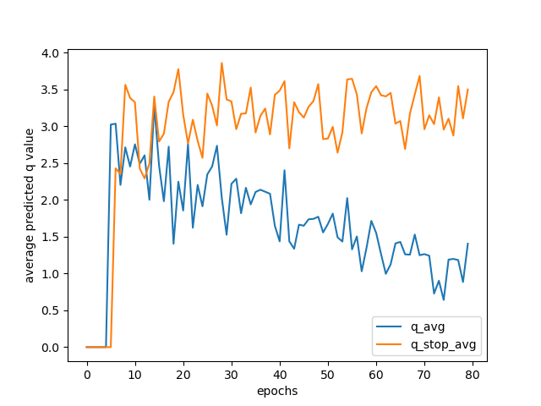
50 Epoch , 0.50 IoU Threshold
50 Epoch , 0.80 IoU Threshold
80 Epoch , 0.50 IoU Threshold

Slide 39
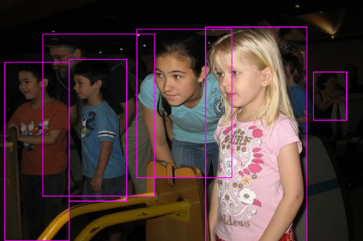
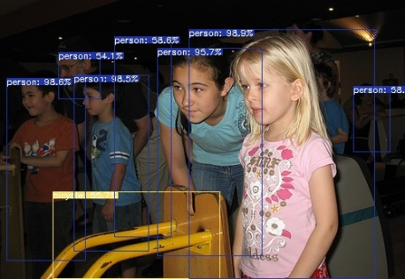
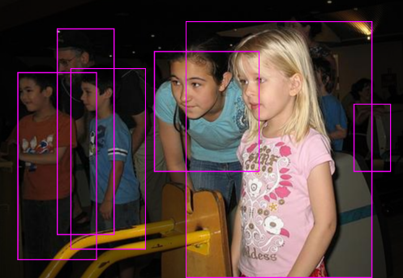
Ground Truth Annotations
Faster R-CNN Detections
Corrected Bounding Box by DQN Agent

Slide 40
Future Work
The improvement in the AP was around 4% which even though isn’t that great but may widely vary depending on the business problem and use case.
This report contains dataset of PASCAL. Future work can be done in exploring other standard datasets like COCO which is the baseline dataset used and also dataset images of warehouses because of the reason being that one of the area of potential application can be found in the field of logistics because it happens more often than not that we may find a huge number of images overlapped with each other at warehouses and store items.
The other works in this field can also be in the area of finding some different approach for the policy, as here only greedy epsilon policy is used.
Here the actions taken my the DQN agent is discrete. A possible area of work can also be using a continuous form of taking the actions that are taken by the DQN agent.

Slide 41
Publications
1. IEEE International Conference on “Machine Learning, Big Data, Cloud and Parallel Computing: Trends, Perspectives and Prospects” (Com-ITCon-2022), 26th-27th May 2022, Manav Rachna International Institute of Research & Studies, Faridabad, India
Paper ID: 237
Paper Title: PREDICTING GROWTH IN TOURISM INDUSTRY USING MACHINE LEARNING METHODS
Authors: Anindya Ghosal, Jyotsna Singh, Ashutosh Singh
Status: Accepted and Presented
2. 2nd International Conference on Signals, Machines, and Automation (SIGMA)-2022, 05th – 06th August 2022, Netaji Subhas University of Technology, New Delhi, India
Paper ID: 63
Paper Title: Bounding Box Refinement Agent for Overlapping Objects
Authors: Anindya Ghosal, Jyotsna Singh, Ashutosh Singh
Status: Under Review

Slide 42
References
[1] Le, N., Rathour, V.S., Yamazaki, K. et al. Deep reinforcement learning in computer vision: a comprehensive survey. Artif Intell Rev (2021). https://doi.org/10.1007/s10462-021-10061-9
[2] Sutton, R.S. and Barto, A.G., 2018. Reinforcement learning: An introduction. MIT press.
[3] Ayle, Morgane et al. “BAR - A Reinforcement Learning Agent for Bounding-Box Automated Refinement.” AAAI (2020).
[4] Mnih, V., Kavukcuoglu, K., Silver, D., Rusu, A.A., Veness, J., Bellemare, M.G., Graves, A., Riedmiller, M., Fidjeland, A.K., Ostrovski, G. and Petersen, S., 2015. Human-level control through deep reinforcement learning. nature, 518(7540), pp.529-533
[5] Simonyan, K. and Zisserman, A., 2014. Very deep convolutional networks for large-scale image recognition. arXiv preprint arXiv:1409.1556.
[6] He, Kaiming, Xiangyu Zhang, Shaoqing Ren, and Jian Sun. "Deep residual learning for image recognition." In Proceedings of the IEEE conference on computer vision and pattern recognition, pp. 770-778. 2016.
[7] Ren, S., He, K., Girshick, R. and Sun, J., 2015. Faster r-cnn: Towards real-time object detection with region proposal networks. Advances in neural information processing systems, 28.

Slide 43

In RL framework, the tuple (s_{t} , a_{t} , r_{t+1}, s_{t+1}) is called transition. Several sequential transitions are usually referred to as roll-out. Full sequence (s₀, a₀, r₁, s₁, a₁, r₂,….) is called a trajectory.
Theoretically, trajectory is infinitely long, but the episodic property holds in most practical cases. One trajectory of some finite length is called an episode.
For given MDP and policy $π$ , the probability of observing (s₀, a₀, r₁, s₁, a₁, r₂,….) is called trajectory distribution and is denoted as:

Slide 44
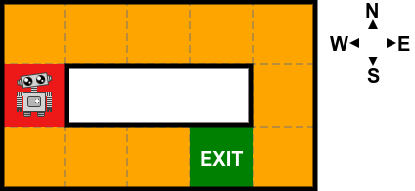
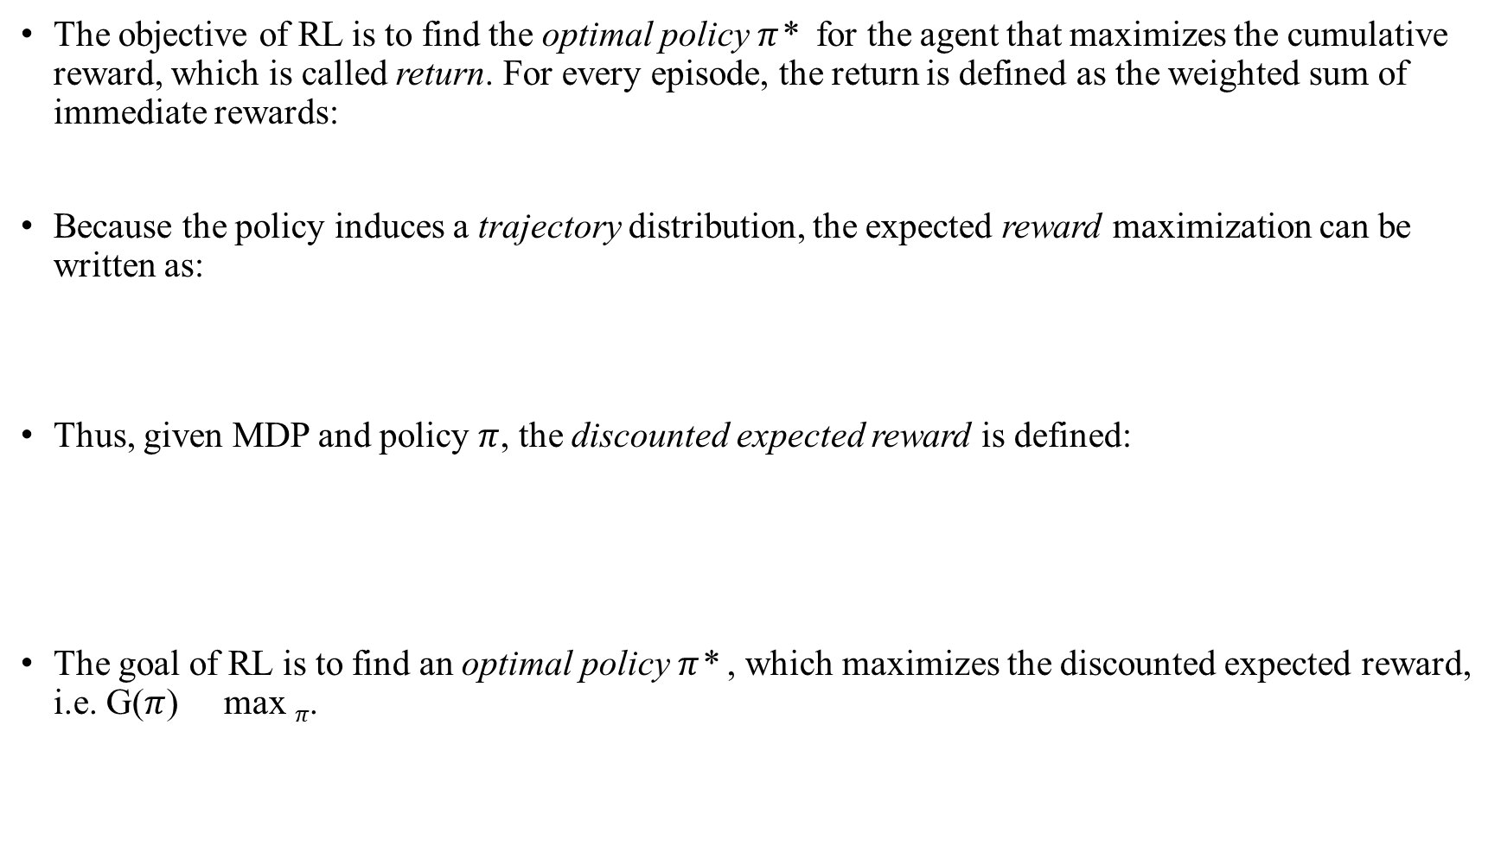
The objective of RL is to find the optimal policy $π$* for the agent that maximizes the cumulative reward, which is called return. For every episode, the return is defined as the weighted sum of immediate rewards:
Because the policy induces a trajectory distribution, the expected reward maximization can be written as:
Thus, given MDP and policy $π$, the discounted expected reward is defined:
The goal of RL is to find an optimal policy $π$* , which maximizes the discounted expected reward, i.e. G($π$) max $π$.

Slide 45


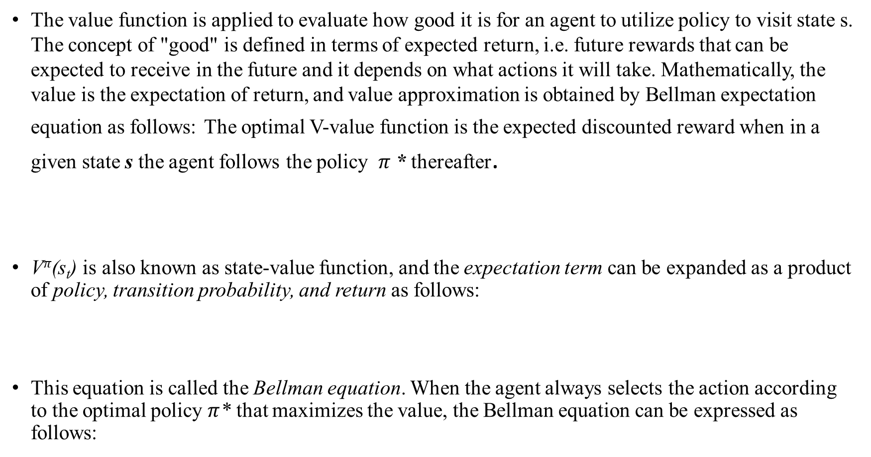
Value and Q- functions
The value function is applied to evaluate how good it is for an agent to utilize policy to visit state s. The concept of "good" is defined in terms of expected return, i.e. future rewards that can be expected to receive in the future and it depends on what actions it will take. Mathematically, the value is the expectation of return, and value approximation is obtained by Bellman expectation equation as follows: The optimal V-value function is the expected discounted reward when in a given state s the agent follows the policy $π$* thereafter.
V$π$(s_{t}) is also known as state-value function, and the expectation term can be expanded as a product of policy, transition probability, and return as follows:
This equation is called the Bellman equation. When the agent always selects the action according to the optimal policy $π$* that maximizes the value, the Bellman equation can be expressed as follows:

Slide 46



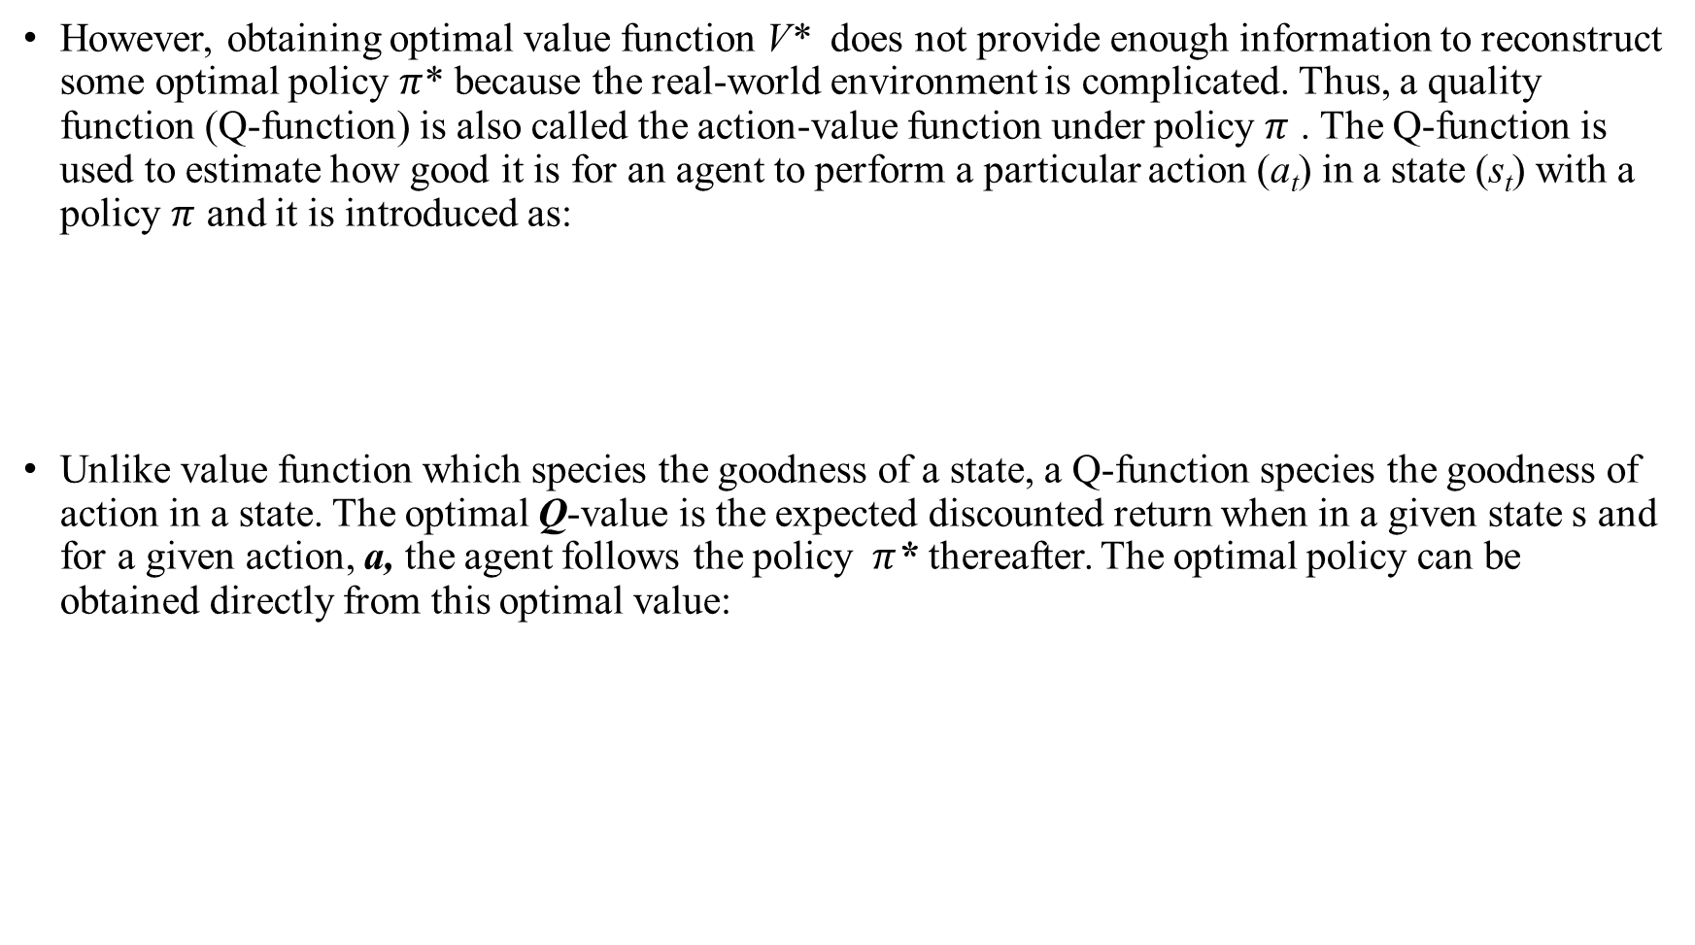
However, obtaining optimal value function V* does not provide enough information to reconstruct some optimal policy $π$* because the real-world environment is complicated. Thus, a quality function (Q-function) is also called the action-value function under policy $π$ . The Q-function is used to estimate how good it is for an agent to perform a particular action (a_{t}) in a state (s_{t}) with a policy $π$ and it is introduced as:
Unlike value function which species the goodness of a state, a Q-function species the goodness of action in a state. The optimal Q-value is the expected discounted return when in a given state s and for a given action, a, the agent follows the policy $π$* thereafter. The optimal policy can be obtained directly from this optimal value:

Slide 47
