Slide 1

Mid-Semester Dissertation Evaluation 2021-22
Presented By: Anindya Ghosal
Roll No: 2020PSP3007
Branch: MTech (Signal Processing)
Supervisor: Prof. Jyotsna Singh
Division of Electronics & Communication Engineering NETAJI SUBHAS UNIVERSITY OFTECHNOLOGY
(Formerly NSIT) NEW DELHI-110078

Slide 2
Proposed Topic :Bounding Box Refinement Agent for Overlapping Objects

Slide 3
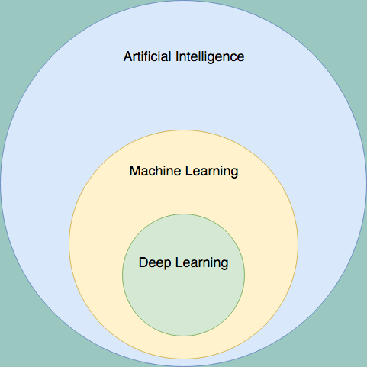
What is Machine Learning?
Machine Learning is an application of Artificial Intelligence (AI) it gives devices the ability to learn from their experiences and improve their self without doing any coding.
For Example, when you shop from any website it’s shows related search like:- People who bought also saw this.
Arthur Samuel coined the term Machine Learning in the year 1959.
He defined Machine Learning as “Field of study that gives computers the capability to learn without being explicitly programmed”.

Slide 4
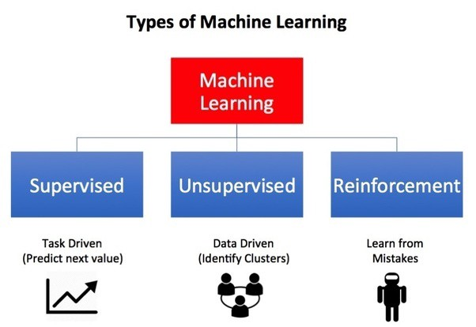
Types of Machine Learning

Slide 5
Supervised Machine Learning
Supervised learning is one of the most basic types of machine learning. In this type, the machine learning algorithm is trained on labeled data. Even though the data needs to be labeled accurately for this method to work, supervised learning is extremely powerful when used in the right circumstances.
In supervised learning, the ML algorithm is given a small training dataset to work with. This training dataset is a smaller part of the bigger dataset and serves to give the algorithm a basic idea of the problem, solution, and data points to be dealt with. The training dataset is also very similar to the final dataset in its characteristics and provides the algorithm with the labeled parameters required for the problem.
The algorithm then finds relationships between the parameters given, essentially establishing a cause and effect relationship between the variables in the dataset. At the end of the training, the algorithm has an idea of how the data works and the relationship between the input and the output.
This solution is then deployed for use with the final dataset, which it learns from in the same way as the training dataset. This means that supervised machine learning algorithms will continue to improve even after being deployed, discovering new patterns and relationships as it trains itself on new data.

Slide 6
Unsupervised Machine Learning
Unsupervised machine learning holds the advantage of being able to work with unlabeled data. This means that human labor is not required to make the dataset machine-readable, allowing much larger datasets to be worked on by the program.
In supervised learning, the labels allow the algorithm to find the exact nature of the relationship between any two data points.
However, unsupervised learning does not have labels to work off of, resulting in the creation of hidden structures. Relationships between data points are perceived by the algorithm in an abstract manner, with no input required from human beings.
The creation of these hidden structures is what makes unsupervised learning algorithms versatile. Instead of a defined and set problem statement, unsupervised learning algorithms can adapt to the data by dynamically changing hidden structures.
This offers more post-deployment development than supervised learning algorithms.

Slide 7
Reinforcement Learning
Reinforcement learning directly takes inspiration from how human beings learn from data in their lives. It features an algorithm that improves upon itself and learns from new situations using a trial-and-error method. Favorable outputs are encouraged or ‘reinforced’, and non-favorable outputs are discouraged or ‘punished’.
Based on the psychological concept of conditioning, reinforcement learning works by putting the algorithm in a work environment with an interpreter and a reward system. In every iteration of the algorithm, the output result is given to the interpreter, which decides whether the outcome is favorable or not.
In case of the program finding the correct solution, the interpreter reinforces the solution by providing a reward to the algorithm. If the outcome is not favorable, the algorithm is forced to reiterate until it finds a better result. In most cases, the reward system is directly tied to the effectiveness of the result.
In typical reinforcement learning use-cases, such as finding the shortest route between two points on a map, the solution is not an absolute value. Instead, it takes on a score of effectiveness, expressed in a percentage value. The higher this percentage value is, the more reward is given to the algorithm. Thus, the program is trained to give the best possible solution for the best possible reward.

Slide 8
What is Pattern Recognition?
Pattern is everything around in this digital world. A pattern can either be seen physically or it can be observed mathematically by applying algorithms.
Pattern recognition is the process of recognizing patterns by using a machine learning algorithm. Pattern recognition can be defined as the classification of data based on knowledge already gained or on statistical information extracted from patterns and/or their representation. One of the important aspects of pattern recognition is its application potential.
Examples: Speech recognition, speaker identification, multimedia document recognition (MDR), automatic medical diagnosis. In a typical pattern recognition application, the raw data is processed and converted into a form that is amenable for a machine to use.
Pattern recognition involves the classification and cluster of patterns.

Slide 9
Some Terminologies:
Model: Also known as “hypothesis”, a machine learning model is the mathematical representation of a real-world process. A machine learning algorithm along with the training data builds a machine learning model.
Feature: A feature is a measurable property or parameter of the data-set.
Feature Vector: It is a set of multiple numeric features. We use it as an input to the machine learning model for training and prediction purposes.
Training: An algorithm takes a set of data known as “training data” as input. The learning algorithm finds patterns in the input data and trains the model for expected results (target). The output of the training process is the machine learning model.
Prediction: Once the machine learning model is ready, it can be fed with input data to provide a predicted output.
Target (Label): The value that the machine learning model has to predict is called the target or label.
Overfitting: When a massive amount of data trains a machine learning model, it tends to learn from the noise and inaccurate data entries. Here the model fails to characterize the data correctly.
Underfitting: It is the scenario when the model fails to decipher the underlying trend in the input data. It destroys the accuracy of the machine learning model. In simple terms, the model or the algorithm does not fit the data well enough.

Slide 10
How is Reinforcement Learning different from traditional machine learning algorithms?
Unsupervised learning is a geometric problem. Meaning, it tries to understand the structure of the problem in order to discover how to partition the data meaningfully.
Supervised learning is all about how to partition the data based on labels. In a sense, the structure is much less important, and the labels are the critical hints of how we should partition the data.
Reinforcement learning (RL) is something different. It involves feedback from the environment, depend on the previous states. It doesn’t necessarily involves labels, and you may get the reward well after the actions were taken.
These points differentiate reinforcement learning totally from run of the mill supervised and unsupervised learning:
It works on interacting with the environment, no predefined data, Exploration V/s Exploitation, no supervision, with the aim of learning a series of action.

Slide 11
Reinforcement Learning in Depth:
Reinforcement learning (RL) is learning what to do—how to map situations to actions—so as to maximize a numerical reward signal.
The learner is not told which actions to take, but instead must discover which actions yield the most reward by trying them.
Though both supervised and reinforcement learning use mapping between input and output, unlike supervised learning where the feedback provided to the agent is correct set of actions for performing a task, reinforcement learning uses rewards and punishments as signals for positive and negative behavior.
As compared to unsupervised learning, reinforcement learning is different in terms of goals. While the goal in unsupervised learning is to find similarities and differences between data points, in the case of reinforcement learning the goal is to find a suitable action model that would maximize the total cumulative reward of the agent.

Slide 12

The following are couple of terminologies when it comes to Reinforcement Learning:
Environment — Physical world in which the agent operates
State — Current situation of the agent
Reward — Feedback from the environment
Policy — Method to map agent’s state to actions
Value — Future reward that an agent would receive by taking an action in a particular state
Agent — The main working entity of the reinforcement learning paradigm

Slide 13
Markov Decision Process
The standard theory of RL is defined by a Markov Decision Process (MDP), which is an extension of the Markov process (also known as the Markov chain).
Mathematically, the Markov process is a discrete-time stochastic process whose conditional probability distribution of the future states only depends upon the present state and it provides a framework to model decision-making situations.
An MDP is typically defined by five elements as follows:
• S: a set of state or observation space of an environment. s₀ is starting state.
• A: set of actions the agent can choose.
• T: a transition probability function T(s_{t+1}|s_{t}; a_{t}), specifying the probability that the environment will transition to state s_{t+1} ∈ S if the agent takes action a_{t} ∈ A in state s_{t} ∈ S.
• R: a reward function where r_{t+1} = R(s_{t} , s_{t+1}) is a reward received for taking action at a_{t} state s_{t} and transfer to the next state s_{t+1}.
γ : a discount factor.

Slide 14
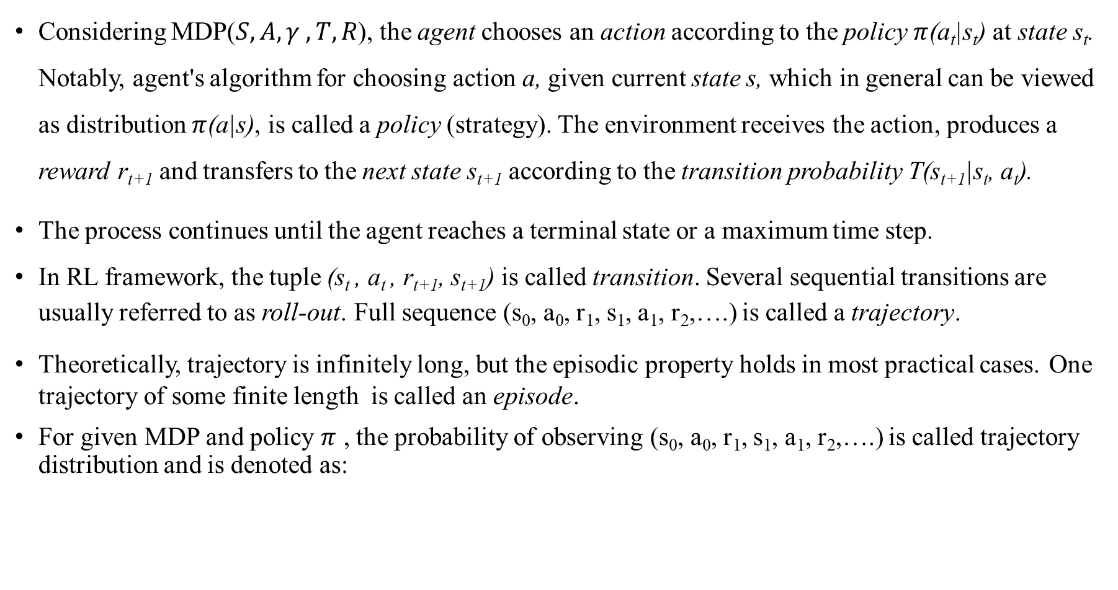
Considering MDP($S, A, γ , T, R$), the agent chooses an action according to the policy $π$(a_{t}|s_{t}) at state s_{t}. Notably, agent's algorithm for choosing action a, given current state s, which in general can be viewed as distribution $π$(a|s), is called a policy (strategy). The environment receives the action, produces a reward r_{t+1} and transfers to the next state s_{t+1} according to the transition probability T(s_{t+1}|s_{t}, a_{t}).
The process continues until the agent reaches a terminal state or a maximum time step.
In RL framework, the tuple (s_{t} , a_{t} , r_{t+1}, s_{t+1}) is called transition. Several sequential transitions are usually referred to as roll-out. Full sequence (s₀, a₀, r₁, s₁, a₁, r₂,….) is called a trajectory.
Theoretically, trajectory is infinitely long, but the episodic property holds in most practical cases. One trajectory of some finite length is called an episode.
For given MDP and policy $π$ , the probability of observing (s₀, a₀, r₁, s₁, a₁, r₂,….) is called trajectory distribution and is denoted as:

Slide 15
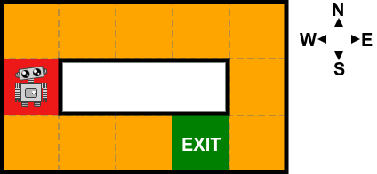
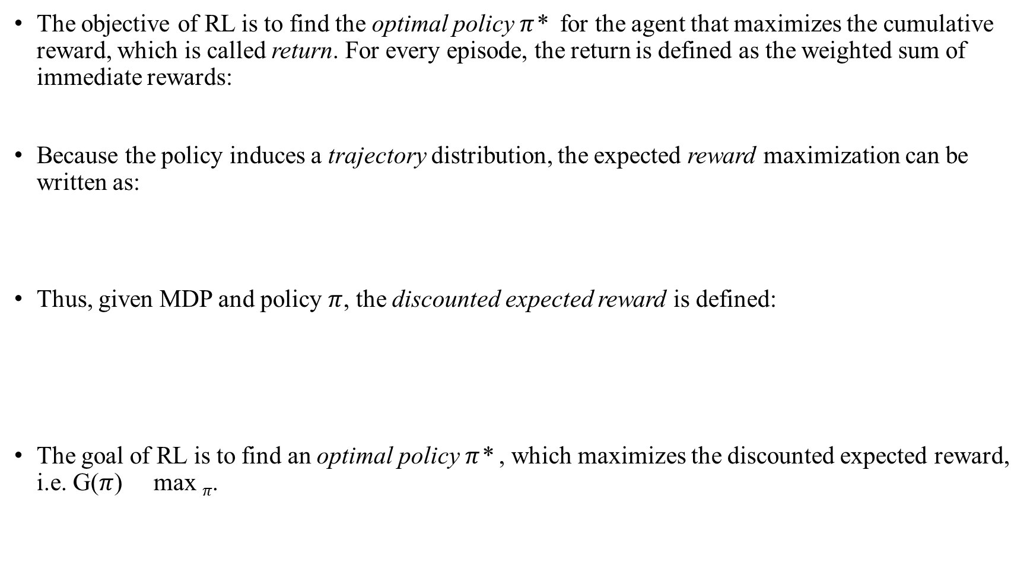
The objective of RL is to find the optimal policy $π$* for the agent that maximizes the cumulative reward, which is called return. For every episode, the return is defined as the weighted sum of immediate rewards:
Because the policy induces a trajectory distribution, the expected reward maximization can be written as:
Thus, given MDP and policy $π$, the discounted expected reward is defined:
The goal of RL is to find an optimal policy $π$* , which maximizes the discounted expected reward, i.e. G($π$) max $π$.

Slide 16


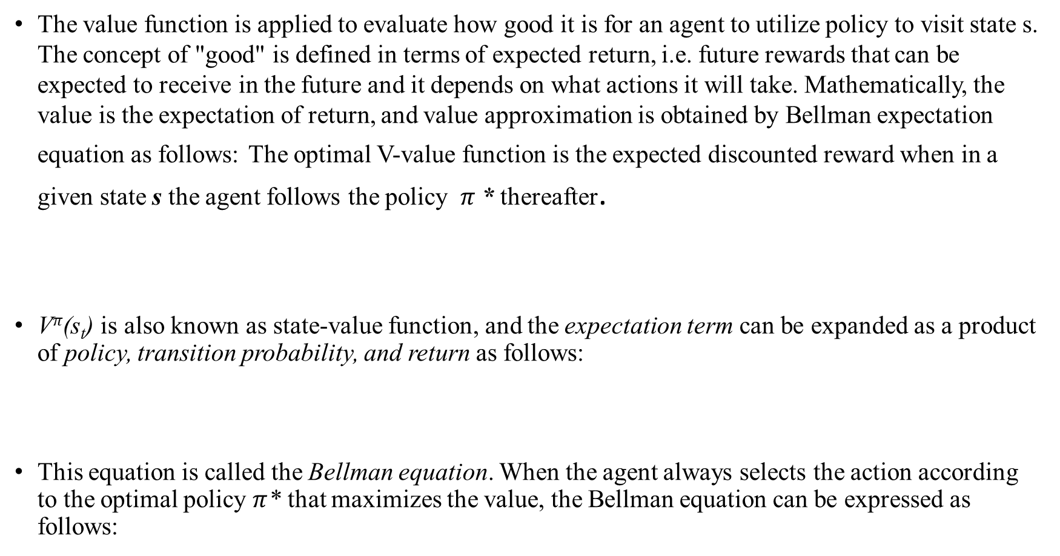
Value and Q- functions
The value function is applied to evaluate how good it is for an agent to utilize policy to visit state s. The concept of "good" is defined in terms of expected return, i.e. future rewards that can be expected to receive in the future and it depends on what actions it will take. Mathematically, the value is the expectation of return, and value approximation is obtained by Bellman expectation equation as follows: The optimal V-value function is the expected discounted reward when in a given state s the agent follows the policy $π$* thereafter.
V$π$(s_{t}) is also known as state-value function, and the expectation term can be expanded as a product of policy, transition probability, and return as follows:
This equation is called the Bellman equation. When the agent always selects the action according to the optimal policy $π$* that maximizes the value, the Bellman equation can be expressed as follows:

Slide 17



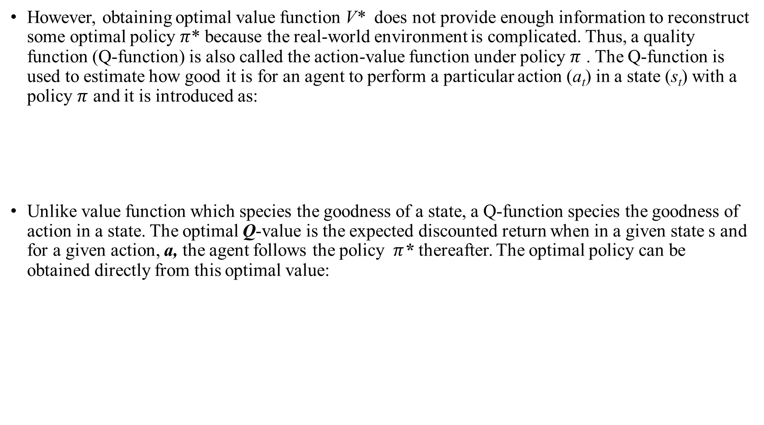
However, obtaining optimal value function V* does not provide enough information to reconstruct some optimal policy $π$* because the real-world environment is complicated. Thus, a quality function (Q-function) is also called the action-value function under policy $π$ . The Q-function is used to estimate how good it is for an agent to perform a particular action (a_{t}) in a state (s_{t}) with a policy $π$ and it is introduced as:
Unlike value function which species the goodness of a state, a Q-function species the goodness of action in a state. The optimal Q-value is the expected discounted return when in a given state s and for a given action, a, the agent follows the policy $π$* thereafter. The optimal policy can be obtained directly from this optimal value:

Slide 18
Category
In general, RL can be divided into either model-free or model-based methods. Here, "model“ is defined by the two quantity: transition probability function T(s_{t+1}|s_{t ,} a_{t}) and the reward function R(s_{t} , s_{t+1}).
Model-based RL is an approach that uses a learnt model, i.e. T(s_{t+1}|s_{t ,} a_{t}) and reward function R(s_{t} , s_{t+1}) to predict the future action. There are four main model-based techniques as follows:
Value Function: The objective of value function methods is to obtain the best policy by maximizing the value functions in each state.
Transition Models: Transition models decide how to map from a state s, taking action a to the next state (s') and it strongly affects the performance of model-based RL algorithms. Based on whether predicting the future state s' is based on the probability distribution of a random variable or not, there are two main approaches in this group: stochastic and deterministic.
Policy Search: Policy search approach directly searches for the optimal policy by modifying its parameters, whereas the value function methods indirectly find the actions that maximize the value function at each state.
Return Functions: Return functions decide how to aggregate rewards or punishments over an episode. They affect both the convergence and the feasibility of the model. There are two main approaches in this group: discounted returns functions and averaged returns functions

Slide 19
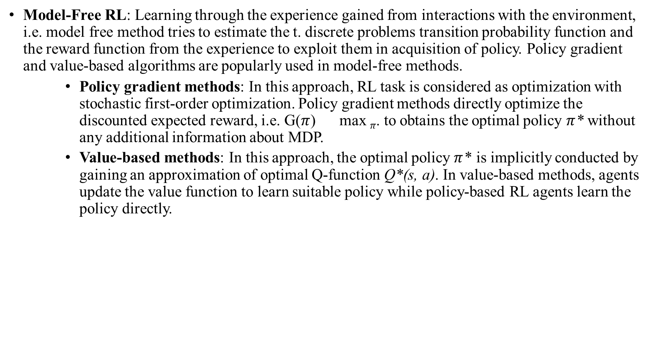
Model-Free RL: Learning through the experience gained from interactions with the environment, i.e. model free method tries to estimate the t. discrete problems transition probability function and the reward function from the experience to exploit them in acquisition of policy. Policy gradient and value-based algorithms are popularly used in model-free methods.
Policy gradient methods: In this approach, RL task is considered as optimization with stochastic first-order optimization. Policy gradient methods directly optimize the discounted expected reward, i.e. G($π$) max $π$. to obtains the optimal policy $π$* without any additional information about MDP.
Value-based methods: In this approach, the optimal policy $π$* is implicitly conducted by gaining an approximation of optimal Q-function Q*(s, a). In value-based methods, agents update the value function to learn suitable policy while policy-based RL agents learn the policy directly.

Slide 20
Deep Reinforcement Learning (DRL)
Deep Reinforcement Learning (DRL) is the combination of Reinforcement Learning and Deep Learning (DL) and it has become one of the most intriguing areas of artificial intelligence today.
DRL has been successfully applied into many domains including games, robotics, autonomous driving, healthcare, natural language processing, and computer vision. In contrast to supervised learning which requires large labeled training data, DRL samples training data from an environment.
Far from supervised learning, DRL-based approaches focus on solving sequential decision making problems. They aim at deciding, based on a set of experiences collected by interacting with the environment, the sequence of actions in an uncertain environment to achieve some targets.
Different from supervised learning where the feedback is available after each system action, it is simply a scalar value that may be delayed in time in the DRL framework.
For example, the success or failure of the entire system is reflected after a sequence of actions. Furthermore, the supervised learning model is updated based on the loss/error of the output and there is no mechanism to get the correct value when it is wrong.
This is addressed by policy gradients in DRL by assigning gradients without a differentiable loss function. This aims at teaching a model to try things out randomly and learn to do correct things more.

Slide 21
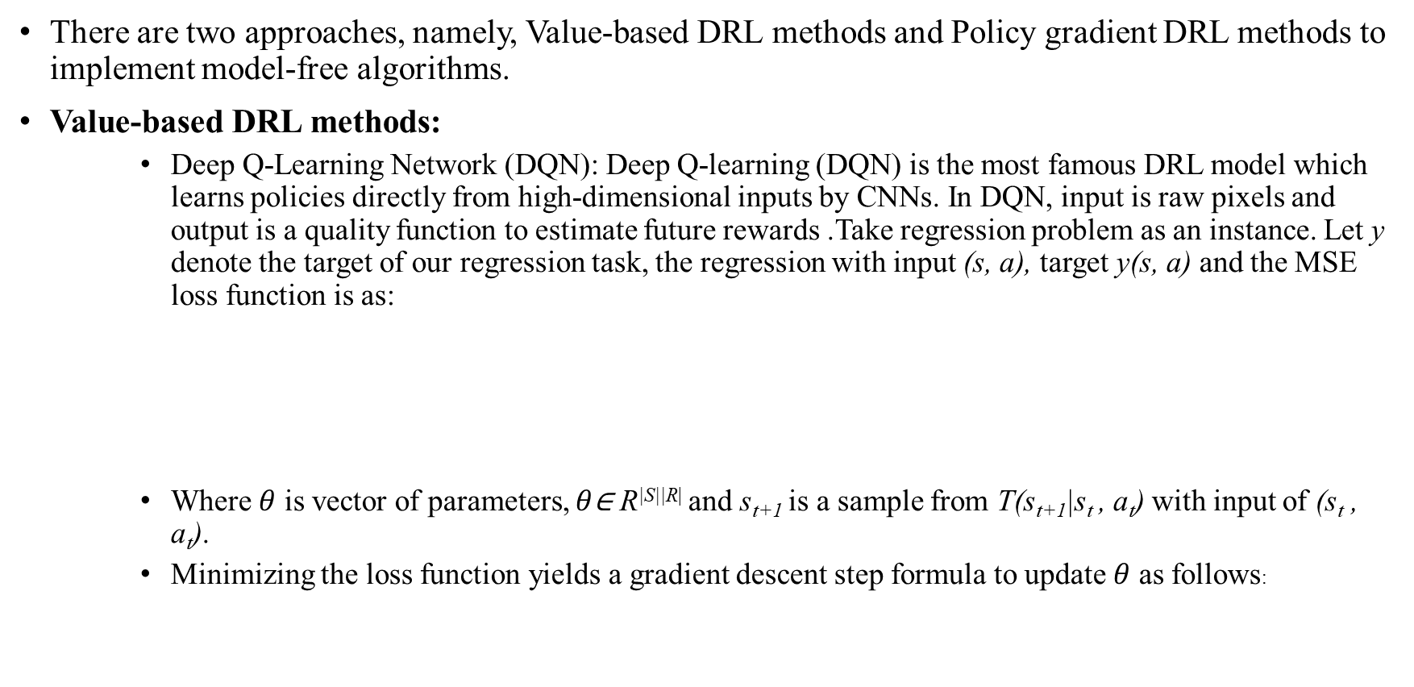
Model-Free Algorithms
There are two approaches, namely, Value-based DRL methods and Policy gradient DRL methods to implement model-free algorithms.
Value-based DRL methods:
Deep Q-Learning Network (DQN): Deep Q-learning (DQN) is the most famous DRL model which learns policies directly from high-dimensional inputs by CNNs. In DQN, input is raw pixels and output is a quality function to estimate future rewards .Take regression problem as an instance. Let y denote the target of our regression task, the regression with input (s, a), target y(s, a) and the MSE loss function is as:
Where $θ$ is vector of parameters, $θ$∈ R^{|S||R|} and s_{t+1} is a sample from T(s_{t+1}|s_{t} , a_{t}) with input of (s_{t} , a_{t}).
Minimizing the loss function yields a gradient descent step formula to update $θ$ as follows:

Slide 22
Fig. Network structure of Deep Q-Network (DQN), where Q-values Q(s , a) are generated for all actions for a given state.

Slide 23
Dueling DQN: In DQN, when the agent visits an unfavorable state, instead of lowering its value V* , it remembers only low pay-off by updating Q*. In order to address this limitation, Dueling DQN incorporates approximation of V* explicitly in a computational graph by introducing an advantage function as follows:
Therefore, we can reformulate Q-value: Q*(s , a) = A*(s , a) + V*(s). This implies that after DL the feature map is decomposed into two parts corresponding to V*(v) and A*(s , a) as illustrated
This can be implemented by splitting the fully connected layers in the DQN architecture to compute the advantage and state value functions separately, then combining them back into a single Q-function.
An interesting result has shown that Dueling DQN obtains better performance if it is formulated as:
In practical implementation, averaging instead of maximum is used, i.e.

Slide 24
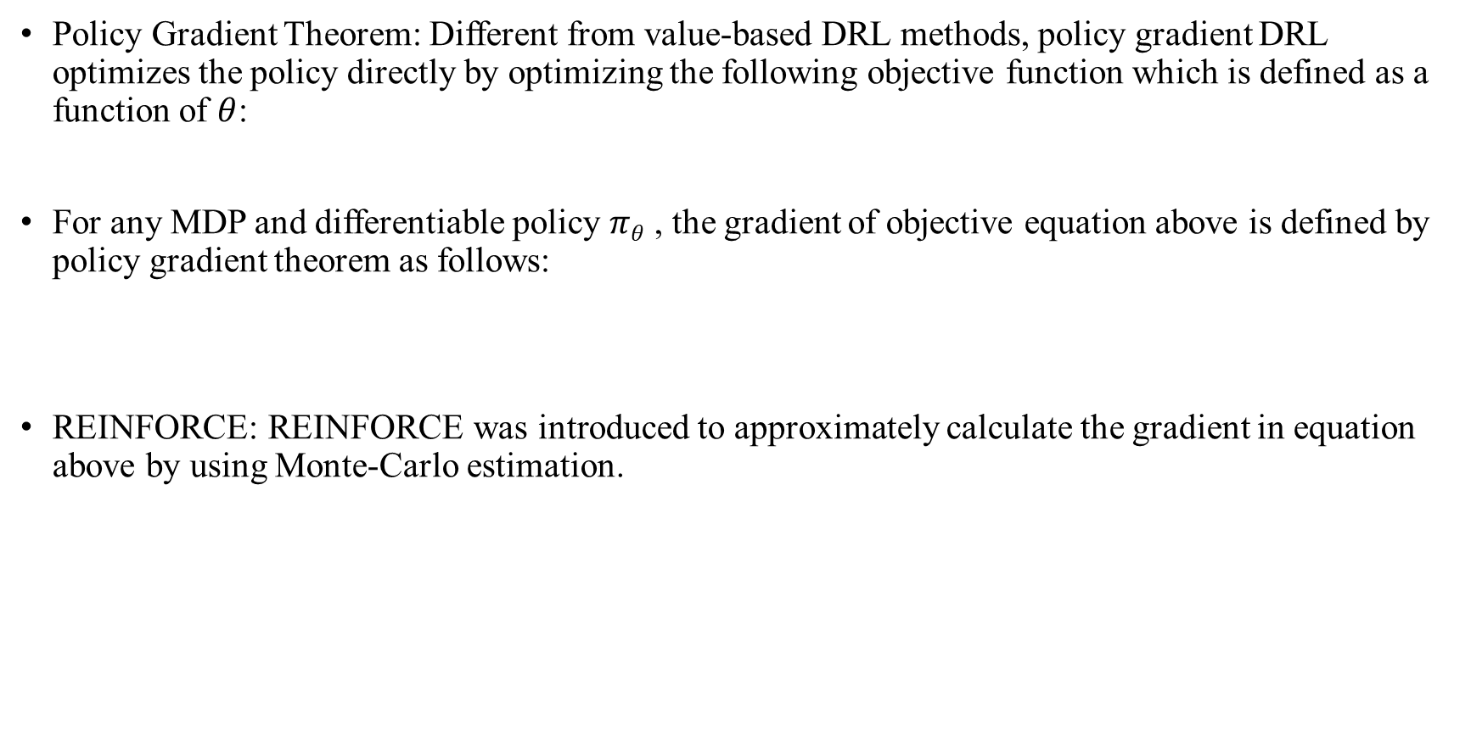
Policy Gradient DRL Methods
Policy Gradient Theorem: Different from value-based DRL methods, policy gradient DRL optimizes the policy directly by optimizing the following objective function which is defined as a function of $θ$:
For any MDP and differentiable policy $πθ$ , the gradient of objective equation above is defined by policy gradient theorem as follows:
REINFORCE: REINFORCE was introduced to approximately calculate the gradient in equation above by using Monte-Carlo estimation.

Slide 25
Actor Critic Method:
Both value-based and policy gradient algorithms have their own pros and cons, i.e. policy gradient methods are better for continuous and stochastic environments, and have a faster convergence whereas, value-based methods are more sample efficient and steady. Lately, actor-critic was born to take advantage from both value-based and policy gradient while limiting their drawbacks.
Actor-critic architecture computes the policy gradient using a value-based critic function to estimate expected future reward.
Principal idea of actor-critic is to divide the model into two parts:
(i) computing an action based on a state and
(ii) producing the Q values of the action.

Slide 26
An illustration of Actor-Critic algorithm in two cases:
(a) sharing parameters (b) not sharing parameters

Slide 27
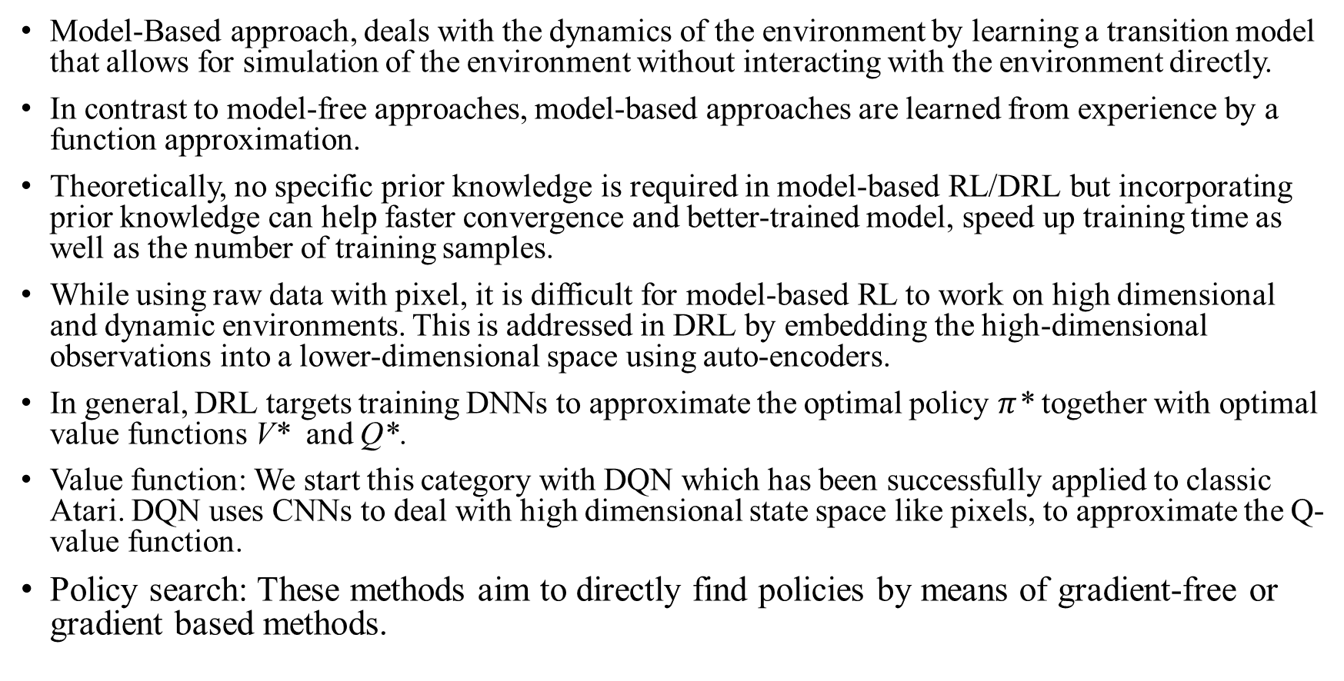
2. Model Based Algorithms
Model-Based approach, deals with the dynamics of the environment by learning a transition model that allows for simulation of the environment without interacting with the environment directly.
In contrast to model-free approaches, model-based approaches are learned from experience by a function approximation.
Theoretically, no specific prior knowledge is required in model-based RL/DRL but incorporating prior knowledge can help faster convergence and better-trained model, speed up training time as well as the number of training samples.
While using raw data with pixel, it is difficult for model-based RL to work on high dimensional and dynamic environments. This is addressed in DRL by embedding the high-dimensional observations into a lower-dimensional space using auto-encoders.
In general, DRL targets training DNNs to approximate the optimal policy $π$* together with optimal value functions V* and Q*.
Value function: We start this category with DQN which has been successfully applied to classic Atari. DQN uses CNNs to deal with high dimensional state space like pixels, to approximate the Q-value function.
Policy search: These methods aim to directly find policies by means of gradient-free or gradient based methods.

Slide 28

Problem Statement
All the existing literature just tends to create bounding boxes around the image but no approach has been taken to actually improve those bounding boxes. Bounding boxes might be very important in a industrial setting or even medical field. Incorrect bounding boxes might hamper the goal that we are trying to reach
So my main literature tends to solve that problem by using a DRL agent to actually correct those bounding boxes and save precious human work to relabel the images.
The criteria used for evaluating the ability of the agent to actually correct those bounding boxes is Intersection Over Union (IoU) or in other words known as Jaccard Index.
The IoU formula is given by

Slide 29
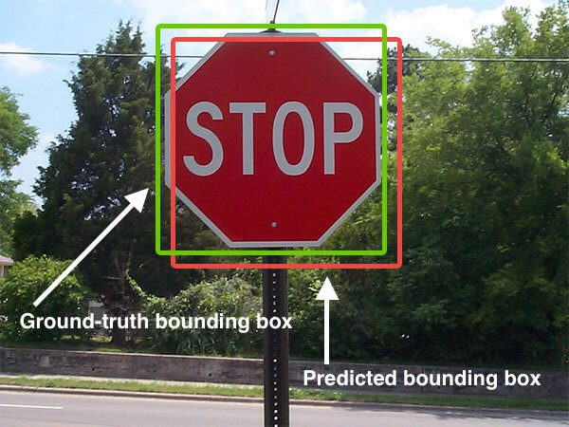
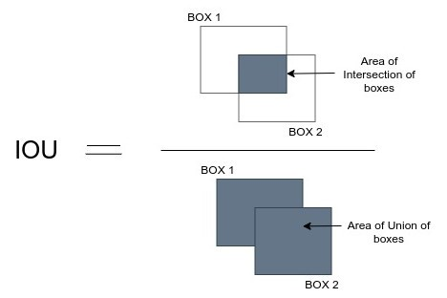
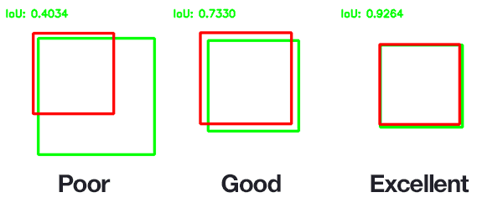

Slide 30
Now this sort of approach works extremely well when having just one item in a particular image or a frame of reference.
What happens if there are multiple items in a particular image? What happens if there are overlapping images in a particular frame?
That is the question that I has ventured on to find out. My aim is to try and figure out how to actually generate bounding boxes for multiple objects, how to generate bounding boxes for multiple overlapping objects and then try to actually refine the incorrect bounding boxes.
So formally defining my problem statement, it is “Bounding Box Refinement Agent for Overlapping Objects”.

Slide 31
Work done till now
For work done, the following progress was done as mentioned in the said paper.
The initial paper is trained on a private dataset. So a workaround that is done my replacing the initial private dataset by just one class from the PACAL VOC 2007 dataset.
20 images of “aeroplane” were chosen at random. 15 of them formed the training set and 5 of them formed testing set. The initial annotations were provided in the PASCAL dataset and random annotation were done randomly by me.
To the say the least the results were not pretty mainly because of absolute random annotations on the image of choice, stopping the step at 10 and most important is overfitting of neural network because of less amount of data. Below are the average IoU plots of different images.
The DQN is a simple 2 layer fully connected architecture containing 500 nodes each and a 9 node output layer for 9 actions namely up, down, left, right, wider, taller, fatter, thinner and stop.

Slide 32
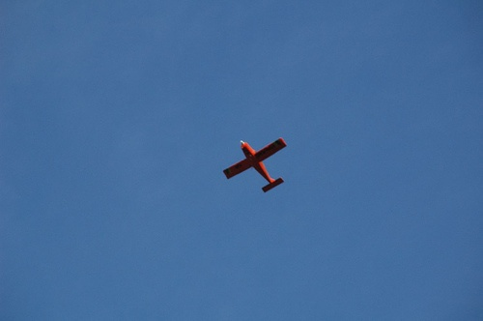
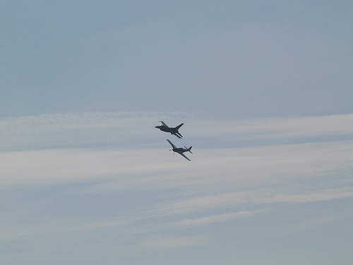
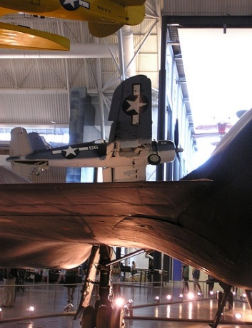

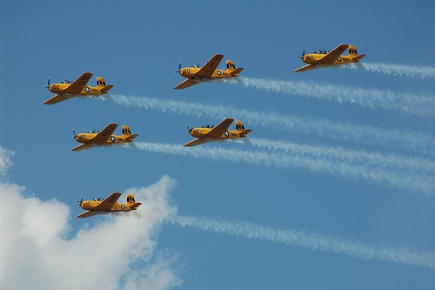

Slide 33
Future Work
Future work of the literature is extended to dealing with refining the bounding boxes of multi-object images.
Future work also deals with using a different DQN altogether. A probable work can be replacing the existing network with a better and deeper CNN.
Future work also extends to dealing with overlapping objects where bounding box refinement can be tricky.

Slide 34
References
Le, N., Rathour, V.S., Yamazaki, K. et al. Deep reinforcement learning in computer vision: a comprehensive survey. Artif Intell Rev (2021). https://doi.org/10.1007/s10462-021-10061-9
Sutton, R.S. and Barto, A.G., 2018. Reinforcement learning: An introduction. MIT press.
Ayle, Morgane et al. “BAR - A Reinforcement Learning Agent for Bounding-Box Automated Refinement.” AAAI (2020).
Mnih, V., Kavukcuoglu, K., Silver, D., Rusu, A.A., Veness, J., Bellemare, M.G., Graves, A., Riedmiller, M., Fidjeland, A.K., Ostrovski, G. and Petersen, S., 2015. Human-level control through deep reinforcement learning. nature, 518(7540), pp.529-533

