Slide 1

Mid-Semester Dissertation Evaluation 2021-22
Presented By: Anindya Ghosal
Roll No: 2020PSP3007
Branch: MTech (Signal Processing)
Supervisor: Prof. Jyotsna Singh
Division of Electronics & Communication Engineering NETAJI SUBHAS UNIVERSITY OFTECHNOLOGY
(Formerly NSIT) NEW DELHI-110078

Slide 2
Dissertation Topic :Bounding Box Refinement Agent for Overlapping Objects

Slide 3
CNN as Feature Extractor
A Convolutional Neural Network (ConvNet/CNN) is a Deep Learning algorithm which can take in an input image, assign importance (learnable weights and biases) to various aspects/objects in the image and be able to differentiate one from the other. The pre-processing required in a ConvNet is much lower as compared to other classification algorithms. While in primitive methods filters are hand-engineered, with enough training, ConvNets have the ability to learn these filters/characteristics.
The architecture of a ConvNet is analogous to that of the connectivity pattern of Neurons in the Human Brain and was inspired by the organization of the Visual Cortex. Individual neurons respond to stimuli only in a restricted region of the visual field known as the Receptive Field. A collection of such fields overlap to cover the entire visual area.
CNNs are highly layered structural neural networks, most of which have the same basic function layers including convolution layers, pooling layers and a classification layer. LeNet-5 was proposed as the first modern Convolutional Neural Network of practical use Basically, CNNs differ from each other by how these fundamental layers are installed and packaged and also the method of training the network.

Slide 4
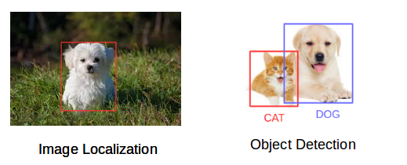
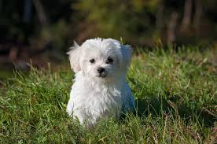
Object Detection V/s Object Classification
Image Classification
From the image we quickly recognized that it’s a dog. Taking a step back and understanding how we came to this conclusion. When shown an image and we classified the class it belonged to (a dog, in this instance). And that, in a nutshell, is what Image Classification is all about.
Now let’s suppose we want to know the location of any particular object in the image, how are we going to do that? That’s where Image Localization comes into the picture. It helps us to identify the location of a single object in the given image.
In case we have multiple objects present, we then rely on the concept of Object Detection. We can predict the location along with the class for each object using Object Detection.
Image Classification helps us to classify what is contained in an image. Image Localization will specify the location of single object in an image whereas Object Detection specifies the location of multiple objects in the image.

Slide 5
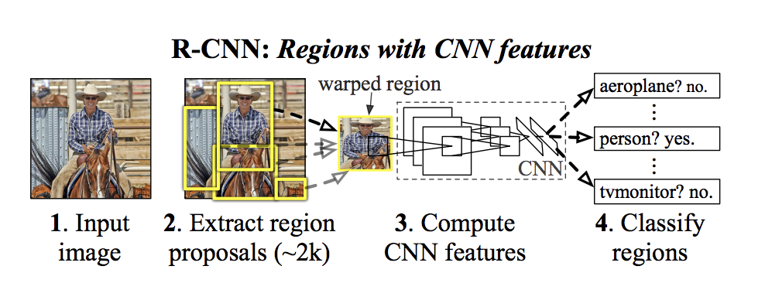
RCNN family of Object Detectors
To bypass the problem of selecting a huge number of regions, Ross Girshick proposed a method where we use selective search to extract just 2000 regions from the image and he called them region proposals. Therefore, now, instead of trying to classify a huge number of regions, you can just work with 2000 regions. These 2000 region proposals are generated using the selective search algorithm which is written below.
RCNN used a selective search algorithm: Selective search algorithm follows this flow:
Generating initial sub-segmentation, we generate many candidate regions
Use greedy algorithm to recursively combine similar regions into larger ones
Use the generated regions to produce the final candidates region proposals
These 2000 candidate region proposals are warped into a square and fed into a convolutional neural network that produces a 4096-dimensional feature vector as output. The CNN acts as a feature extractor and the output dense layer consists of the features extracted from the image and the extracted features are fed into an SVM to classify the presence of the object within that candidate region proposal. In addition to predicting the presence of an object within the region proposals, the algorithm also predicts four values which are offset values to increase the precision of the bounding box. For example, given a region proposal, the algorithm would have predicted the presence of a person but the face of that person within that region proposal could’ve been cut in half. Therefore, the offset values help in adjusting the bounding box of the region proposal.

Slide 6
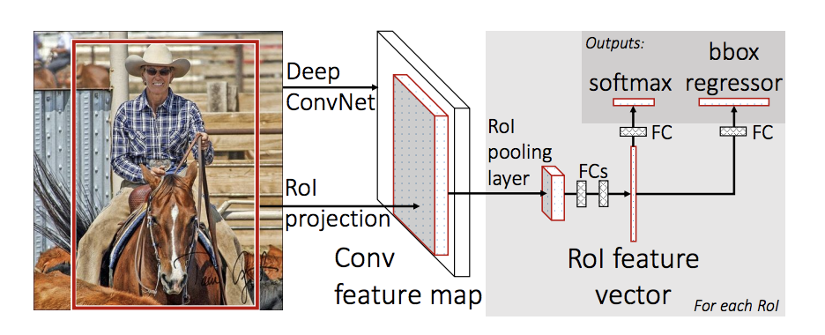
Problems with R-CNN
It still takes a huge amount of time to train the network as you would have to classify 2000 region proposals per image.
It cannot be implemented real time as it takes around 47 seconds for each test image.
The selective search algorithm is a fixed algorithm. Therefore, no learning is happening at that stage. This could lead to the generation of bad candidate region proposals.
Fast R-CNN:
The same author of the previous paper(R-CNN) solved some of the drawbacks of R-CNN to build a faster object detection algorithm and it was called Fast R-CNN. The approach is similar to the R-CNN algorithm. But, instead of feeding the region proposals to the CNN, we feed the input image to the CNN to generate a convolutional feature map. From the convolutional feature map, we identify the region of proposals and warp them into squares and by using a RoI pooling layer we reshape them into a fixed size so that it can be fed into a fully connected layer. From the RoI feature vector, we use a softmax layer to predict the class of the proposed region and also the offset values for the bounding box.
The reason “Fast R-CNN” is faster than R-CNN is because one doesn’t have to feed 2000 region proposals to the convolutional neural network every time. Instead, the convolution operation is done only once per image and a feature map is generated from it.

Slide 7
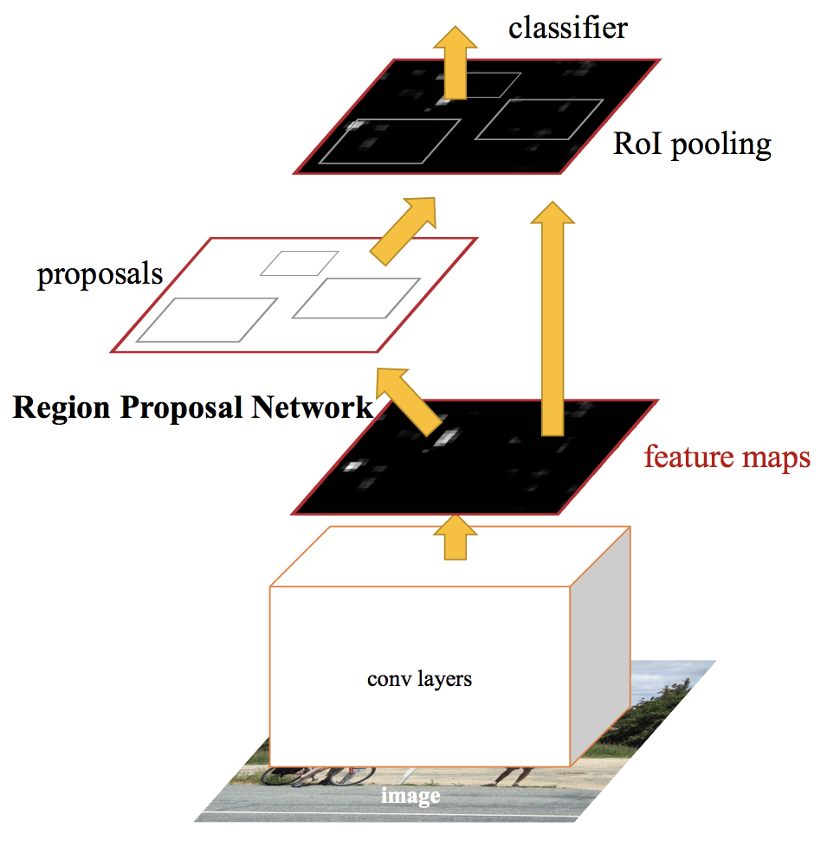
Faster R-CNN
R-CNN and Fast R-CNN both used a selective search algorithm which in turn very computationally expensive and consumed quite a lot of time.
Therefore, Shaoqing Ren along with Ross Girshick and others came up with an object detection algorithm that eliminates the selective search algorithm and lets the network learn the region proposals.
Similar to Fast R-CNN, the image is provided as an input to a convolutional network which provides a convolutional feature map. Instead of using selective search algorithm on the feature map to identify the region proposals, a separate network is used to predict the region proposals. The predicted region proposals are then reshaped using a RoI pooling layer which is then used to classify the image within the proposed region and predict the offset values for the bounding boxes.

Slide 8
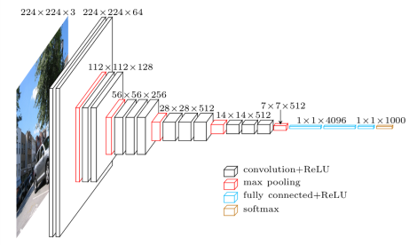
VGG16

Slide 9
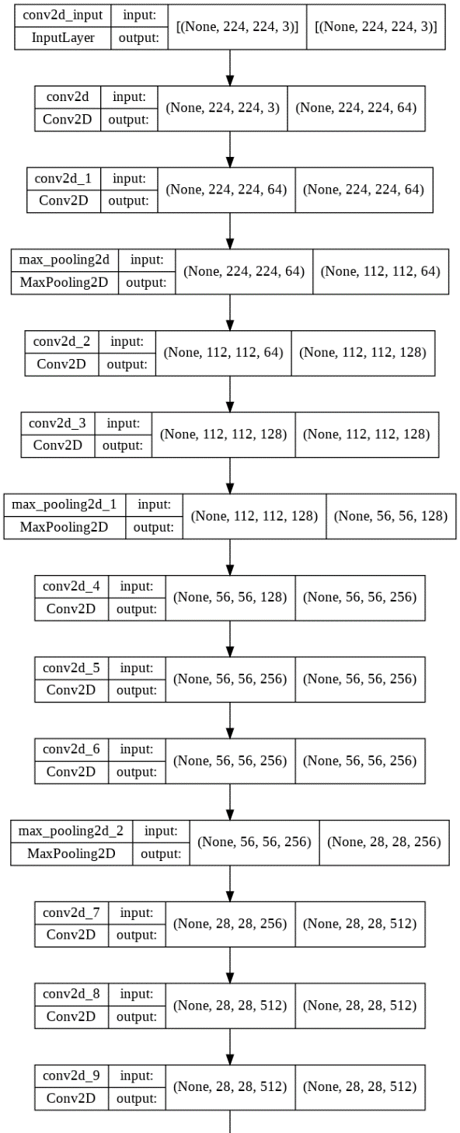
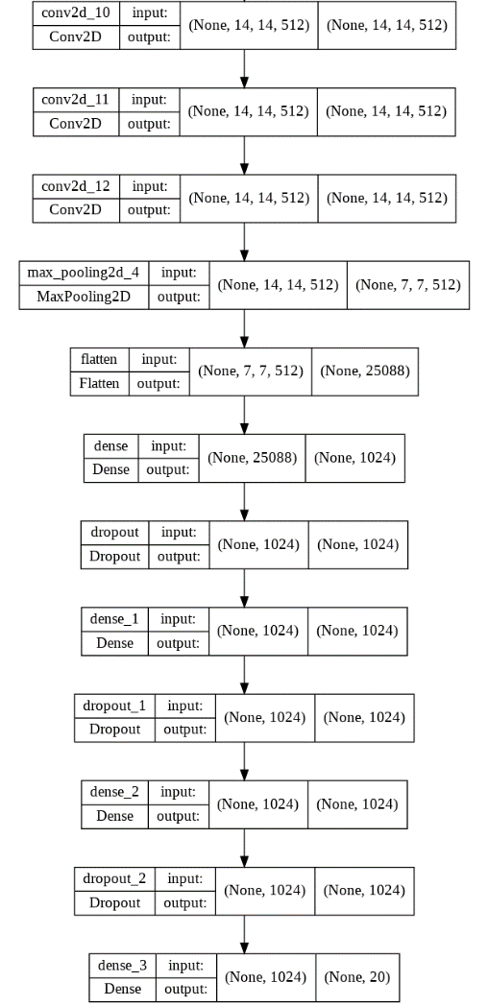
Model Architecture
The change between the original VGG-16 and the modified version used here is instead of choosing 2 Fully Connected Layers of 4096 neurons, they were reduced to 1024 neurons and an extra Fully Connected layer was added to the network. So in total it the modified network had 4 Fully connected layers.
The mAP value came out at around 63% which is definitely less that the original mentioned as 69.9% and the reason can be attributed to lower feature map size.
The main point of implementation gave a very good result with the AP of “Person” Class in PASCAL VOC 2007 is 69.93%

Slide 10
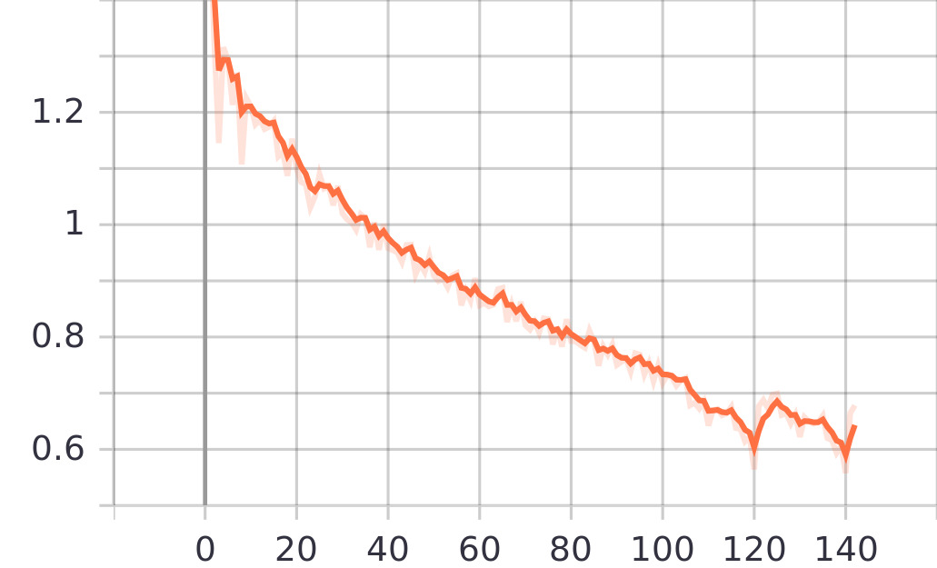
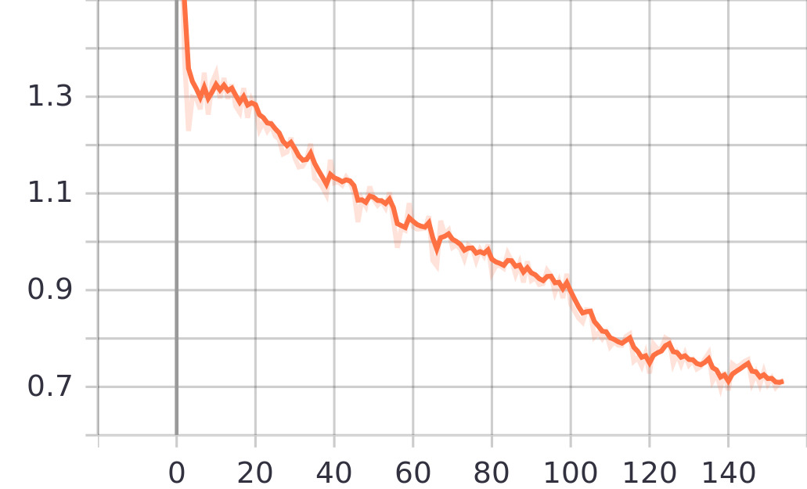
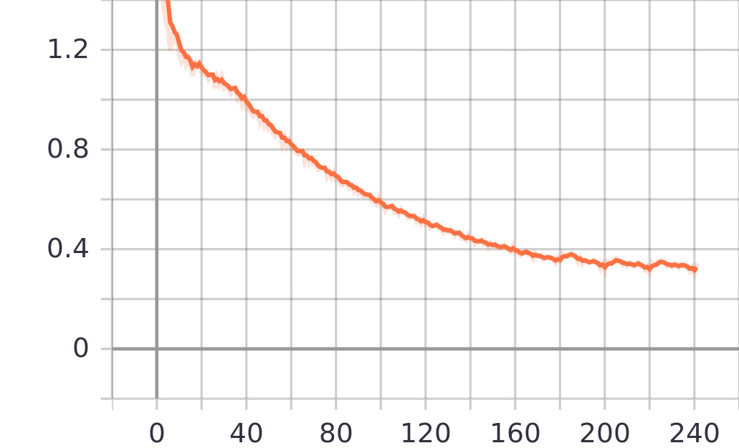
Pretrained, 3 FC Layers, 8 Epochs
Pretrained, 6 FC Layers, 8 Epochs
Pretrained, 3 FC Layers, 12 Epochs
Total Loss Plots ~ Consisting of RoI Bbox +Class Loss+ RPN Bbox + Class Loss

Slide 11
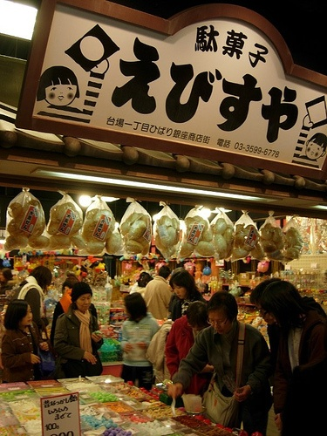
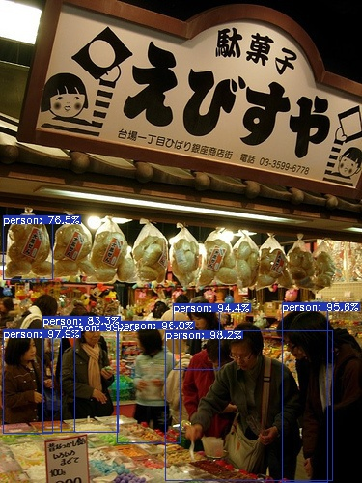

Slide 12
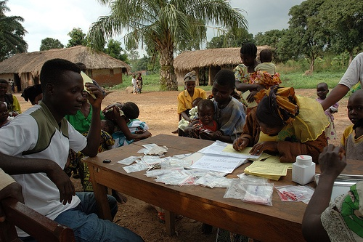
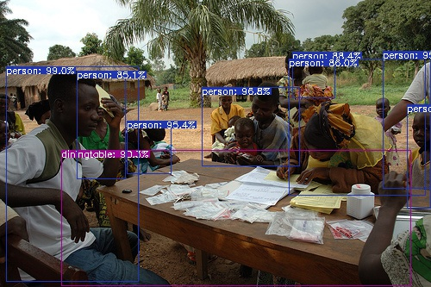
Bounding Box Generation when threshold set at 0.7

Slide 13
Future Work
Integrating the detections of images from the Faster R-CNN network into the DQN agent which will correct these bounding boxes based on the ground truth values from the PASCAL VOC Dataset.
Tweaking the architecture of DQN agent network and use a different feature extractor as the backbone for DQN agent.

Slide 14
THANK YOU

