Slide 1
Linear Regression Analysis
Concepts, Types, and Comparison with Logistic Regression
Master of Science in Data Science | Formative Assignment (40 marks)
Student Name: ____________________ Student ID: ____________
Email: ____________________ Date: ____________
Notes:
Good morning. This presentation covers three things: what linear regression is, the different types of linear regression with examples from different professions, and how linear regression differs from logistic regression. All R output shown was produced by running the code on the data sets named on each slide.

Slide 2
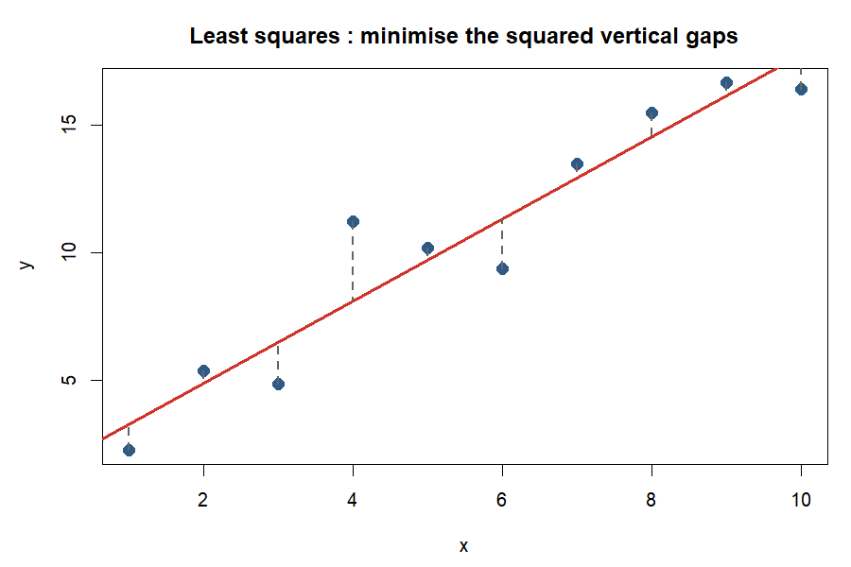
What is Linear Regression?
Part 1 : Concept
• A statistical method that models the relationship between a numeric outcome (y) and one or more predictors (x)
• Fits a straight line through the data:
– y = b₀ + b₁ x + ε
– b₀ = intercept : value of y when x = 0
– b₁ = slope : change in y for a one-unit increase in x
– ε = error : what the line cannot explain
• Two uses: explain which factors matter, and predict y for new cases
• Outcome must be continuous (price, weight, yield, mpg)
Linear Regression Analysis | MSc Data Science | Formative Assignment
1
Notes:
Linear regression answers two questions. First, how strongly is y related to x, and in which direction? Second, what value of y should we expect for a new x? The word linear means the relationship is modelled as a straight line. b0 is where the line crosses the y axis and b1 is how steep it is. The error term epsilon is everything the line cannot explain. Regression is used for two purposes: explanation (which factors matter and by how much) and prediction (what will y be for a new case).

Slide 3
How the Line is Fitted and Judged
Part 1 : Concept
• Least squares: choose b₀, b₁ to minimise Σ (yᵢ − ŷᵢ)²
• Key outputs to read:
– Coefficients with p-values : is the slope different from 0 ?
– R² : share of variation in y explained (0 to 1)
– Residual standard error : typical size of a prediction error
• Assumptions (LINE):
– Linearity • Independence
– Normal residuals • Equal variance
• Check with residual plots and a Q-Q plot before trusting the model
Output | Meaning | Good sign
Slope p-value | H₀: slope = 0 | < 0.05
R² | Variation explained | Close to 1
Residual SE | Typical error | Small vs range of y
F-statistic | Whole model useful? | p < 0.05
model <- lm(y ~ x, data = mydata)
summary(model) # coefficients, R2, p-values
plot(model) # 4 diagnostic plots
predict(model, newdata = data.frame(x = 5))
Linear Regression Analysis | MSc Data Science | Formative Assignment
2
Notes:
The line is chosen by the method of least squares: it minimises the sum of the squared vertical distances between the points and the line. Those distances are the residuals. R-squared of 0.75 means 75 percent of the ups and downs in y are explained by x. The p-value of the slope tests the null hypothesis that the slope is zero; a p-value below 0.05 means x genuinely helps explain y. Before trusting a model we check the four LINE assumptions using a residual plot and a Q-Q plot. If they fail, the p-values and predictions cannot be trusted.

Slide 4
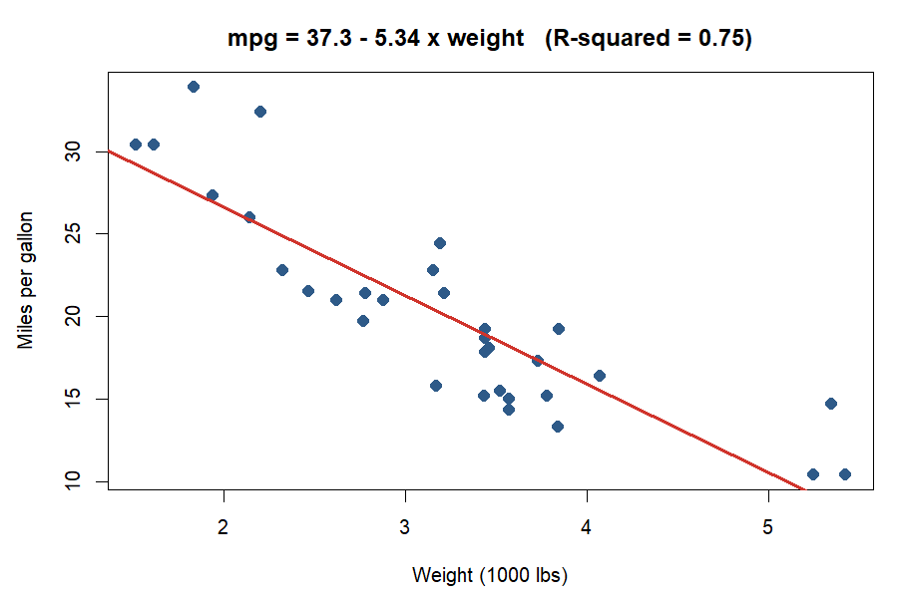
Example 1 : Car Weight and Fuel Economy
Part 1 : Concept
model <- lm(mpg ~ wt, data = mtcars)
coef(model)
# (Intercept) wt
# 37.285 -5.344
summary(model)$r.squared
# 0.753
• Engineering data: 32 cars, weight vs miles per gallon
• Every extra 1000 lbs costs about 5.3 mpg
• Weight explains 75 % of fuel economy (R² = 0.75)
• Slope p-value = 1.3 × 10⁻¹⁰ : highly significant
• Prediction: a 3000 lb car → 37.3 − 5.3 × 3 ≈ 21 mpg
Linear Regression Analysis | MSc Data Science | Formative Assignment
3
Notes:
This example uses the mtcars data set that ships with R: 32 cars from a 1974 magazine. The relationship is negative, so the slope is below zero. Every extra thousand pounds costs about 5.3 miles per gallon, and weight alone explains 75 percent of the variation in fuel economy. The intercept of 37 is the predicted mpg of a car weighing nothing, which is physically meaningless but needed to position the line. Prediction example: a 3000 pound car, so wt equals 3, is predicted to do 37.3 minus 5.3 times 3, about 21 mpg. The p-value of the slope is 1.3 times 10 to the minus 10, so the effect is highly significant.

Slide 5
More Examples from Different Fields
Part 1 : Concept
Field | Outcome (y) | Predictor (x) | What the slope means
Economics | Household spending | Household income | Marginal propensity to consume, about 0.7 to 0.9
Health | Systolic blood pressure | Age | About 0.5 to 1 mmHg increase per year of adult age
Education | Final exam score | Hours studied | Extra marks per hour of study
Real estate | House price | Floor area (sq ft) | Price per square foot
Agriculture | Crop yield | Fertilizer (kg / ha) | Extra bushels per kilogram of fertilizer
Marketing | Monthly sales | Advertising spend | Sales generated per rupee of advertising
Same equation every time — only the meaning and units of the slope change.
Linear Regression Analysis | MSc Data Science | Formative Assignment
4
Notes:
The same equation works in every field. What changes is the meaning of the slope: rupees of spending per rupee of income, millimetres of mercury per year of age, marks per hour of study, price per square foot. In economics the slope of spending on income is the marginal propensity to consume, typically 0.7 to 0.9. In medicine systolic blood pressure rises roughly half to one millimetre of mercury per year of adult age. Ask the audience: what is y and what is x in your own job? That is the best check that the idea has landed.

Slide 6
Types of Linear Regression : Overview
Part 2 : Types
Simple
Multiple
Polynomial
Regularised
One predictor
Straight line
Two or more predictors
Flat plane
Powers of a predictor
Curve
Ridge / Lasso
Penalised coefficients
y = b₀ + b₁x
y = b₀ + b₁x₁ + b₂x₂ + …
y = b₀ + b₁x + b₂x²
least squares + λ × penalty
All are “linear” because the outcome is a linear combination of the coefficients.
Categorical predictors (e.g. manual vs automatic) enter any of them as 0 / 1 dummy variables.
Linear Regression Analysis | MSc Data Science | Formative Assignment
5
Notes:
All of these are called linear because the outcome is a linear combination of the coefficients. Polynomial regression fits a curve but is solved by exactly the same least squares machinery. Ridge and Lasso are multiple regression with a penalty that shrinks the coefficients to prevent overfitting when there are many predictors. We will now look at each type with a data set from a different profession.

Slide 7
Simple Linear Regression : Agriculture
Part 2 : Types
• Data set: crop yield (bushels / acre) vs fertilizer applied (kg / ha) on 30 field plots
• Model: yield = b₀ + b₁ × fertilizer
• Reading: b₁ = extra bushels per extra kg of fertilizer
• Strengths
– Easy to draw, easy to explain to non-statisticians
– Only two numbers to interpret
• Weaknesses
– Ignores rainfall, soil, seed variety
– Slope is biased if a missing cause is linked to fertilizer use
farm <- read.csv("farm_plots.csv")
model <- lm(yield ~ fertilizer, data = farm)
summary(model)
plot(farm$fertilizer, farm$yield)
abline(model, col = "red")
• Best for: a single dominant driver, quick first look, teaching
• In the summative Task 2 data, fertilizer type is categorical, so ANOVA is the matching tool; with a continuous fertilizer amount, simple regression is the tool
Linear Regression Analysis | MSc Data Science | Formative Assignment
6
Notes:
One predictor, one slope. The whole story fits on a single scatter plot, which makes it ideal for explaining results to farmers or managers who are not statisticians. Its weakness is that it ignores every other cause: rainfall, soil quality, seed variety. If those are correlated with fertilizer use, the slope will be biased. Use simple regression when there is a single dominant driver or as a first look before building a bigger model.

Slide 8
Multiple Linear Regression : Real Estate
Part 2 : Types
• Data set: house sale prices with area, bedrooms, age, distance to city centre
• Model: price = b₀ + b₁·area + b₂·bedrooms + b₃·age + b₄·distance
• Each slope = effect of that predictor holding the others constant
• Compare models with adjusted R² and AIC, not plain R²
• Danger: multicollinearity (area and bedrooms move together)
• Fix: variable selection, e.g. backward stepwise by AIC
model <- lm(price ~ area + bedrooms + age + distance,
data = houses)
summary(model)$adj.r.squared
step(model, direction = "backward") # selection
Car data (summative Task 1) | Adj. R² | AIC
mpg ~ wt | 0.745 | 166.0
mpg ~ all 10 predictors | 0.807 | 163.7
mpg ~ wt + qsec + am (stepwise) | 0.834 | 154.1
Linear Regression Analysis | MSc Data Science | Formative Assignment
7
Notes:
This is the workhorse of business analytics. The key phrase is holding the others constant: b1 is the price of one extra square foot for houses with the same number of bedrooms, the same age and the same distance. Use adjusted R-squared rather than R-squared to compare models, because R-squared always rises when you add a predictor even if it is useless. Watch for multicollinearity: area and bedrooms are strongly related, so the model struggles to separate their effects. Variable selection by AIC drops predictors that do not earn their place. In the car example from the summative task, stepwise selection reduced ten predictors to three: weight, quarter-mile time and transmission.

Slide 9
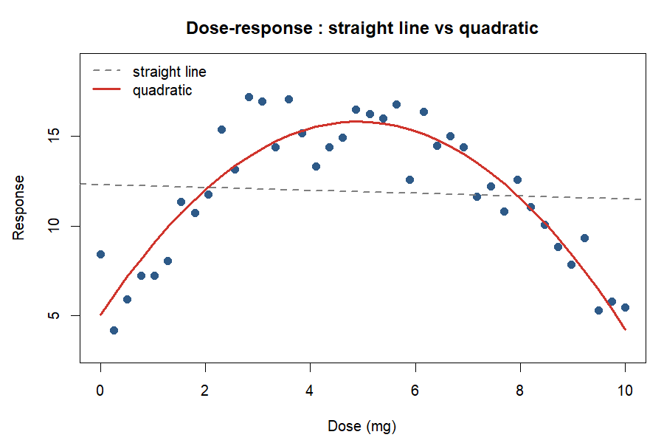
Polynomial Regression : Pharmacology
Part 2 : Types
• Data set: drug dose (mg) vs patient response in a clinical trial
• Response rises, then flattens or falls: a curve, not a line
• Model: response = b₀ + b₁·dose + b₂·dose²
• Still linear in the coefficients, so lm() fits it
model <- lm(response ~ dose + I(dose^2),
data = trial)
# or: lm(response ~ poly(dose, 2), data = trial)
• Risk: high degrees overfit and behave wildly outside the data range
Linear Regression Analysis | MSc Data Science | Formative Assignment
8
Notes:
The dose-response curve is the classic case. Response rises with dose, then flattens or falls. A straight line cannot capture that, but adding a squared term can. A negative b2 gives an inverted U: more drug helps up to a point and then harms. The model is still linear in its coefficients, so lm handles it. Two warnings: always plot the fitted curve over the data, and never extrapolate a polynomial beyond the observed doses because the curve can shoot off in either direction.

Slide 10
Compare and Contrast the Types
Part 2 : Types
Type | Predictors | Shape | Example data set | Best for | Main risk
Simple | 1 | Straight line | Fertilizer vs yield (agriculture) | Explaining, quick checks | Omitted variables
Multiple | 2 or more | Plane | House prices (real estate) | Controlling for several causes | Multicollinearity, overfitting
Polynomial | 1 + its powers | Curve | Dose vs response (pharmacology) | Non-linear trends | Overfitting, bad extrapolation
Ridge / Lasso | Many | Plane, shrunk | 50 marketing channels (business) | Many correlated predictors | Harder to interpret
Rule of thumb: pick the simplest model that passes the LINE checks and has the lowest AIC / highest adjusted R².
Linear Regression Analysis | MSc Data Science | Formative Assignment
9
Notes:
Contrast on three axes: number of predictors, shape of the fitted relationship, and what can go wrong. Simple regression is the most interpretable but the least realistic. Multiple regression is realistic but needs care with correlated predictors. Polynomial handles curves but overfits easily. Ridge and Lasso trade a little bias for much lower variance when there are dozens of predictors, at the cost of coefficients that are harder to interpret. The rule: choose the simplest model that passes the assumption checks and has the lowest AIC or highest adjusted R-squared.

Slide 11
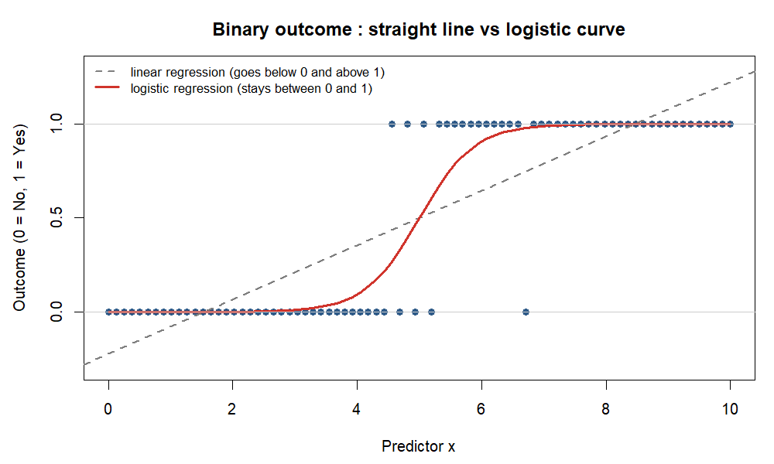
Linear vs Logistic Regression : the Core Difference
Part 3 : Linear vs Logistic
 | Linear | Logistic
Outcome y | Numeric (price, mpg) | Yes / No (0 / 1)
Predicts | Value of y | Probability y = 1
Equation | y = b₀ + b₁x | log(p / (1 − p)) = b₀ + b₁x
Shape | Straight line | S-curve between 0 and 1
Fitting | Least squares | Maximum likelihood
Coefficient | Change in y per unit x | exp(b) = odds ratio
R function | lm() | glm(family = binomial)
Evaluate | R², RMSE | Accuracy, confusion matrix
Linear Regression Analysis | MSc Data Science | Formative Assignment
10
Notes:
The single question to ask is: is my outcome a number, or a yes-no? A number means linear regression. A yes-no means logistic regression. Why not draw a straight line through zeros and ones? Because the line predicts values below zero and above one, which are not probabilities. The logistic curve, an S shape, squeezes any value into the zero to one range. Logistic regression is fitted by maximum likelihood rather than least squares, and its coefficients are read as odds ratios after taking the exponential.

Slide 12
Real-Life Example : a Bank and its Customers
Part 3 : Linear vs Logistic
A bank records for each customer: income, age, credit score, existing debt
Question A → LINEAR
Question B → LOGISTIC
“How much will this customer spend on their card next month?”
Outcome = amount in rupees (a number)
“Will this customer default on the loan?”
Outcome = default Yes / No (a category)
lm(spend ~ income + age + score + debt, data = bank)
glm(default ~ income + age + score + debt,
data = bank, family = binomial)
Same predictors, same data. The TYPE OF OUTCOME decides the method.
Linear Regression Analysis | MSc Data Science | Formative Assignment
11
Notes:
Same bank, same customers, same four predictors. What decides the method is the type of outcome. For the spending question the model returns a rupee amount with a confidence interval. For the default question the model returns a probability, say 0.23. The bank then chooses a cut-off: above 0.20 reject, below approve. Moving the cut-off trades false approvals against false rejections. Logistic coefficients are read as odds ratios: exp of b equal to 1.5 means each extra unit of x multiplies the odds of default by 1.5.

Slide 13
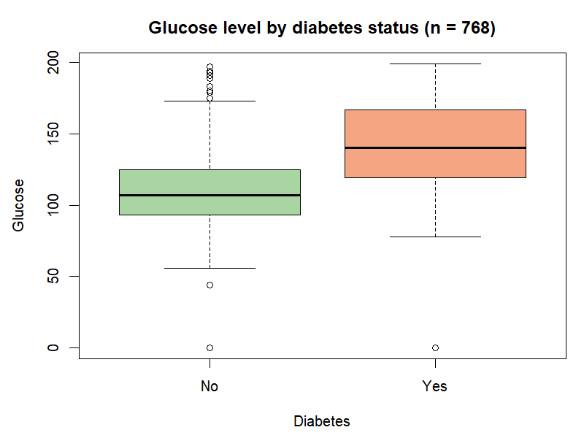
Worked Example in R : Predicting Diabetes
Part 3 : Linear vs Logistic
model <- glm(diabetes ~ glucose + bmi + age,
data = train, family = binomial)
exp(coef(model)) # odds ratios
# glucose 1.03 bmi 1.09 age 1.03
predict(model, type = "response",
newdata = data.frame(glucose = 150, bmi = 33, age = 45))
# 0.63 -> 63 % probability of diabetes
Test-set result | Value
Accuracy | 75 %
Sensitivity | 53 %
Specificity | 87 %
• Cut-off 0.5 → lower it to catch more cases
• Predicting the glucose level instead would need lm()
Linear Regression Analysis | MSc Data Science | Formative Assignment
12
Notes:
The Pima Indians Diabetes data has 768 women and records whether each developed diabetes. Each extra unit of glucose multiplies the odds of diabetes by 1.03, so about twenty extra units roughly doubles the odds. A new patient with glucose 150, BMI 33 and age 45 gets a predicted probability of 0.63. On a held-out test set the model is 75 percent accurate. It is better at ruling out diabetes, specificity 87 percent, than at catching it, sensitivity 53 percent. Lowering the cut-off from 0.5 to 0.3 would catch more cases at the cost of more false alarms. That cut-off trade-off does not exist in linear regression, which is another practical difference. If instead we wanted to predict the glucose level itself, a number, we would go back to lm.

Slide 14
Summary : Which Method, When?
Part 3 : Summary
• Linear regression
– Numeric outcome, straight-line relationship
– Read the slopes directly, check R² and residual plots
• Types: simple, multiple, polynomial, regularised
– Pick the simplest that passes the checks and has the lowest AIC
• Logistic regression
– Yes / No outcome, predicts a probability
– Read odds ratios, choose a cut-off, judge by a confusion matrix
Decision rule
Look at your y first.
Is it a number? → lm()
Is it Yes / No? → glm(family = binomial)
Then check the assumptions before you trust a single p-value.
Linear Regression Analysis | MSc Data Science | Formative Assignment
13
Notes:
Close by repeating the decision rule: look at your y first. A number means linear regression; choose the simplest type that fits and passes the LINE checks. A yes-no means logistic regression; read odds ratios and choose a cut-off. Then invite questions.

Slide 15
References
• James, G., Witten, D., Hastie, T. and Tibshirani, R. (2021) An Introduction to Statistical Learning with Applications in R. 2nd edn. New York: Springer.
• Field, A., Miles, J. and Field, Z. (2012) Discovering Statistics Using R. London: Sage.
• Kutner, M. H., Nachtsheim, C. J., Neter, J. and Li, W. (2005) Applied Linear Statistical Models. 5th edn. New York: McGraw-Hill.
• Hosmer, D. W., Lemeshow, S. and Sturdivant, R. X. (2013) Applied Logistic Regression. 3rd edn. Hoboken: Wiley.
• R Core Team (2023) R: A Language and Environment for Statistical Computing. Vienna: R Foundation for Statistical Computing. Available at: https://www.R-project.org/
• Henderson, H. V. and Velleman, P. F. (1981) ‘Building multiple regression models interactively’, Biometrics, 37, pp. 391–411. (source of the mtcars data set)
• Smith, J. W. et al. (1988) ‘Using the ADAP learning algorithm to forecast the onset of diabetes mellitus’, Proceedings of the Symposium on Computer Applications and Medical Care, pp. 261–265. (source of the Pima Indians Diabetes data set)
Linear Regression Analysis | MSc Data Science | Formative Assignment
14
Notes:
References in Harvard style. The mtcars and Pima data sets are the sources of all R output in this presentation.

Slide 16
Thank you
Questions and discussion
Notes:
Thank the audience and invite questions.

