Slide 1
Chapter 1
Defining & Collecting Data

Slide 2
Learning Objectives
In this chapter you learn:
The types of variables used in statistics
The measurement scales of variables
How to collect data
The different ways to collect a sample
About the types of survey errors

Slide 3
Types of Variables
DCOVA
Categorical (qualitative) variables have values that can only be placed into categories, such as “yes” and “no.”
Numerical (quantitative) variables have values that represent quantities.
  Discrete variables arise from a counting process
  Continuous variables arise from a measuring process

Slide 4
Types of Variables
Variables
DCOVA
Categorical
Numerical
Examples:
Marital Status
Political Party
Eye Color
(Defined categories)
Discrete
Continuous
Examples:
Number of Children
Defects per hour
(Counted items)
Examples:
Weight
Voltage
(Measured characteristics)

Slide 5
Levels of Measurement
DCOVA
A nominal scale classifies data into distinct categories in which no ranking is implied.
Categorical Variables Categories
Personal Computer Ownership
Type of Stocks Owned
Internet Provider
Yes / No
Growth / Value / Other
AT&T, Verizon, Time Warner Cable

Slide 6

Levels of Measurement (con’t.)
DCOVA
An ordinal scale classifies data into distinct categories in which ranking is implied
Categorical Variable Ordered Categories
Student class designation | Freshman, Sophomore, Junior, Senior
Product satisfaction | Satisfied, Neutral, Unsatisfied
Faculty rank | Professor, Associate Professor, Assistant Professor, Instructor
Standard & Poor’s bond ratings | AAA, AA, A, BBB, BB, B, CCC, CC, C, DDD, DD, D
Student Grades | A, B, C, D, F

Slide 7
Levels of Measurement (con’t.)
DCOVA
An interval scale is an ordered scale in which the difference between measurements is a meaningful quantity but the measurements do not have a true zero point.
A ratio scale is an ordered scale in which the difference between the measurements is a meaningful quantity and the measurements have a true zero point.

Slide 8
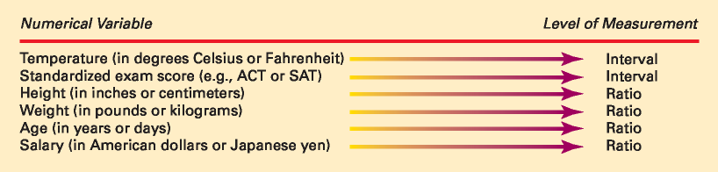
Interval and Ratio Scales
DCOVA

Slide 9
Establishing A Business Objective Focuses Data Collection
DCOVA
Examples Of Business Objectives:
A marketing research analyst needs to assess the effectiveness of a new television advertisement.
A pharmaceutical manufacturer needs to determine whether a new drug is more effective than those currently in use.
An operations manager wants to monitor a manufacturing process to find out whether the quality of the product being manufactured is conforming to company standards.
An auditor wants to review the financial transactions of a company in order to determine whether the company is in compliance with generally accepted accounting principles.

Slide 10
Sources of Data
DCOVA
Primary Sources: The data collector is the one using the data for analysis
  Data from a political survey
  Data collected from an experiment
  Observed data
Secondary Sources: The person performing data analysis is not the data collector
  Analyzing census data
  Examining data from print journals or data published on the internet.

Slide 11
Sources of data fall into five categories
DCOVA
Data distributed by an organization or an individual
A designed experiment
A survey
An observational study
Data collected by ongoing business activities

Slide 12
Examples Of Data Distributed By Organizations or Individuals
DCOVA
Financial data on a company provided by investment services.
Industry or market data from market research firms and trade associations.
Stock prices, weather conditions, and sports statistics in daily newspapers.

Slide 13
Examples of Data From A Designed Experiment
DCOVA
Consumer testing of different versions of a product to help determine which product should be pursued further.
Material testing to determine which supplier’s material should be used in a product.
Market testing on alternative product promotions to determine which promotion to use more broadly.

Slide 14
Examples of Survey Data
DCOVA
Political polls of registered voters during political campaigns.
People being surveyed to determine their satisfaction with a recent product or service experience.

Slide 15
Examples of Data Collected From Observational Studies
DCOVA
Market researchers utilizing focus groups to elicit unstructured responses to open-ended questions.
Measuring the time it takes for customers to be served in a fast food establishment.
Measuring the volume of traffic through an intersection to determine if some form of advertising at the intersection is justified.

Slide 16
Examples of Data Collected From Ongoing Business Activities
DCOVA
A bank studies years of financial transactions to help them identify patterns of fraud.
Economists utilize data on searches done via Google to help forecast future economic conditions.
Marketing companies use tracking data to evaluate the effectiveness of a web site.

Slide 17
Data Is Collected From Either A Population or A Sample
DCOVA
POPULATION A population consists of all the items or individuals about which you want to draw a conclusion. The population is the “large group” SAMPLE A sample is the portion of a population selected for analysis. The sample is the “small group”

Slide 18
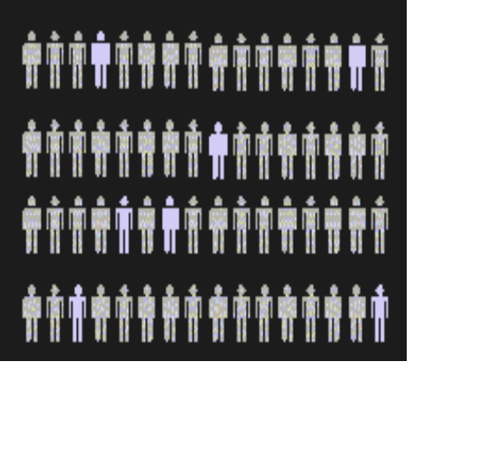
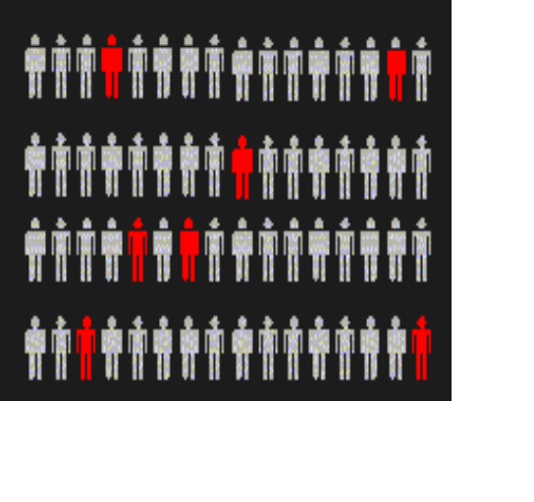
Population vs. Sample
Population
Sample
All the items or individuals about which you want to draw conclusion(s)
A portion of the population of items or individuals

Slide 19
Data Cleaning Is Often A Necessary Activity When Collecting Data
Often find “irregularities” in the data
  Typographical or data entry errors
  Values that are impossible or undefined
  Missing values
  Outliers
When found these irregularities should be reviewed
Many statistical software packages will handle irregularities in an automated fashion (Excel does not)

Slide 20
A Sampling Process Begins With A Sampling Frame
DCOVA
The sampling frame is a listing of items that make up the population
Frames are data sources such as population lists, directories, or maps
Inaccurate or biased results can result if a frame excludes certain portions of the population
Using different frames to generate data can lead to dissimilar conclusions

Slide 21
Types of Samples
DCOVA
Samples
Non-Probability Samples
Probability Samples
Simple
Random
Stratified
Judgment
Convenience
Systematic
Cluster

Slide 22
Types of Samples:
Nonprobability Sample
DCOVA
In a nonprobability sample, items included are chosen without regard to their probability of occurrence.
  In convenience sampling, items are selected based only on the fact that they are easy, inexpensive, or convenient to sample.
  In a judgment sample, you get the opinions of pre-selected experts in the subject matter.

Slide 23
Types of Samples:
Probability Sample
DCOVA
In a probability sample, items in the sample are chosen on the basis of known probabilities.
Probability Samples
Simple
Random
Systematic
Stratified
Cluster

Slide 24
Probability Sample:
Simple Random Sample
DCOVA
Every individual or item from the frame has an equal chance of being selected
Selection may be with replacement (selected individual is returned to frame for possible reselection) or without replacement (selected individual isn’t returned to the frame).
Samples obtained from table of random numbers or computer random number generators.

Slide 25
Selecting a Simple Random Sample Using A Random Number Table
DCOVA
Portion Of A Random Number Table
49280 88924 35779 00283 81163 07275
11100 02340 12860 74697 96644 89439
09893 23997 20048 49420 88872 08401
Sampling Frame For Population With 850 Items
Item Name Item #
Bev R. 001
Ulan X. 002
. .
. .
. .
. .
Joann P. 849
Paul F. 850
The First 5 Items in a simple random sample
Item # 492
Item # 808
Item # 892 -- does not exist so ignore
Item # 435
Item # 779
Item # 002

Slide 26



Probability Sample:
Systematic Sample
DCOVA
Decide on sample size: n
Divide frame of N individuals into groups of k individuals: k=N/n
Randomly select one individual from the 1st group
Select every k^{th} individual thereafter
N = 40
n = 4
k = 10
First Group

Slide 27
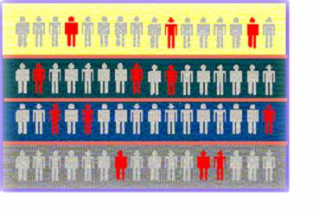
Probability Sample:
Stratified Sample
DCOVA
Divide population into two or more subgroups (called strata) according to some common characteristic
A simple random sample is selected from each subgroup, with sample sizes proportional to strata sizes
Samples from subgroups are combined into one
This is a common technique when sampling population of voters, stratifying across racial or socio-economic lines.
Population
Divided
into 4
strata

Slide 28
Probability Sample
Cluster Sample
DCOVA
Population is divided into several “clusters,” each representative of the population
A simple random sample of clusters is selected
All items in the selected clusters can be used, or items can be chosen from a cluster using another probability sampling technique
A common application of cluster sampling involves election exit polls, where certain election districts are selected and sampled.
Population divided into 16 clusters.
Randomly selected clusters for sample

Slide 29
Probability Sample:
Comparing Sampling Methods
DCOVA
Simple random sample and Systematic sample
  Simple to use
  May not be a good representation of the population’s underlying characteristics
Stratified sample
  Ensures representation of individuals across the entire population
Cluster sample
  More cost effective
  Less efficient (need larger sample to acquire the same level of precision)

Slide 30
Evaluating Survey Worthiness
DCOVA
What is the purpose of the survey?
Is the survey based on a probability sample?
Coverage error – appropriate frame?
Nonresponse error – follow up
Measurement error – good questions elicit good responses
Sampling error – always exists

Slide 31
Types of Survey Errors
DCOVA
Coverage error or selection bias
  Exists if some groups are excluded from the frame and have no chance of being selected
Nonresponse error or bias
  People who do not respond may be different from those who do respond
Sampling error
  Variation from sample to sample will always exist
Measurement error
  Due to weaknesses in question design, respondent error, and interviewer’s effects on the respondent (“Hawthorne effect”)

Slide 32
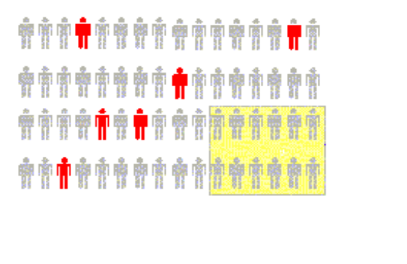

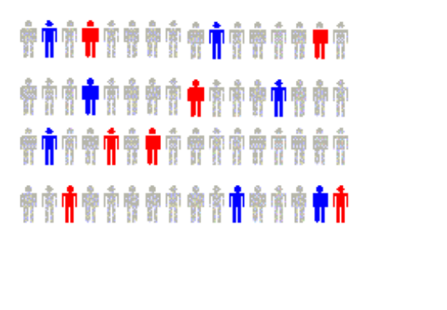

Types of Survey Errors
DCOVA
(continued)
Coverage error
Nonresponse error
Sampling error
Measurement error
Excluded from frame
Follow up on nonresponses
Random differences from sample to sample
Bad or leading question

Slide 33
Chapter Summary
In this chapter we have discussed:
The types of variables used in statistics
The measurement scales of variables
How to collect data
The different ways to collect a sample
The types of survey errors

