Slide 2
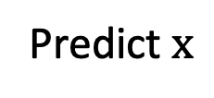
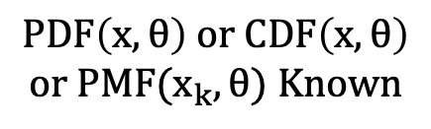

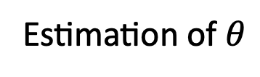
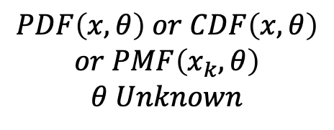
$$Samples x_{1},x_{2}, ⋯x_{n}$$
$$PDF\left(x,θ\right) or CDF\left(x,θ\right)$$
$$or PMF(x_{k},θ) Known$$
$$PDF\left(x,θ\right) or CDF\left(x,θ\right)$$
$$or PMF\left(x_{k},θ\right)$$
$$θ Unknown$$
Predict $x$
Estimation of $θ$

