Slide 1


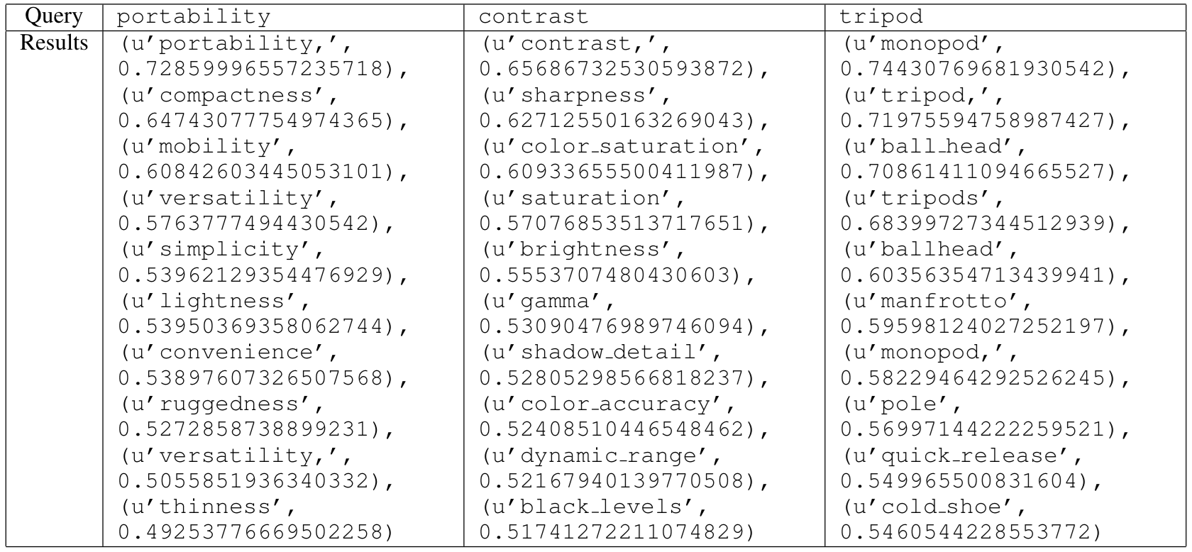
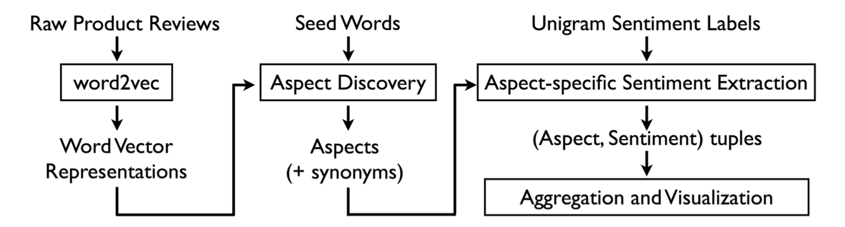
Extracting and Aggregating Aspect-Level Sentiment from Product Reviews
Desmond Ong, Shane Soh, Matthew Long
CS224D
Motivation
Approach
Results
Consumers not only have access to online stores through which they might purchase anything she desires, but they also have unprecedented access to a deluge of information—most notably, product reviews written by other consumers—with which they can make their decision. Sifting through hundreds of reviews across tens of different websites to acquire specific information about the product and its important attributes (e.g. battery life for electronics) is a time-consuming chore. It is difficult to automatically summarize this information, especially because of the heterogeneity of attributes across different product categories. Because of this, there has been much recent research tackling the two separate but connected components of this problem: (1) automatic discovery of aspects, and (2) aspect-specific sentiment analysis.
Aspect Discovery
Tokenized reviews with NLTK’s punkt tokenizer
Removed all non-alphanumeric characters and replaced digits with DG
Detected and combined common bigrams
Trained word2vec (CBOW, Skipgram) with tuned hyperparameters using Gensim package
Each attribute in seed set expanded with top n nearest-neighbors in terms of cosine similarity
Aspect-Specific Sentiment Extraction
Needs updating
The word2vec model was able to learn not only the synonyms for the product aspects we listed in the “seed” set, but also could discover aspects of particular products that were not “seeded”. For instance, the query tripod returned results ball_head and quick_release, both of which refer to features of tripods that are non-obvious to a person unfamiliar with photography.
Problem
Aspect Discovery
Problem : Given a short list of attributes (“seed” attributes), we discover an expanded list of attributes by returning top n related words vectors based on cosine similarity
Dataset : 6 million reviews of electronics product from Amazon.com¹
Aspect-Specific Sentiment Extraction
Problem : Given a set of reviews (for a single product) identify (aspect, aspect-related sentiment) tuples
Evaluation : We will construct word cloud visualizations color coded to express sentiment. We will perform comparisons with “expert review” sites, such as CNET and DPReview, and the aspect-specific ratings on Google Shopping.
Maybe new table?
Models
Aspect Discover
Three models were trained, the most successful of which used window sizes of 10 and 300 dimensional feature vectors. Frequency-based pruning was also performed.
Aspect-Specific Sentiment Extraction
Conclusions
Acknowledgments
We would like to thank Richard Socher and the teaching assistants of CS224D for teaching us the skills necessary to make this project a success and the Stanford Deep Social Learning Lab for providing computing resources.
¹McAuley, J., Targett, C., Shi, J., & van den Hengel, A. (2015). Image-based recommendations on styles and substitutes. ACM Special Interest Group on Information Retrieval (SIGIR)
²placeholder

