Slide 1
<Agency>’s
TechStat Framework
Agency Seal
<Date>

Slide 2
Agenda
TechStat Overview
TechStat Process
Managing Outcomes

Slide 3
TechStat Overview
What is a TechStat?
TechStat is a face-to-face, evidence-based accountability review of an IT investment
TechStat results in concrete actions to address weaknesses
TechStat reduces wasteful spending by turning around troubled programs and
terminating failed programs sooner
TECHSTAT IS: | TECHSTAT IS NOT:
Actionable: participants should leave the session armed with next steps to improve outcomes | Routine: sessions should not be used for routine, small impact change requests
A Spotlight: sessions should highlight problems areas and focus deeply on pain points | Comprehensive: not an IV&V, IBR, PIR (though these could be inputs or requested actions of a TechStat)
Prescriptive: sessions should be limited to 60 minutes and result in clear actions, with owners and deadlines | One-Size-Fits-All: the roles and responsibilities of the CIO, IRB, and TechStat will vary by agency
A Tool: sessions should be used when executive level influence is needed | A Review: sessions should not be used for cyclical control reviews (“business as usual”)

Slide 4
TechStat Implementation Requires Organizational Change
TechStat Overview
Training
  Leadership
  Project and Program Staff
Governance
  Revised Investment Review Board Charter
Amended Roles and Responsibilities
  TechStat team, CIO, Investment Manager, Business Owner, IRB

Slide 5
TechStat Overview (continued)
TechStat Analysis (by Investment Lifecycle)
 | Initial Baseline Review | Control Review | Rebaseline Request Review
Applicable Investment Lifecycle | Planning Development | Development Mixed Lifecycle | Development Mixed Lifecycle
Goals | Verify the technical content of the Performance Measurement Baseline Review and assess both resource and schedule estimates Identify potential risks | Provide a systematic assessment of the investment’s current state Identify any new risks and changes in scope since prior review | Review and redefine project baselines that are affected by a significant change in project goals Reconsider baselines that are no longer useful as a management tool
TechStat Analysis Outcomes:
  Questions and information requests for the investment being reviewed
  TechStat thesis - discovered through analysis of the investment documentation requested
  Briefing deck for the IRB that highlights key issues needing resolution
  Additional outputs as requested by the agency CIO

Slide 6
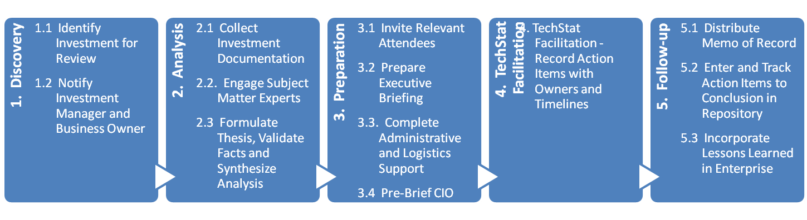
TechStat Process
High-Level Process

Slide 7
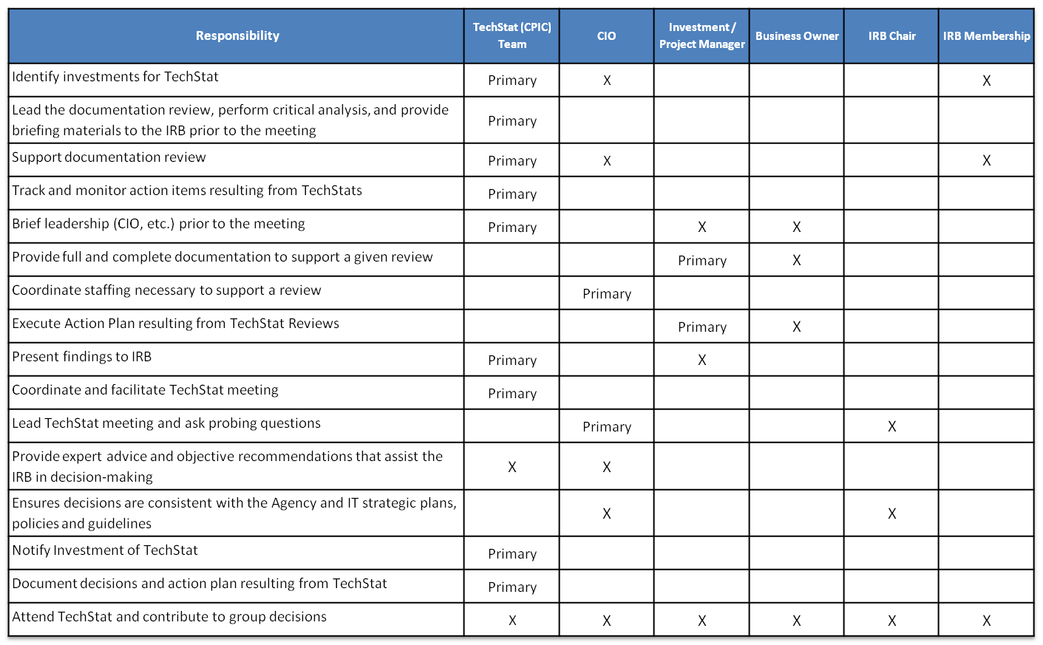
Roles and Responsibilities
TechStat Process

Slide 8
Day of TechStat
TechStat Process
Roles
  CIO and IRB Co-Chair will chair the meeting
  TechStat team lead will facilitate
  Investment Manager will serve as primary respondent
Format (Structured 1 hour meeting)
  10 minute briefing on issues and challenges
  40 minute discussion of root causes and potential corrective actions
  10 minute decisions on corrective action items

Slide 9
Managing Outcomes
Potential Outcomes
  Continue as planned with minor recovery and corrective action plans;
  Continue with modifications such as:
    Rescope and rebaseline,
    Reassess make/buy approach,
    Reassign project team and/or vendor,
    Implement extensive corrective action plans,
    Thorough root cause analysis of performance issues;
  Halt investment and:
    Determine if the project is still necessary,
    Recharter – agency performs a deeper analysis of the program,
    Stabilize the application to a point of non-impact to users and business operations.
Managing Action Items
Incorporating Lessons Learned

