Slide 1
<Agency> TechStat
<Investment NAME>
<Date>
Presented By
<CIO NAME>, <Agency>
Agency Seal

Slide 2
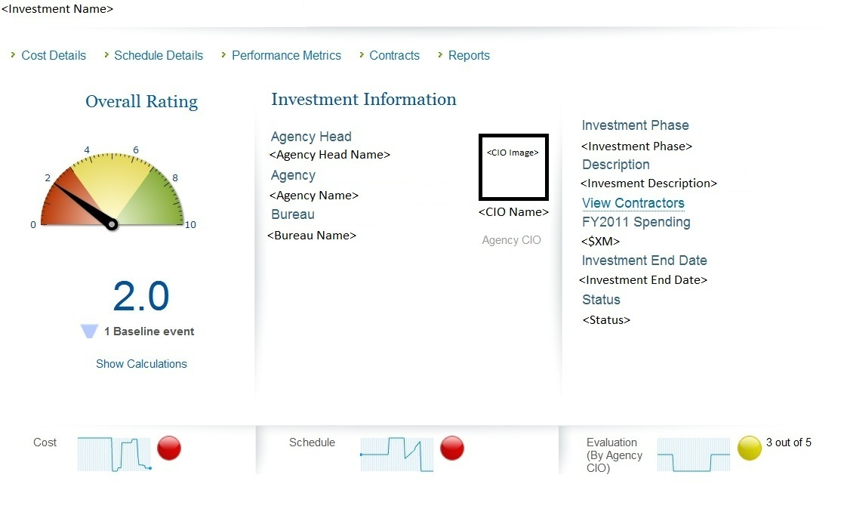
Thesis
<Plain language thesis>
Point 1
<Insert Dashboard Snapshot>
Point 2
Point 3

Slide 3
Background
Investment to… <Insert plain language investment objective>
2-4 bullets on investment background
Keep background to no more than 2 slides; the following slides are examples.

Slide 4
Schedule Highlights
Background slide example
2003
Contract awarded and development begins
2009
Transition milestone missed
Future unknown date
Transition to new system of record
2008
Bid accepted
October 2008
Transition milestone missed
June 2010
Corrective action presented
May 2008
Transition milestone missed
2006
Contractor hired to PMO
July 2009
First cure notice given to contractor
2007
Rebaseline
March 2008
Misrepresents independent evaluation of investment
November 2009
Contract terminated

Slide 5
Funding Profile
Background slide example
Point 1
 | 2011 (CY) | 2012 (Request) | 2013+
 | Pre | Pre
Planning / Acquisition
O&M
FTEs
Total
Point 2

Slide 6
Project Management Challenges
Challenge slide example
Lack of system and requirements documentation
Governance Issues
  Hiring practices led to potential conflict of interest
  Key officials were unaware of decisions made about contractors performance
Lack of skilled staff in key positions
Weaknesses in internal controls and financial reporting
GAO/IG Report Cover
(if applicable)
Keep challenges to no more than 2 slides; the following slides are examples
<Summary of GAO/IG issues (if applicable)>

Slide 7
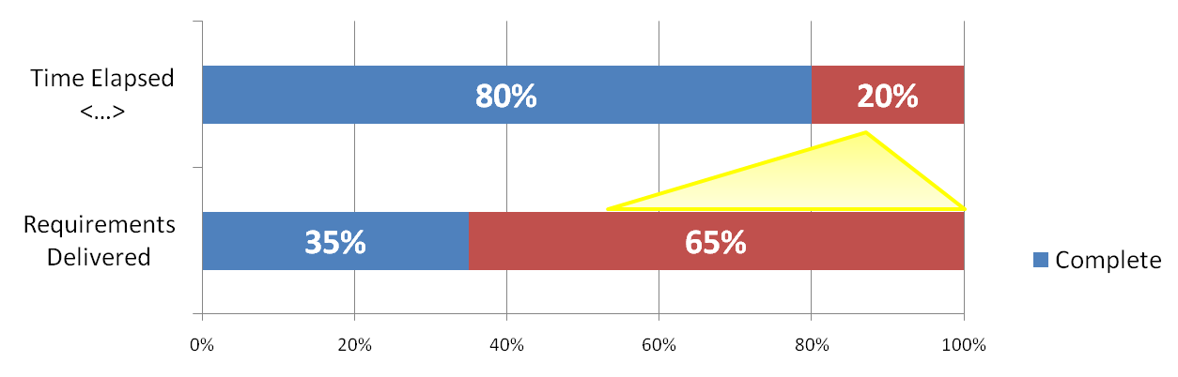
Requirements Management Needs Improvement
Redacted challenge slide example
<…> of requirements will remain incomplete at the end <…>
  It took <…> to complete <…> and only <…> years is budgeted to complete the remaining <…>
More than half of the requirements remaining
Data Source: <…>

Slide 8
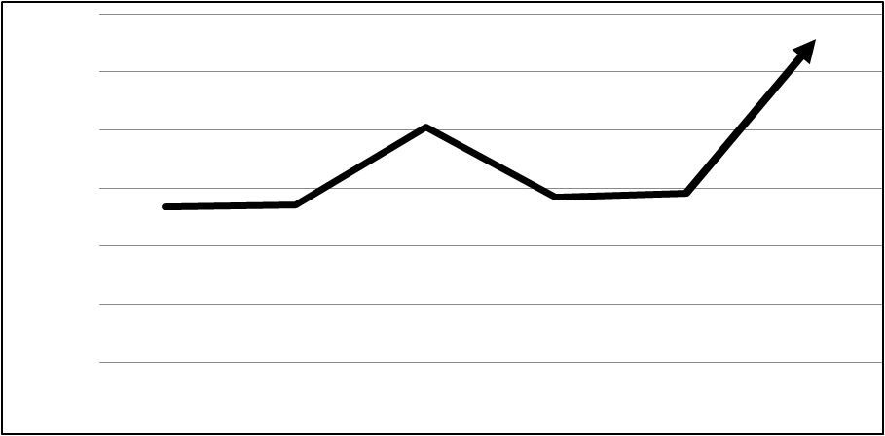
Not Realizing Cost Savings
Redacted challenge slide example
  Consolidated <…> systems into <…>,
  yet O&M costs increase
Yearly O&M Costs
($ millions)
  Source: <…>
Data Source: <…>

Slide 9
History of Poor Cost and Schedule Control
Redacted challenge slide example
Incident Management, Analysis, and Reporting System (IMARS)
 | PLANNED |  |  | ACTUAL
Milestone | Start Date | Completion Date | Total Cost | Start Date | Completion Date | Total Cost | Percent Complete
Data Source: <…>

Slide 10
History of Unmet Performance Targets
Redacted challenge slide example
Incident Management, Analysis, and Reporting System (IMARS)
Fiscal Year | Performance Metric | Baseline | Target | Actual Data | Performance Goal Achieved ? (If no, why not?)
Data Source: <…>

Slide 11
Current Staff Challenges
Redacted challenge slide example
Project Team overallocated by <…>
Vendor resources overallocated by <…>
Data Source: <…>

Slide 12
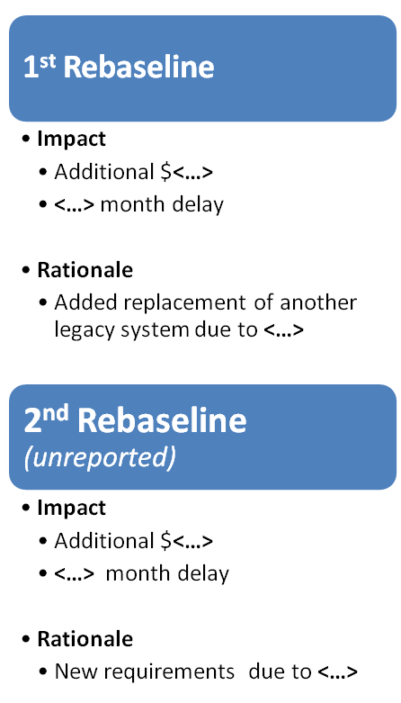
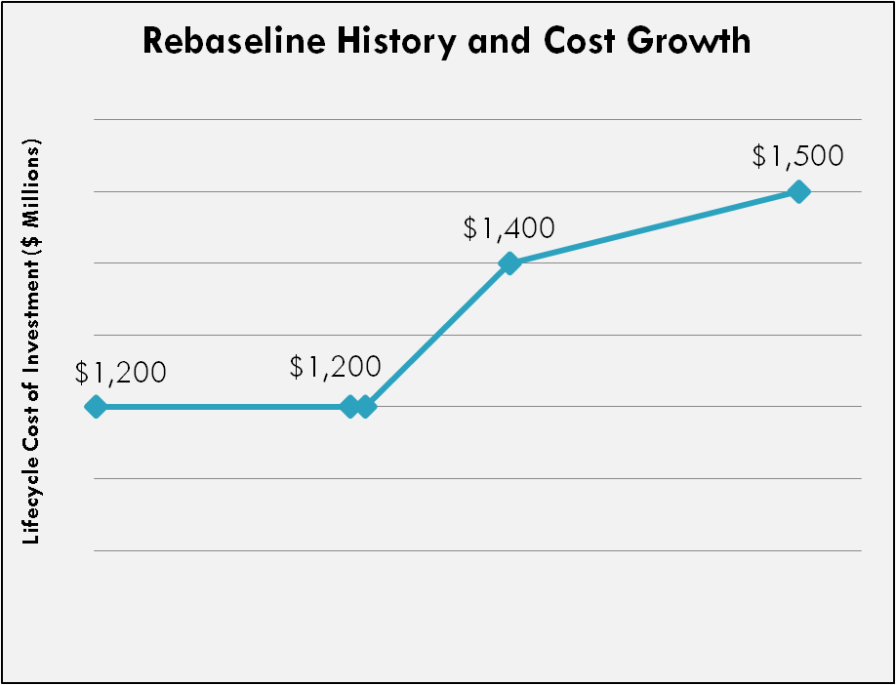
<…> Has Been Rebaselined <…> Times in <…> Months
Redacted challenge slide example
Data Source: <…>

Slide 13
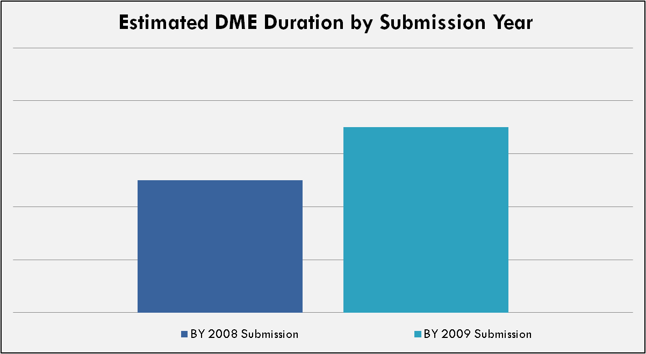
Milestones Extend Beyond Original Plan
Redacted challenge slide example
Over time, milestones have been pushed out further
6 Years
8 Years
7
Years
5 Years
10 Years
Data Source: <…>

Slide 14
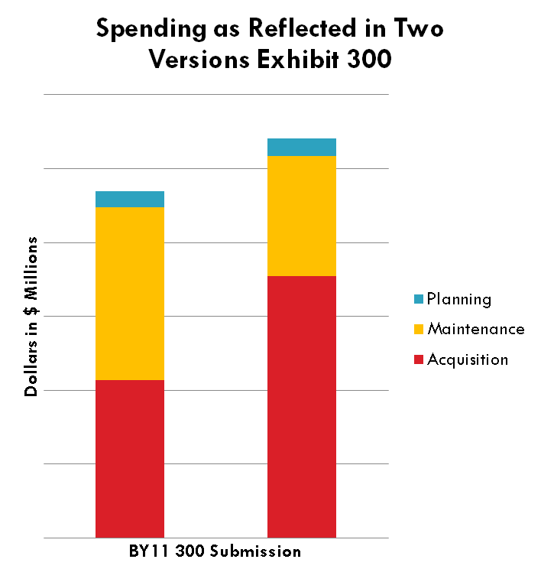
Spending Has Been Redirected
Toward Acquisition
Redacted challenge slide example
Between versions submitted in September and March:
  <…> re-categorized from maintenance to acquisition
  <…> in additional acquisition expenses
Is the investment requiring more acquisition than originally planned?
Data Source: <…>

Slide 15
<AGENCY> TECHSTAT
<INVESTMENT NAME>
Agency Seal

