Slide 1
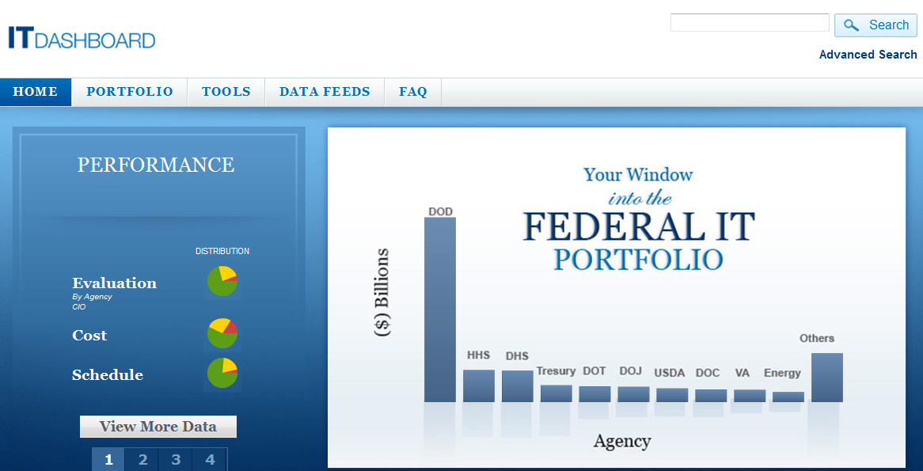
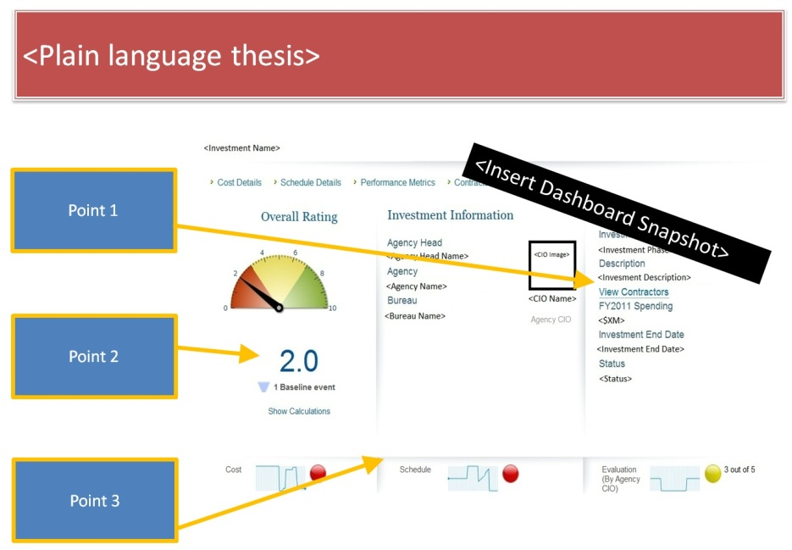
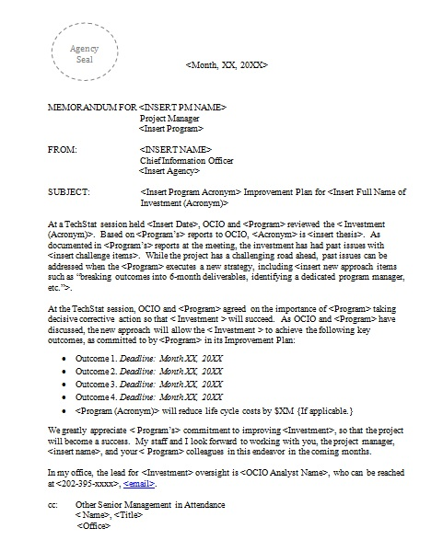
TechStat
Agency Seal
This deck allows OCIO to easily brief agency leadership, OMB, and/or other key internal USG stakeholders on TechStat outcomes
1
Identify Troubled Projects
2
Conduct TechStat Accountability Sessions
3
Relentless Follow up

Slide 2
TechStat Reviews
Agency Seal
This slide summarizes the outcomes of all reviews completed
Results of <X> TechStat Reviews
<$X
in budget
reduction>
<X>
<X>
<X>
<X>
<X>
Projects Reviewed
As of <Date>
Proceeded with Minor Changes
Accelerated Delivery
Budget Reduction
Terminated

Slide 3

<Investment Name>
Investment to… <plain language of investment objectives>
Agency Seal
Each investment reviewed during a TechStat should have a slide that summarizes the outcome
Issue: <plain language thesis>
 | BEFORE | AFTER
Governance
Usability
Enterprise Architecture
Mainframe / Server
Lifecycle costs | $XM | $XM
Outcome categories are specific to the investment reviewed
Outcome: <Plain language outcome of TechStat review, follow up memo, and improvement plan>

