Slide 1

https://static.wikia.nocookie.net/matrix/images/0/01/Agents.png/revision/latest/scale-to-width-down/1920?cb=20190202144738

Slide 2

https://i.stack.imgur.com/zymAc.gif

Slide 3
Fear

Slide 4
Power is about assuming a true regression model, then estimating how often you will reject the null hypothesis of no treatment effect with the given sample size.

Slide 5
$$Outcome \sim Normal(μ=10+treatment∗2.5 −age∗10, σ=10)$$

Slide 6
Reject null hypothesis
Tolerated type 1 error
P-value
Uncertainty in regression
estimate
Magnitude of regression estimate
True treatment effect
Sample size
Variance in outcome

Slide 7
Increasing power activity
Using the diagram, list 3 ways to increase power besides increasing the sample size.

Slide 8
You can estimate how often this happens using derived equations, or by simulating the experiment many times and calculating how often you reject the null hypothesis.

Slide 9
Limitations of power
A type 2 error / false negative is one of only several ways you can be wrong. (Poll)
A given power calculation relies on many specific assumptions. You must assume a full regression model that generated the data (approximately), as well as a missing data mechanism.
Power calculations are often based upon scenarios far simpler than the actual dataset you will collect.
Power calculations tend to be optimistic because you have limited resources for your grant submission.

Slide 10
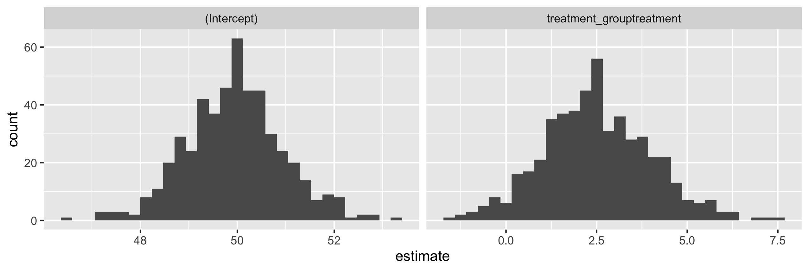
Simulation of a t-test example. Sample size of 100, variance in outcome of 50, mean difference of 2.5 for treatment compared to placebo
Probability of estimating the treatment to be negative/harmful: 0.042
Probability of estimating that the treatment is twice as good as it is: 0.046

Slide 11
Calculating power activity
You are designing a study of a new chemotherapy treatment compared to standard therapy. Your outcome of interest is percent change in tumor size after 3 months of therapy. You expect a 10% reduction in tumor size with the standard therapy, as well as a 15% reduction in size with the new therapy. You also know that participant sex and age are important predictors of tumor size reduction. Women are expected to have 2.5% more reduction in tumor size compared to men, regardless of treatment received. Also, for every 1 year increase in age, tumor size is expected to grow by 0.01%. For this particular cancer, 10% of the population are men and the mean and standard deviation of age are 62 and 3, respectively. You plan to perform 1:1 randomization of treatment:control. The variance in reduction in tumor size after 3 months is 20%, after accounting for treatment, sex, and age.
Through trial and error, find the approximate number of participants you need to achieve 90% power to reject the null hypothesis that the tumor reduction is the same in the new chemotherapy and standard therapy groups. Write 3 sentences you would put in a grant application to describe your power calculation.

Slide 12
“Plans are worthless, but planning is everything.”
-- President Eisenhower

