Slide 1
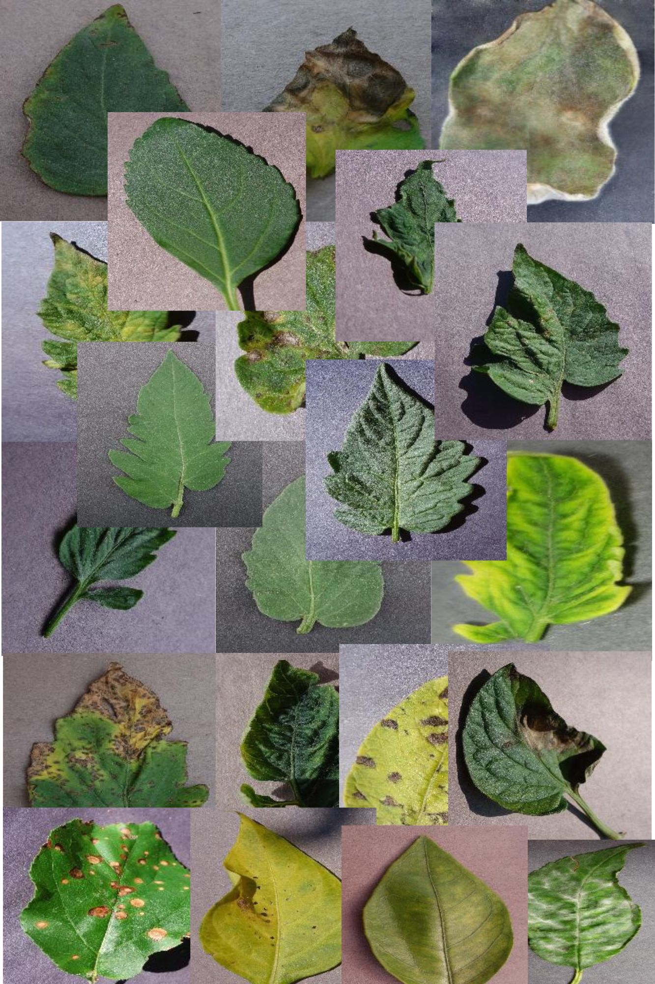
Plant Doctors
Team Members:
Matthew Lopez
Mitchell Fairgrieve
Austin Rothe
Steven Carrasquillo

Slide 2
Agenda
Introduction – The Problem and Solution
Research
Process
Results
Outcome

Slide 3
The Problem
Every year more and more people are getting into plants and gardening as a hobby.
Additionally, a study found that 42% of Americans have started growing their own produce recently, reflecting a broader trend towards self-sufficiency in response to rising food costs and concerns about food security​ (Study Finds)​.
However not everyone has a green thumb, has all the knowledge needed to maintain healthy plants nor know how to identify and treat diseases that could be affecting their plants.

Slide 4
Our Solution
Develop a website using a machine learning algorithm where users can submit photos and can be provided an identified illness and course for treatment with 90% accuracy.
Start with more common plants and illnesses.

Slide 5
Research
We found on Kaggle a dataset with 87K images of 38 different plants and diseases
new-plant-diseases-dataset
What libraries we used, why:
Tensorflow –platform for machine learning
Keras_Tuner – hyperparameter search
PIL (Pillow) – python library for image processing
Flask – display interactive webpage

Slide 6
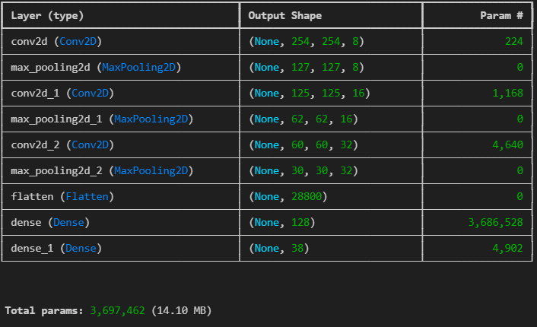
Process
Import files into training & validation directories.
Define model building function (create_model).
Instantiate the tuner.
Run the hyperparameter tuner search.
Using best model build (tuner.get_best_models), begin training model with training data & validation data.

Slide 7
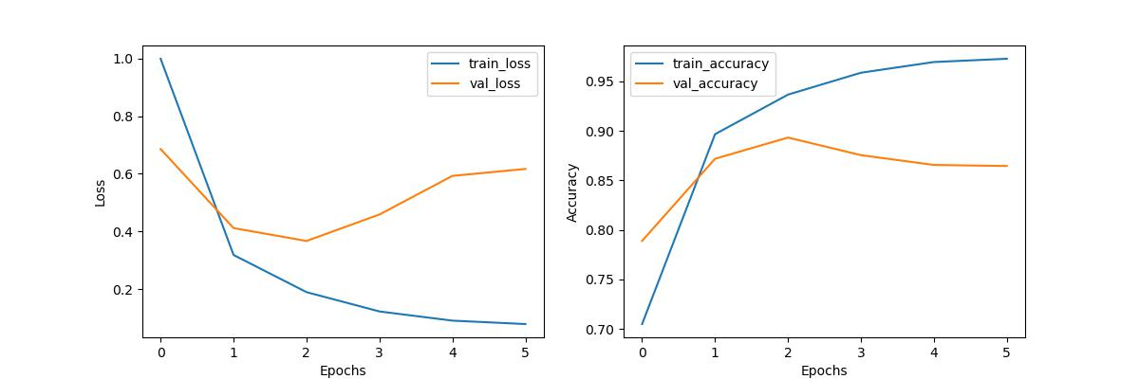
Process
Normalize pixel values (normalization layer)
Build and Train Model
View Accuracy vs Loss (accuracy: 0.9710)
Use Model to make Plant Disease Predictions!

Slide 8
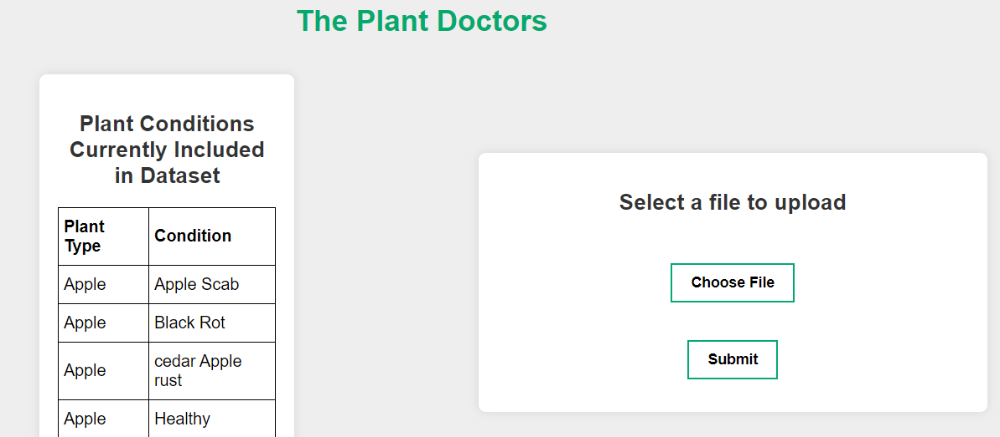
Results
Introduce web page and demo
link

