Slide 1
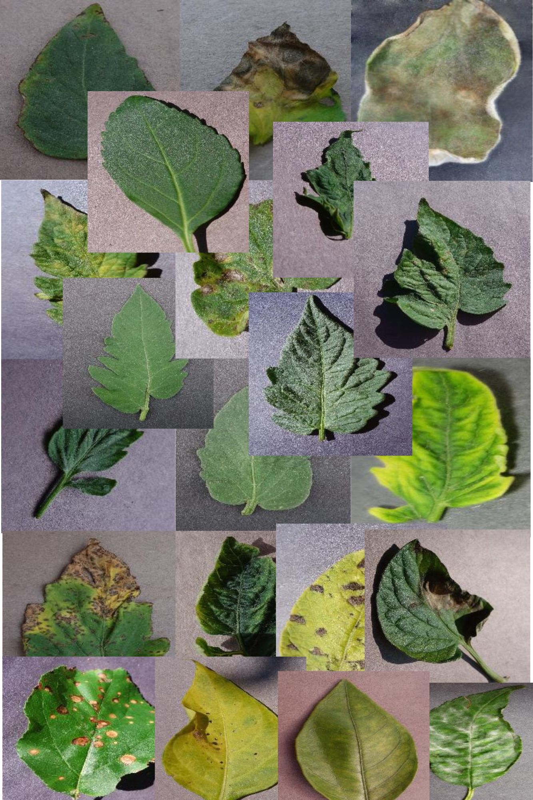
Plant Doctors
Team Members:
Matthew Lopez
Mitchell Fairgrieve
Austin Rothe
Steven Carrasquillo

Slide 2
Agenda
Introduction – The Problem and Solution
Research
Process
Results
Outcome

Slide 3
The Problem
Every year more and more people are getting into plants and gardening as a hobby.
Additionally, a study found that 42% of Americans have started growing their own produce recently, reflecting a broader trend towards self-sufficiency in response to rising food costs and concerns about food security​ (Study Finds)​.
However not everyone has a green thumb, has all the knowledge needed to maintain healthy plants nor know how to identify and treat diseases that could be affecting their plants.

Slide 4
Our Solution
Develop a website using a machine learning algorithm where users can submit photos and can be provided an identified illness and course for treatment with 90% accuracy.
Start with more common plants and illnesses.

Slide 5
Research
We found on Kaggle a dataset with #### images of ### plants and diseases
Link
What libraries we used, why

Slide 6
Process
Steps in our development process.

Slide 7
Process
Steps in our development process.

Slide 8
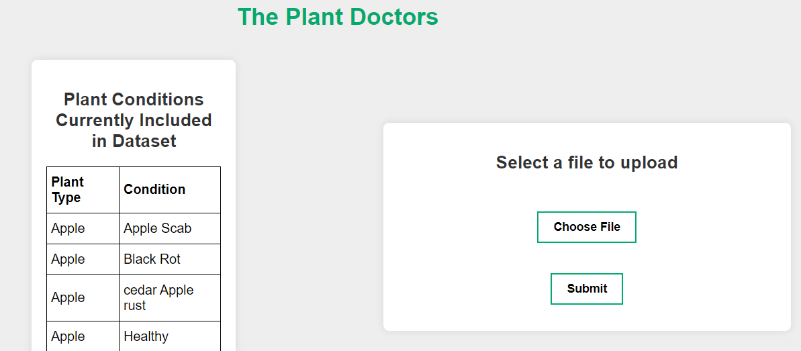
Results
Introduce web page and demo

