Slide 1
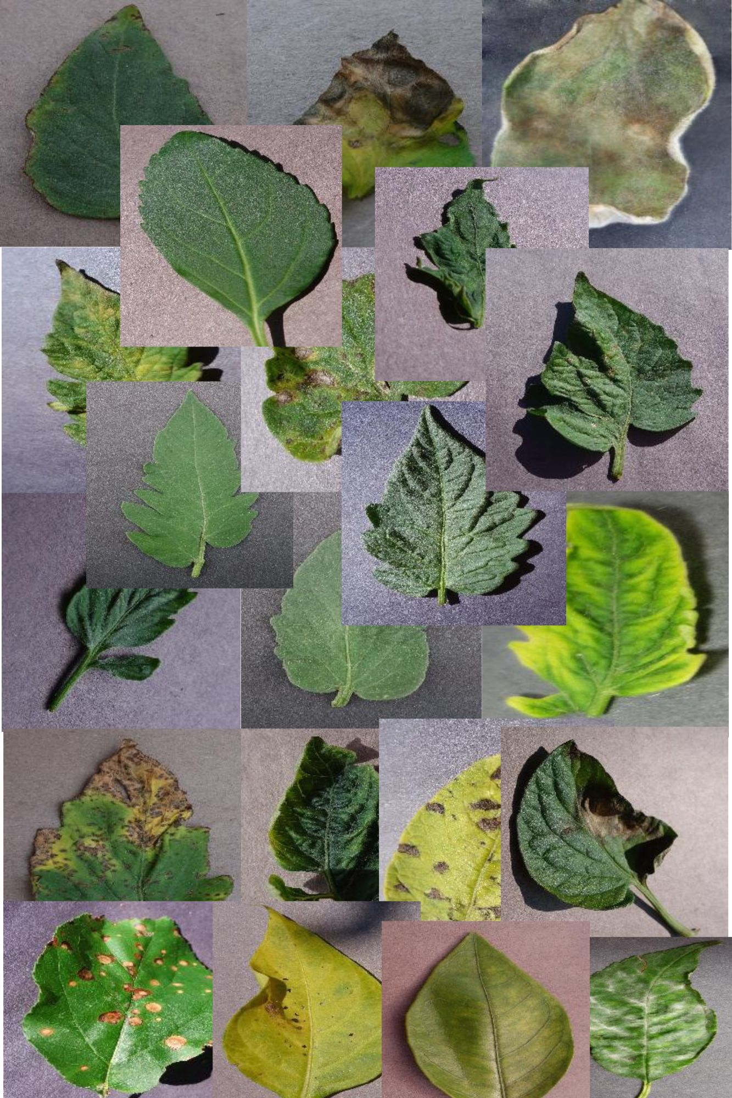
Plant Doctors
Team Members:
Matthew Lopez
Mitchell Fairgrieve
Austin Rothe
Steven Carrasquillo

Slide 2
Agenda
Problem
Solution Proposal
Research
Process
Results

Slide 3
The Problem
Every year more and more people are getting into plants and gardening as a hobby.
Additionally, a study found that 42% of Americans have started growing their own produce recently, reflecting a broader trend towards self-sufficiency in response to rising food costs and concerns about food security​ (Study Finds)​.
However not everyone has a green thumb, has all the knowledge needed to maintain healthy plants nor know how to identify and treat diseases that could be affecting their plants.

Slide 4
Our Solution
Develop a website using a machine learning algorithm where users can submit photos and can be provided an identified illness and course for treatment with 90% accuracy.
Start with more common plants and illnesses.

Slide 5
Research
We found on Kaggle a dataset with 87K images of 38 different plants and diseases
new-plant-diseases-dataset
What libraries we used, why:
Tensorflow –platform for machine learning
Keras_Tuner – hyperparameter search
PIL (Pillow) – python library for image processing
Flask – display interactive webpage

Slide 6
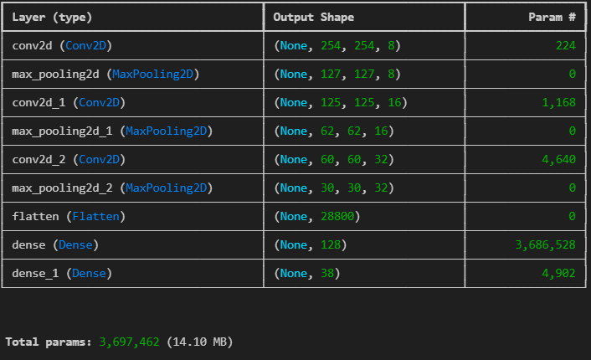
Process
Import files into training & validation directories.
Define model building function (create_model).
Instantiate the tuner.
Run the hyperparameter tuner search.
Using best model build (tuner.get_best_models), begin training model with training data & validation data.

Slide 7
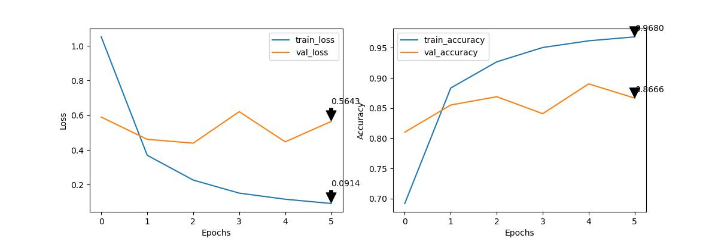
Process
Normalize pixel values (normalization layer)
Build and Train Model
View Accuracy vs Loss (accuracy: 0.9680)
Use Model to make Plant Disease Predictions!

Slide 8
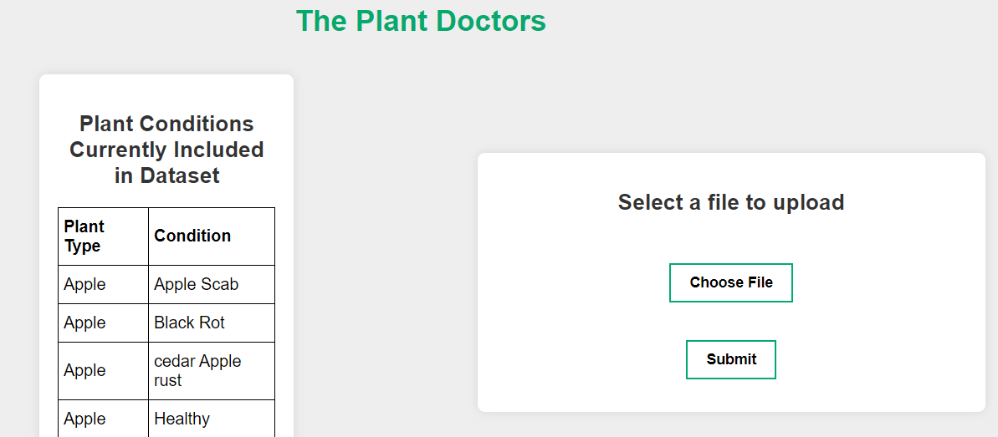
Results
Introduce web page and demo!

Slide 9
What’s Next (Theoretically)
Next phases for The Plant Doctors
Add function for approved users to submit images with known illnesses to increase training dataset.
Expand dataset to include more plants species and illnesses.
Add symptoms library for users to include additional data for more accurate prediction.

