Slide 1

Book Recommendation with Self-Supervised Learning
TSM MachLeData – Spring 2026
Book Club: Christoph Walser, Kaloyan Georgiev, Jeanot Zubler, Sven Leutenegger

Slide 2


Motivation & Goal
2-4 Million books published each year
To find the gems in this sea of books is very hard
Our Goal: Create a highly personalized, data-driven book recommendation system using self-supervised learning.

Slide 3

Achieving good Recommendations
Use dataset from https://github.com/zygmuntz/goodbooks-10k
10000 books most popular books on goodreads.com
~6 Million ratings by 50000 users
Books marked as «to be read» by users
Generate labels by excluding some of the ratings for each user

Slide 4
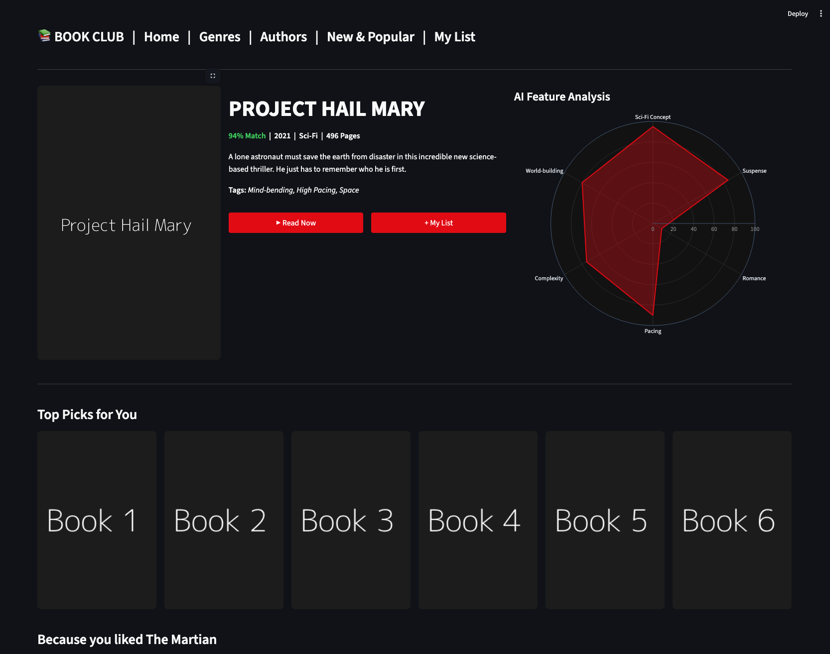
Mockup

Slide 5










Technologies
Task | Tools
Versioning (data, model & code)
Containerization
Experiment tracking & tuning
Training
CI/CD & testing
Deployment

Slide 6
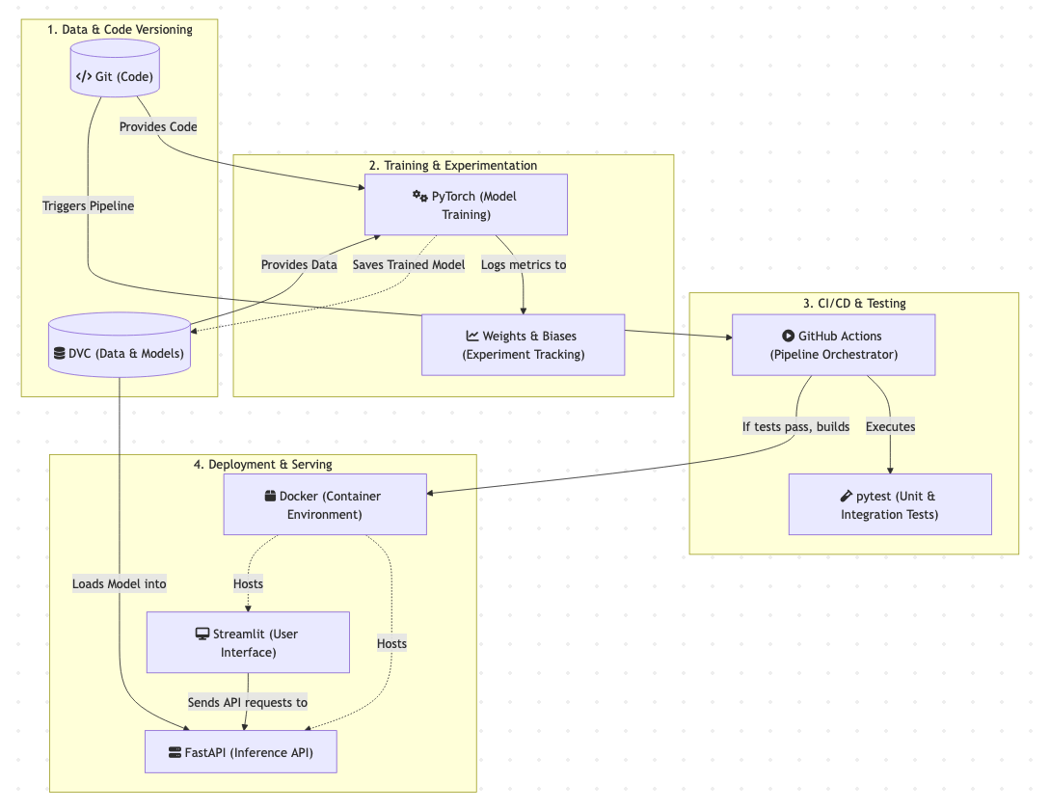
System Architecture

Slide 7
Versioning
Code versioning in git
Data and model versioning & validation in DVC
DVC allows fast data and ML model access through built-in data caching
Allows reproducibility
Allows collaboration and parallel feature development

Slide 8
Training
Training and inference with PyTorch
Track and visualize experiments with Weights & Biases
Hyperparameter tuning with W&B

Slide 9
Testing
Test different stages of ML system
Infrastructure tests for training
Training tests for data storage and training infrastructure
Functionality tests for prediction
…
Automatically run tests in CI/CD pipeline
Detect problems and regressions

Slide 10
Deployment
Dockerized deployment for reproducibility and flexibility
Use FastAPI to provide REST endpoints for model access
Use Streamlit for a clean and simple UI

