Slide 1

MLOps
Movie Recommendation System
ML & AI in Production • Fall 2025 • FAU
Dan Zimmerman
Arvin Nourian
Lakshmi Latchireddi
Krushal Kalkani
PM/Delivery
Data Lead
ML Lead
DevOps Lead

Slide 2
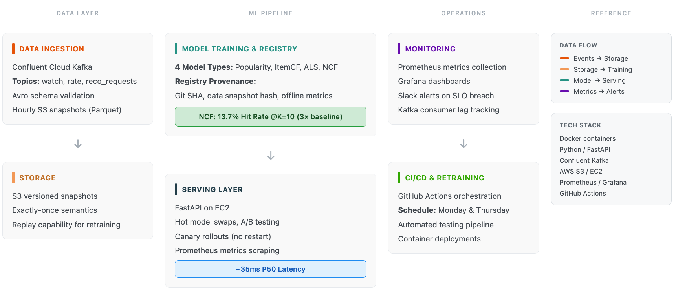
System Architecture

Slide 3
CI/CD and Monitoring
GITHUB ACTIONS WORKFLOWS
GRAFANA SLO DASHBOARD
ci.yml - PASS
cd.yml - PASS
100%
24ms
probes.yml - PASS
Test coverage: 81% (target: 70%)
Availability (72h)
P95 Latency
DEPLOYMENT TARGET
0%
5
Multi-stage Docker images on Render
Error Rate
Model Updates (7d)
2 tasks for HA
Image: 450MB optimized
Drift Metrics: PSI(user)=0.005, PSI(item)=0.076 - both under 0.25 threshold

Slide 4
Fairness and Feedback Loops
FAIRNESS METRICS
PROPOSED MITIGATIONS
Exposure Gini
0.213
Diversity re-ranking: Inject tail items into top-K
Threshold: 0.35 or less
PASS
Exposure constraints: Cap max recs per item
Catalog Coverage
37.2%
Monitoring: Track Gini drift over time
Target: 40% or more
NEAR
ANALYSIS METHOD
Analyzed 10K+ recommendations from Kafka logs
FEEDBACK LOOP DETECTED
Computed Lorenz curve for exposure distribution
Popularity Echo Chamber
Stratified items into popularity tiers
Popular items receive disproportionate exposure
Measured amplification ratio per tier
5.7x
Amplification for top-tier items

Slide 5
Security and Provenance
THREAT MODEL
MITIGATIONS
Kafka: Unauthorized access, message injection
SASL/SSL authentication for Kafka
API: DoS attacks, injection, unauthorized access
Avro schema validation (reject malformed)
Registry: Model poisoning, unauthorized promotion
GitHub Secrets for credentials
Trivy container scanning in CI
Approval gates for model promotion
MODEL ATTACK: RATING SPAM
Malicious users flood system with fake ratings
FULL PROVENANCE TRACKING
Detected: 2 spam accounts
Users 8888, 9999 (mean + 3 sigma threshold)
request_id: 7ea6a783...
model_version: v_ncf
git_sha: ab9511e7...
data_snapshot: m1m_20231115
latency_ms: 6
Every prediction traceable to exact code + data

Slide 6



Key Achievements
100%
MILESTONES COMPLETED
M1: Architecture - DONE
Availability (72h window)
M2: Kafka + Baselines - DONE
M3: Eval + CI/CD - DONE
M4: Monitoring + A/B - DONE
M5: Fairness + Security - DONE
24ms
PRODUCTION FEATURES
P95 Latency (target: 100ms)
Real-time Kafka streaming
4 trained ML models
Automated retraining
A/B testing framework
81%
Hot-swap model switching
Full provenance tracking
Test Coverage (target: 70%)
Drift detection (PSI/KL)
Grafana dashboards
Fairness analysis
Security threat model

Slide 7
Thank You
Questions?
github.com/mlops-group-proj/movie-recs
API: http://ec2-54-221-101-86.compute-1.amazonaws.com:8080/docs
Dan Zimmerman
Arvin Nourian
Lakshmi Latchireddi
Krushal Kalkani
dzimmerman2021@fau.edu
anourian2024@fau.edu
llatchireddi2022@fau.edu
kkalkani2024@fau.edu

