Slide 1










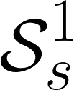


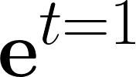
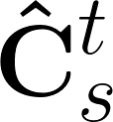




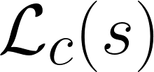
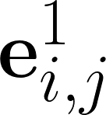

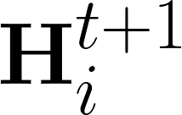






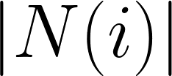

a
b
hidden states
input data
model output (subject-level)
final output (population)
message passing
view 1
view 2
hidden state embeddings initialization
rep
abs
...
view v
T
cell 1
cell 2
cell t
sum
learnable mapping
predefined mapping
replication
absolute difference
average along z axis
...
...
...
normalized subjects at time 1 (baseline)
subject-specific CBT at time t
rep
view normalizer
abs
time
avg
diff
1st discrete difference along z axis (a[x+1] – a[x])
sum of all
sum along y axis
median along z axis
e
d
c
trained ReMI-Net*
subjects at time 1
-
linear
total
...
frob
cat
sum
forecasted subject-specific CBTs
k random subjects at time t
+
med
...
cat
concatenation
total frobenius distance
transpose
elementwise subtraction
elementwise addition
loss function
avg
frob
diff
total
RNN cell
T
med
med
messages from neighbors to node $i$
-
forecasted population CBTs
linear
...
+
...

