Slide 1
Dataset Splits 5-fold Cross Validation
4/10
1/10
1/2
Training (258 reports)
Validation (64 reports)
Testing (323 reports)

Slide 3
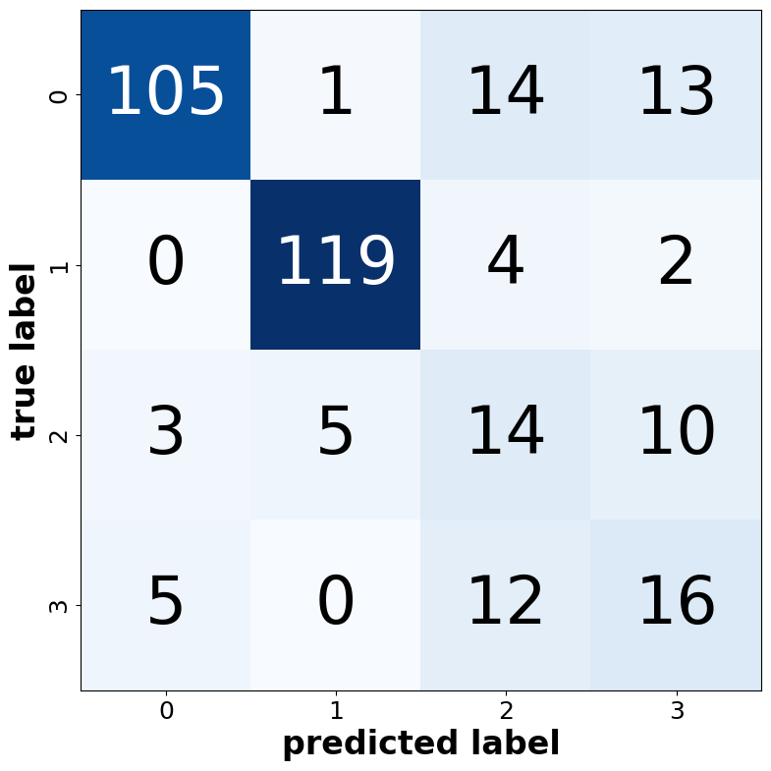
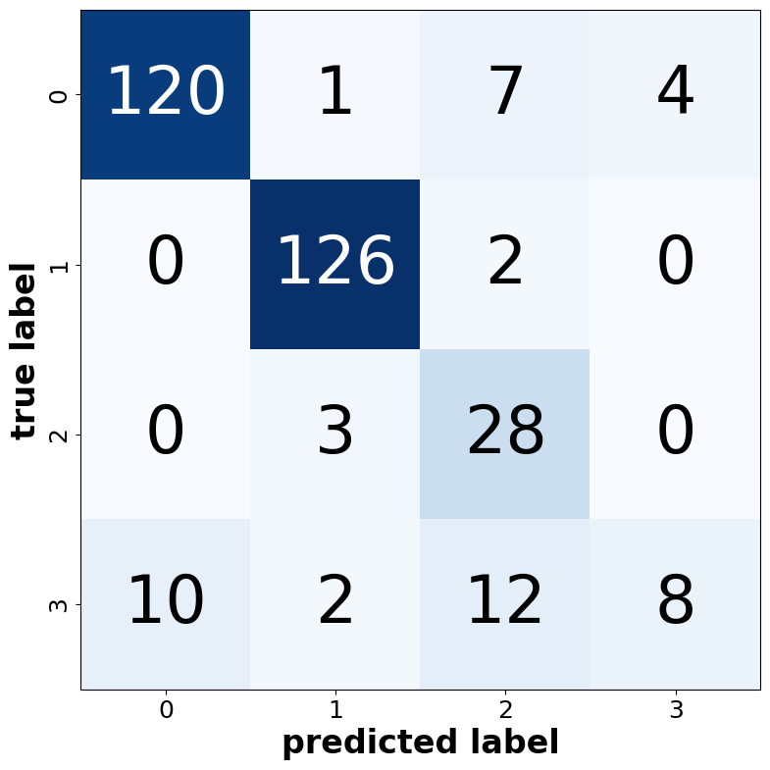
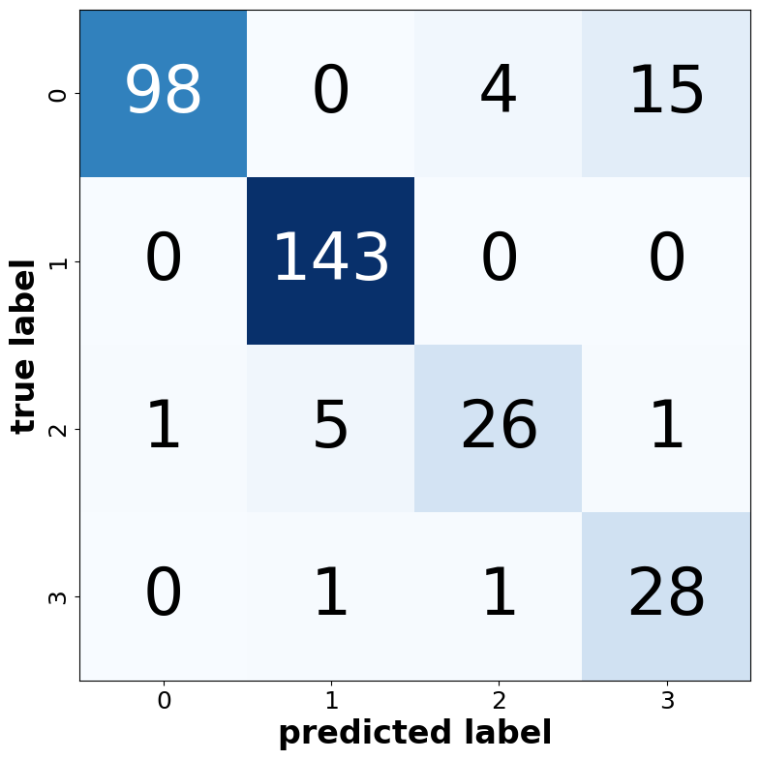
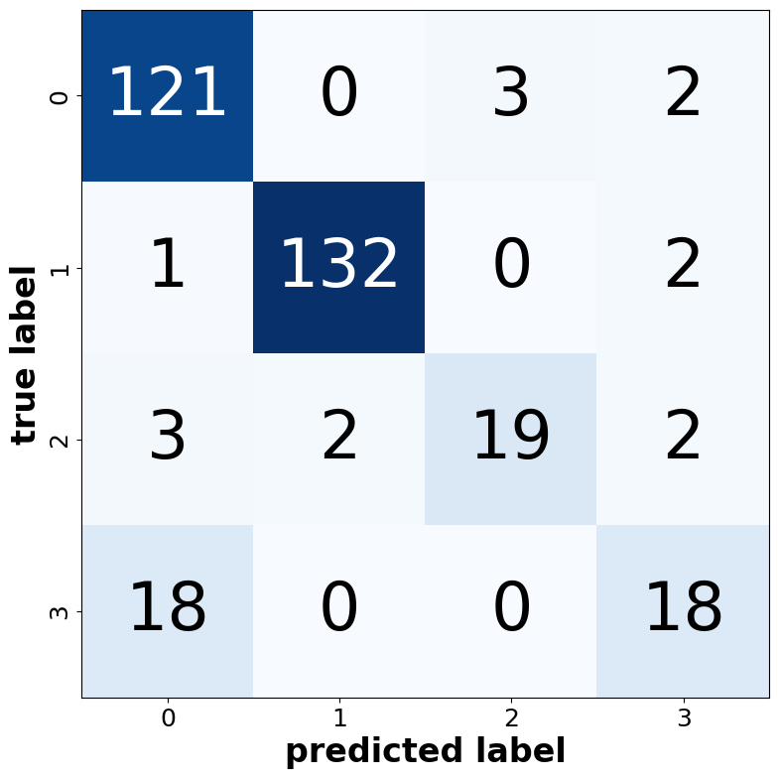
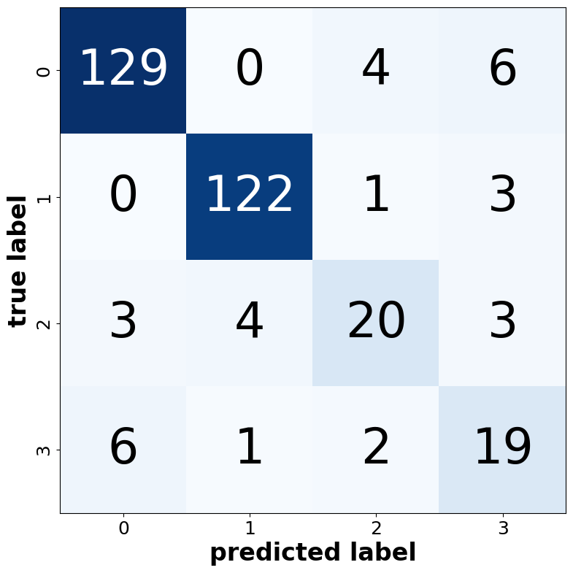
0: Emergency
1: Normal
2: Non-Emergency No-Doctor
3: Non-Emergency Doctor

Slide 4
How would/should model behave on excluded cases?
REPORT DATE: 22/09/2022 FILM NO:***\n\nBrain CT\n\nThe base of the skull and calvarial bone structures are within normal limits.\n\nThe fourth…
REPORT DATE: 08/06/2022 EXAMINATION NO: 12626826 CRANIAL CT In the operated patient, a defect is observed in the left occipital bone, as well…
input text
trained model
trained model
0 | 1 | 2 | 3
classes
0 | 1 | 2 | 3
0.1 | 0.2 | 3.5 | 0.5
output logits
0.9 | 0.2 | 0.5 | 0.5
Non-Emergency No-Doctor
0: Emergency
1: Normal
2: Non-Emergency No-Doctor
3: Non-Emergency Doctor
not enough confidence !

Slide 5
With more data

Slide 6
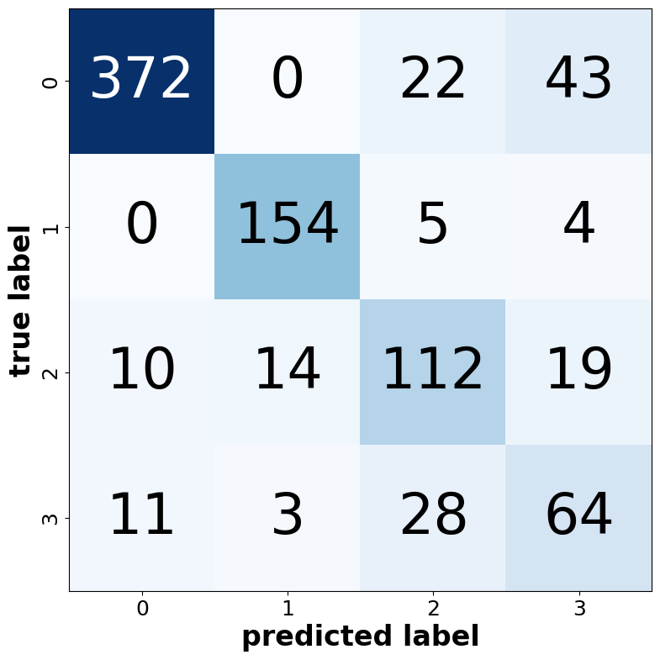
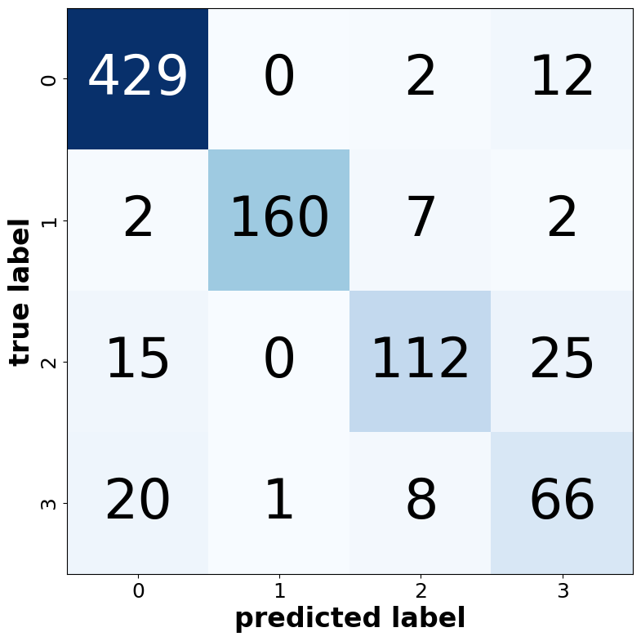
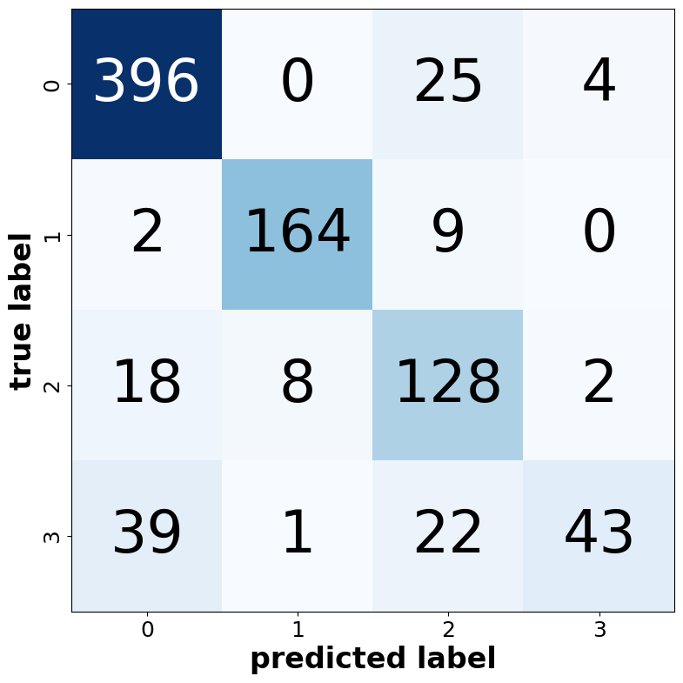

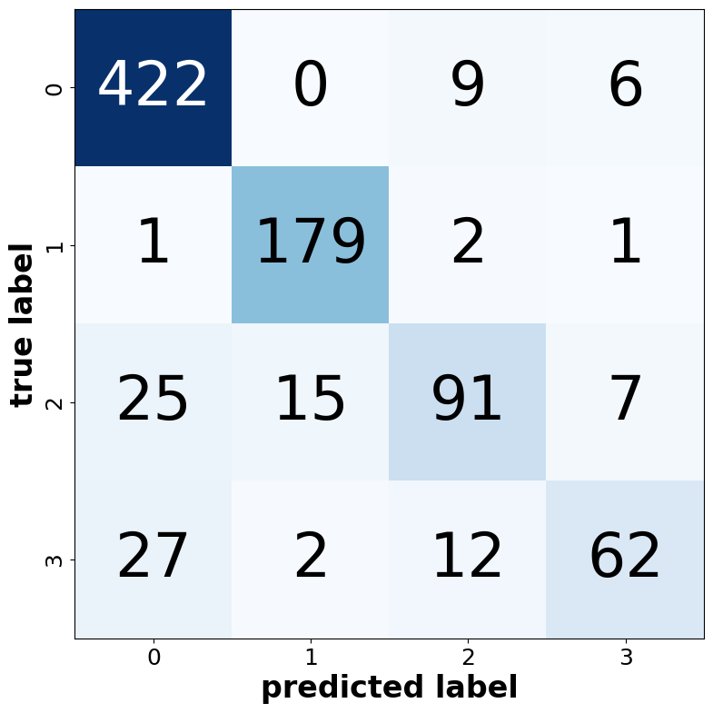
0: Emergency
1: Normal
2: Non-Emergency No-Doctor
3: Non-Emergency Doctor

