Slide 1


Infoblox Intelligent CIDR Allocation
Self-service, alignment-aware subnet allocation, delivered through Red Hat Ansible Automation Platform.
Turn "give me a /22 from 10.217.0.0/16" into one click — and one Infoblox API call.

Slide 2

The Problem with Manual CIDR Allocation
⚠️ Error-Prone by Design
Engineers hand-pick subnets from spreadsheets or eyeball IPAM — risking overlapping and misaligned blocks that cause outages and painful renumbering.
🐌 Slow Ticket Queues
Every request becomes a network team ticket. Lead times stretch from minutes to days, blocking developer and platform teams.
🚫 No Self-Service
A deterministic, rules-based task requires human intervention. There's no automation path for a predictable, repeatable process.

Slide 3




The Solution at a Glance
A one-form, self-service request that returns the next valid subnet and reserves it automatically.
Launch
Compute
Reserve
Operator launches the "Allocate Infoblox CIDR" AAP job template and fills a short survey
Solution queries Infoblox for existing allocations and computes the next aligned, non-overlapping block
Reserves the result via a single Infoblox API call — supports both NIOS Grid and Universal DDI
Built for Ansible Automation Platform — governance, RBAC, audit logging, and encrypted secret storage included.

Slide 4
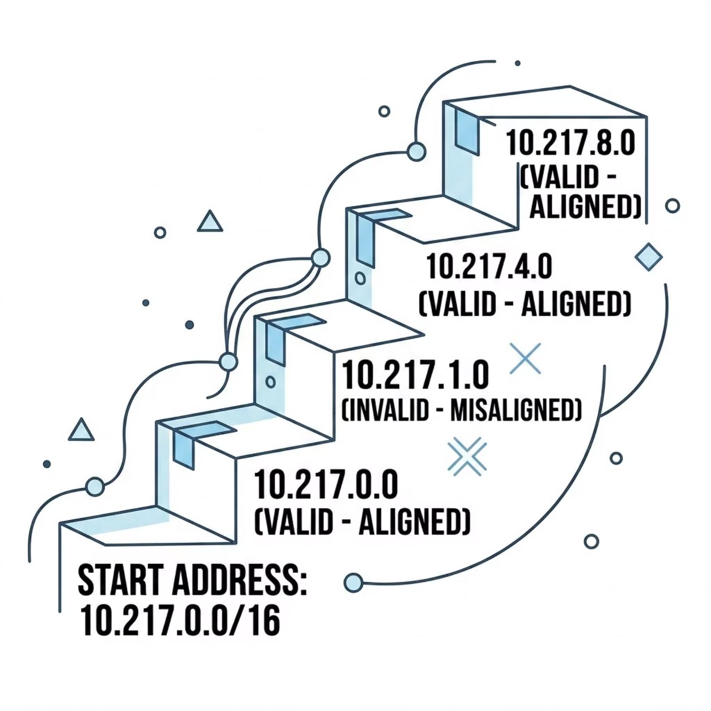


CORE CONCEPT
Why "Alignment-Aware" Matters
A subnet must start on an address evenly divisible by its block size. This is not optional — it is enforced by routers and IPAM systems alike.
Requesting a /22 (1,024 addresses) inside 10.217.0.0/16 means valid answers are only: 10.217.0.0, 10.217.4.0, 10.217.8.0 — never 10.217.1.0.
Misaligned subnets are rejected by routers. Humans get this wrong under time pressure. The algorithm never does.

Slide 5
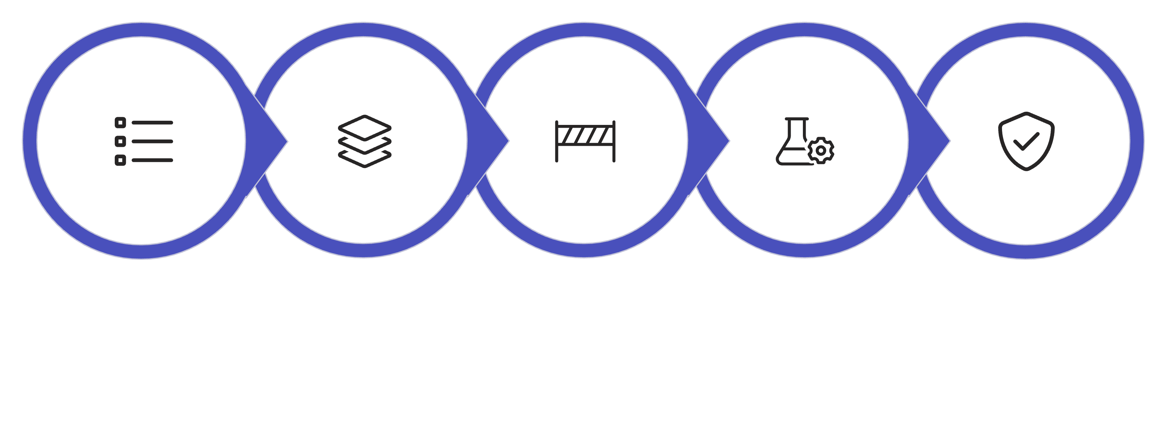
ALGORITHM
The Allocation Algorithm — 5 Deterministic Steps
Generate candidates
Remove overlaps
Reserve in Infoblox
List children
Apply policy
The selection logic lives in a single, unit-tested Python filter plugin — cidr_allocation.py — making the algorithm portable, testable, and platform-agnostic.

Slide 6


Dual-Platform Support & Automatic Dispatch
One solution. Two Infoblox backends. Selected automatically by the credential attached to the job.
On-Prem: NIOS Grid
Cloud: Universal DDI
Uses the certified infoblox.nios_modules collection. Credential injects infoblox_platform = nios, dynamically including discover_nios.yml and reserve_nios.yml.
Uses the certified infoblox.universal_ddi collection. Credential injects infoblox_platform = universal_ddi — the right backend runs with no extra prompts.
The allocation math is identical for both platforms. No extra operator input required — just attach the correct credential type.

Slide 7
SELF-SERVICE
The Survey: One Short Form
No Ansible knowledge required. The operator fills a version-controlled survey attached to the job template.
1
cidr_parent
Parent container — e.g. 10.217.0.0/16
2
cidr_prefix
Desired prefix length — e.g. 22 (must be more specific than parent)
3
cidr_allocation_policy
first-fit (lowest slot) or last-fit (highest slot)
4
cidr_dry_run
Compute and display the result without reserving — safe preview mode
5
cidr_comment
Free-text justification recorded on the new Infoblox object
Platform-specific extras: NIOS adds cidr_network_view; Universal DDI adds cidr_ip_space and cidr_object_type.

Slide 8
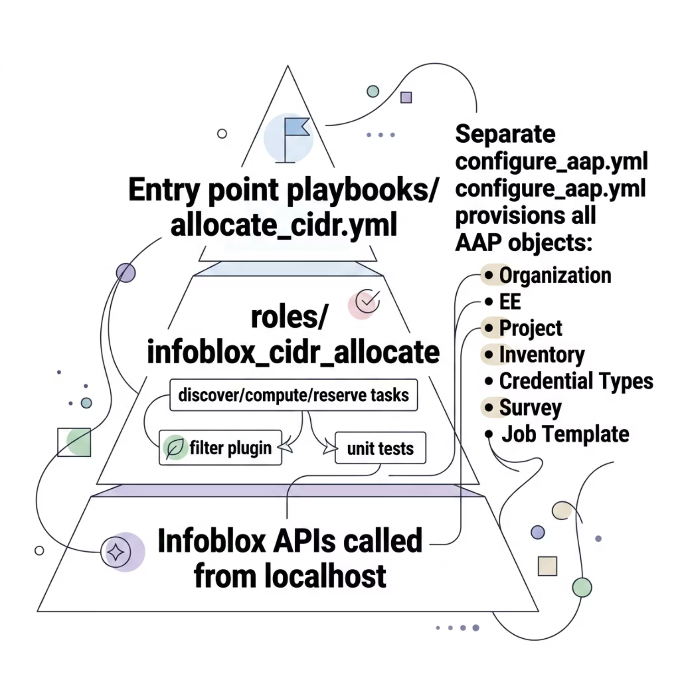


Architecture & Config-as-Code
Clean Separation of Concerns
allocate_cidr.yml is the job-template entry point. The role drives all Infoblox API calls from localhost — no managed nodes required.
One Idempotent Setup Playbook
configure_aap.yml provisions every AAP object automatically. New adopters only edit simple group_vars (EE image path and Git URL). No UI clicking required.
Re-runnable and idempotent — safe to execute multiple times without side effects.

Slide 9


Security & Certified Content
Secrets Stay in AAP
Certified Collections Only
Custom credential types map host, username, password, and API key to environment variables at runtime. Secret values are encrypted in AAP's credential store — never in Git.
Built on Red Hat certified infoblox.nios_modules and infoblox.universal_ddi — not unverified community content.
Tested & Auditable
The alignment algorithm is covered by pytest unit tests. Dry-run mode safely previews any allocation before it is committed to Infoblox.

Slide 10
GETTING STARTED
Three Steps to Self-Service CIDR Allocation
Launch & Allocate
Provision & Configure
Open "Allocate Infoblox CIDR," fill the survey, and receive an aligned, reserved subnet in seconds — every time.
Install & Build
Run configure_aap.yml to provision all AAP objects automatically, then set real Infoblox credentials once in the UI.
Install the certified Infoblox collections and build/push the Execution Environment image to your registry.
From spreadsheet guesswork to deterministic self-service — powered by Ansible Automation Platform.

