Slide 1
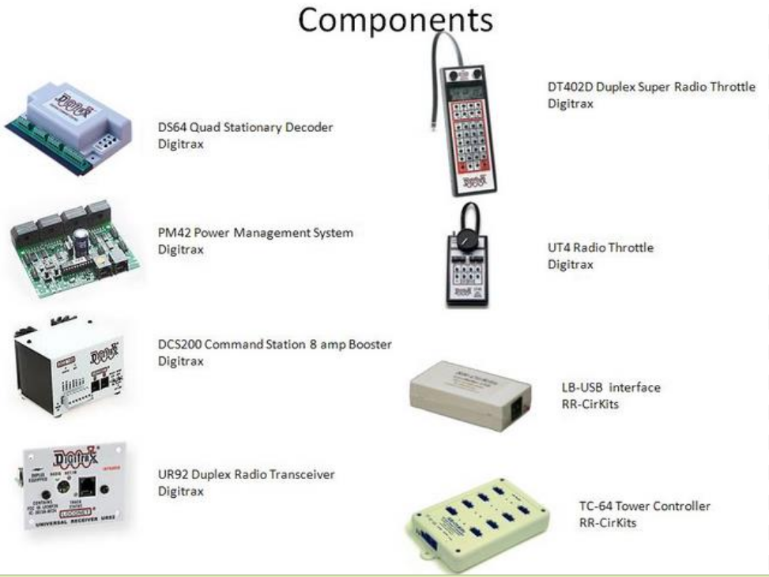

Slide 2
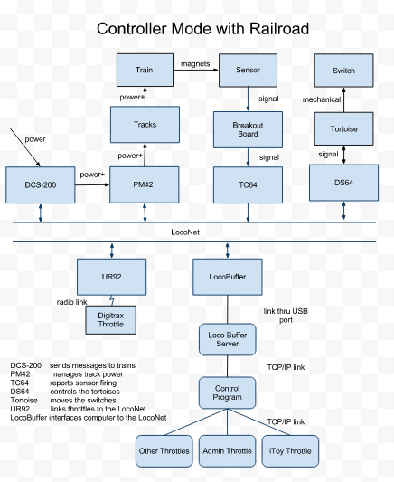

Slide 3
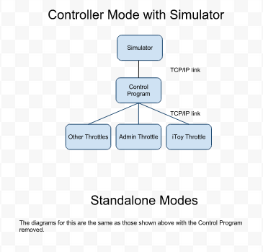

Slide 4
Controller Behavior
Condition | Action
Train: decouples and gets too long | Release reservation and error stop train
Train: tries to reserve a disconnected section | Pause the train and don’t allow the train to reserve the section.
Train: tries to get too close to another train | Pause the train until condition changes (with or without operator intervention)
Switch: operator tries to move a switch in an occupied section | Supress request
Switch: operator tries to move a switch in a reserved section | Pause train, remove reservation, perform action
Register train: operator specifies sections that aren’t free or don’t line up or are in wrong order or are disconnected | Refuse to register the train
Sensor fires: number not recognized | Ignore it
Sensor fires: not close to any train | Release all reservation and error stop all trains
Sensor at front of a train: closes | Ignore
Sensor at front of a train: opens | Tell train (see state diagram)
Sensor at next to back of train: closes | Tell train (see state diagram)
Sensor at next to back of train: opens | Ignore
Sensors fires anything else | Try to compensate for the error else error stop one or more trains.
Error stop train: clear by re-registering the train
Section disconnected: the section is unuseable until one or mores switches are moved
Sensors close when magnet approaches and open when magnet departs. Each transition should place two signals on the Loconet (one hi, one lo); HOWEVER, one or both signals can be lost.

Slide 5
Server side socket
Client side socket
DFD for Standalone Mode
39DLL
Sim Throttle
Our
Throttle
Simulator
Our
Throttle
Digitrax
Throttle
Digitrax
Throttle
Read Loco Byte Task
UR92
Our
Throttle
LocoNet
LocoBuffer
cLocoIO
Our
Throttle
Write Loco String Task
Railroad
Socket List
Sim Throttle
Tasks that listen for TCP/IP connection requests need to publize the port number in some way.
Listen for Client Task

Slide 6
DFD for Controller Mode
with Railroad
Controller
Listen for Throttles Tasks
Connect To Railroad Task
Our
Throttle
Our
Throttle
Socket List
Sim Throttle
Receive
Message
Task
CQM
Digitrax
Throttle
Digitrax
Throttle
Send
Message
Task
Read Loco Byte Task
Out Queue
UR92
LocoNet
LocoBuffer
Write Loco String Task
Railroad
Socket List
XML File
Listen for Client Task

Slide 7
DFD in Controller Mode
with Simulator
Controller
Listen for Throttles Tasks
Connect To Railroad Task
Our
Throttle
Our
Throttle
Socket List
Sim Throttle
Receive
Message
Task
CQM
Send
Message
Task
Out Queue
Simulator
XML File

Slide 8
DFD for Inside Controller
Message Translation Library
CQM
Queues
Listen for Throttles Tasks
Connect To Railroad Task
File Library
Socket List
Layout
Task
Receive
Message
Task
Command
Queue
Manager
Layout Manager
Send
Message
Task
Train
Task
XML File
Slot Lookup Table
SSI
Task
Train
Task
Train
Task
SSI = Select/Steal/Initialize
SSI instantiates train tasks
A task that get messages from the CQM must register with the CQM so that the CMQ can create an out queue for the task and give the task a pointer to this out queue

Slide 9
Packages
List Generic²
+put
+get
+next
CQM³
+put
+get
+pairTrainWithQueue
Message IO
ListenForThrottleTask
ConnectToRailroadTask
SendMessageTask
ReceiveMessageTask
TrainIdQueueList⁴
cLocoIO
Out Queue
SSI Queue
Train Queues
Layout Queue
39DLL
Loco Buffer IO
ListenForClientTask
ReadLocoByteTask
WriteLocoStringTask
Socket List
SlotLookupTable
Layout Manager
Message Translation Library
Layout Task
Globals¹
File Library
Train Task
Controller.adb
This consists primarily of type declarations that are needed in numerous other packages. This is also a good place to define constants.
Lists are needed in various places throughout the system, including as queues.
This package has two public functions and several queue protected type objects. Pointers to these queues must be passed to the tasks which get items from the queues.
This is a list that pairs a train id with a pointer to the corresponding train queue.
SSI Task
Some Throttle

Slide 10
Visibility and Startup
Instantiate train tasks and train queues dynamically. A train task communicate with its train queues via a pointer.
Instantiate all other tasks and protected types statically, for instance, in Controller.adb.
Protected types need to be visible to the tasks that use them. Pointers are not needed for tasks and queues which are created statically.
The CQM keeps a table that associates train ids with pointers to the corresponding train queues in the TrainIdQueueList.
OThrottles can be started at any time.
Instantiate The LocoBuffer IO tasks statically.

Slide 11
LocoBufferIO Package
MessageIO Package
Read
ReadLocoByte Task
SendMessage
ReceiveMessage
ReceiveMessage Task
Put
CQM
LocoBuffer
cLocoIO
functions
Write
WriteLocoString Task
ReceiveMessage
SendMessage
SendMessage Task
Get
Out Queue
LocoNet
39DLL
functions

Slide 12
Administrator Throttle
See the document AdminThrottle.pptx

Slide 13
A Look at Messages as They Enter and Leave Controller
Send
Message
Task
Receive
Message
Task
OutQueue
iTrainQueue
LayoutQueue
SSIQueue
CQM
1
message
2
put(message)
3
put(message)
4
get(message)
5
message
ReceiveMessageTask receives a message from one of the sockets. If the message is one that refers to a slot#, then RMT looks in the slot lookup for a matching virtual slot#. If it finds none, it discards the message else it replaces the slot# with the corresponding train id and does a put operation against the CQM.
CQM places the message in the correct queue.
CQM places the message in the correct queue
SendMessageTask gets a message.
For messages that are based on a slot number, SendMessageTask uses the slot lookup table to replace a train id with a corresponding physical slot#. SMT also decides who should receive the message. Some messages are sent only to the railroad socket while others are sent only to all the Othrottles. Compute the check sum here.
Subsequent diagrams of this sort
Start with a message already in the correct input queue
Don’t show messages leaving the OutQueue
Don’t show the put function calls needed to pass messages to the CQM or the get function calls needed to remove messages from a queue.
Function calls to the LayoutManager and other protected types will be named explicitly.

Slide 14
Message Involved in
Selecting, Stealing, and Initialization of a Loco
ReceiveMessageTask and SendMessageTask make no changes to these instructions.
When Incoming | From Railroad Slot | From Othrottle Slots
OPC_LOCO_ADR | Discard | Put in SSIQueue
OPC_SL_RD_DATA | Put in SSIQueue | Shouldn’t happen
OPC_MOVE_SLOTS | Discard | Discard
OPC_LONG_ACK | Put in SSIQueue | Discard
doLocoInit | Shouldn’t happen | Put in SSIQueue
When Outgoing | To Railroad Slot | To Othrottle Slots
OPC_LOCO_ADR | Yes | No
OPC_SL_RD_DATA | No | Yes
OPC_MOVE_SLOTS | Yes | No
OPC_LONG_ACK | No | Yes
doInitOutcome | No | Yes

Slide 15
OPC_LOCO_SPD
OPC_LOCO_DIRF
OPC_LOCO_SND (mute)
Train
Task
Layout Manager
iTrainQueue
OutQueue
CQM
OPC_...
1
releaseReservation makeReservation
changeDirectionTo
2
3
putSectionState
4
msgTryToMoveAgain
Later ….
5
OPC_...
6
putTrainState
TrainTask gets message from queue
TrainTask analyzes message and might ask LayoutManager to release a reservation or make a reservation
LayoutManager might send putSectionState (received by all Othrottles)
LayoutManager might send msgTryToMoveAgain. (received by all train queues)
The TrainTask might send one or more of the following messages: SPD, DIRF, SND (received by the railroad socket)
TrainTask might inform the world that its state has change (received by all Othrottles)

Slide 16
OPC_LOCO_SND (throw/close next switch)
Handling a sequence of switch requests will be added here later.
iTrainQueue
OutQueue
LayoutQueue
Train
Task
Layout Manager
CQM
OPC_...
1
2
moveNextSwitch(trainid), direction)
3
OPC_SW_REQ
Later…
The train task will NOT change state.
TrainTask gets message from queue
TrainTask asks LayoutManager to move the next switch in the indicated direction
LayoutManager creates an OPC_SW_REQ message if no safety rules are violated (received by the railroad)

Slide 17
OPC_INPUT_REP
(sensor fired)
iTrainQueue
OutQueue
LayoutQueue
Layout
Task
Layout Manager
CQM
OPC_...
1
2
identifyTrain
3
msgFrontSensorFired
msgBackSensorFired
Later …
4
msgSensorError
Later …
5
putSensorState
putTrainPosition
putSectionState
LayoutTask gets the message
LayoutTask tells the LayoutManager to identify which train set off the sensor
LayoutManager decides that it’s the front or back of some train (received by only the train involved)
LayoutManager decides that there is an error (received by all train queues)
LayoutManager informs the world that a sensor has changed state and/or a train has changed position and/or a section has changed state (received by all Othrottles)

Slide 18
msgFrontSensorFired
msgBackSensorFired
msgSensorError
iTrainQueue
OutQueue
LayoutQueue
Train
Task
Layout Manager
CQM
msgFrontSensorFired
msgBackSensorFired
msgSensorError
1
makeReservation
releaseReservation
2
3
putSectionState
4
msgTryToMoveAgain
Later…
5
OPC_LOCO_SPD
putTrainState
TrainTask gets message
TrainTask analyzes message and tells the LayoutManager to release or make a reservation
LayoutManager informs the world that a section has changed state (received by all Othrottles)
LayoutManager might tell all trains to try to move again (received by all train queues)
TrainTask might indicates that its speed and state have changed (OPC_LOCO_SPD received by railroad socket and putTrainState received by all Othrottles)

Slide 19
OPC_SW_REQ
iTrainQueue
OutQueue
LayoutQueue
Layout
Task
Layout Manager
CQM
1
OPC_...
2
moveSwitch
3
msgLoseReservation
Later…
putSwitchState
putSectionState
OPC_SW_REQ
4
LayoutTask gets the message
LayoutTask tells the LayoutManager to move the switch
LayoutManager determines if it’s okay to move the switch. The outcome might involve ignoring the request or telling a train it has lost a reservation….. (received by one train)
LayoutManager might also tell the world that a switch is moving, tell the world that a section has changed state, and/or tell the railroad to move the switch. (OPC_SW_REW is received by the railroad socket and the other messages are received by all Othrottles)

Slide 20
OPC_SW_REP
iTrainQueue
OutQueue
LayoutQueue
Layout
Task
Layout Manager
CQM
1
OPC_...
2
switchDone
3
msgTryToMoveAgain
Later…
4
putSwitchState
LayoutTask gets the message
LayoutTask tells the LayoutManager
LayoutManager tells all trains to try to move again (received by all trains)
Layout Manager tells the world that a switch has changed state (received by all Othrottles)

Slide 21
getSwitchSuccessor
putSwitchSuccessor
iTrainQueue
OutQueue
LayoutQueue
SSIQueue
Train
Task
Layout
Task
SSI
Task
Layout Manager
CQM
??? Jared and Ben please figure this out. ???
………………………….

Slide 22
Stealing
OutQueue
SSIQueue
SSI
Task
Slot Lookup Table
CQM
1
OPC_LOCO_ADR
2
convertPhyAdrToVirtAdr
3
OPC_SL_RD_DATA
SSITask obtains the message which came from an Othrottle using a physical loco address else the SSITask quits processing the message. If the message is from a Dthrottle using a virtual loco address then everything is fine else there is an error that Controller ignores.
SSITask asks the slot lookup table to convert a physical address to a virtual address
SSITask responds with OPC_SL_RD_DATA (received by all Othrottles) If physical address found in table then Slot# = corresponding virtual slot# STAT = already registered else Slot# = 0 STAT = not yet registered end if

Slide 23
doLocoInit
OutQueue
SSIQueue
TrainIdQueueList
SSI
Task
Slot Lookup Table
Layout
Manager
CQM
1
doLocoInit
areTrainSensorsLegal(<count><sensor#>...<sensor#>)
2
3
putInitOutcomes
isPhyAdrInTable(phy adr)
4
5
putInitOutcomes
6
startNewEntery
7 create train queue and train task
8
pairTrainWithQueue
9
10
OPC_LOCO_ADR
OPC_LOCO_ADR
11
positionTrain(trainid, <count><sensor#>...<sensor#>)
OPC_SL_RD_DATA
OPC_LONG_ACK OPC_MOVE_SLOTS
Later…
SSITask receives doLocoInit from an Othrottle. The message format is <0x00><msg#><physical loco address><count><sensor#>...<sensor#>
SSITask asks the layout manager if the sensor#s are legal. The answer is yes if the sensors describe a sequence of contiguous sections.
If the sensor#s aren’t legal, the SSITask sends putInitOutcomes with first slot# = 121 and is done with the message (received by all Othrottles)
Else the SSITask continues processing by asking the slot lookup table if the physical address is already registered.
If the physical address is already registered, then the SSITask sends putInitOutcome with data from the lookup table and jumpts to step 9 (received by all Othrottles)
Else the SSITask starts a new enter in the lookkup table consisting of the physical loco address and a corresponding virtual address. Virtual addresses are assigned by the SSITask and are numbered 1, 2, 3, etc. These numbers shouldn’t conflict with the physical loco addresses. The train id is returned.
After creating a new enter in the lookup table, SSITask creates a new train queue, creates a new train task with the train id and a pointer to the queue.
SSITask also passes the train id and a pointer to the queue to the CQM for insertion in the TrainIdQueueList.
SSITask sends OPC_LOCO_ADR with the physical loco address (received by railroad socket)
SSITask sends OPC_LOC_ADR with the virtual loco address (received by railroad socket)
SSITask tells the layout manager the position of the train.
Now the SSITask must wait for responses from the DCS200

Slide 24
OPC_SL_RD_DATA, OPC_LONG_ACK, OPC_MOVE_SLOTS
OutQueue
SSIQueue
SSI
Task
Slot Lookup Table
Layout
Manager
CQM
1
OPC_MOVE_SLOTS
2
OPC_LONG_ACK
3
OPC_SL_RD_DATA
4
5
saveSlotNumber
OPC_MOVE_SLOTS
6
putInitOutcomeMessage
SSITask ignores OPC_MOVE_SLOTS because we aren’t a DCS200
SSITask ignores OPC_LONG_ACK. This shouldn’t happen, so we cross our fingers and ignore it.
SSITask examines the OPC_SL_RD_DATA message <0xE7><0E><slot#><status><adrlow><spd><dirf><trk><ss2><adrhigh><snd><id1><id2><chk>
SSITask tells the slot lookup table to pair <slot#> with <adrlow><adrhigh>. If the address is missing from the table, then the table returns an error code else it returns a copy of the line in the table containing the address. The address could be a physical or a virtual address.
If there was no error in step 4, SSITask sends a null move (both slot numbers the same) to the OutQueue (received by train socket). If there was an error, the SSITask ignores it and stop processing the message.
If there was no error in step 4 and if the line in the table now contains two slot numbers, then SSITask sends the putInitOutcomeMessage (received by all Othrottles). A the line in table contains two address and there won’t be two slot numbers until after both have been registered with the DCS200.

Slide 25
doReadLayout
OutQueue
LayoutQueue
Layout
Task
Layout Manager
CQM
1
doReadLayout
2
doReadLayout
3
doReadLayout
4
putReadLayoutResponse
5
OPC_SW_REQ
putSwitchState
An Othrottle gets the name of the XML file from the user and sends it to Controller
LayoutTask gets the message
LayoutTask tells the LayoutManager to read the XML file.
LayoutTask sends a response back (received by all Othrottles)
LayoutManager tells the railroad to move all the switches to the positions specified in the XML file (received by the railroad) and also tells the Othrottles the state of all the switches (received by all Othrottles)

Slide 26
msgLoseReservation
iTrainQueue
OutQueue
Train
Task
CQM
1
msgLoseReservation
2
OPC_LOC_SPD
3
putTrainState
You can probably work out the details from here.
Let me know if you have any questions.

Slide 27
msgTryToMoveAgain
iTrainQueue
OutQueue
Train
Task
Layout Manager
CQM
1
msgTryToMoveAgain
2
makeReservation
3
putSectionState
4
OPC_LOC_SPD
5
putTrainState
You can probably work out the details from here.
Let me know if you have any questions.

Slide 28
Missing Sequence Diagrams
doSaveState
doRestoreState

Slide 29
XML File Structure
97
98
99
97, 98, 99 are virtual sensors that mark the end of a siding
The XML file layout is shown on the slides that follow.

Slide 30
<railroad>
<section-list>
<section id="97"> <!-- dummy section at end of siding -->
<sensor id="97" />
<sensor id="24" />
</section>
<section id="98"> <!-- dummy section at end of siding -->
<sensor id="98" />
<sensor id="25" />
</section>
<section id="99"> <!-- dummy section at end of siding -->
<sensor id="99" />
<sensor id="26" />
</section>
<section id="1">
<sensor id="4" />
<sensor id="2" />
<switch id="1" />
<blocking id="2" />
</section>
<section id="2">
<sensor id="4" />
<sensor id="3" />
<switch id="1" />
<blocking id="1" />
</section>
<section id="3">
<sensor id="4" />
<sensor id="5" />
</section>

Slide 31
<section id="4">
<sensor id="5" />
<sensor id="16" />
<switch id="2" />
<blocking id="5" />
<blocking id="16" />
</section>
<section id="5">
<sensor id="5" />
<sensor id="6" />
<switch id="2" />
<blocking id="4" />
<blocking id="16" />
</section>
<section id="6">
<sensor id="6" />
<sensor id="7" />
</section>
<section id="7">
<sensor id="7" />
<sensor id="8" />
</section>
<section id="8">
<sensor id="8" />
<sensor id="9" />
<blocking id="18" />
</section>
<section id="9">
<sensor id="9" />
<sensor id="10" />
<blocking id="20" />
</section>

Slide 32
<section id="10">
<sensor id="10" />
<sensor id="11" />
</section>
<section id="11">
<sensor id="11" />
<sensor id="2" />
<switch id="5" />
<blocking id="12" />
</section>
<section id="12">
<sensor id="11" />
<sensor id="13" />
<switch id="5" />
<blocking id="11" />
<blocking id="13" />
</section>
<section id="13">
<sensor id="3" />
<sensor id="12" />
<blocking id="12" />
</section>
<section id="14">
<sensor id="13" />
<sensor id="14" />
</section>
<section id="15">
<sensor id="14" />
<sensor id="15" />
</section>

Slide 33
<section id="16">
<sensor id="16" />
<sensor id="15" />
<switch id="2" />
<blocking id="4" />
<blocking id="5" />
</section>
<section id="17">
<sensor id="16" />
<sensor id="17" />
</section>
<section id="18">
<sensor id="17" />
<sensor id="18" />
<blocking id="8" />
</section>
<section id="19">
<sensor id="18" />
<sensor id="19" />
</section>
<section id="20">
<sensor id="19" />
<sensor id="20" />
<blocking id="9" />
<blocking id="24" />
</section>
<section id="21">
<sensor id="20" />
<sensor id="21" />
</section>

Slide 34
<section id="22">
<sensor id="12" />
<sensor id="21" />
<switch id="4" />
<blocking id="23" />
</section>
<section id="23">
<sensor id="12" />
<sensor id="22" />
<switch id="4" />
<blocking id="22" />
</section>
<section id="24">
<sensor id="22" />
<sensor id="23" />
<blocking id="20" />
</section>
<section id="25">
<sensor id="23" />
<sensor id="24" />
<switch id="6" />
<blocking id="26" />
<blocking id="27" />
</section>
<section id="26">
<sensor id="23" />
<sensor id="25" />
<switch id="6" />
<switch id="7" />
<blocking id="25" />
<blocking id="27" />
</section>

Slide 35
<section id="27">
<sensor id="23" />
<sensor id="26" />
<switch id="6" />
<switch id="7" />
<blocking id="25" />
<blocking id="26" />
</section>
</section-list>
<switch-list>
<switch id = "1" state=“read"> <!–- controller will read actual value from -->
<!–- railroad at run time -->
<narrow-end id = "4" />
<closed-end id = "2" />
<thrown-end id = "3" />
</switch>
<switch id = "2" type = "crossover" state="closed">
<narrow-end id = "5" />
<narrow-end id = "16" />
<closed-end id = "6" />
<closed-end id = "15" />
</switch>
<switch id = "4" state="thrown"> <!–- controller will set switch to this value -->
<!–- at run time -->
<narrow-end id = "12" />
<closed-end id = "22" />
<thrown-end id = "21" />
</switch>
<switch id = "5" state="thrown">
<narrow-end id = "11" />
<closed-end id = "2" />
<thrown-end id = "13" />
</switch>

Slide 36
<switch id = "6" state="closed">
<narrow-end id = "23" />
<closed-end id = "25" /> <!-- Not a mistake -->
<closed-end id = "26" />
<thrown-end id = "24" />
</switch>
<switch id = "7" state="closed">
<narrow-end id = "23" />
<closed-end id = "26" />
<thrown-end id = "25" />
</switch>
</switch-list>
</railroad>

Slide 37
Train state diagram for event (all events)
For all states enter/send putTrainState
Begin Change Direction
enter/wait
Begin Wait
enter/wait
Wait
enter/release reservation
Move
enter/ send speed msg
exit/send speed 0 msg
Error
Begin Halt
enter/wait
Halt
enter/release reservation
Notes:
02

Slide 38
Train state diagram for event (SPD speed 0)
If this is not a change then do nothing else remember the new speed and continue
Begin Change Direction
enter/wait
Begin Wait
enter/wait
Wait
enter/release reservation
Move
enter/ send speed msg
exit/send speed 0 msg
Error
Begin Halt
enter/wait
[wait over]
Halt
enter/release reservation
Notes:
02

Slide 39
Train state diagram for event (SPD speed > 0)
Remember new speed and continue
Begin Change Direction
enter/wait
Begin Wait
enter/wait
/send speed msg
Wait
enter/release reservation
[else]
Move
enter/ send speed msg
exit/send speed 0 msg
[make reservation]
Error
Begin Halt
enter/wait
Halt
enter/release reservation
Notes:
02

Slide 40
Train state diagram for event (DIRF change direction)
If not a change in direction then do nothing else remember the new direction and continue
Begin Change Direction
enter/wait
Begin Wait
enter/wait
[wait over]
/tell LayoutManager new direction
/send direction msg
/tell LayoutManager new direction
/send direction msg
Wait
enter/release reservation
Move
enter/ send speed msg
exit/send speed 0 msg
[make reservation]
[else]
Error
/tell LayoutManager new direction
/send direction msg
Begin Halt
enter/wait
Halt
enter/release reservation
/tell LayoutManager new direction
/send direction msg
Notes:
02

Slide 41
Train state diagram for event (DIRF bell, light, bell, horn or SND mute)
If there is no change then do nothing else record new values and send the msg back out.
Begin Change Direction
enter/wait
Begin Wait
enter/wait
Wait
enter/release reservation
Move
enter/ send speed msg
exit/send speed 0 msg
Error
Begin Halt
enter/wait
Halt
enter/release reservation
Notes:
02

Slide 42
Train state diagram for event (msgFrontSensorFired)
occupy section
Begin Change Direction
enter/wait
Begin Wait
enter/wait
[wait over]
Wait
enter/release reservation
[else]
Move
enter/ send speed msg
exit/send speed 0 msg
[make reservation]
Error
Begin Halt
enter/wait
Halt
enter/release reservation

Slide 43
Train state diagram for event (msgBackSensorFired)
Release section
Begin Change Direction
enter/wait
Begin Wait
enter/wait
Wait
enter/release reservation
Move
enter/ send speed msg
exit/send speed 0 msg
Error
Begin Halt
enter/wait
Halt
enter/release reservation
Notes:
02

Slide 44
Train state diagram for event (msgSensorError)
Begin Change Direction
enter/wait
Begin Wait
enter/wait
Wait
enter/release reservation
Move
enter/ send speed msg
exit/send speed 0 msg
Error
enter/release reservation
Begin Halt
enter/wait
Halt
enter/release reservation
Notes:
02

Slide 45
Train state diagram for event (msgTryToMoveAgain)
Begin Change Direction
enter/wait
Begin Wait
enter/wait
Wait
enter/release reservation
Move
enter/ send speed msg
exit/send speed 0 msg
[make reservation]
[else]
Error
Begin Halt
enter/wait
Halt
enter/release reservation
Notes:
02

Slide 46
Train state diagram for event (msgLoseReservation)
Begin Change Direction
enter/wait
Begin Wait
enter/wait
[wait over]
Wait
enter/release reservation
Move
enter/ send speed msg
exit/send speed 0 msg
Error
Begin Halt
enter/wait
Halt
enter/release reservation
Notes:
02

Slide 47
Switch state diagram for event (throw next switch or close next switch)
For all states enter/putSwitchState
If switch Closed/Begin Close, then close swithch is a nop.
If switch Thrown/Begin Throw, then throw swithch is a nop.
Begin Close
enter/
send close message
[else]/
possibly tell a train it has lost a reservation
report closed
throw next switch
[in an occupied section or in a reserved section not owned by the requester]
close next switch
Closed
enter/send try again message
Thrown
enter/send try again message
throw next switch
[in an occupied section or in a reserved section not owned by the requester]
report thrown
close next switch
[else]/
possibly tell a train it has lost a reservation
Begin Throw
enter/
send throw message
Notes:
02

Slide 48
Switch state diagram for event (throw switch# or close switch#)
For all states enter/putSwitchState
If switch Closed/Begin Close, then close swithch is a nop.
If switch Thrown/Begin Throw, then throw swithch is a nop.
Begin Close
enter/
send close message
[else]/
possibly tell a train it has lost a reservation
report closed
throw switch#
[in an occupied section]
close switch#
Closed
enter/send try again message
Thrown
enter/send try again message
throw switch#
[in an occupied section]
report thrown
close switch#
[else]/
possibly tell a train it has lost a reservation
Begin Throw
enter/
send throw message
Notes:
02

Slide 49
Sensor state diagram
For all states enter/putSensorState
sensor fires
Open
Closed
sensor fires
Notes:
02

Slide 50
Section state diagram
For all states enter/putSectionState
A section’s blockCount is initially 0
Reserved
[no moving switches]
train’s front sensor opens
[else]
switch is thrown in section
train releases reservation
train makes reservation
Free
train’s back sensor closes
Occupied
a companion section is reserved/blockCount := 1
[blockCount= 0]
Blocked
a companion section is reserved/blockCount++
a companion section is freed/blockCount--
Notes:
02

Slide 51
New version of cLocoLib.c
See the attached notes below
Notes:
//Cody Baxter
//Spring 2011, CS 493
#include <stdio.h>
#include <windows.h>
#include <string.h>
#include <conio.h>
static HANDLE hSerial;
static BOOL portOpen = 0;
int StartSerialPort()
{
int fail = 0;
hSerial = CreateFile("COM3", GENERIC_READ | GENERIC_WRITE, 0, 0, OPEN_EXISTING, FILE_ATTRIBUTE_NORMAL, 0);
if (hSerial == INVALID_HANDLE_VALUE) //connection failed
return 0;
DCB dcbSerialParams = {0};
dcbSerialParams.DCBlength = sizeof(dcbSerialParams);
dcbSerialParams.BaudRate = CBR_57600;
dcbSerialParams.ByteSize = 8;
dcbSerialParams.StopBits = ONESTOPBIT;
dcbSerialParams.Parity = NOPARITY;
dcbSerialParams.fOutxCtsFlow = 0;
dcbSerialParams.fOutxDsrFlow = 0;
dcbSerialParams.fOutX = 0;
dcbSerialParams.fInX = 0;
dcbSerialParams.fRtsControl = RTS_CONTROL_ENABLE;
dcbSerialParams.fDtrControl = DTR_CONTROL_ENABLE;
fail = SetCommState (hSerial, &dcbSerialParams);
if (fail == 0) //SetCommState failed
return 0;
COMMTIMEOUTS timeouts = {0};
timeouts.ReadIntervalTimeout = 1; //was 50
timeouts.ReadTotalTimeoutConstant = 100; //was 50
timeouts.ReadTotalTimeoutMultiplier = 1000; //was 10
timeouts.WriteTotalTimeoutConstant = 0; //was 0
timeouts.WriteTotalTimeoutMultiplier = 0; //was 0
fail = SetCommTimeouts(hSerial, &timeouts);
if (fail == 0) //SetCommTimeouts failed
return 0;
//Connection made
portOpen = 1;
return 1;
}
unsigned __int8 ReadFromSerial()
{
DWORD bytesRead;
unsigned __int8 read;
BOOL readError;
readError = ReadFile(hSerial, &read, 1, &bytesRead, NULL);
return read;
}
void WriteToSerial(unsigned __int8 write)
{
DWORD bytesWrote;
BOOL writeError;
writeError = WriteFile(hSerial, &write, 1, &bytesWrote, NULL);
return;
}

Slide 52
More to follow.

