Slide 1

LifeBlood

Slide 2
Want to donate blood?
Become a donor at LifeBlood
Connect with us at:
Quixsolutions.com

Slide 3
Connect People in need to commit a heavenly deed!
Project Idea:

Slide 4
Description
This Web based app is intended to connect people in need to acquire/seek blood in conditions where it difficult for seekers to find a person who can donate.

Slide 5
Potential Scope
A web-app for everyone who are in need. One can register on the website and can SEEK or DONATE blood. A donor should be 18. A seeker can be any person a neighbor / relative or doctor of the seeker.

Slide 6
Financial Feasibility
This Web-App is being developed by a group of CS students so this cuts down the financial investment. We plan to buy a domain and use Search engine optimization techniques.

Slide 7
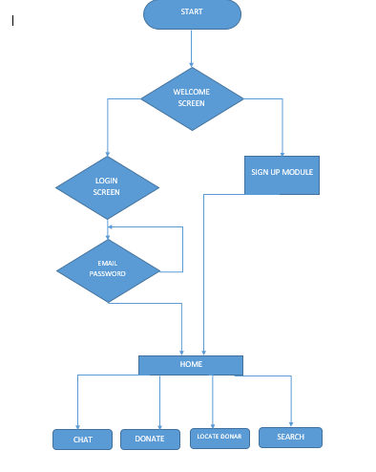
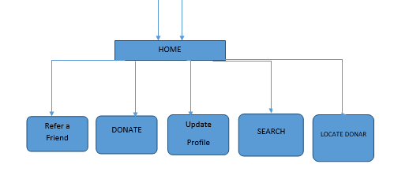
Flow Chart:
[1] WEBSITE FLOW

Slide 8
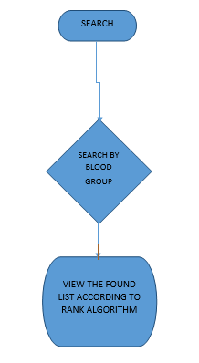
Flow Chart: [2]SEARCH FLOW

Slide 9
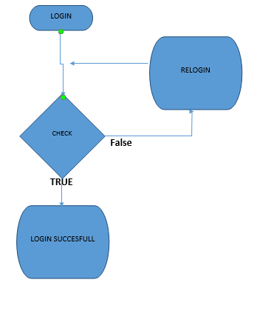
Flow Chart(cont): [3]LOGIN

Slide 10
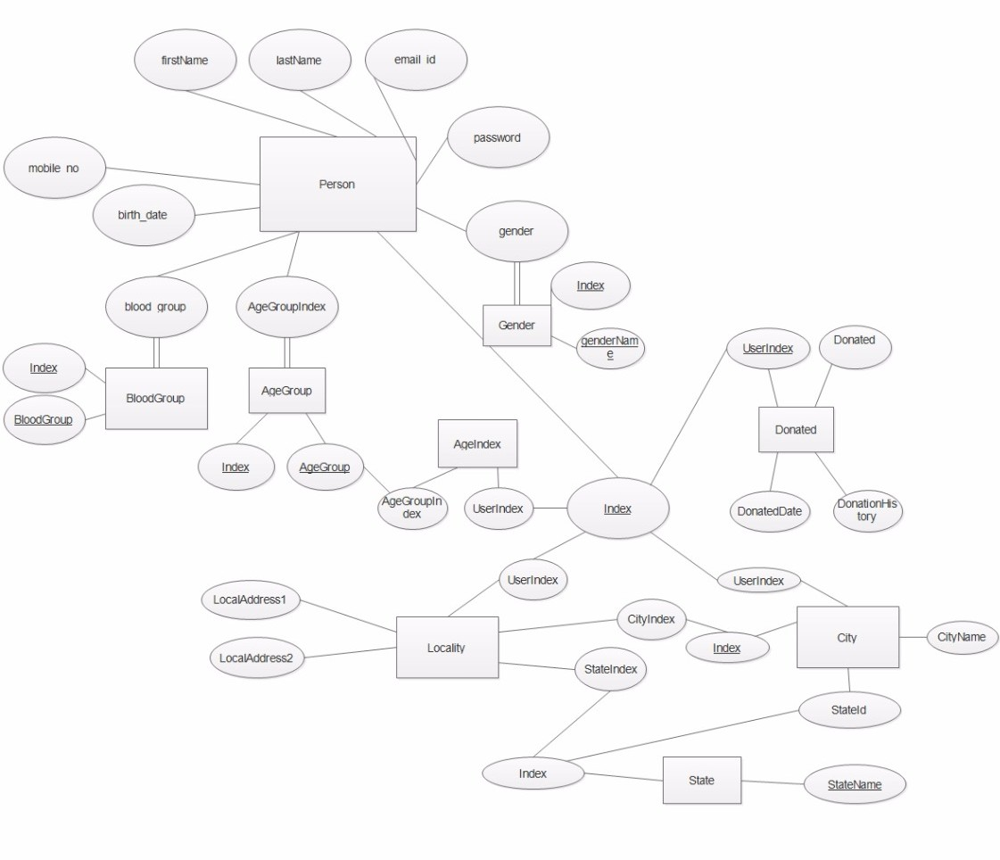
E-R Diagram

Slide 11
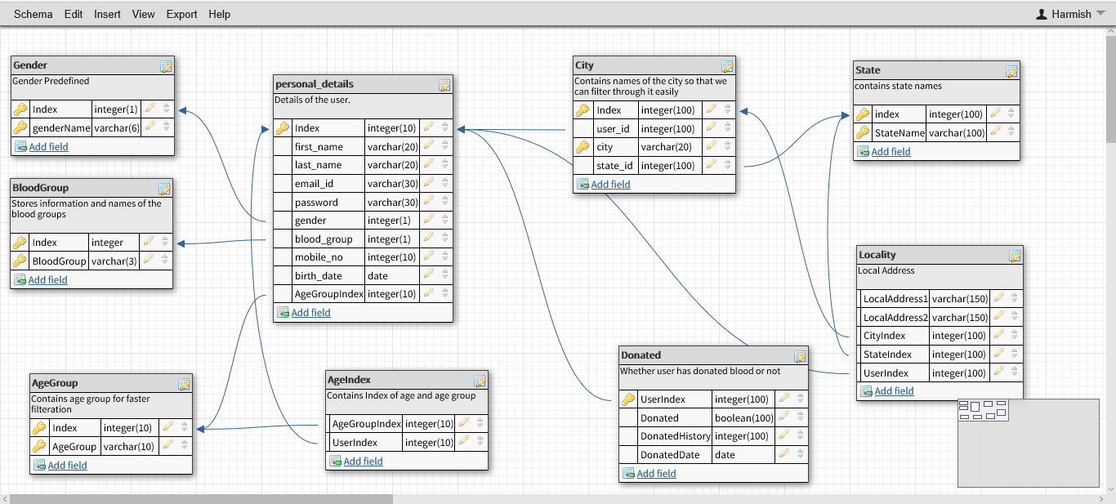
Database Dictionary

Slide 12
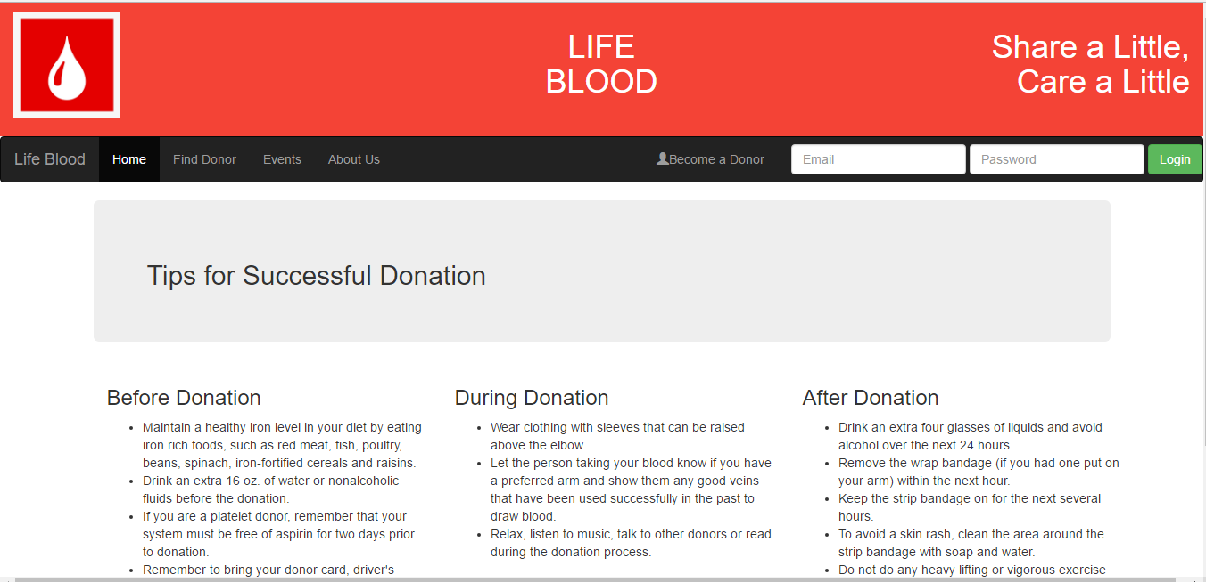
SNAPSHOT USER SIDE LAYOUT: Home Page:

Slide 13
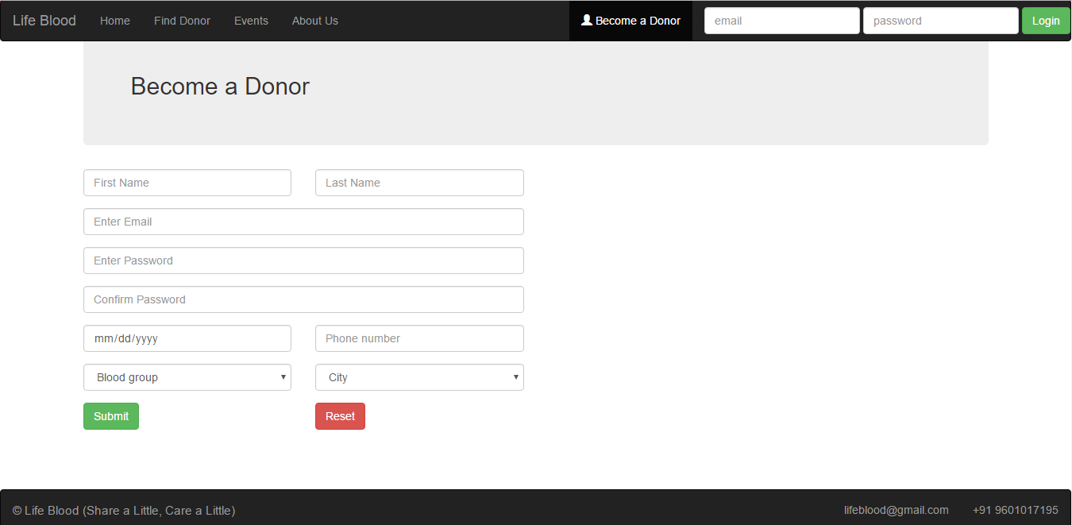
USER SIDE LAYOUT: Become a Donor:

Slide 14
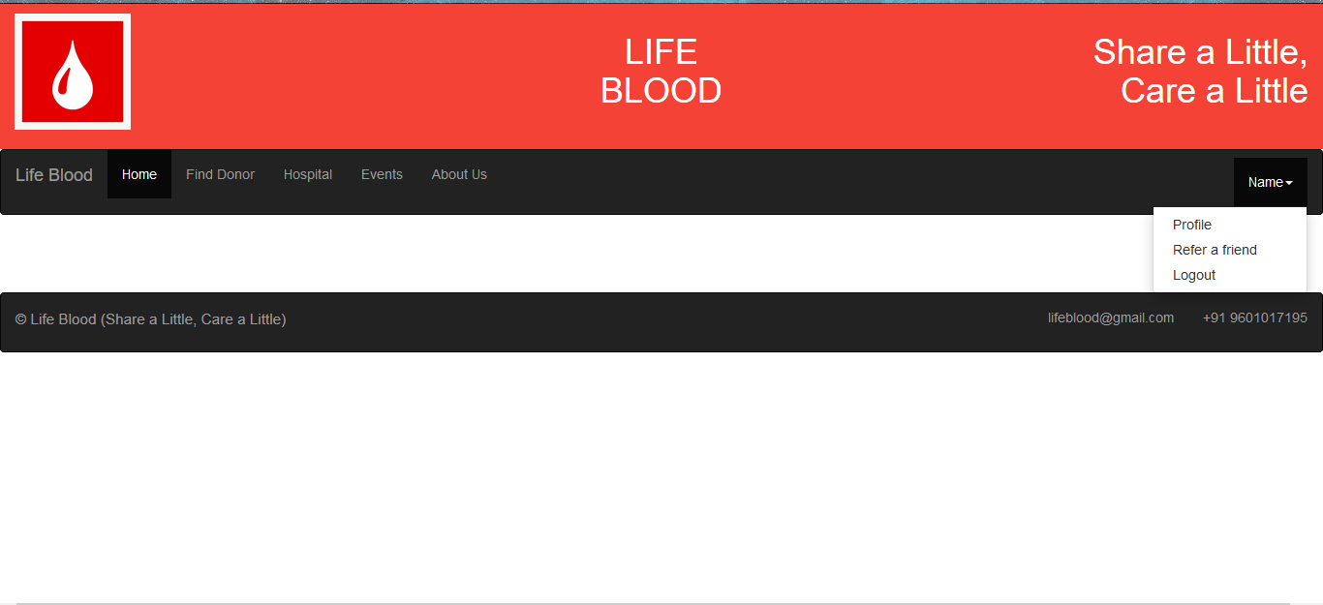
USER SIDE LAYOUT: After Login:

Slide 15
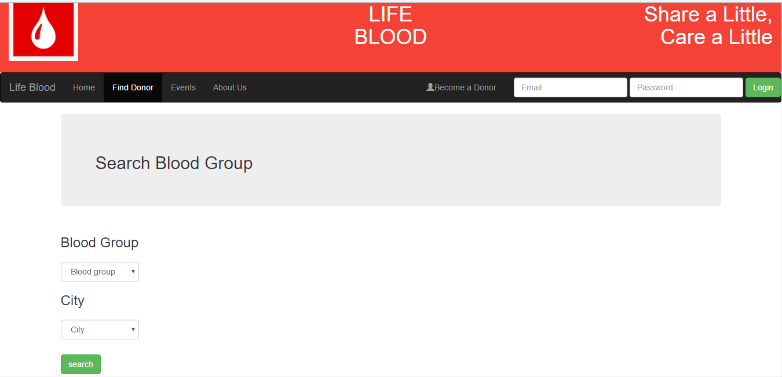
USER SIDE LAYOUT: Find donor:

Slide 16
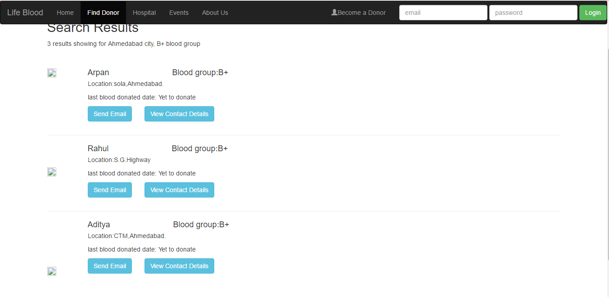
USER SIDE LAYOUT: Find donor result:

Slide 17
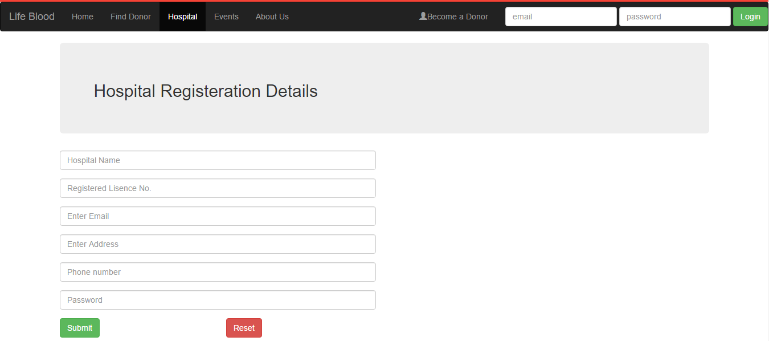
USER SIDE LAYOUT: Hospital Registration:

Slide 18
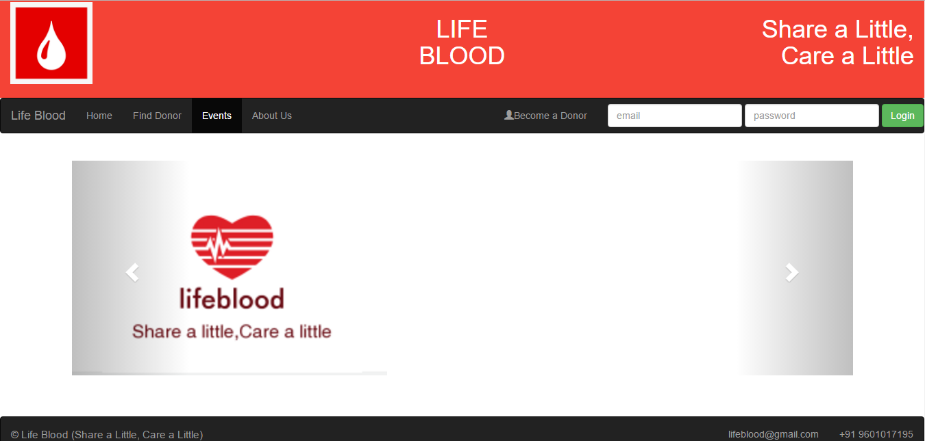
USER SIDE LAYOUT: Become a Donor:

Slide 19
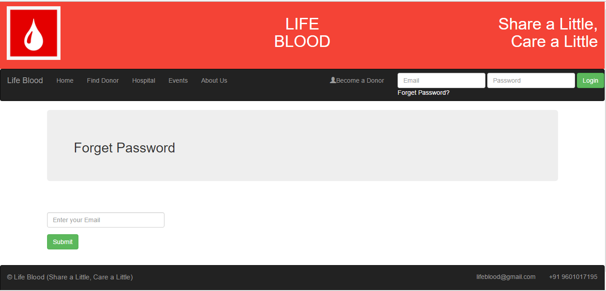
USER SIDE LAYOUT: Become a Donor:

Slide 20
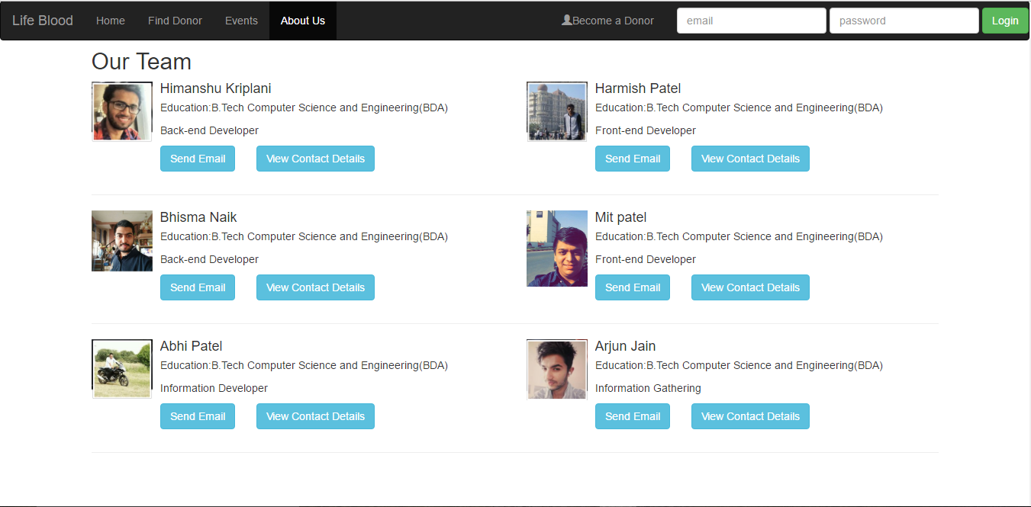
USER SIDE LAYOUT: Become a Donor:

Slide 21
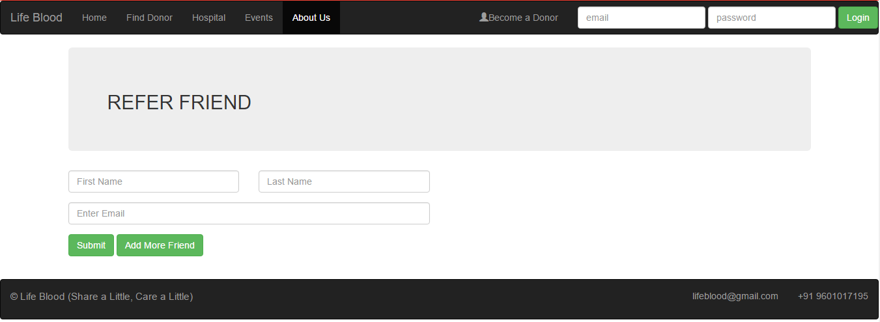
USER SIDE LAYOUT: Become a Donor:

Slide 22
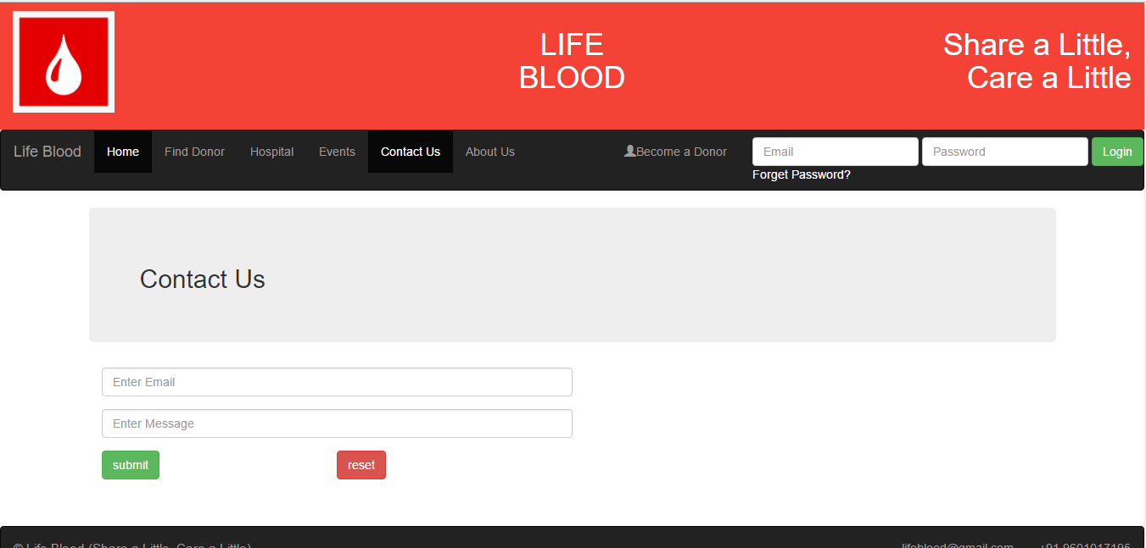
USER SIDE LAYOUT: Become a Donor:

Slide 23
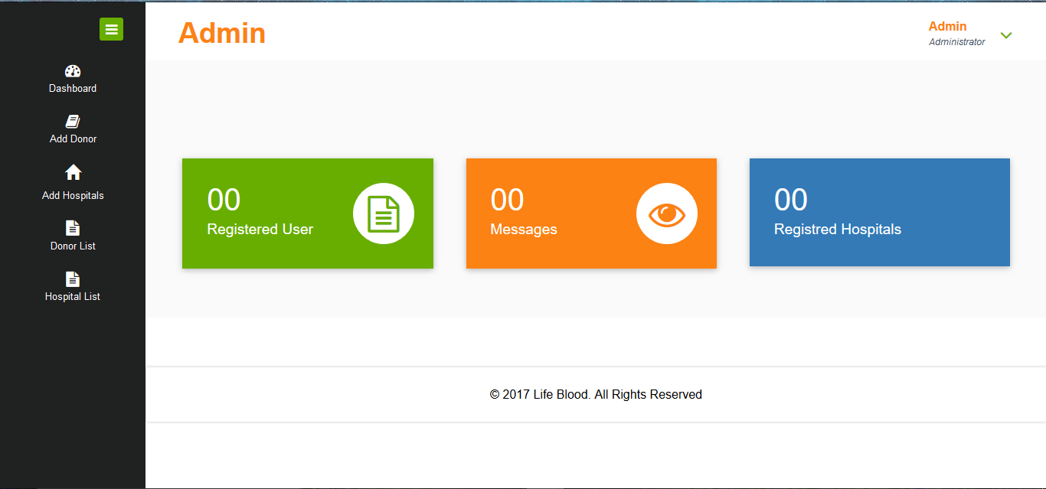
ADMIN SIDE LAYOUT: Dashboard of Admin:

Slide 24
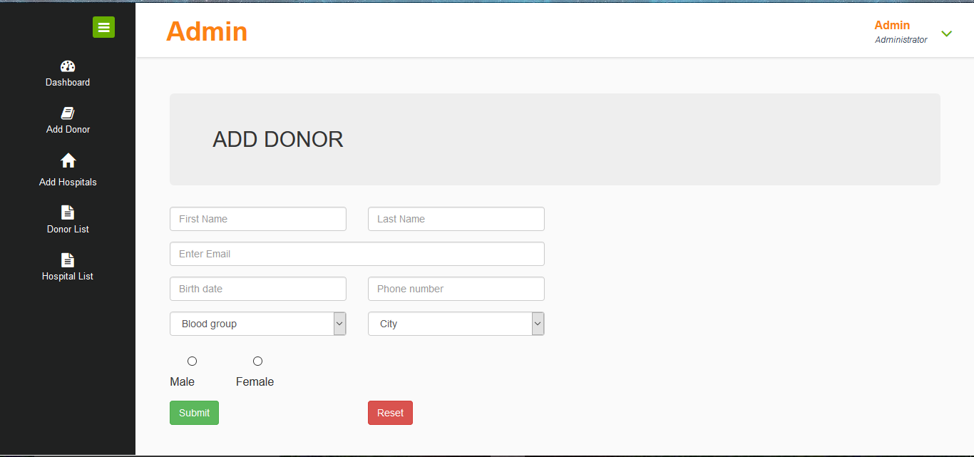
ADMIN SIDE LAYOUT: Add Donor:

Slide 25
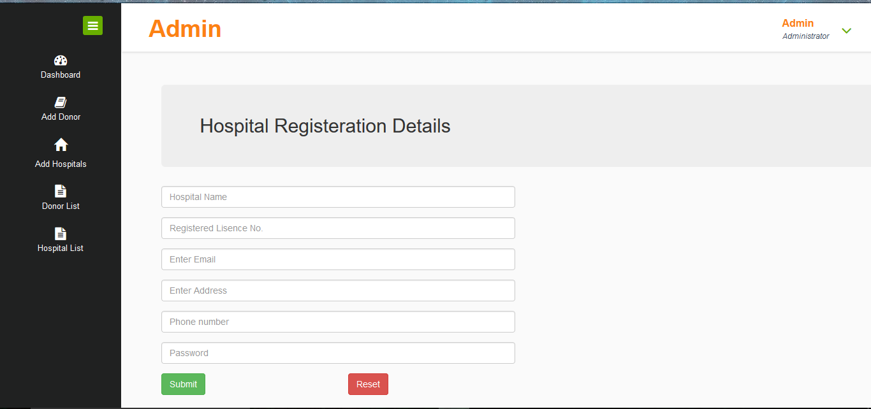
ADMIN SIDE LAYOUT: Hospital Register Admin side:

Slide 26
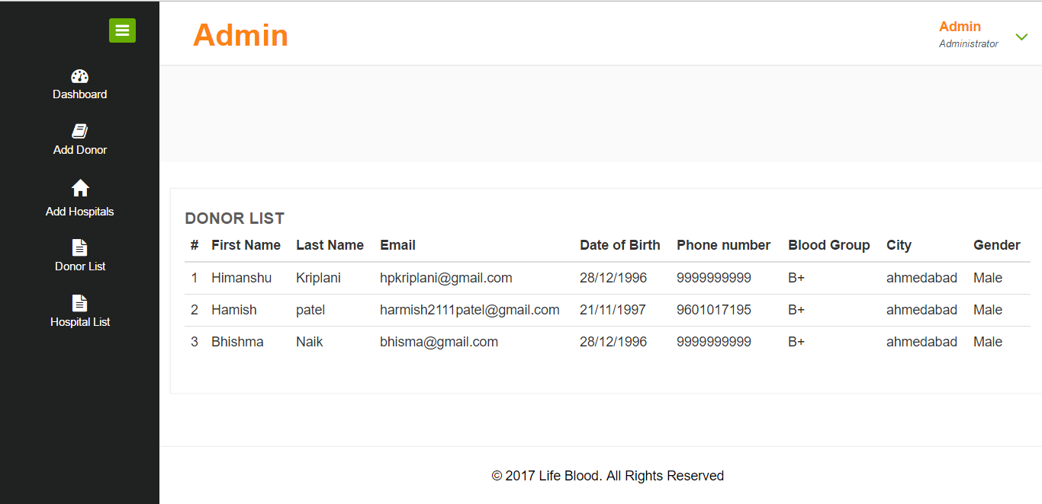
ADMIN SIDE LAYOUT: Donor List:

Slide 27
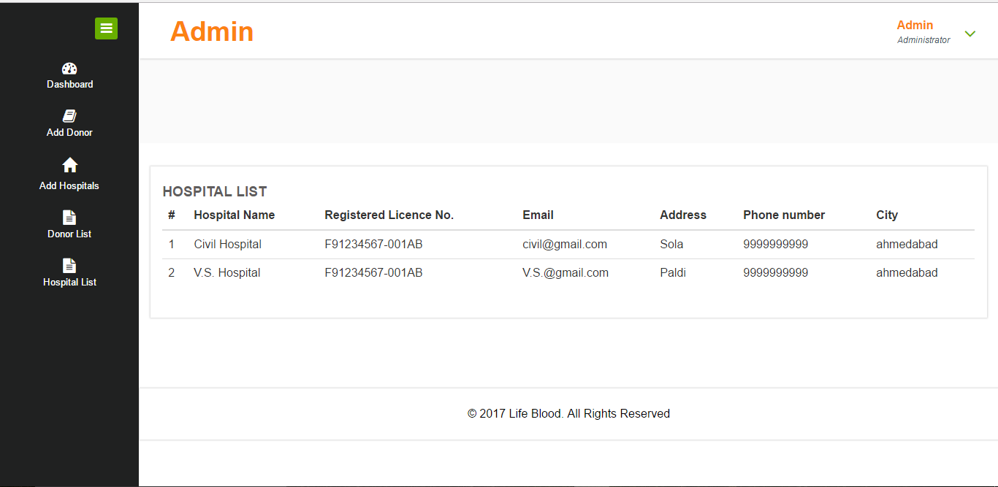
ADMIN SIDE LAYOUT: Hospital List:

Slide 28
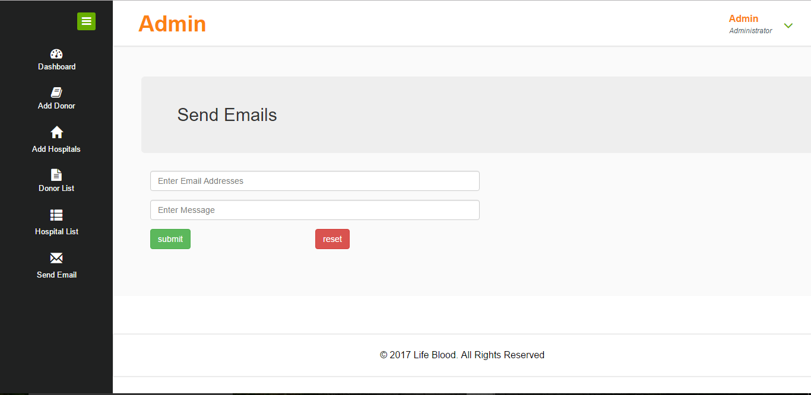
ADMIN SIDE LAYOUT: Admin E-Mail sending:

Slide 29
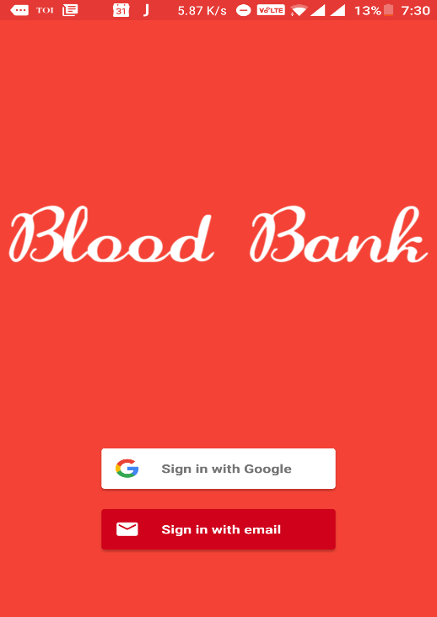
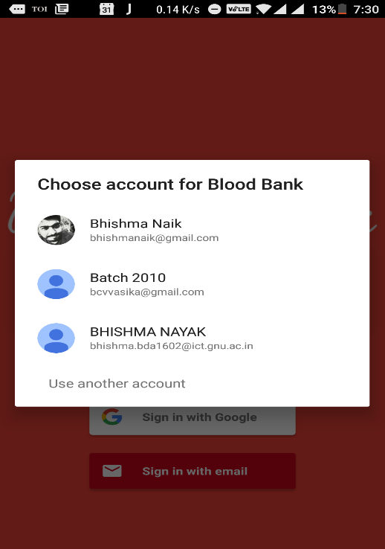
MOBILE APP: Log In Page

Slide 30
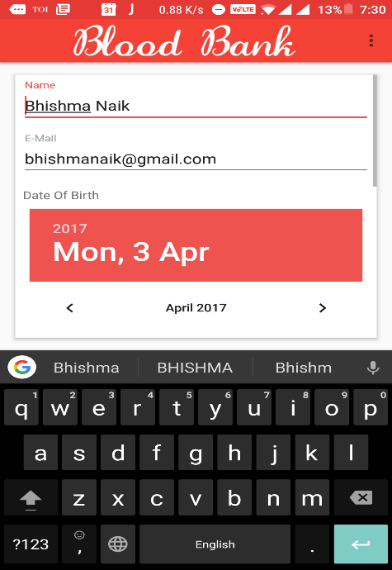
MOBILE APP: Registration Page

Slide 31
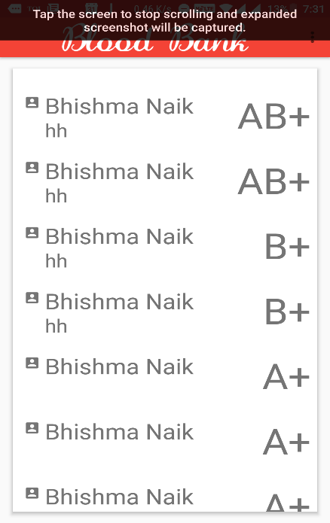
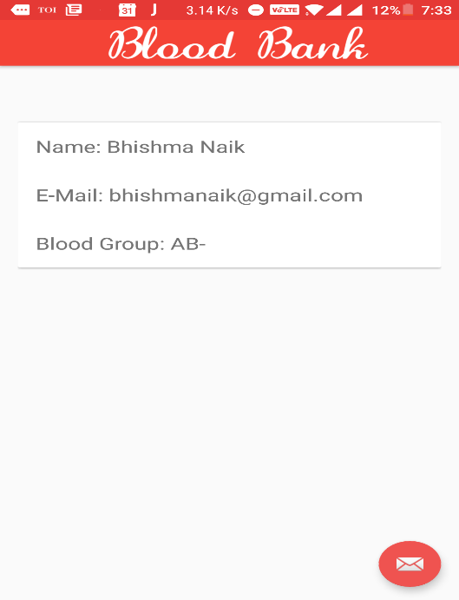
MOBILE APP: Donor List& Donor Details

Slide 32
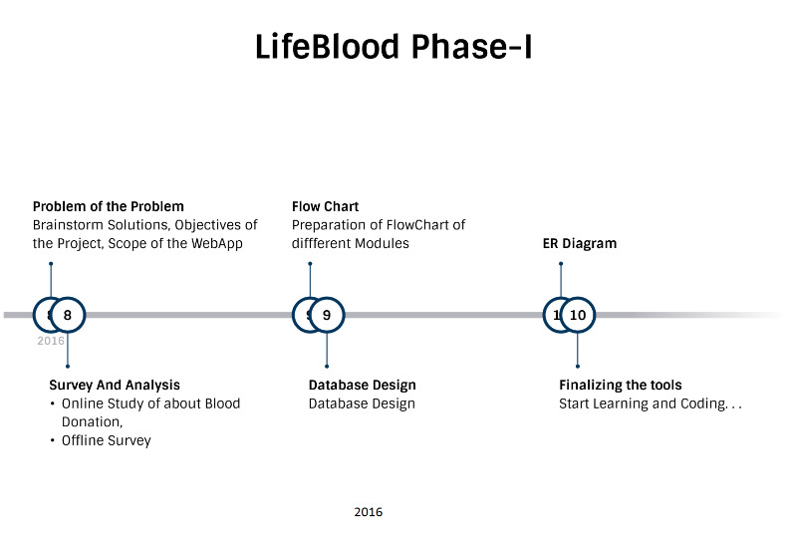
Timeline chart

Slide 33
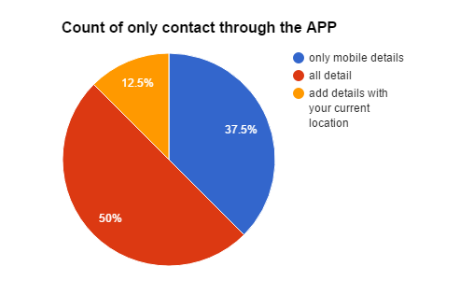
Survey As a donor of blood being listed when someone searches you, how would you like to share your contact details?

Slide 34
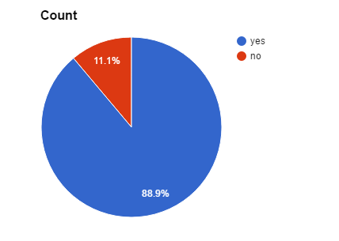
Would you use our Webapp?

Slide 35
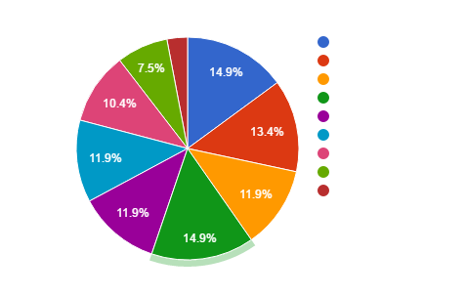
Usefulness of APP(1-10)

Slide 36
Team
Dhavalraj Dodia(003)
Arjun Jain(005)
Himasnhu Kriplani(007)
Mit Patel(008)
Mohit Kapadia(010)
Abhi Patel(013)
Harmish Patel(015)
Bhisma Naik(d2d)
Mentors:
-Raj Parmar
-Malav Shashtri
Guided By:
Prof Hirav Shah
Prof Sameer Mansuri

