Slide 1
Scalable Manifold Learning with Applications in Speech
Nikolaos Vasiloglou II

Slide 2
Outline
Motivation:
  Why manifold learning
  Why Scalable
  Choosing the kernel
  Forming/Multiplying the Kernel Matrix
  Sparsification for Eigen-decomposition
  Eigen-decomposition
Application to Speech so far

Slide 3
Birth of the idea
Google’s first ambitious attempt to index Broadcast video based on caption
My idea was the inverse. Index Broadcast caption based on audio.
Captioned audio is huge and for free

Slide 4
Why Μanifold Learning?
Dimensionality of speech is yet undetermined, Ad-hoc solutions
Evidence that speech waveforms lie on manifolds [Alder1991]
Principal Component Analysis is not sufficient to capture the complex structure

Slide 5
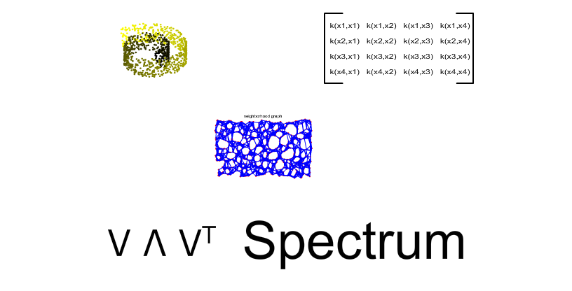
Kernel PCA [Scholkopf2002]
Dimensionality Reduction / Creation

Slide 6
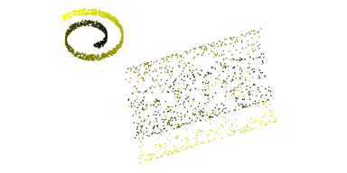
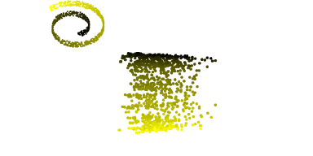
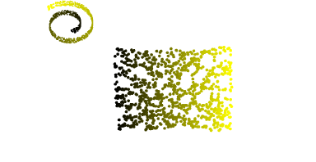
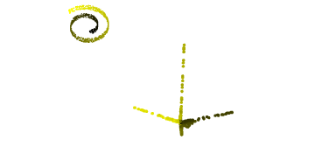
Special cases of Kernel PCA
Linear PCA, Isomap, Laplacian EigenMaps, Kernel(Gaussian) PCA
Principal Component Analysis
Laplacian Eigenmaps
ISOMAP
Kernel PCA

Slide 7
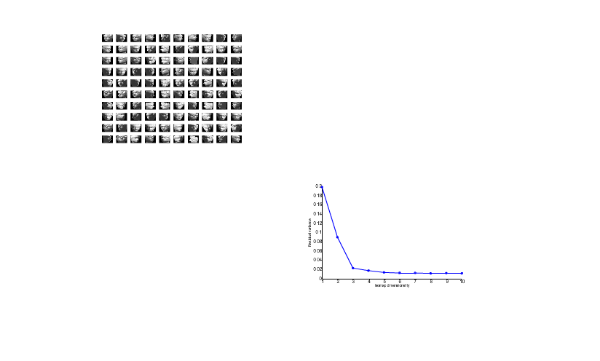
An example with real data

Slide 8
Scalability Issues on Kernel PCA
Kernel Matrix grows O(N²)
Eigenvalue computations are O(N³)
Optimizing the Kernel Matrix O((N²)³)
For speech datasets N>10⁸
~10⁴⁸ operations, even supercomputers are useless

Slide 9
Outline
Motivation:
  Why manifold learning
  Why Scalable
  Choosing the kernel
  Forming/Multiplying the Kernel Matrix
  Sparsification for Eigen-decomposition
  Eigen-decomposition
Application to Speech so far

Slide 10
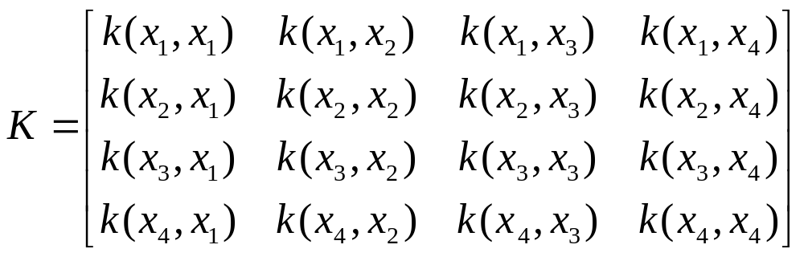
Forming the Kernel Matrix
All pairs distance (all nearest neighbors)
Brute force computation O(N²)
Solution: The dual-tree algorithm O(N)

Slide 11
Multidimensional Trees
Partition/Group data points in bounded boxes
Points that are in the same box are close
The opposite cannot be guaranteed
Fast nearest neighbor computation
Error bounds for the points in the box

Slide 12
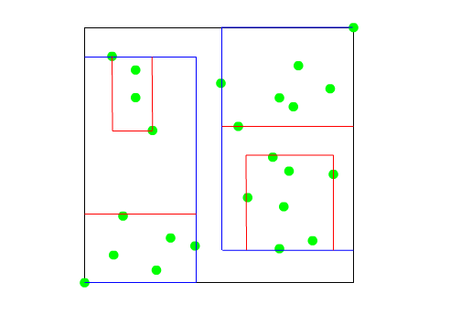
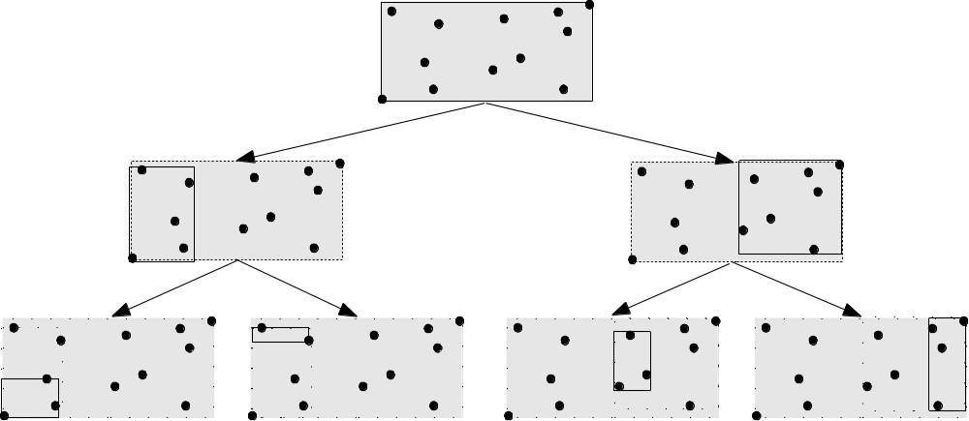
Kd-tree [Moore 1991]

Slide 13
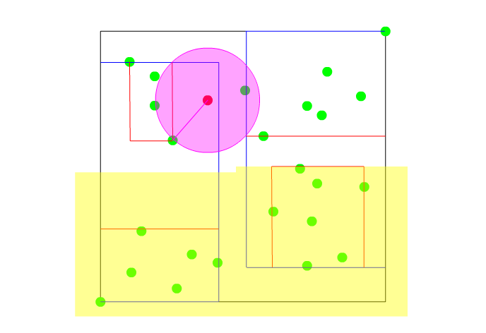
Nearest Neighbor Search

Slide 14
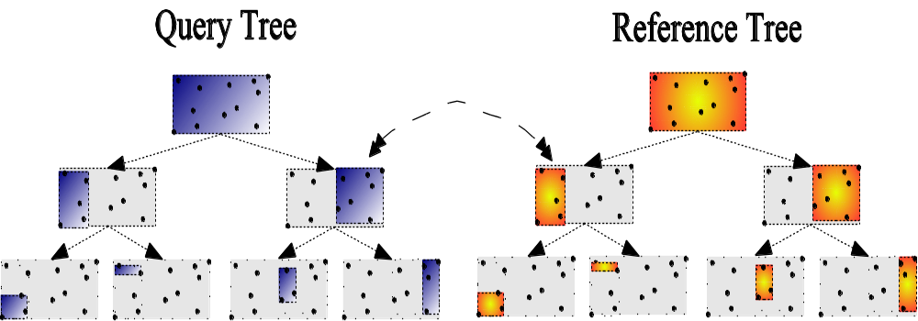
Dual-tree [Gray2000]

Slide 15
Properties of the dual-tree algorithm
Empirically O(N) complexity (All nearest neighbors)
Experimentally proven very good locality
Parallelizable
Easy to scale for out of core data

Slide 16
Outline
Motivation:
  Why manifold learning
  Why Scalable
  Choosing the kernel
  Forming/Multiplying the Kernel Matrix
  Sparsification for Eigen-decomposition
  Eigen-decomposition
Application to Speech so far

Slide 17
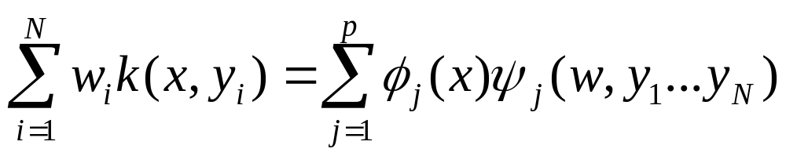
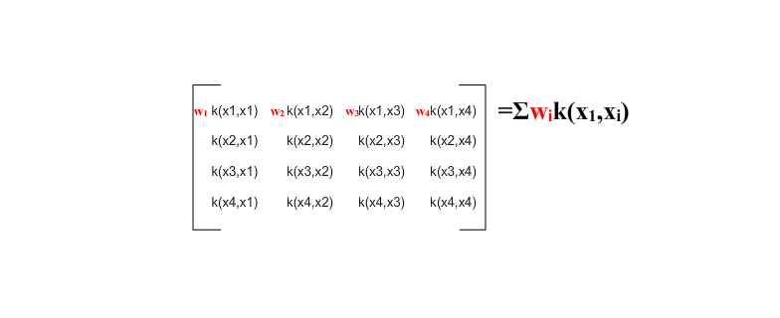
Fast kernel summation [Strain1990]

Slide 18
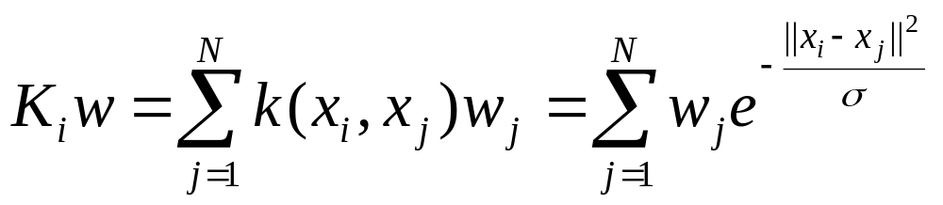
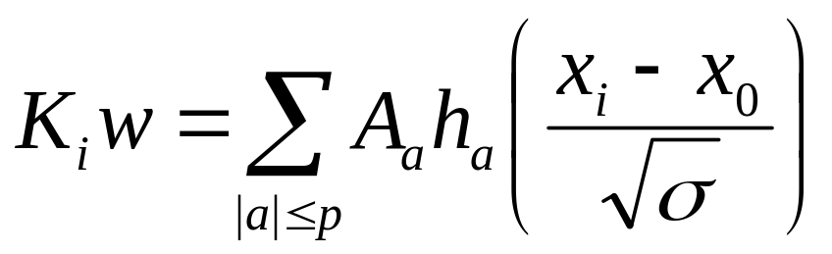
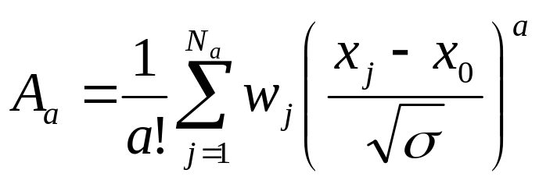
Fast vector matrix multiplication
(FVMM)
O(d^{p})
O(d^{p}N)

Slide 19
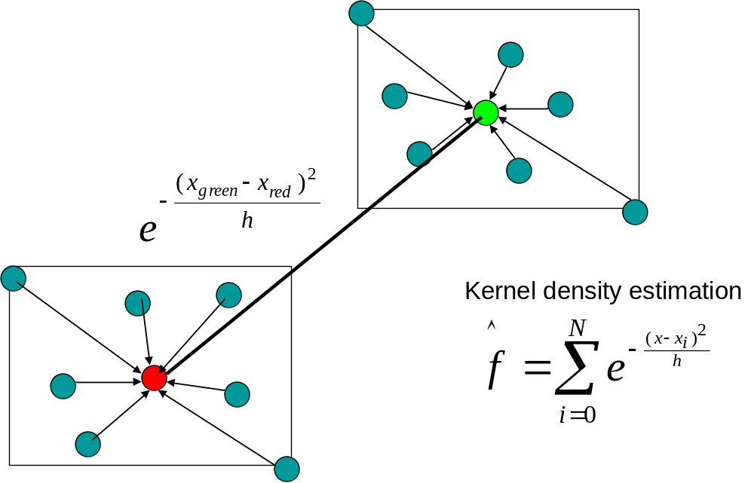
Compression Expansion Operators [Lee2005]

Slide 20
Computational benefits/drawbacks
Linear time Vector Matrix Multiplication
Speedup of the power method of the eigenvalues
Low storage requirements (No need to store N² elements)
Applicable only for low dimensional data
Applicable for kernel with Analytic expansion

Slide 21
Outline
Motivation:
  Why manifold learning
  Why Scalable
  Choosing the kernel
  Forming/Multiplying the Kernel Matrix
  Sparsification for Eigen-decomposition
  Eigen-decomposition
Application to Speech so far

Slide 22
Sparse Kernel Matrix
For higher dimensions where Analytic factorization is not applicable
Dense matrices require O(N³) operations for eigen-decomposition
Fast conjugate gradient techniques for sparse matrices
Solution: Error control of imposed sparsity conditions

Slide 23
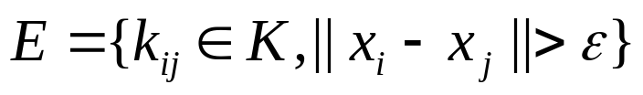

Kernel Matrix Thresholding
Most of the kernels have infinite support
Matrix is dense, most of the elements ~0
Thresholding, set
The kernel matrix has the nearest neighbors of every point
E has the furthest neighbors
Need error bounds

Slide 24
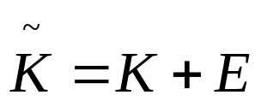
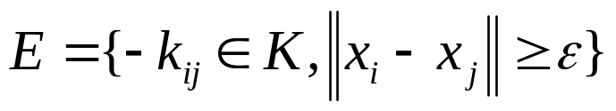
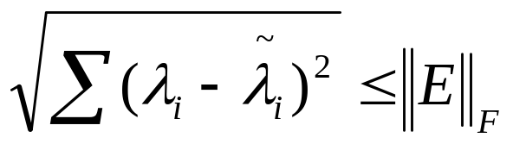
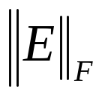
Error Bounds
Let
Where
Then [Stewart1990]
is bounded by the sum of furthest neighbors of every point

Slide 25


Pictorial Example
d

Slide 26
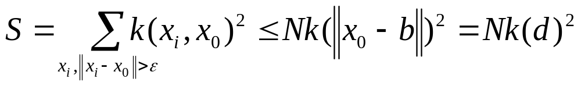

Approximating the sum of furthest neighbors
Bounding box

Slide 27
Outline
Motivation:
  Why manifold learning
  Why Scalable
  Choosing the kernel
  Forming/Multiplying the Kernel Matrix
  Sparsification for Eigen-decomposition
  Eigen-decomposition
Application to Speech so far

Slide 28

Domain Decomposition for Fast Manifold Learning [Zha2002]
Kernel Matrix Partition/Parallelization

Slide 29
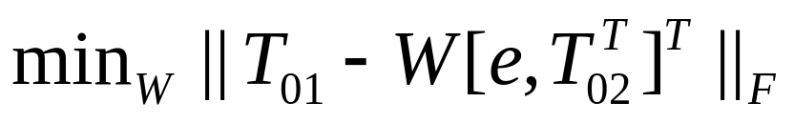
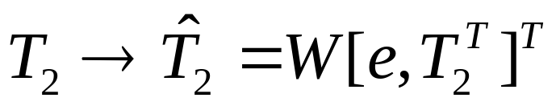
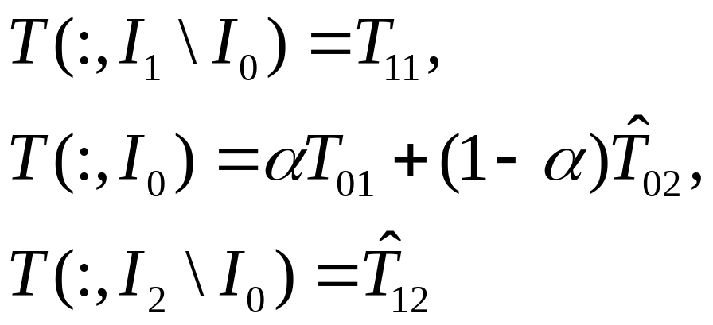
Domain Decomposition Algorithm
Compute
Affinely transform
Set the global coordinate matrix T by

Slide 30

Spill Trees for the Decomposition

Slide 31
Outline
Motivation:
  Why manifold learning
  Why Scalable
  Choosing/Optimizing the kernel
  Forming/Multiplying the Kernel Matrix
  Sparsification for Eigen-decomposition
  Eigen-decomposition
Application to Speech so far

Slide 32
Kernel Optimization
Kernel choice is critical for the performance
Solution: Customize the kernel matrix
Define an objective function
Maximize the variance

Slide 33

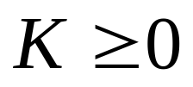
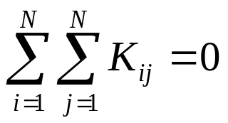
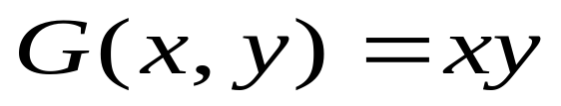
SDP Kernel PCA [Weinberger2004]
Maximize
Subject to:
For all i, j such that i point is in the neighborhood of j point
where G is the Gram matrix under the linear dot product

Slide 34
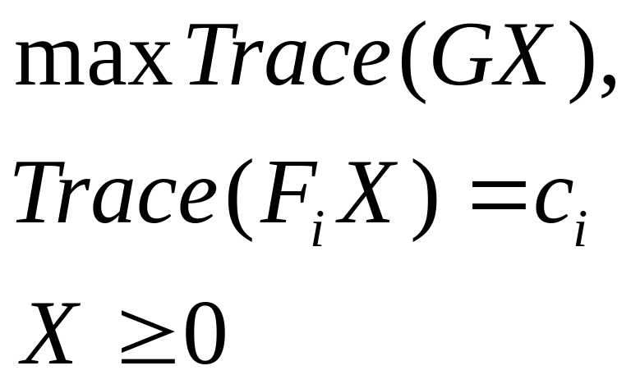
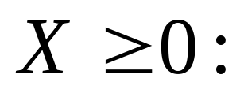
Semidefinite Programming SDP
SDP is a convex optimization method
It handles constraints of the form
Positive semidefinite matrix

Slide 35
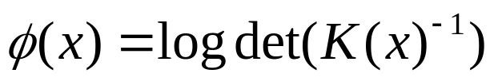
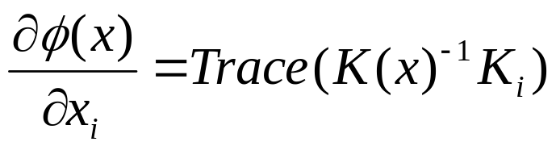
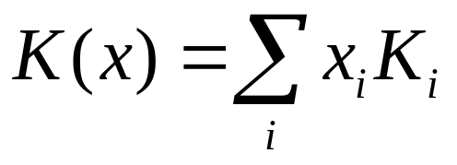
Problems of SDP
SDP is solved with Interior Point Method
Polynomial complexity
Barrier Function:
Gradient:

Slide 36
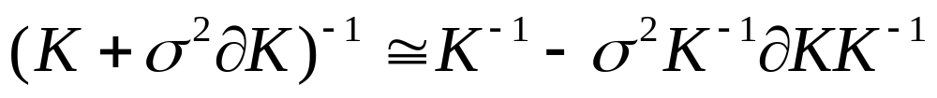
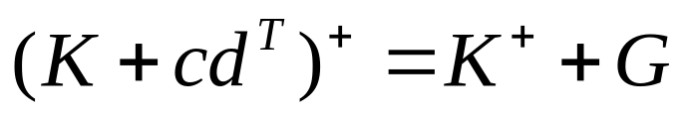
Reducing the computations
The bottleneck is in K(x)⁻¹
K(x) is sparse and PSD so conjugate gradient methods can be used
Stochastic updates on K(x)⁻¹
Rank-1 Moore Penrose Inverse

Slide 37

Use the Domain Decomposition

Slide 38

SDP on a Tree

Slide 39
Outline
Motivation:
  Why manifold learning
  Why Scalable
  Choosing/Optimizing the kernel
  Forming/Multiplying the Kernel Matrix
  Sparsification for Eigen-decomposition
  Eigen-decomposition
Application to Speech so far

Slide 40
Trees for Speech Classification
Speedup Example
TIMIT | 1-nearest | 3-nearest | 4-nearest | 7-nearest | 10-nearest
MFCC | 62.2% | 70.4% | 69.7% | 65.3% | 63.4%
NRAF | 66.9% | 74.1% | 73.2% | 67.3% | 64.7%
TIMIT | 1-nearest | 3-nearest | 4-nearest | 7-nearest | 10-nearest
MFCC | 44.0% | 56.3% | 56.3% | 54.7% | 54.6%
NRAF | 42.2% | 53.5% | 53.7% | 52.4% | 52.4%
1.5Million | Naïve | Single tree | Dual Tree
MFCC | 100hours | 4.3hours | 3.6hours
NRAF | 100hours | 2.9hours | 2.2hours

Slide 41
Features on different timescales
Speech is dynamical signal
Different behavior in different timescales
Find the optimal dimension at every scale
Use optimized dimensionality reduction

Slide 42
Thesis Plan
Fast SDP PCA
Fast Kernel PCA with Fast Kernel Summation and error bounds (Low dimensions)
Sparse Kernel PCA with error bounds (High dimensions)
Applications to Speech
Domain Decomposition with Trees with applications to PCA and Kernel PCA with error bounds

Slide 43
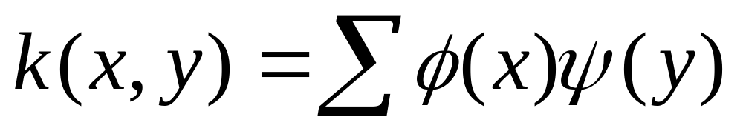
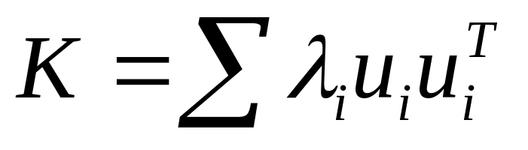
Kernel Factorization
There is an analytic expansion based on Taylor expansion and Hermite Polynomials
Eigenvalue decomposition of the kernel matrix (Kernel PCA)

Slide 44
Kernel Factorization
There is an analytic expansion based on Taylor expansion and Hermite Polynomials
Eigenvalue decomposition of the kernel matrix (Kernel PCA)

Slide 45
Speech Feature Generation
Multiple time scale features
Take advantage of the manifold structure
Estimate the intrinsic dimensionality

Slide 46
Famous trees
The first tree and one of the best is kd-tree
Kd-tree works only in the Euclidean space
Ball (Metric)-trees suitable for non-euclidean metrics
Database oriented trees (X-tree, TV-tree, R*-tree, etc)

Slide 47
Kd-tree node

Slide 48
2 node Kd-tree

Slide 49
Finding the nearest neighbor for a new test (query) point
Pivot axis

Slide 50
No possible prune
Pivot axis
Candidate nearest neighbor

Slide 51
True nearest neighbor
Pivot axis
Candidate nearest neighbor
True nearest neighbor

Slide 52
Pathological Case
Pivot axis
Consider as query point every point in the tree. It’s nn is in the other node

Slide 53
Pathological points

Slide 54
Domain Decomposition
Decompose the matrix from NxN to mxm submatrices and solve it
Reduces the complexity O(km³)
Problem: Efficient Data partitioning
Solution: Trees

Slide 55
The dual tree algorithm
The maximum distance nn in the box

Slide 56
Box pruning
Any box/point not overlapping with the dashed box can be pruned

Slide 57
Box pruning

Slide 58
Computational Gain
Maximum nn distance
In the single tree method it would require 5 recursions top down to the leaf
With dual tree all of them are grouped into one top down search for the whole block
Single tree algorithm is O(NlogN)
Dual tree is O(N)(empirically)

Slide 59
Intuitional complexity estimation
This is a very good case where nn can be computed in linear time

Slide 60
Dimensionality Reduction
Nonlinear dimensionality methods
Kernel Methods
  Kernel PCA
  Laplacian EigenMaps
  Diffusion Maps
Non Kernel Methods
  LTSA
  ISOMAP
  LLE

Slide 61
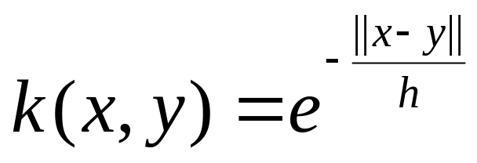
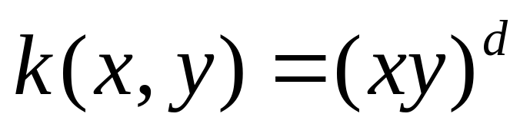
Kernel = Dot Product function
Kernel matrix=Gram Matrix, dot product matrix
The kernel function is a nonlinear dot-product
Examples

Slide 62
Example
Positive Semidefinite
Symmetric
Eigenvalue decomposition of the kernel matrix (Kernel PCA)

