Slide 1
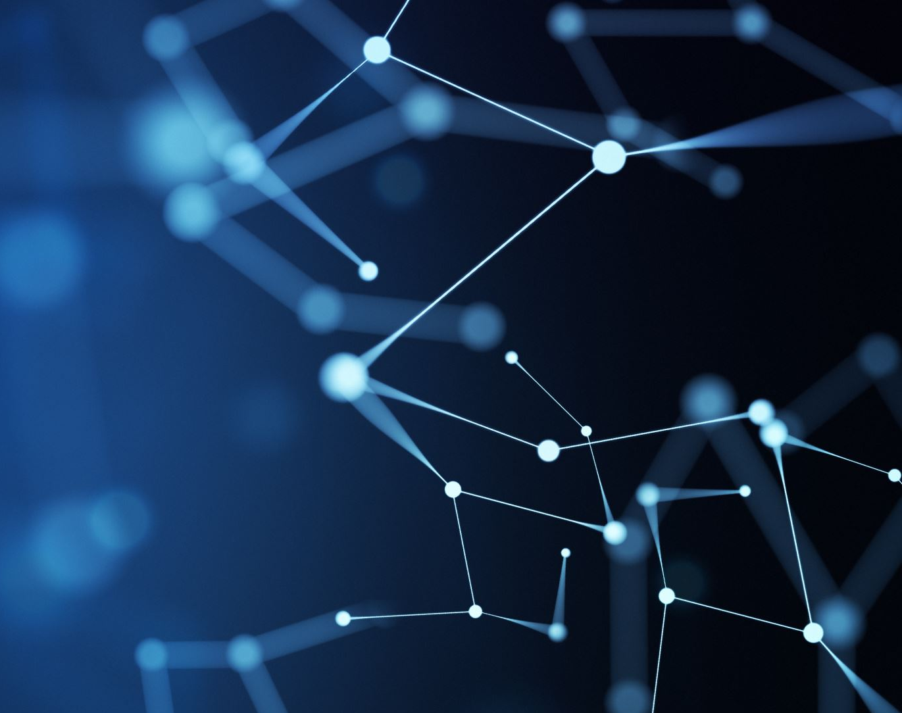
DIABETES PREDICTION USING DIFFERENT SUPERVISED MACHINE LEARNING MODELS

Slide 2
PROJECT TEAM MEMBERS
Bhargavi Chukkapalli (700743393)
Meghana Chodagiri (700749050)
Kallepu Tejaswi Reddy (700743859)
Deeksha Ceeti (700743669)

Slide 3
ROLES AND CONTRIBUTION IN PROJECT
The Requirement analysis ,Data Collection and Preprocessing of data is done by Meghana and Bhargavi .
The implementation of KNN machine learning model is done by Bhargavi.
The execution of Naive-Bayes is performed by Meghana
The Support Vector Machine (SVM) is carried out by Tejaswi
The application of Decision tree is done by Deeksha
Implementation of ML model Random Forest is done by Deeksha and Tejaswi.

Slide 4
MOTIVATION
Early intervention: Early detection of diabetes can allow for early intervention and treatment, which can prevent or delay the onset of complications associated with the disease.
Personalized treatment: ML algorithms can be used to analyze patient data and generate personalized treatment plans based on the patient's individual risk factors and medical history.
Research: Large datasets can be analyzed using ML algorithms to find patterns and risk factors related to diabetes, which can guide future research and therapy development.

Slide 5
OBJECTIVES
The main objective of this study is to implement various machine learning models to predict diabetes
The PIMA India diabetes dataset , which is freely accessible on the Kaggle platform is used to carry out this study
This dataset has few features such as glucose, age, BMI , blood pressure ,pregnancies, Insulin , skin thickness
We have implemented five machine learning algorithms for the prediction and compared the results

Slide 6
RELATED WORK
The use of machine learning algorithms to predict diabetes has been the subject of numerous studies and research projects.
Gridsearch method was used by authors in reference [5] titled as “A Novel Prediction Model for Diabetes Detection Using Gridsearch and A Voting Classifier between LightGBM and KNN”. As evaluation metric between LightGBM and KNN classifier algorithms. In their research combination of both models have given 90% accuracy
Robust framework for diabetes prediction was used by authors in ref. [2] titled as “ s Diabetes Prediction Using Ensembling of Different Machine Learning Classifiers” where the outlier rejection, filling the missing values, data standardization, feature selection, K-fold cross-validation with Machine Learning (ML) classifiers

Slide 7
RELATED WORK
Prediction of diabetes empowered with fused machine learning [4]- In their research the authors discusses about 2 models (SVM, ANN), these are analyzed on the dataset to determine whether a diabetes diagnosis is positive or negative. The proposed fused ML model has a prediction accuracy of 94.87, which is higher than the previously published methods.
A Novel Approach to Predict Diabetes by Using Naive Bayes Classifier [3]- The classifier gives results in probabilistic character where it calculates the individual probability of occurrence of particular thing. Outcomes show that the proposed novel strategy can foresee the diabetes with higher exactness levels (0.96) than the customary/existing techniques.

Slide 8
PROBLEM STATEMENT
Diabetes is a most common disease caused by a group of metabolic disorders. It is also known as Diabetic mellitus. It affects the organs of the human body.
It can be controlled by predicting this disease earlier. If diabetics patient is untreated for a long time, it may lead to increase in blood sugar.
Early prediction of disease like diabetes can be controlled and save the human life.

Slide 9
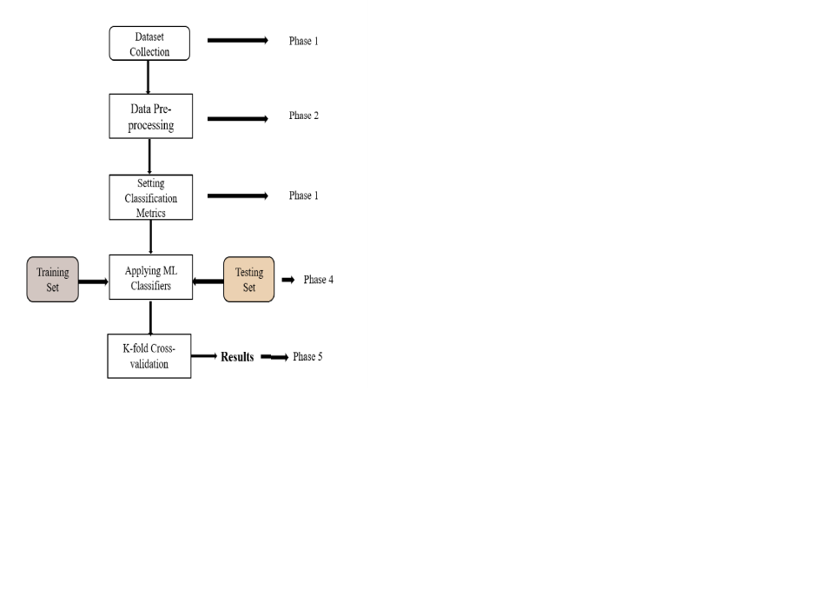
PROPOSED SOLUTION
We performed 5 supervised machine learning algorithms on the pre-processed data
The algorithms which we used are:
1. K-Nearest neighbor with K=10
2.Naive Bayes
3.Random Forest
4.Decision tree
5. Support Vector machine
we have used another evaluation method, namely K- Fold cross-validation for precise use of dataset and also for calculating most optimal accuracy results

Slide 10
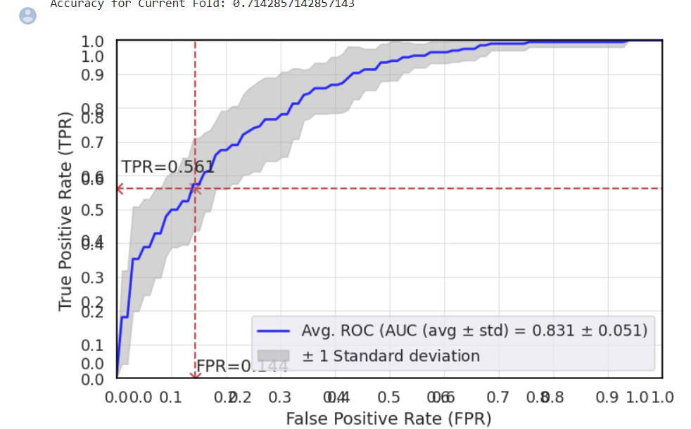
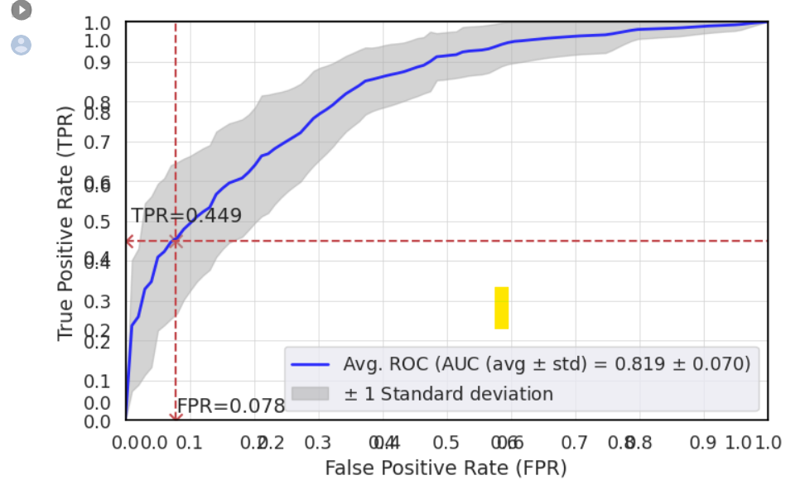
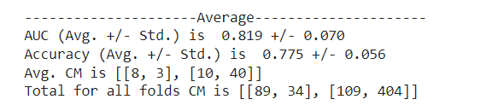
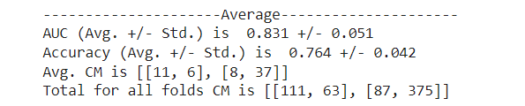
RESULTS/SIMULATIONS
K-Nearest Neighbor
Naive Bayes

Slide 11
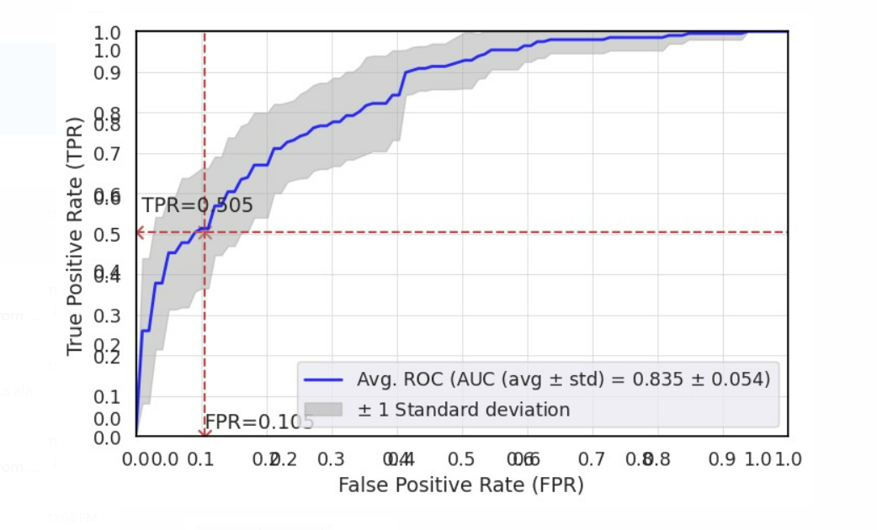
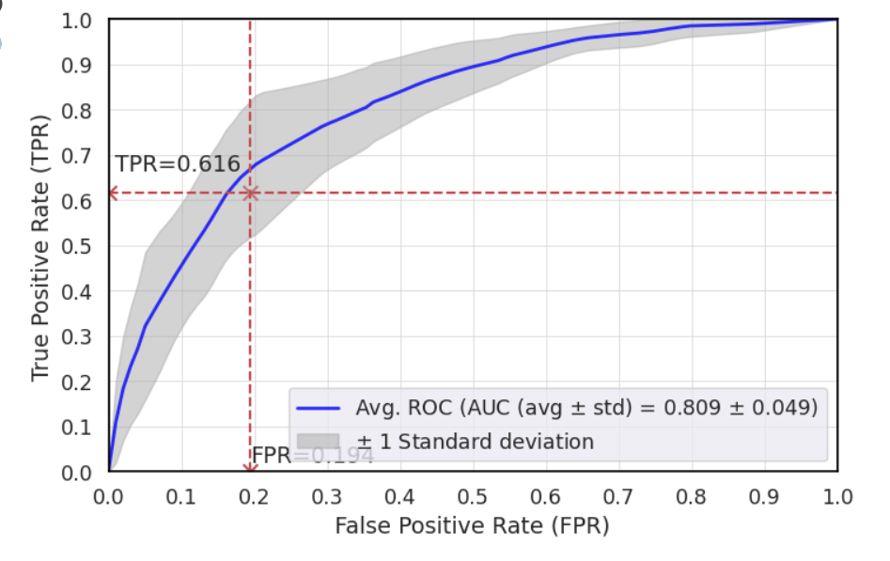
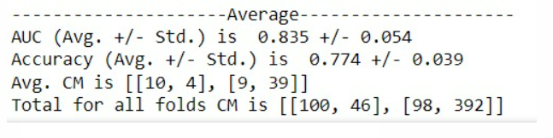
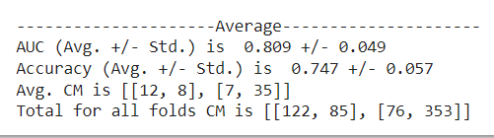
RESULTS/SIMULATIONS
Support Vector Machine
Decision Tree

Slide 12
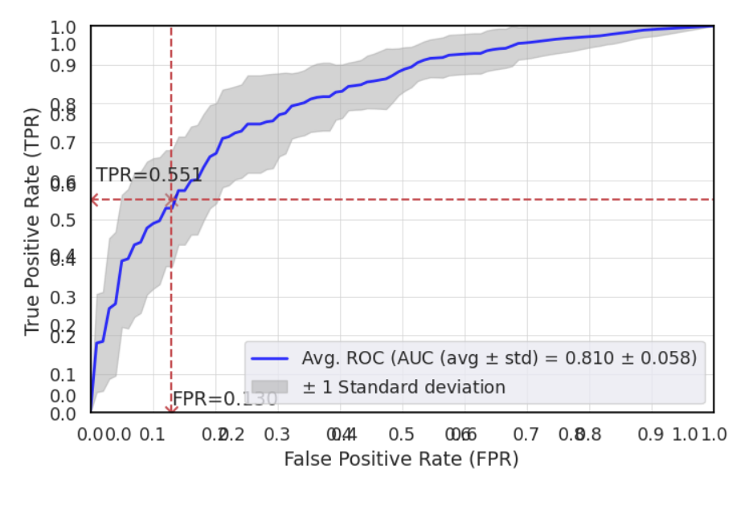
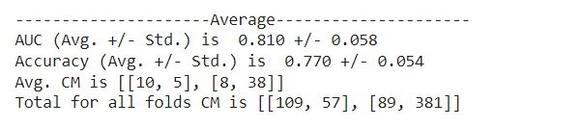
RESULTS/SIMULATIONS
Random Forest

Slide 13
REFERENCES
[1] Md. Kamrul Hasan1 , Md. Ashraful Alam , Dola Das, Eklas Hossain (Senior Member, Ieee), Mahmudul Hasan, “Diabetes Prediction Using Ensembling of Different Machine Learning Classifiers,” A CCESS.2020.2989857, IEEE Access.
[2] Nurul Amin Choudhury, National Institute of Technology, Silchar, Soumen Moulik National Institute of Technology, Meghalaya “Diabetes Disease Prediction Using Machine Learning Algorithms”, March 2021.
[3] K. Lakshmi Priya, Mourya Sai Charan Reddy Kypa, Muchumarri Madhu Sudhan Reddy, G. Ram Mohan Reddy, “A Novel Approach to Predict Diabetes by Using Naive Bayes Classifier,” (ICOEI 2020) IEEE Xplore Part Number: CFP20J32-ART; ISBN: 978-1-7281-5518-0
[4] Usama Ahmed, Ghassan F. Issa , Shabib Aftab , Muhammad Farhan Khan , Raed A. T. Said , Taher M. Ghazal , (Member, IEEE), Munir Ahmad, (Member, IEEE) and Muhammad Adnan Khan, “Prediction Of Diabetes Empowered With Fused Machine Learning,” unpublished.
[5] Rashmi Rane Dr. Vishwanath Karad MIT World Peace University, “A Novel Prediction Model for Diabetes Detection Using Gridsearch and A Voting Classifier between Lightgbm and KNN,” October 2021

Slide 14
REFERENCES
[6] P. Saeedi, I. Petersohn, P. Salpea, B. Malanda, S. Karuranga, N. Unwin, S. Colagiuri, L. Guariguata, A. A. Motala, K. Ogurtsova, J. E. Shaw, D. Bright, and R. Williams, “Global and regional diabetes prevalence estimates for 2019 and projections for 2030 and 2045: Results from the international diabetes federation diabetes atlas, 9th edition,” Diabetes Research and Clinical Practice, vol. 157, p. 107843, 2019.
[7] C. R. Harris, K. J. Millman, S. J. van der Walt, R. Gommers, P. Virtanen, D. Cournapeau, E. Wieser, J. Taylor, S. Berg, N. J. Smith, R. Kern, M. Picus, S. Hoyer, M. H. van Kerkwijk, M. Brett, A. Haldane, J. F. del R’ıo, M. Wiebe, P. Peterson, P. G’erard-Marchant, K. Sheppard, T. Reddy, W. Weckesser, H. Abbasi, C. Gohlke, and T. E. Oliphant, “Array programming with NumPy,” Nature, vol. 585, no. 7825, pp. 357–362, Sep. 2020. [Online]. Available: https://doi.org/10.1038/s41586-020-2649-2
[8] P. S. Kohli and S. Arora, “Application of machine learning in disease prediction,” in 2018 4th International Conference on Computing Communication and Automation (ICCCA), 2018, pp. 1–4.
[9] S. P. Chatrati, G. Hossain, A. Goyal, A. Bhan, S. Bhattacharya, D. Gaurav, and S. M. Tiwari, “Smart Home Health Monitoring System for Predicting Type 2 Diabetes and Hypertension,” Journal of King Saud University[1]computer and Information Sciences, Jan. 2020
[10] F. Han and H. Liu, “Statistical analysis of latent generalized correlation matrix estimation in transelliptical distribution,” Bernoulli: official journal of the Bernoulli Society for Mathematical Statistics and Probability, vol. 23, no. 1, pp. 23-57, Feb. 2017.

