Slide 1


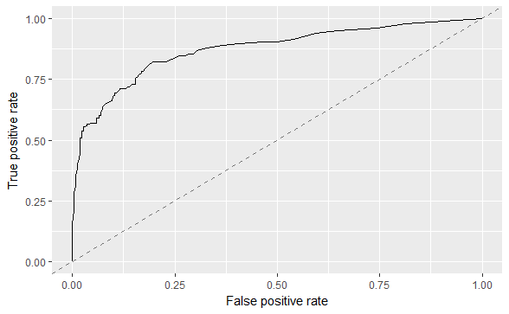
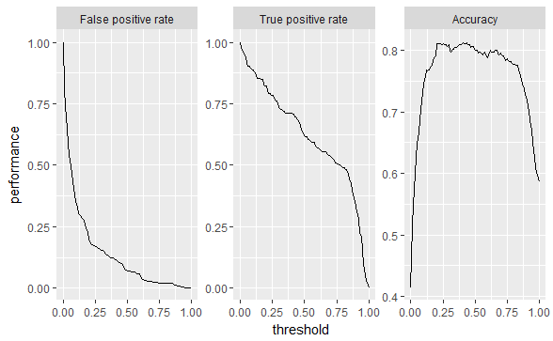
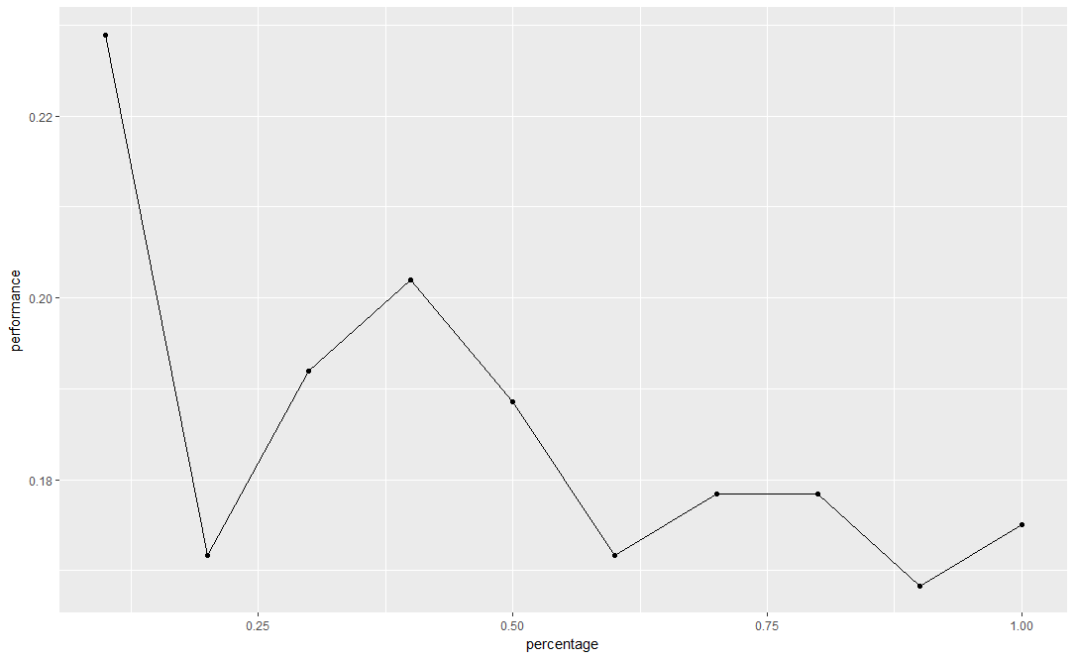
Machine Learning with R
Basics
Task
Learner
Train
Encapsulate data set and specify target variable
Task types
makeRegrTask(id = "bh", data = BostonHousing, target = "medv") makeClassifTask(id = "BreastCancer", data = df, target = "Class") makeSurvTask(data = lung, target = c("time", "status")) makeClusterTask(data = mtcars) makeMultilabelTask(id = "multi", data = yeast, target = labels) makeCostSensTask(data = df, cost = cost)
Example tasks can be found here, e.g. bh.task for regression
Specify learning method and set hyperparameters
makeLearner(“classif.randomForest", predict.type = “prob")
makeLearner(“regr.gbm",
predict.type = “se”)
makeLearner(“cluster.kmeans", centers = 5,
predict.type = “response”)
You can also create learners for survival analysis, multilabel classification and cost-sensitve classification
Learners are always constructed like
“task_type.<R_method_name>”
View all possible learners depending on your task listLearners()
Fit model to given data set
mod = train(learner, task)
Accessing learner models
train returns object of class WrapperModel → contains also information about learner, task, features and observations
names(mod)
getLearnerModel(mod)
use training data to fit the model
n = getTaskSize(task)
trainSet = seq(1, n, by = 2)
train(learner, task,
subset = trainSet)
Visualization:
PlotLearnerprediction
confusionMatrix
performance
calculateROCMeasures
Documentation families:
?mlrFamilies
(see also, „other“ = family)
Für perfromance
Learner
Überall die Hilfe „verlinken“
?Lerners
Plots für Benchmark
Bmr boxplot
Introduction
mlr offers a unified interface for the basic building blocks: tasks, learners, hyperparameters, …
mlr package provides a generic, object-oriented, and extensible framework for classification, regression, survival analysis and clustering. It provides a unified interface to more than 160 basic learners and includes meta-algorithms and model selection techniques to improve and extend the functionality of basic learners with, e.g., hyperparameter tuning, feature selection, and ensemble construction. Parallel high-performance computing is natively supported
For more help, please see the mlr tutorial
Benchmarking
Evaluate multiple tasks / learners
bmr = benchmark(learnersList, task, rdesc)
Accessing benchmark experiment
getBMRAggrPerformances(bmr, as.df = TRUE)
getBMRPerformances(bmr, as.df = TRUE)
getBMRPredictions(bmr)
getBMRLearners(bmr)
getBMRMeasures(bmr)
Merging benchmark results
mergeBenchmarkResults(list(bmr, bmr2))
Resampling
Predict
Define a resampling strategy (example)
rdesc = makeResampleDesc("CV",
iters = 3, predict = both, stratify = TRUE)
Resampling strategies
Cross-validation ("CV")
Leave-one-out cross-validation ("LOO")
Repeated cross-validation ("RepCV")
Out-of-bag bootstrap and other variants like b632 ("Bootstrap")
Subsampling ("Subsample")
Holdout (training/test) ("Holdout")
Predict: Get prediction on “training” / “test” data set or on “both”
Stratify = TRUE to conduct stratified sampling
Access the results (example)
resample(learner, task, rdesc)
task
Predict target
If training & test data set available → predict(mod, task = bh.task, subset = test.set)
If new data should be predicted → predict(mod, newdata = iris.test)
resampling
strategy
learner
test data
train data
Performance
model
Check performance (example)
performance(pred, measures = auc)
View all performance measures
listMeasures()
df = generateThreshVsPerfData(pred, list(fpr, tpr, acc))
plotThreshVsPerf(df)
plotROCCurves(df)
Imputation
iterative
process
prediction
Techniques
Using simple functions, e.g. mode and mean impute(data, classes = list(integer = imputeMean(), factor = imputeMode()), dummy.classes = "integer")
Using supervised learning algorithms for imputation impute(airquality, target = “y", cols = list(Wind = imputeLearner("classif.rpart")), dummy.cols = c("Solar.R", "Wind"))
performance
Quickstart
Use single measure or list
task = makeClassifTask(data = iris, target = "Species")
learner = makeLearner("classif.lda")
train(learner, task, subset = seq(1, n, by = 2))
Visualization
mlr relies on generating functions
naming is always like generate<FunctionPurpose>Data
e.g. generateThreshVsPerfData(pred, measures = list(fpr, fnr, mmce))
d = generateLearningCurveData(lrn, task)
plotLearningCurve(d)
anpassen
RStudio® is a trademark of RStudio, Inc. • CC BY Your Name • Your@email.com • 844-448-1212 • rstudio.com

Slide 2
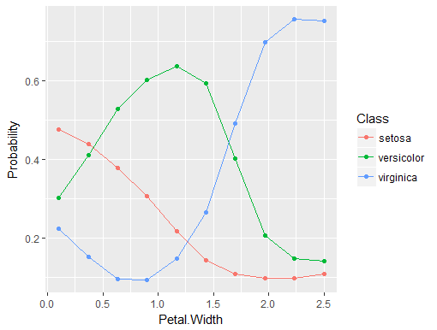
Machine Learning with R
Advanced
Tuning
Nested Resampling
Feature Selection
In order to tune a machine learning algorithm, you have to specify
the search space ps = makeParamSet( makeNumericParam("C", lower = 0.01, upper = 0.1))
the optimization algorithm ctrl = makeTuneControlRandom( maxit = 100L) For numeric search space and no randomizazion: ctrl = makeTuneControlGrid( resolution = 15L)
an evaluation method, i.e., a resampling strategy and a performance measure rdesc = makeResampleDesc("CV", iters = 3L) measure = acc
Performing the tuning
res = tuneParams(learner, task, rdesc, ps, ctrl, measure)
Accessing the tuning result
Best found settings res$x
Corresponding performance res$y
Further options
Multiplexer model lrn = makeModelMultiplexer( learnersList) tuneParams(lrn, iris.task, rdesc, ps, ctrl)
Multi-criteria evaluation and optimization tuneParamsMultiCrit("classif.ksvm“ , task = sonar.task, resampling = rdesc, par.set = ps, measures = list(fpr, fnr), control = ctrl)
Accessing results plotTuneMultiCritResultGGVIS(res)
Specify inner resampling method inner = makeResampleDesc(...)
Create learner with inner resampling method
Tuning wrapper lrn = makeTuneWrapper(..., resampling=inner, ...)
feature selection wrapper approach lrn = makeFeatSelWrapper(..., resampling=inner, ...)
feature selection with filter approach lrn = makeFilterWrapper(...) lrn = makeTuneWrapper(lrn, ..., resampling = inner, ...)
Specify outer resampling method outer = makeResampleDesc(...)
Call resample function r = resample(learner = lrn, ..., resampling=outer, ...) r$extract
Benchmarking with Nested resampling
Given learners with specified inner resampling tasks = list(task1, task2)
lrns = list(lrn1, lrn2)
outer = list(outer1, outer2)
benchmark(lrns, tasks, outer, ...)
Filter methods: assign importance values to features
fv = generateFilterValuesData(task,
method = “information.gain”)
plotFilterValues(fv)
filtered.task = filterFeatures(task,
fval = fv, abs=2)
Options: specify method instead of fval and perc or threshold instead of abs
Fuse learner with filter method:
lrn = makeFilterWrapper(learner =
„classif.fnn“, fw.method =
„information.gain“, fw.abs = 2)
getFilteredFeatures(mod)
Wrapper methods: use performance of learning strategies: GA, Exhaustive, Random, Sequential
ctrl = makeFeatSelControlGA(...)
sfeats = selectFeatures(...,
control = ctrl)
analyzeFeatSelResult(sfeats)
Fuse learner with feature selection
lrn = makeFeatSelWrapper(
“surv.coxph“,..., control = ctrl)
mod = train(lrn, task = task)
getFeatSelResult(mod)
Configuration
Set global options for the current R session.
configureMlr(show.info = TRUE,
on.learner.error =
‘stop’,
on.par.without.desc =
‘stop’,
show.learner.output = TRUE, … )
Example: configureMlr(on.learner.error = "warn")
Warning instead of exception is issued and object (mod) of class FailureModel is created
isFailureModel(mod)
getFailureModelMsg(mod)
Handle Errors
If an error is caught, R exception is
generated
Set ‚quiet‘ to ignore error and ‚warn‘ to produce a warning
Check Parameters
Add how to create a „pipline“
NA – impute – feature select – task
Feature filter →graifk
Tuning und feature s. nebeneinander
Partial Dependence Plots
Generate a grid for the chosen feature
pd = generatePartialDependenceData( mod, task, “feature")
Plot the partial dependencies
plotPartialDependence(pd)
anpassen
RStudio® is a trademark of RStudio, Inc. • CC BY Your Name • Your@email.com • 844-448-1212 • rstudio.com

