Slide 1
Chapter 2: Mathematical Optimization
Machine Learning Refined: Foundations, Applications, and Algorithms Cambridge University Press (2016)

Slide 2
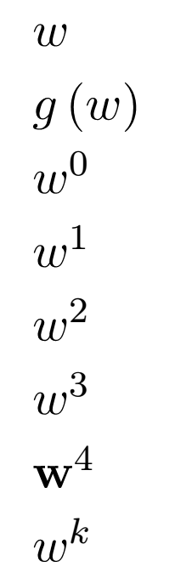

Why learn numerical optimization?
In virtually all machine learning applications we look to find the (global) minimum of an associated cost function
This (global) minimum corresponds to the optimal parameters/weights for the model at hand
(global) minimum

Slide 3

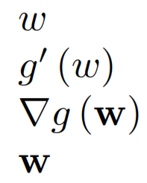

A useful tool from Calculus
The first order condition for optimality gives a nice criterion for finding all stationary points:
is a stationary point of if
For a general N-d input , we have the analogous condition
saddle point
(global) minimum
maximum
minimum
Notes:
wiggly.tif

Slide 4


The convenience of convexity
All stationary points of a convex cost function are global minima!
Many machine learning models have convex formulations (linear regression, logistic regression, SVMs, etc.)
(global) minimum
Notes:
wiggly.tif

Slide 5
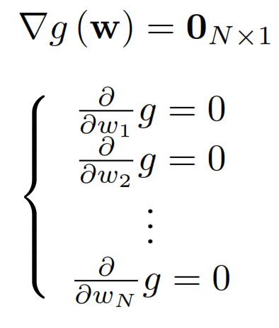
Solving the first order system
is a system of N equations
Easy to solve when linear (e.g., linear regression)
But in most cases nonlinear in with no closed form solution
Iterative methods (e.g., gradient descent or Newton’s method)
are used to approximately solve this system

Slide 6
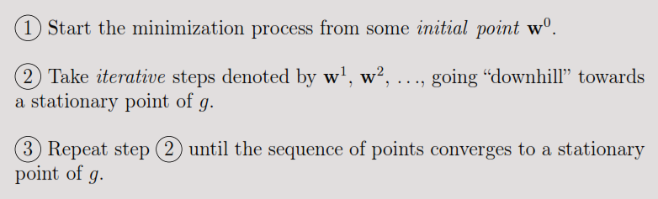
Iterative methods
want to get here (where the gradient is zero!)

Slide 7


Initial point
saddle point
local minimum
global minimum

Slide 8
Initial point
With non-convex cost functions it is possible to end up at a saddle point or a local minimum depending on the initialization
In such cases run the iterative method multiple times with different initializations and take the lowest result
Convex costs do not require multiple runs!

Slide 9

When to stop?
Theoretically speaking an iterative algorithm must be run until the gradient becomes exactly zero!
In practice we stop after a pre-determined number of iterations or when we reach an approximate stationary point where for some small user-defined threshold

Slide 10
The iterative steps
The iterative steps are taken based on the Taylor series approximation of the cost function
We discuss two popular methods: gradient descent (based on 1st order Taylor approximation), and Newton’s method (based on 2nd order Taylor approximation)

Slide 11


Gradient descent
The most basic yet extremely popular numerical optimization method
Iterative steps are taken based on the 1st order Taylor series approximation
The minimum is sought by traveling downward on the hyperplanes tangent to at each iteration

Slide 12
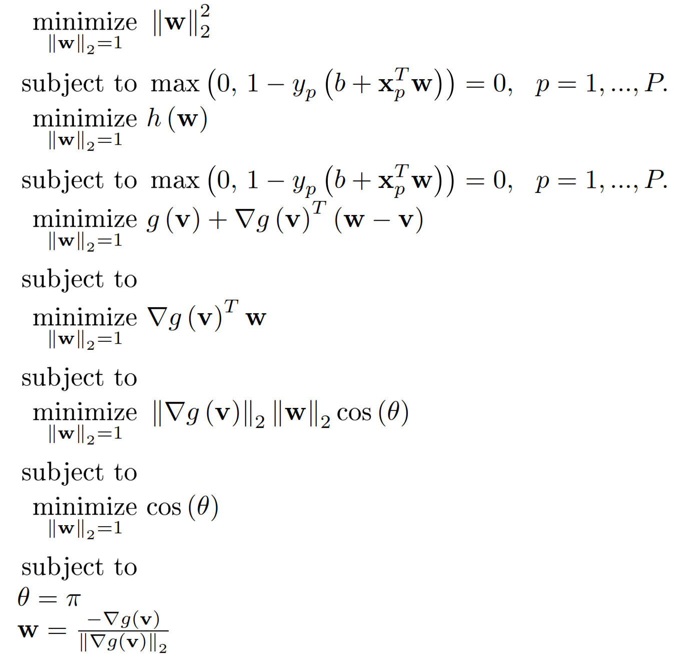
Gradient descent
The idea is to minimize instead of
But is a hyperplane with its minimum at -∞ !
So we take a finite-length step in the steepest descent direction

Slide 13

Gradient descent
Begin at a point w⁰
Travel downward on tangent hyperplane to at w⁰ in the direction of negative gradient
(Hop back onto the function)
Repeat until a stationary point is reached
step length (aka learning rate)
determines how far to travel down the negative gradient direction
Notes:
Note point iterations written with a superscript, also notice that this function differs from the other wiggly version as we have removed the saddle point. This is just so we can more easily illustrate gradient descent visually.

Slide 14
Gradient descent step length
What happens when the step length is too large?

Slide 15
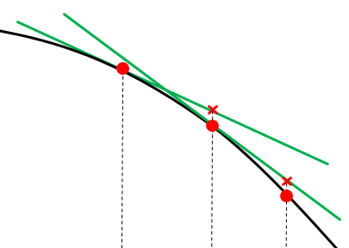
Gradient descent step length
What happens when the step length is too small?

Slide 16
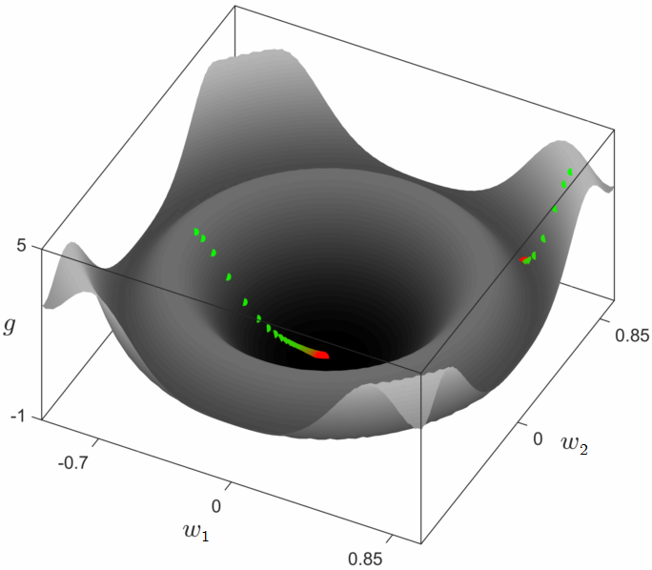
MATLAB
grad_2d.fig

Slide 17
Gradient descent step length
How to select a “good” step length?
Naïve trial and error: Start with a fixed large step size for all iterations, if it does not produce decreasing values in then decrease and try again!
Does have bounded curvature? If so, a fixed step length can be calculated with provable convergence (details ahead)
Adaptive step length selection: Use an adaptive step length procedure that essentially does “trial and error” at each step (details ahead)

Slide 18
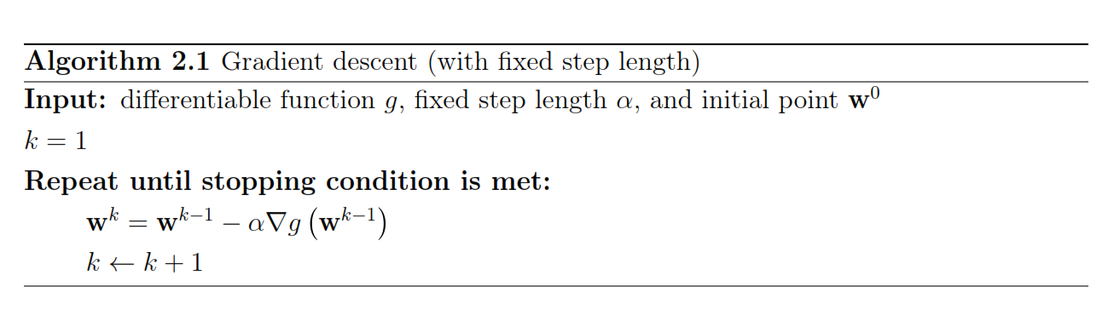
Pseudo-code

Slide 19

Newton’s method
Iterative steps are taken based on the 2nd order Taylor series approximation
The minimum is sought by traveling downward on the quadratics tangent to at each iteration

Slide 20
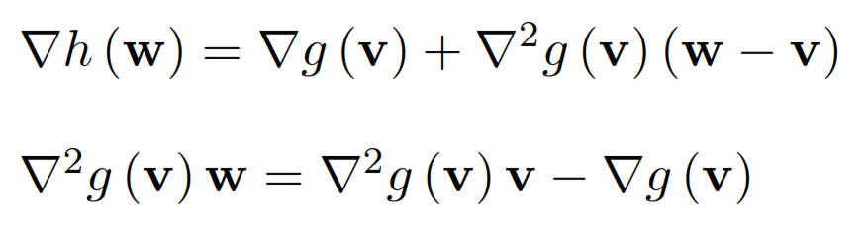
Newton’s method
Once again the idea is to minimize at each step
is quadratic
So we can find its stationary point using the first order condition
Setting to zero gives the following linear system in

Slide 21
Newton’s method
Begin at a point w⁰
Travel to the minimum of the tangent quadratic
(Hop back onto the function)
Repeat until a stationary point is reached
Again, the minimum of each quadratic is found via solving
Notes:
Note point iterations written with a superscript, also notice that this function differs from the other wiggly version as we have removed the saddle point. This is just so we can more easily illustrate gradient descent visually.

Slide 22
Warning!
For a non-convex function quadratics can be concave
With such functions Newton’s method can climb to a maximum, or diverge!

Slide 23
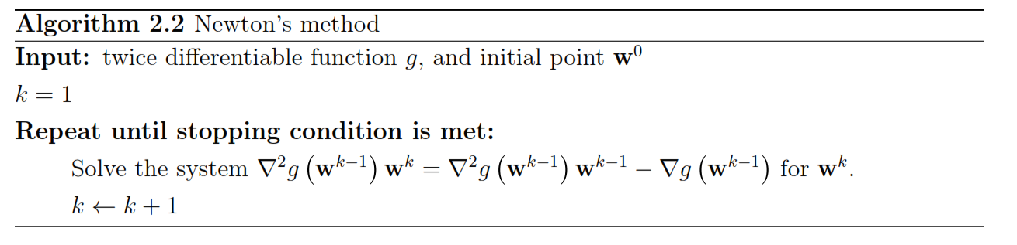
Pseudo-code

Slide 24
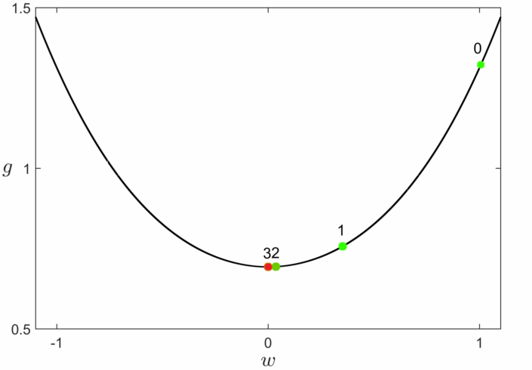

Slide 25
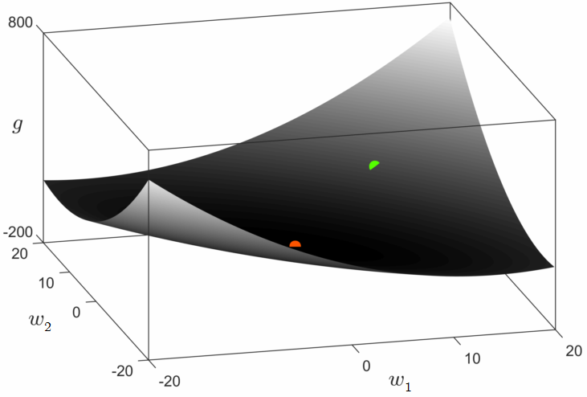

Slide 26
Gradient descent vs. Newton’s method
Gradient descent uses 1st order (linear) approximations while Newton’s method uses
2nd order (quadratic) approximations
Newton’s method converges in fewer steps as a result
Unlike Newton’s method, gradient descent needs properly chosen step length for convergence
Newton’s method requires calculation/storage of the Hessian (in addition to the gradient) at each iteration, thus not suitable for large scale problems
Newton’s method can be problematic when applied to non-convex functions

