Slide 1
Chapter 5: Automatic Feature Design for Regression
Machine Learning Refined: Foundations, Applications, and Algorithms Cambridge University Press (2016)

Slide 2
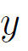

Regression as continuous function approximation
A typical/realistic regression dataset
The underlying continuous data-generating function is a sinusoidal in this case. Our goal is to approximate this function
Realistic data is always noisy but lets momentarily assume that data is clean (i.e., noiseless)
Still infinitely-many potential continuous functions that go through all these samples. Lets increase the samples!
As the number of samples goes to infinity, the problem of regression reduces to the classic problem of continuous function approximation

Slide 3
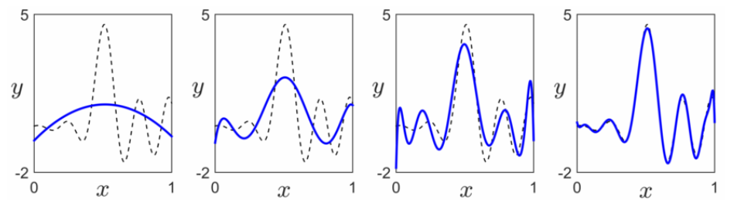


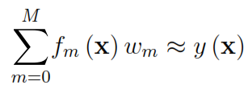

Continuous function approximation
Input: for all
Output: An approximate functional form for
The functional form is found via decomposing over a given basis as
This idea is closely related to the concept of representing a given vector in
(i.e. a discrete function) over a set of basis vectors in

Slide 4

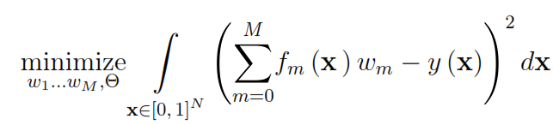

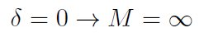
Continuous function approximation: More the merrier!
For any there’s a large enough M so that
M = 2
M = 6
M = 10
M = 20

Slide 5
Common bases for continuous function approximation
1. Fixed bases
2. Adjustable bases
Polynomial basis
Feed-forward neural network basis
Fourier basis
The name is coined by neuroscientists in the late 1940s who used this sort of basis to roughly model how the human brain processes information
Consists of monomials of varying degree
Taylor expansion of a function also uses these basis functions
Consists of sine and cosine waves of varying frequency
Named after its inventor Joseph Fourier who used these basis functions in the early 1800s to study heat diffusion

Slide 6
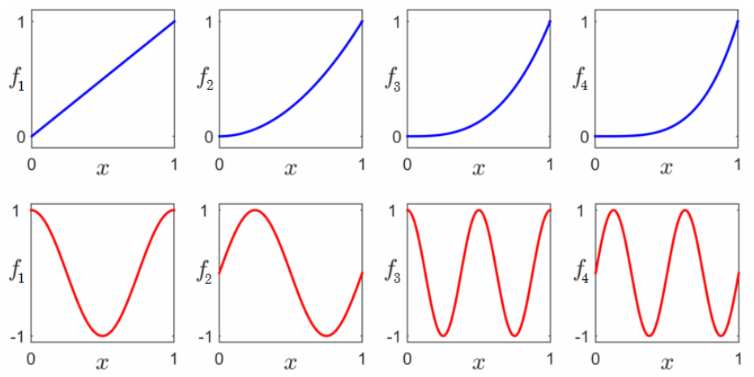


Common bases for continuous function approximation
1. Fixed bases
2. Adjustable bases
Polynomial basis
Feed-forward neural network basis
Fourier basis

Slide 7
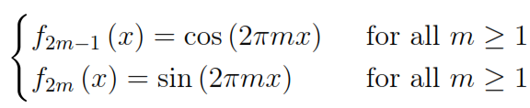
Common bases for continuous function approximation
1. Fixed bases
2. Adjustable bases
Polynomial basis
Feed-forward neural network basis
Fourier basis

Slide 8
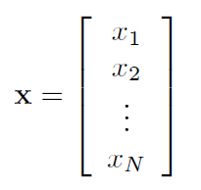

Common bases for continuous function approximation
1. Fixed bases
2. Adjustable bases
Polynomial basis (N-d)
Feed-forward neural network basis
Fourier basis

Slide 9

Common bases for continuous function approximation
1. Fixed bases
2. Adjustable bases
Polynomial basis
Feed-forward neural network basis
Fourier basis (N-d)
1-d
N-d

Slide 10
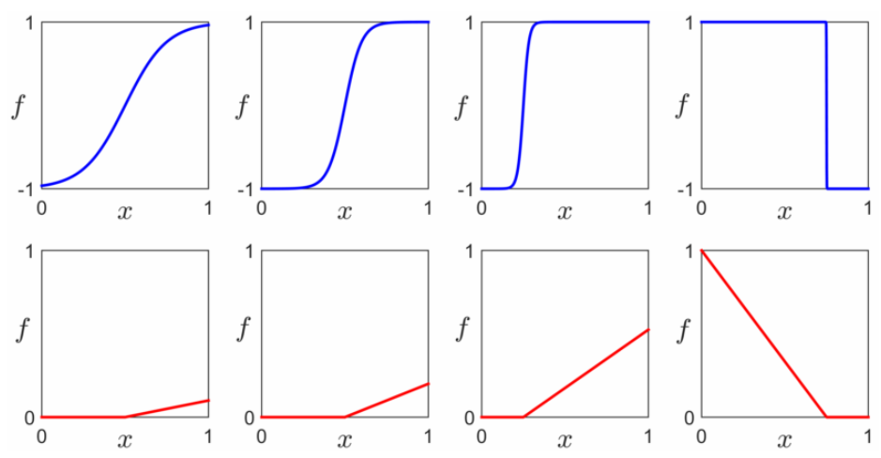



Common bases for continuous function approximation
1. Fixed bases
2. Adjustable bases
Polynomial basis
Feed-forward neural network basis
Single hidden-layer network
Fourier basis
‘tanh’ activation

Slide 11
Common bases for continuous function approximation
1. Fixed bases
2. Adjustable bases
Polynomial basis
Feed-forward neural network basis
Single hidden-layer network
Fourier basis
‘max’ activation

Slide 12
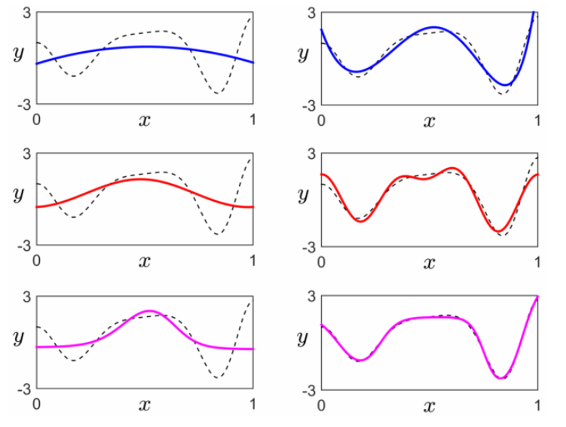
Common bases for continuous function approximation
M = 2
M = 6
Polynomial basis
M = 2
M = 6
Fourier basis
M = 2
M = 6
Single hidden-layer basis (with ‘tanh’ activation)

Slide 13
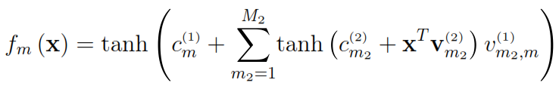
From single hidden-layer to multi hidden-layer bases
Flexibility of the single hidden-layer basis functions is gained by introduction of adjustable internal parameters and
To create even more flexible basis functions we can compose the activation function with itself, giving two-hidden layer basis functions of the form
This composition procedure can be repeated to arrive at a general L-hidden layer basis
A basis with L>2 hidden-layers is usually called a ‘deep network’

Slide 14
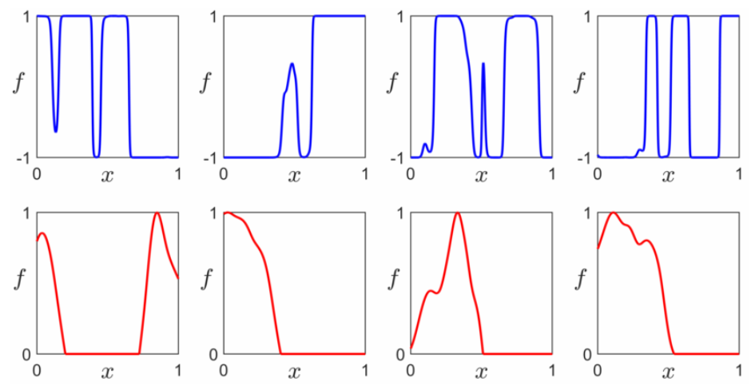
Two hidden-layer basis functions
‘tanh’ activation
‘max’ activation

Slide 15
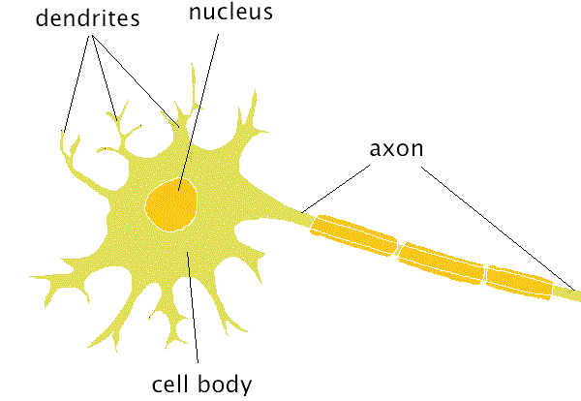
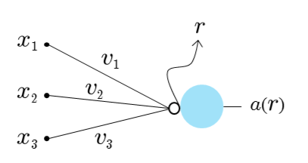


Graphical representation of a neural network
A biological neuron:
An artificial neuron:
activation unit

Slide 16
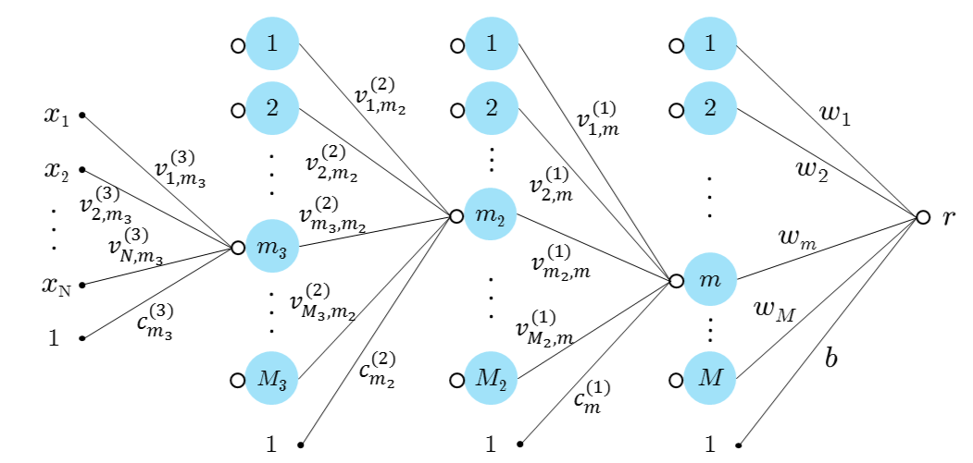
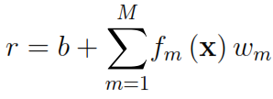
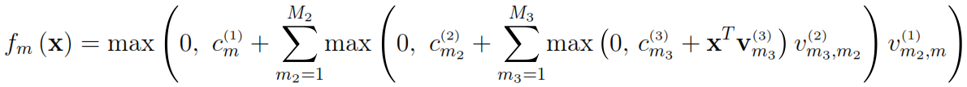
Graphical representation of a neural network

Slide 17
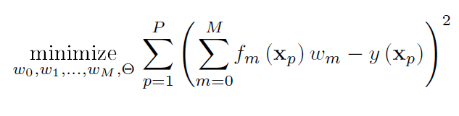
Recovering the weights
contains internal parameters when adjustable bases are used; otherwise empty
The continuous Least Squares integral above is intractable esp. when using neural net bases
One can approximate this integral by discretizing all the continuous functions involved using a fine grid of P evenly spaced points over the unit hypercube, giving

Slide 18
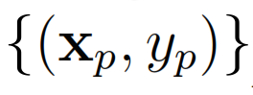

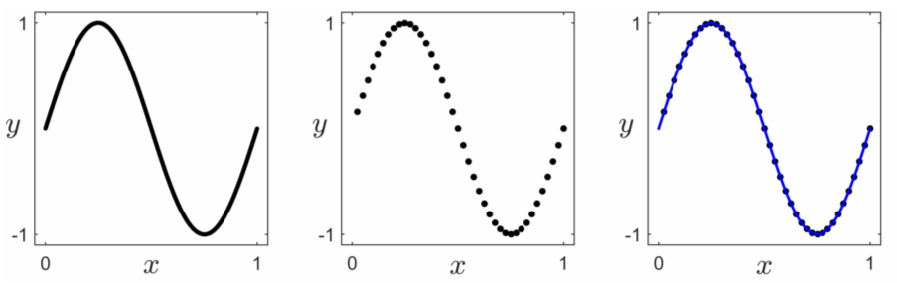
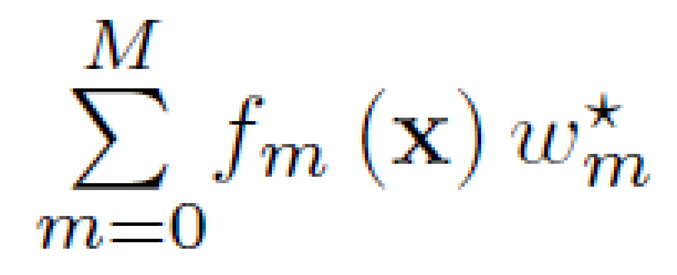
Recovering the weights
for all
discretize
solve

Slide 19
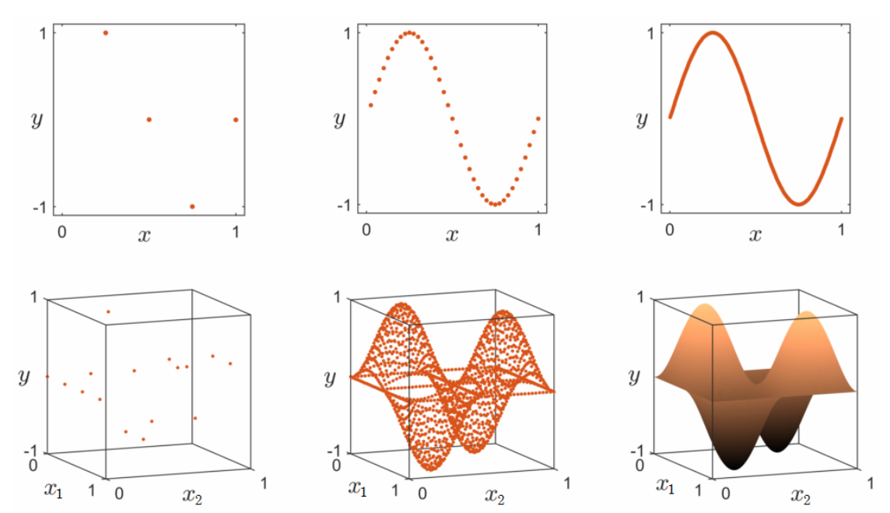
P and the curse of dimensionality
P = 4
P = 40
P = 400
N = 1
P = 4²
P = 40²
P = 400²
N = 2

Slide 20
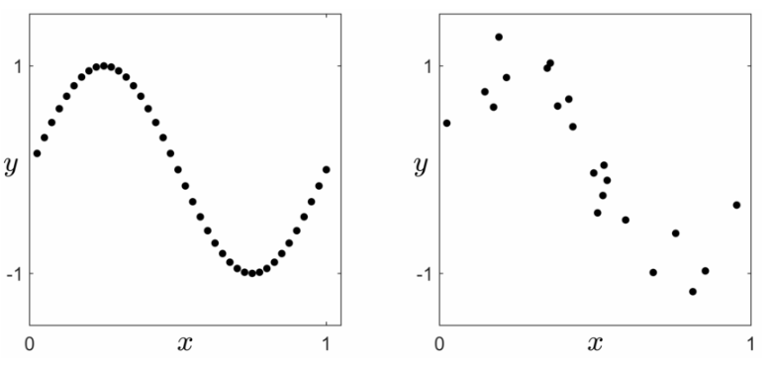
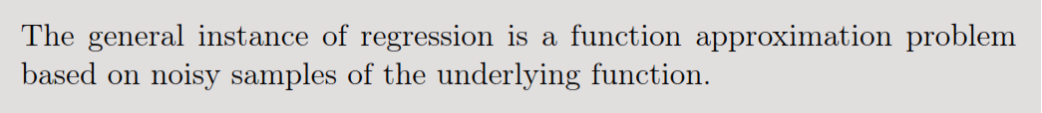
Realistic regression scenario
Ideal regression dataset
Realistic regression dataset
P is relatively large
evenly distributed samples
data is clean
P is relatively small
samples are not distributed evenly
data is noisy

Slide 21

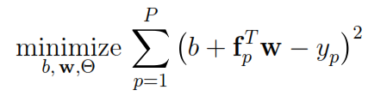



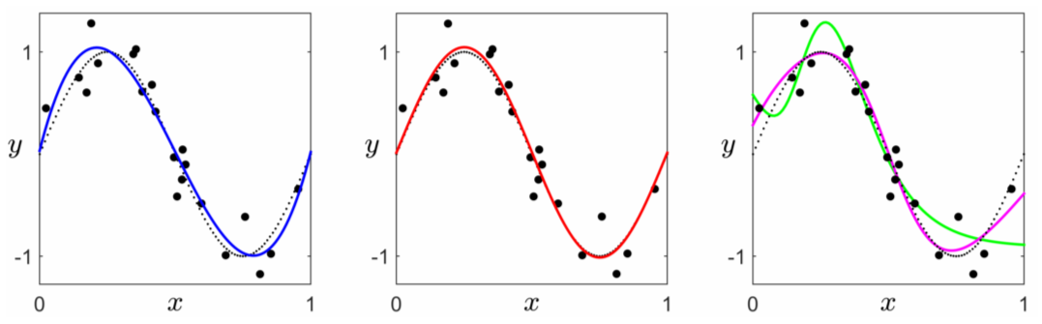
Realistic regression scenario
Single hidden layer NN
Fourier
Polynomial

Slide 22
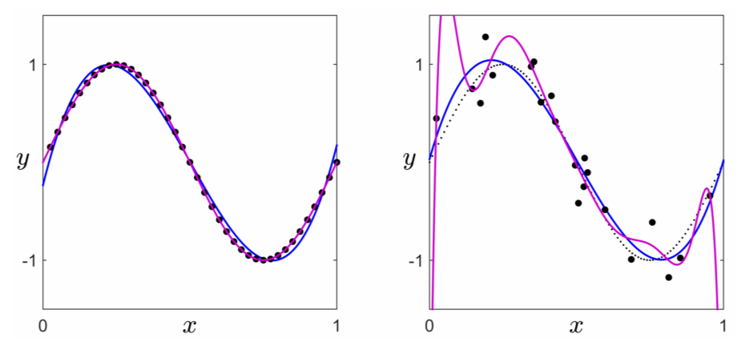
Choice of M
Ideal dataset
Realistic dataset
M = 3 (polynomial)
M = 3 (polynomial)
M 10 (polynomial)
M = 10 (polynomial)
With realistic data, increasing M could worsen our approximation of the underlying function!

Slide 23
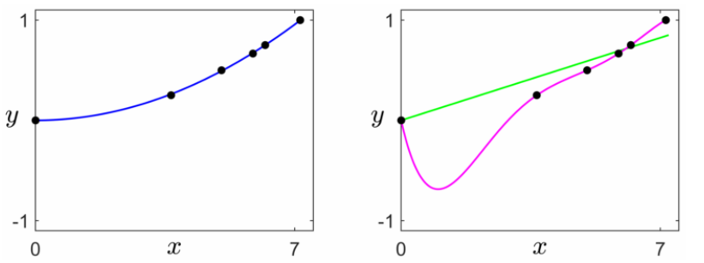
In search of a sweet spot for M
Galileo’s ramp data
When M is too small, the corresponding model will be too rigid and inflexible to effectively approximate the underlying phenomenon → underfitting
M = 1 (polynomial)
M = 6 (polynomial)
When M is too large, the corresponding will be needlessly complicated resulting in a very close fit to our noisy data → overfitting
When M is chosen appropriately, the resulting model will be simple yet flexible enough to explain the underlying phenomenon → Occam’s Razor
M = 2 (polynomial)

Slide 24
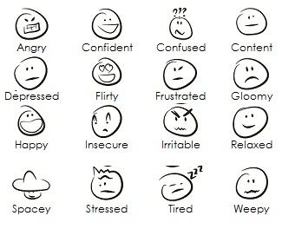
In search of a sweet spot for M
With the date we have currently we can avoid underfitting
current data
future data
M too small
To rule out overfitting we need access to future data!
M too large
Cross-validation provides a way to simulate future data
M is proper

Slide 25
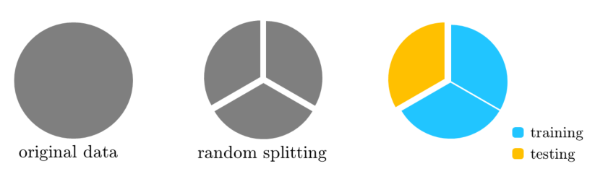
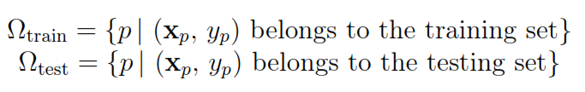
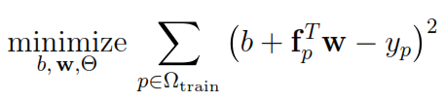

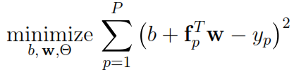
Hold-out cross-validation
entire
dateset
Begin by splitting the data into a larger training set and a smaller testing set
Select a range of values for M, and for each M in that range:
Train the model on the training set by solving
Calculate the testing error via
Choose the value of M that gives the lowest testing error, and form
Train the model one last time on the entire dataset by solving

Slide 26
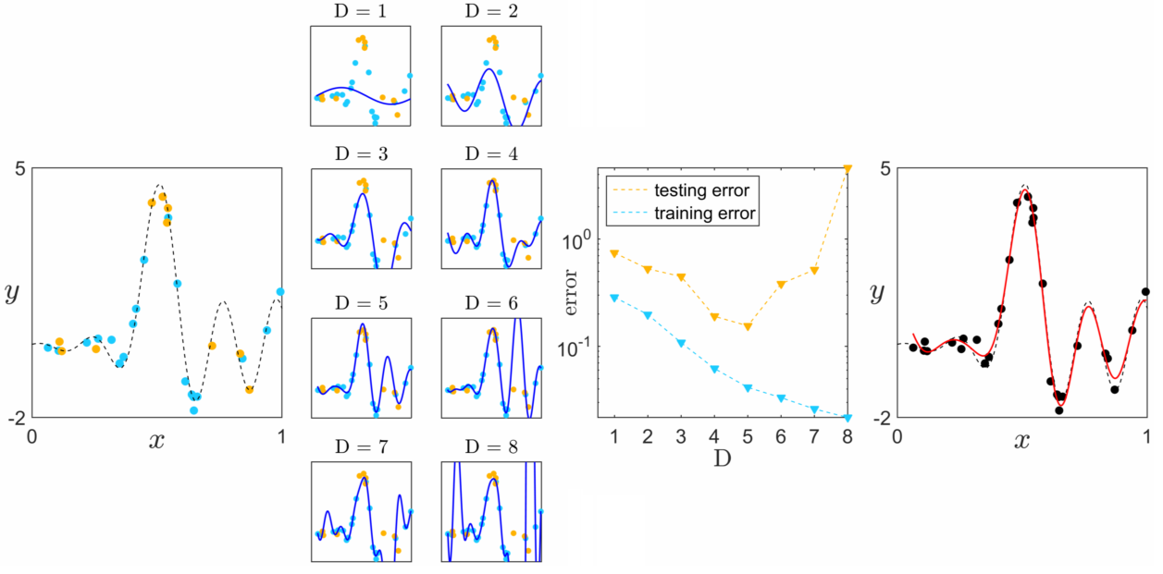
Hold-out cross-validation: Example
Basis: Fourier

Slide 27
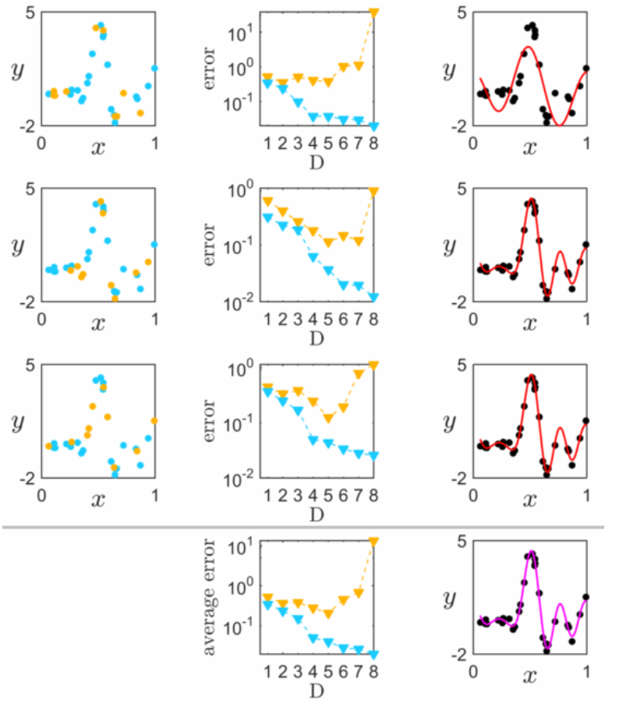
Hold-out cross-validation
A major flaw with hold-out cross-validation: having been chosen at random, the points assigned to the training set may not adequately describe the original data
For instance, the following random split does not recover the correct choice for D/M
Luckily the hold-out scheme can be extended and made robust as we will see next

Slide 28
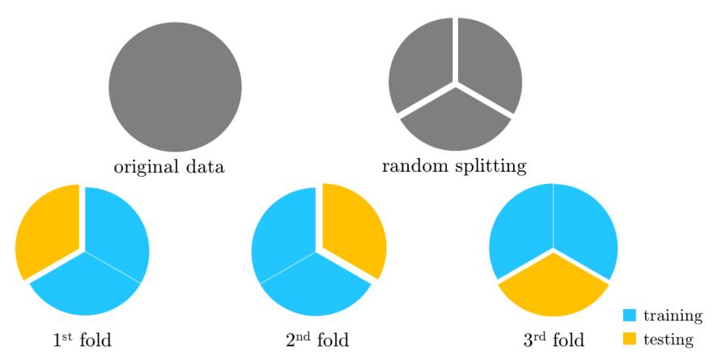
k-fold cross-validation
With k-fold cross-validation the data is randomly split into k folds (here k = 3)
A hold-out cross-validation procedure is performed k times, each time using one of the folds as the testing set and the rest as training
The optimal value for M is then selected based on the testing error averaged over all k folds

Slide 29
k-fold cross-validation: Example
Relying on the average testing error, k-fold cross-validation is robust to the occasional problematic random splits

Slide 30
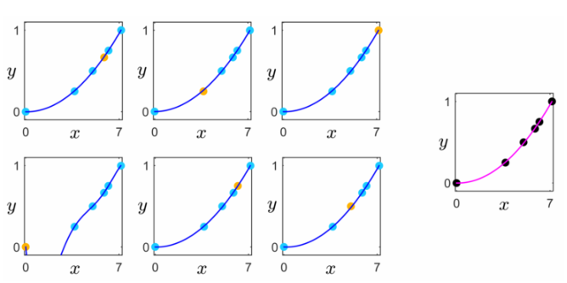
Choice of k
No hard rule. In practice, k = 3…10
The larger the k the more robust cross-validation becomes. This advantage however comes at a high computational cost
Generally speaking k should be set inversely proportional to P, i.e. the larger the dataset the smaller k can be set and vice-versa
When data is plentiful hold-out cross-validation will perform well
When data is extremely scarce (e.g., Galileo’s ramp data with P = 6), k must be set to its maximal value P, in which case k-fold cross-validation is also referred to as one-leave-out cross-validation

Slide 31
Which basis to choose?
Depends entirely on the underlying phenomenon. Even though one could not have a full understanding of the data-generating function, any cues can lead to a particular choice of basis or eliminate potential candidates, e.g. :
The gravitational phenomenon underlying Galileo’s ramp dataset is quadratic in nature, inferring the appropriateness of a Polynomial basis
Fourier basis is intuitively appropriate when dealing with periodic phenomena arising in a variety of disciplines including speech processing and financial modeling
Neural network bases are often employed with image and audio data due to their compositional structure as well as a belief in the correspondence of these bases and the way such data is processed by the brain

Slide 32
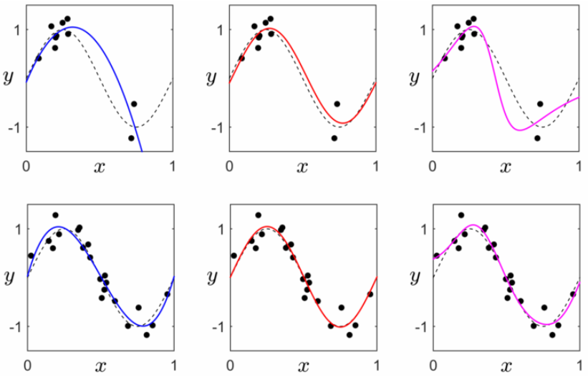
When the choice of basis is arbitrary
P is large
evenly distributed samples
no noise
P is small
samples distributed very unevenly
extreme levels of noise
‘Quality of data’ spectrum
Polynomial
Fourier
Single hidden-layer NN

Slide 33
When the choice of basis is arbitrary
P is large
evenly distributed samples
no noise
P is small
samples distributed very unevenly
extreme levels of noise
‘Quality of data’ spectrum
Polynomial
Fourier
Single hidden-layer NN

