Slide 1
Chapter 6: Automatic Feature Design for Classification
Machine Learning Refined: Foundations, Applications, and Algorithms Cambridge University Press (2016)

Slide 2

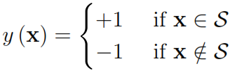
Classification as indicator function approximation
Two-class classification can be thought of as a particular instance of regression, where the output only takes on values in
Hence with classification the underlying data-generating function we aim to approximate is not a continuous function but an indicator function defined over a set as
In other words, and its complement respectively determine subsets of the input space that the ‘+1 class’ and ‘-1 class’ occupy

Slide 3
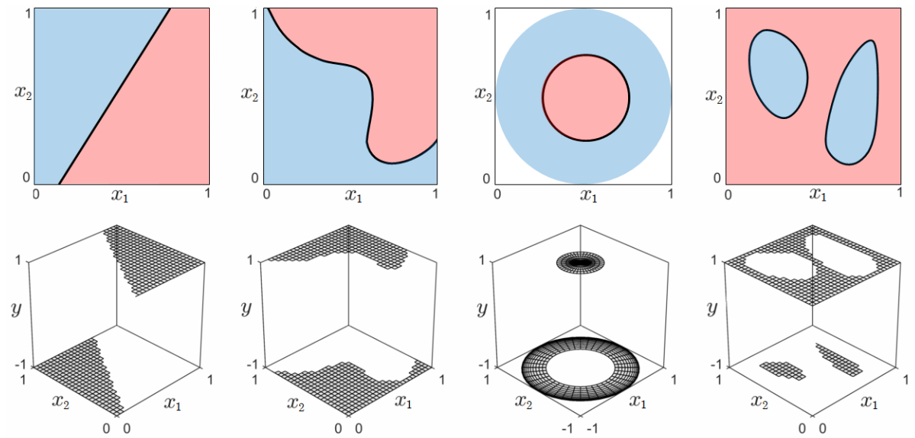
Classification as indicator function approximation
Although can take any arbitrary shape in general, practically speaking we are only interested in sets that have an interior to them, like the ones show below. This excludes degenerate cases such as the union of isolated points

Slide 4
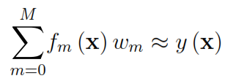
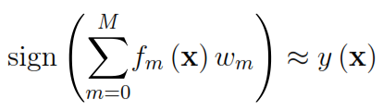
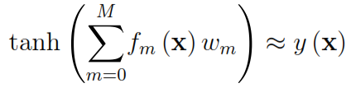
Classification as indicator function approximation
Continuous function approximation for regression:
Indicator function approximation for classification:
Once again (as we saw with logistic regression) we can approximate the discontinuous ‘sign’ function with the smooth ‘tanh’ resulting in the following logistic approximation to

Slide 5

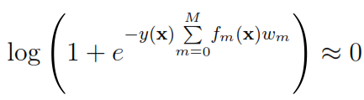
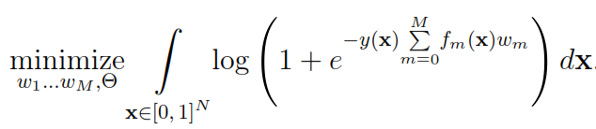
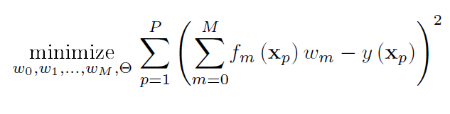
Recovering weights in the logistic approximation
Noting that ‘tanh’ is an odd function and only takes values in we can write the above as
With a few algebraic manipulations this can be further simplified to
giving the following optimization problem to tune the weights

Slide 6
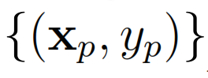


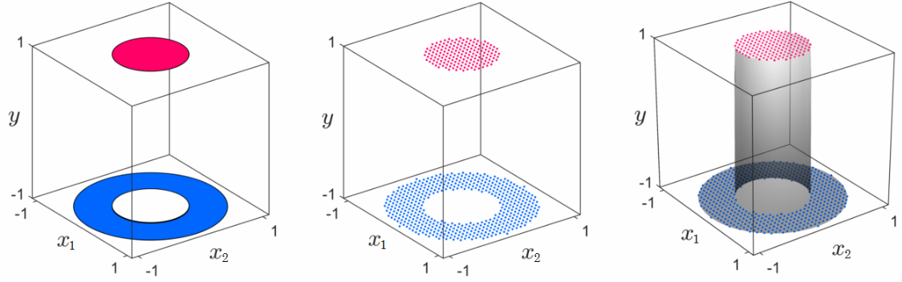
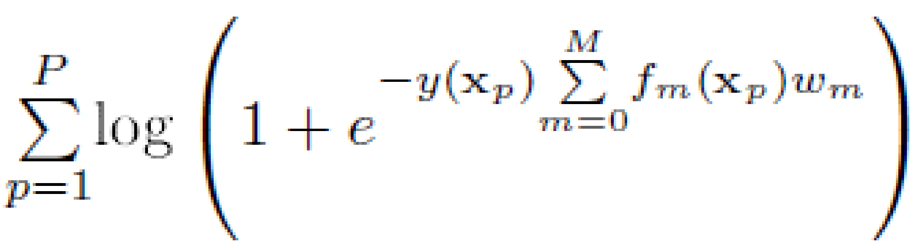
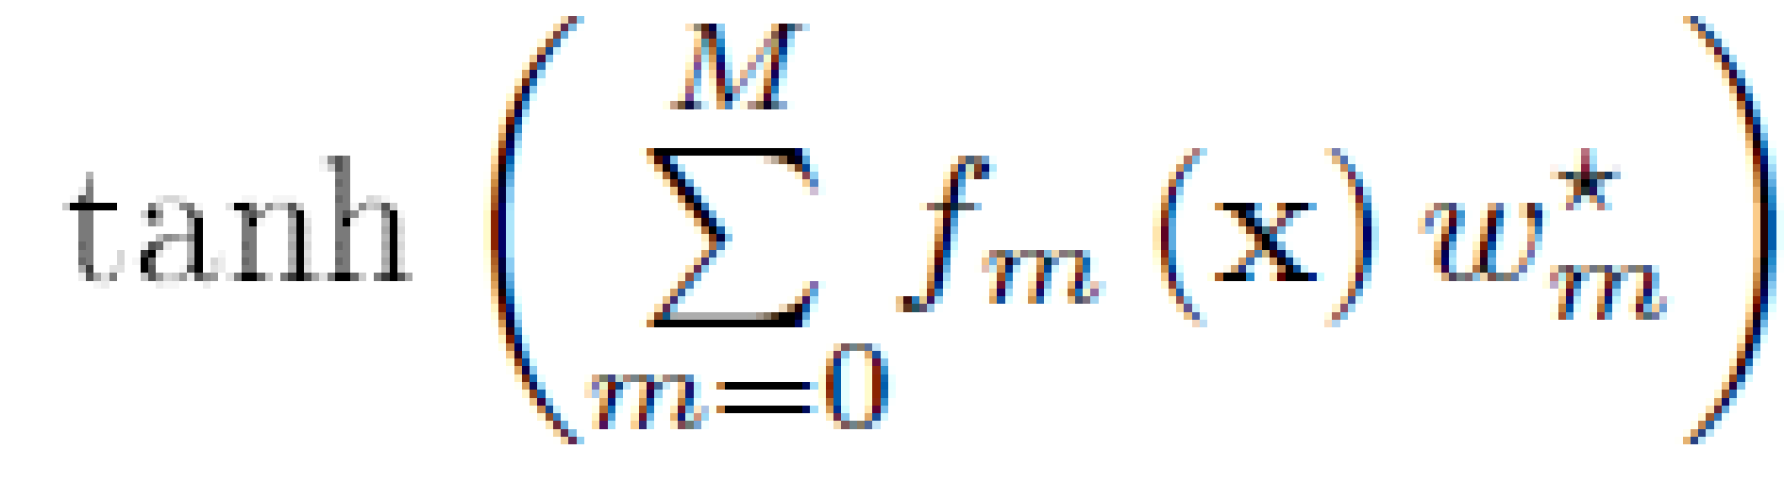
Dealing with the intractable integral!
discretize
solve

Slide 7
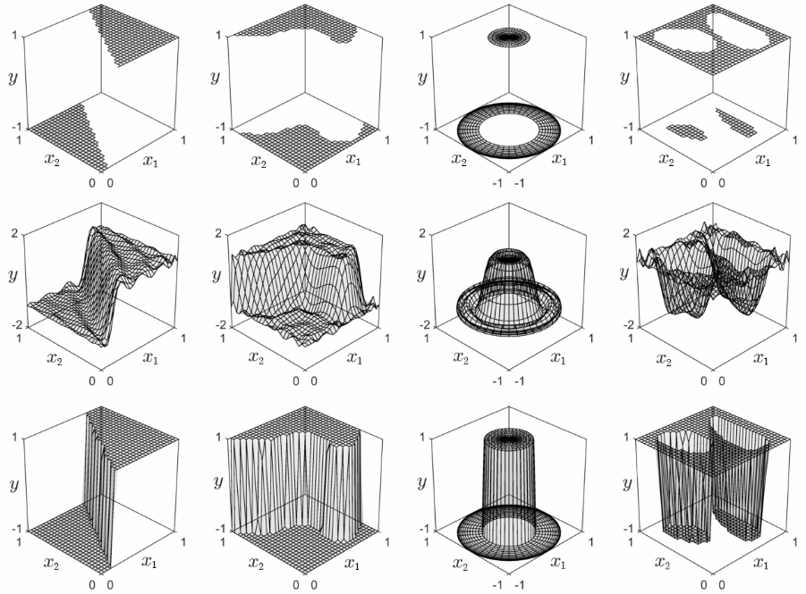
Logistic approximation in action
original indicator functions
regression-style continuous approximations w/ M = 30 polynomial features
logistic approximations w/ M = 30 polynomial features

Slide 8
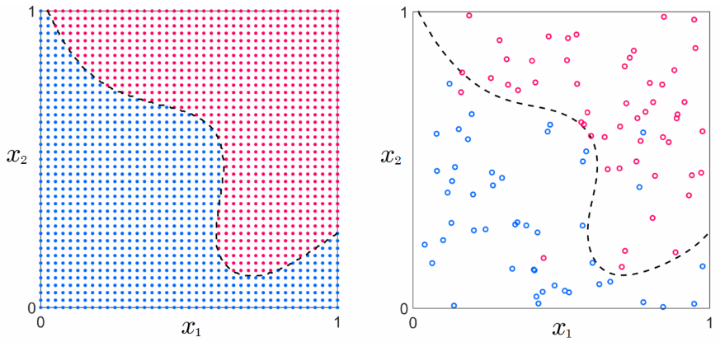
Realistic classification scenario
Ideal classification dataset
Realistic classification dataset
P is relatively large
evenly distributed samples
data is clean
P is relatively small
samples are not distributed evenly
data is ‘noisy’
In the context of classification ‘noisy’ means that some data points have been assigned the wrong labels

Slide 9

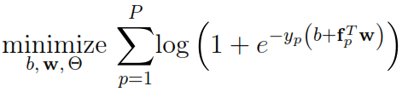



Realistic classification scenario
Polynomial features
Fourier features
1-hidden layer NN features

Slide 10
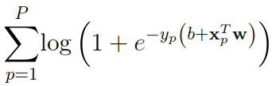
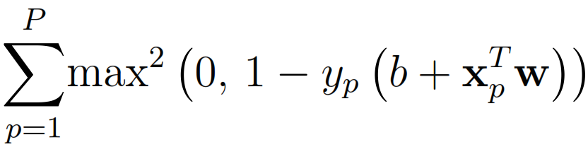
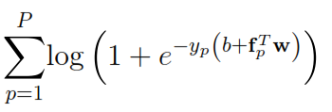
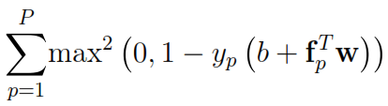
Squared-margin cost for general classification
Softmax cost
Squared margin cost
Linear classification
General classification

Slide 11
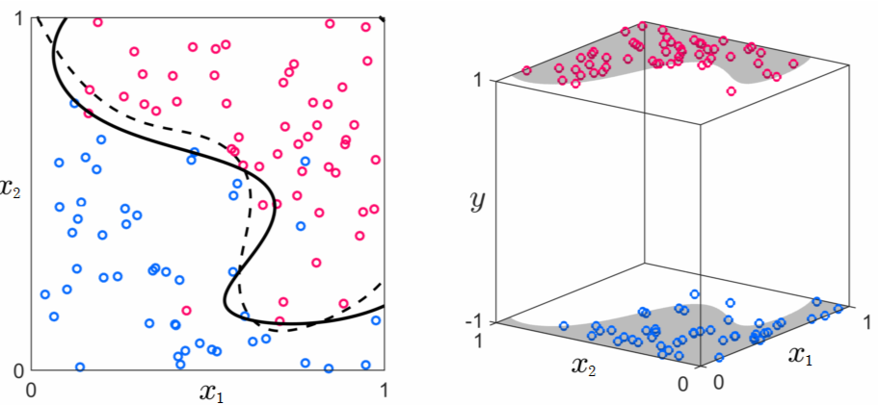
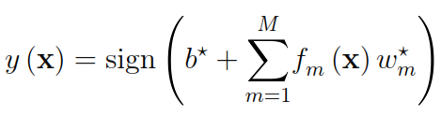
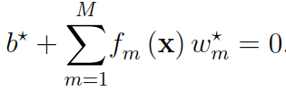
Example toy dataset
Feature map: Polynomial

Slide 12
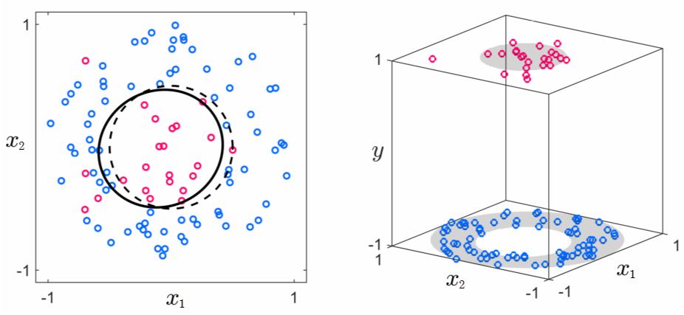
Example toy dataset
Feature map: Polynomial

Slide 13
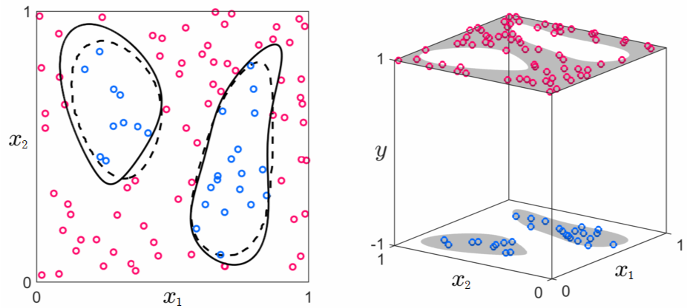
Example toy dataset
Feature map: Polynomial

Slide 14
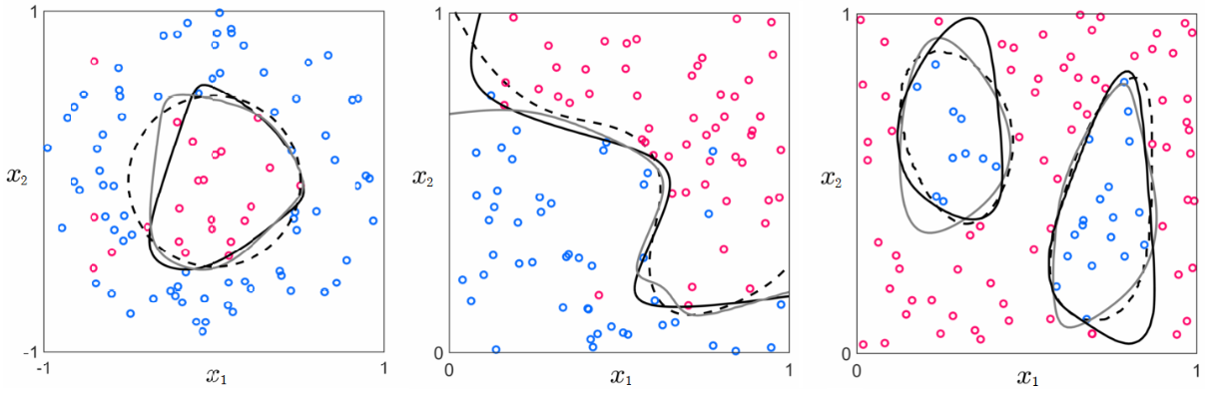
Example toy dataset
Feature map: single hidden-layer NN

Slide 15
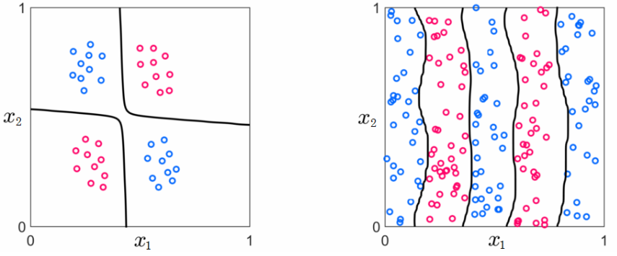
Example toy dataset
Feature map: Polynomial
Feature map: Fourier

Slide 16
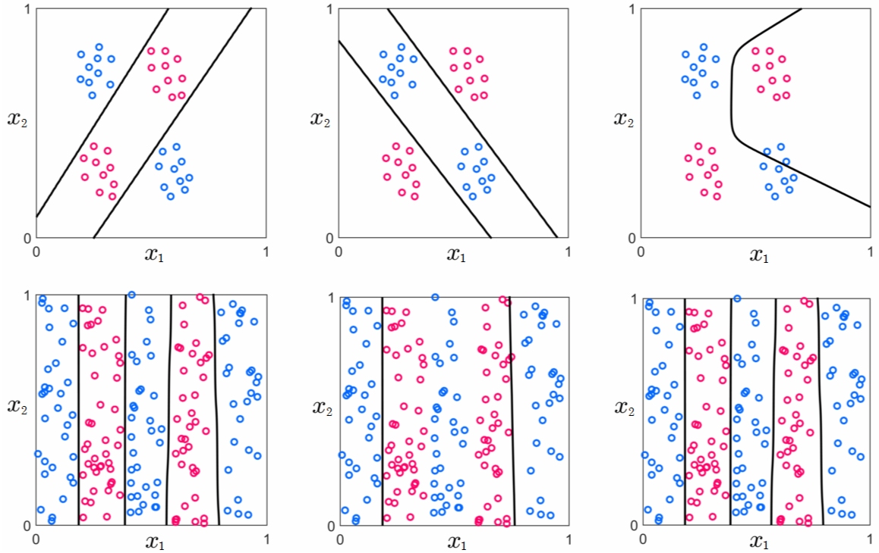
Example toy dataset
Feature map: single hidden-layer NN
bad local minimum!

Slide 17
Example toy dataset
Feature map: single hidden-layer NN
bad local minimum!

Slide 18
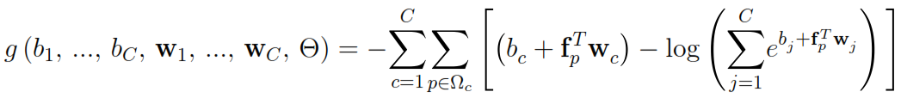
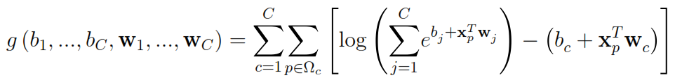
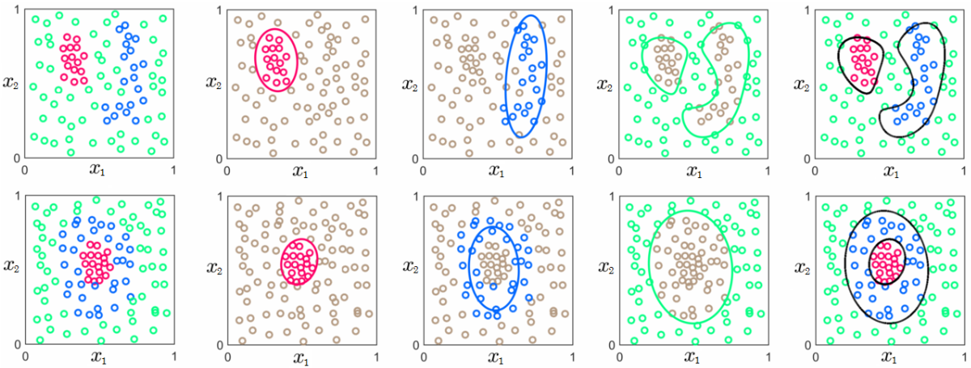
Multiclass softmax classification
Linear
General
Nonlinear boundaries

Slide 19
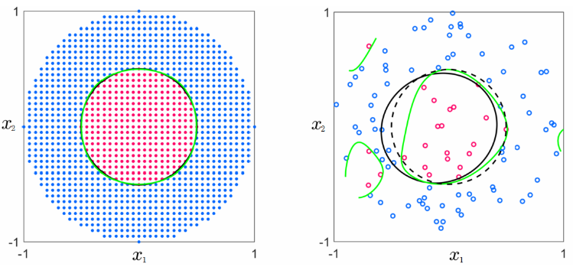
Choice of M
Ideal dataset
Realistic dataset
M = 5 (polynomial)
M = 20 (polynomial)
With realistic data, increasing M could worsen our approximation of the underlying function!

Slide 20
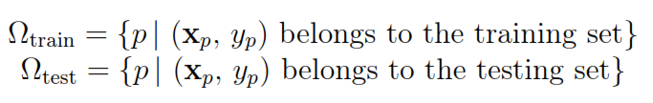

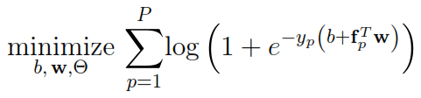
Hold-out cross-validation
entire
dateset
Begin by splitting the data into a larger training set and a smaller testing set
Select a range of values for M, and for each M in that range:
Train the model on the training set by solving
Calculate the testing error as
Choose the value of M that gives the lowest testing error, and form
Train the model one last time on the entire dataset

Slide 21
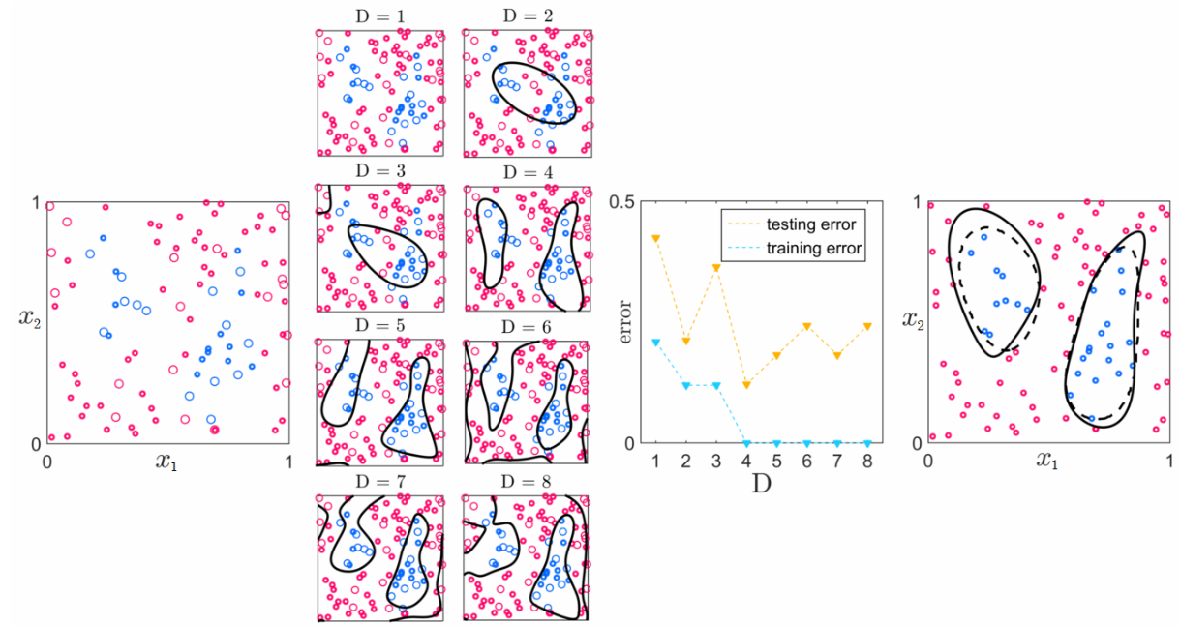
Hold-out cross-validation: Example
Basis: Polynomial

Slide 22
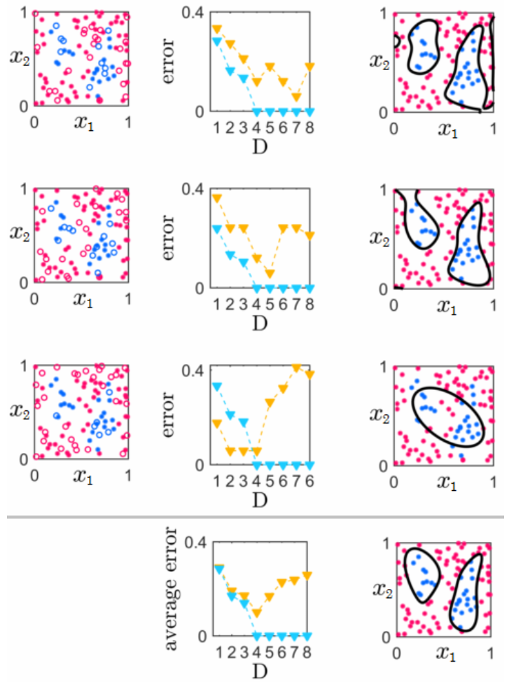
k-fold cross-validation: Example
Once again, k-fold cross-validation produces a more robust choice of M as would be poor hold-out choices on individual folds can be averaged out, producing a stronger model

Slide 23
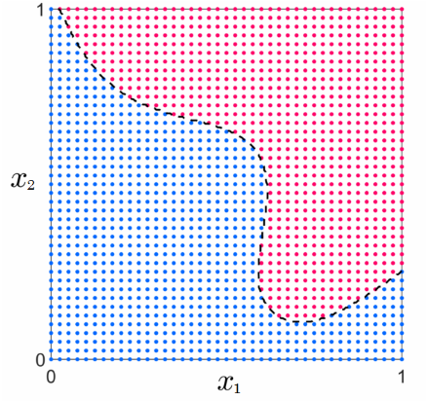
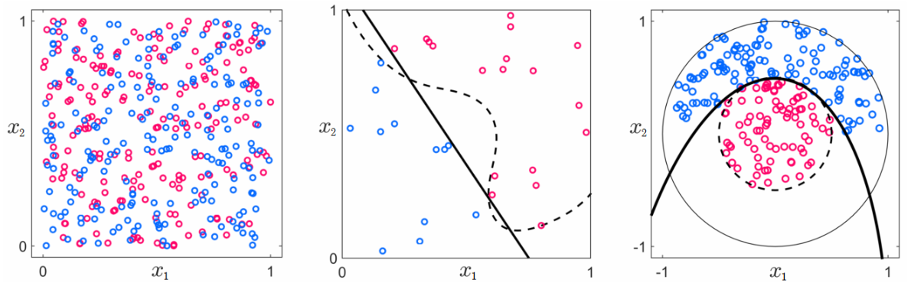
When cross-validation fails
P is large
evenly distributed samples
no noise
P is small
samples distributed very unevenly
extreme levels of noise
‘Quality of data’ spectrum
This sort of problem arises in applications like automated medical diagnosis where access to data is limited!

Slide 24
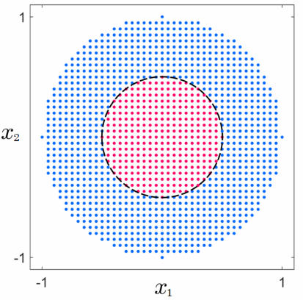

When cross-validation fails
P is large
evenly distributed samples
no noise
P is small
samples distributed very unevenly
extreme levels of noise
‘Quality of data’ spectrum
Tony Award

Slide 25
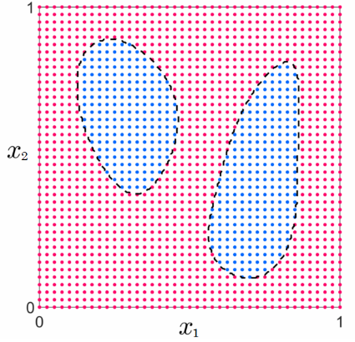
When cross-validation fails
P is large
evenly distributed samples
no noise
P is small
samples distributed very unevenly
extreme levels of noise
‘Quality of data’ spectrum
Noise in this case completely drowns out the structure in the data!

