Slide 1

Pocket-Care CWRU Full Stack Project 3
Michael Beebe, Gino Kamau, Stephen Kainec, Maria Ratino
January 30, 2020

Slide 2
Project Requirements
Use a Node and Express Web Server
* Be backed by a MySQL Database an ORM (Mongo)
* Have both GET and POST routes for retrieving and adding new data
* Be deployed using Heroku (with Data)
* Utilize at least one new library, package, or technology that we haven’t discussed
* Have a polished frontend / UI
* Have folder structure that meets MVC Paradigm;
* Meet good quality coding standards (indentation, scoping, naming)
* Must not expose sensitive API key information on the server

Slide 3

.
A Tool to Remind You
Pocket Care stores your personal medical information at your fingertips. A responsive tool that uses Bootstrap React and Mongoose to keep your medication list, medical history, appointments, and important details safe through a password protected database.
Your medical history can be invaluable in an emergency. When there’s limited time, your medical information could mean the difference between life and death
In less serious situations, it saves valuable time searching for relevant facts like medications or allergies.

Slide 4
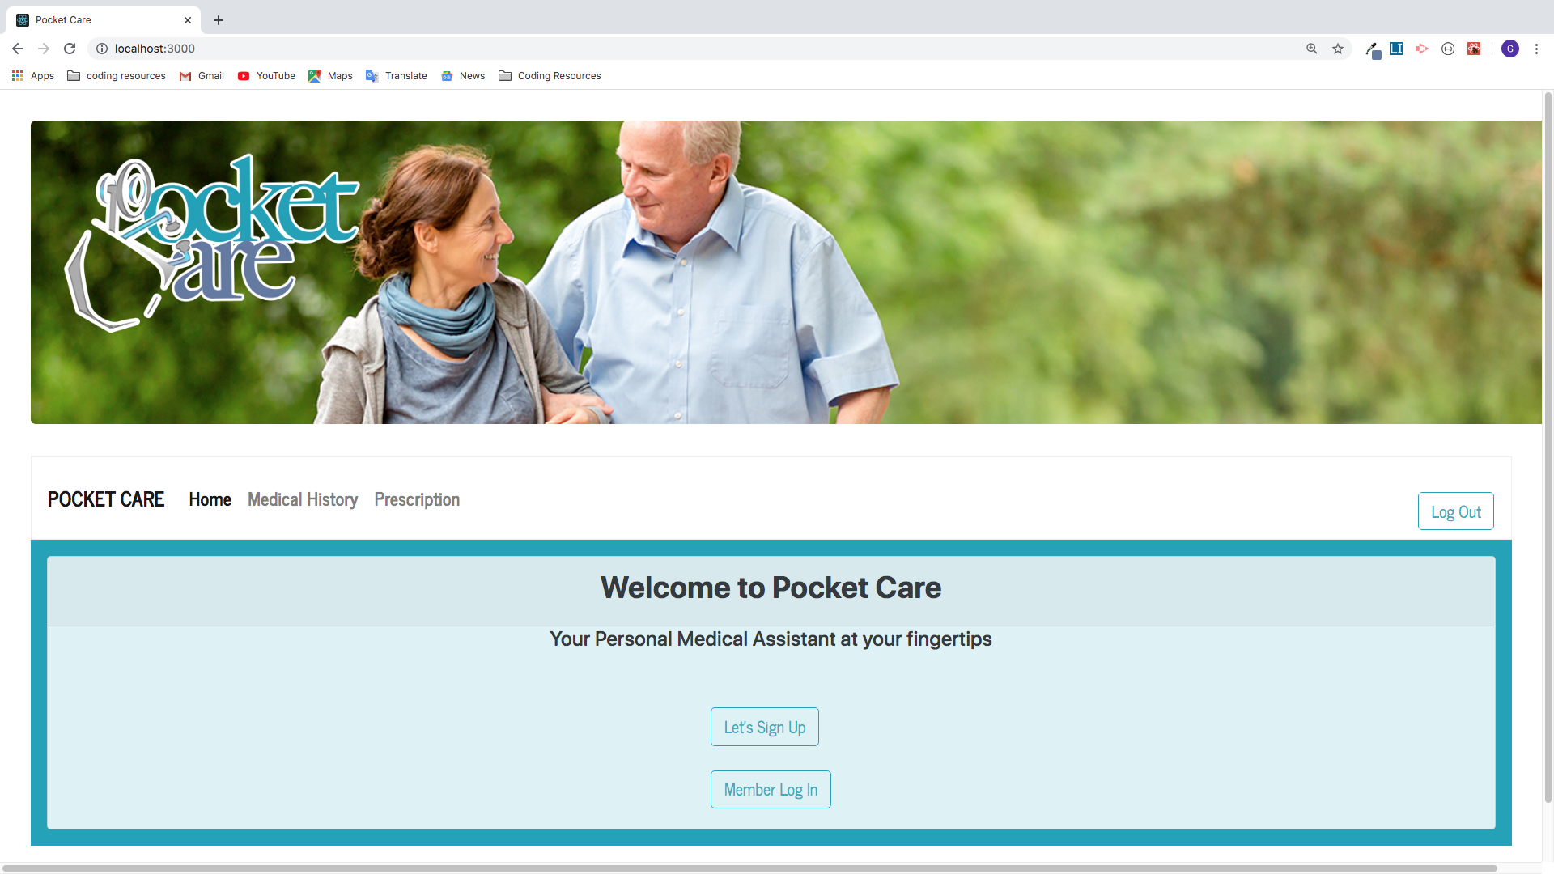

Slide 5
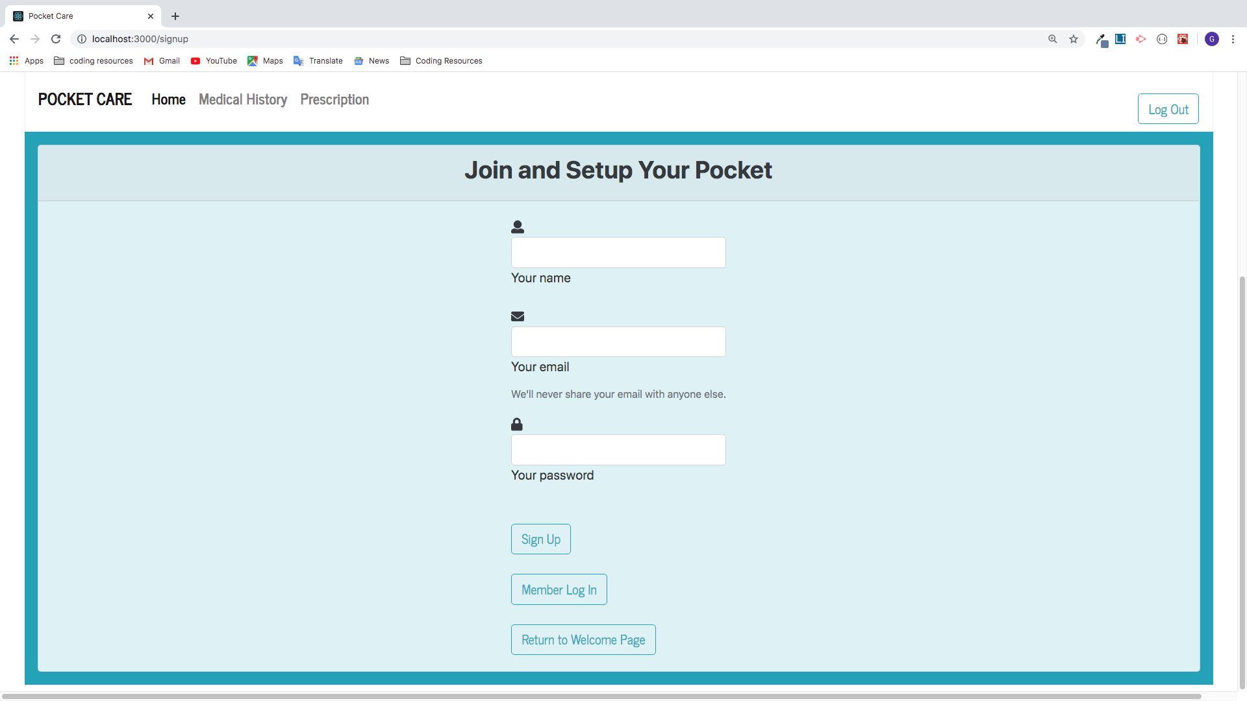

Slide 6
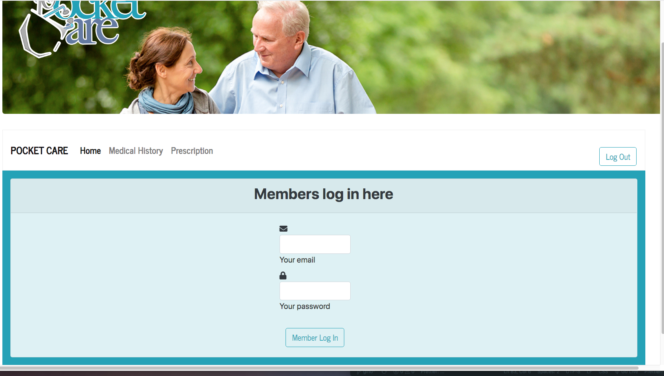

Slide 7
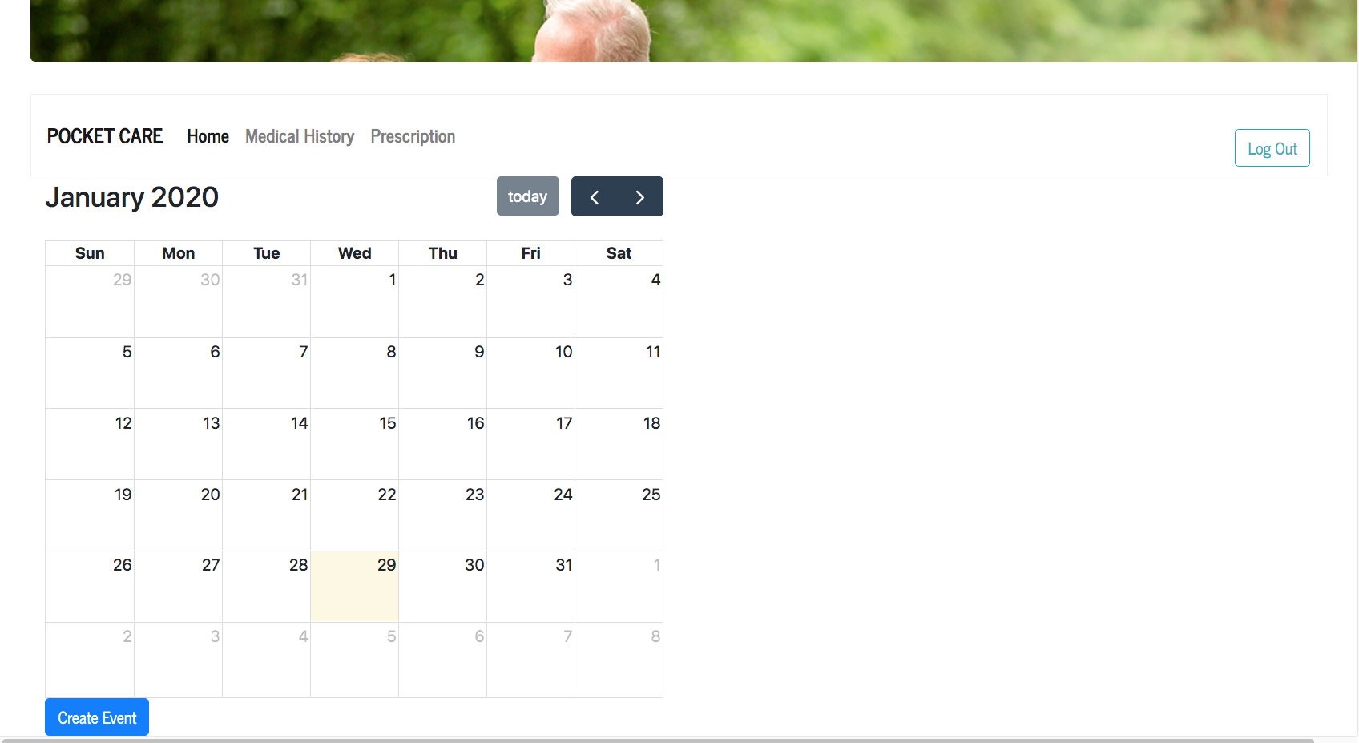

Slide 8
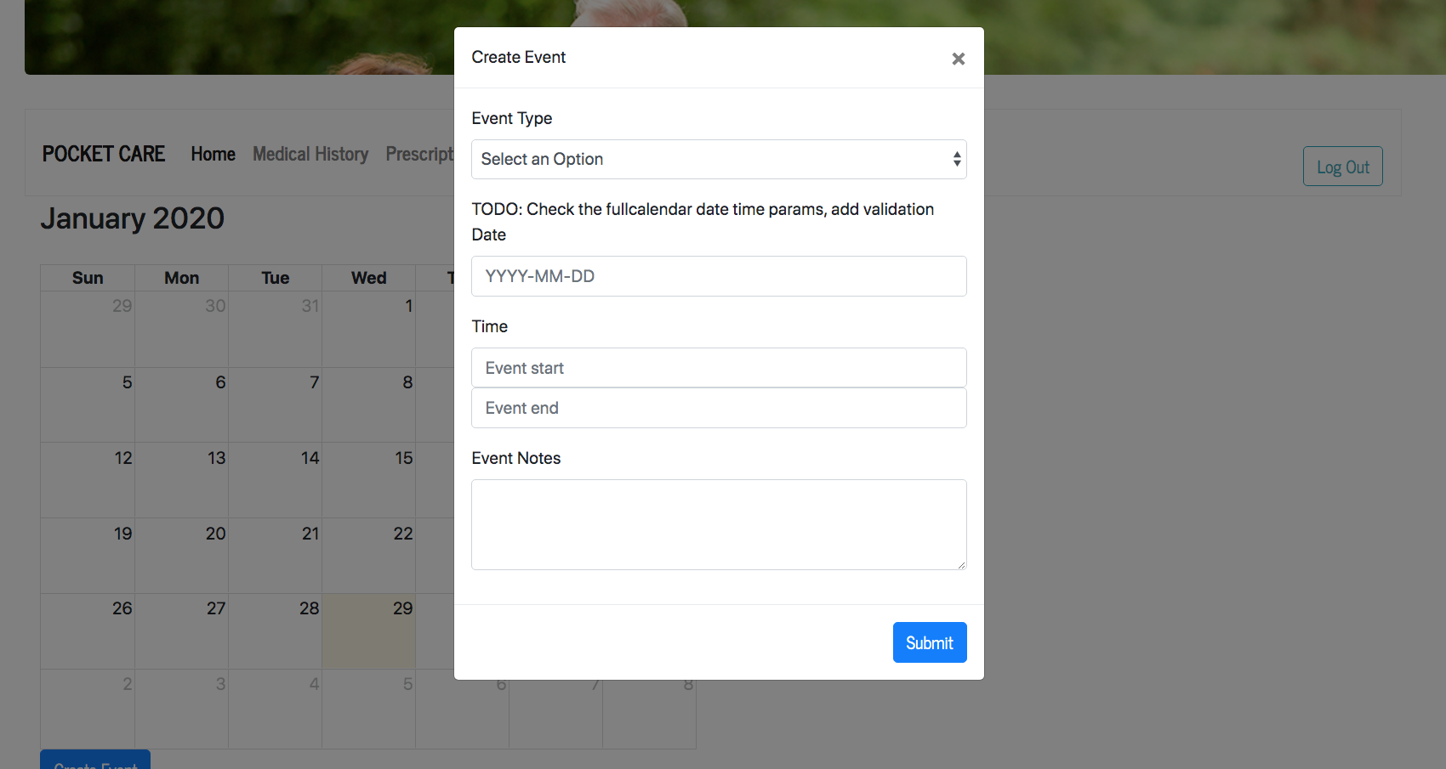

Slide 9
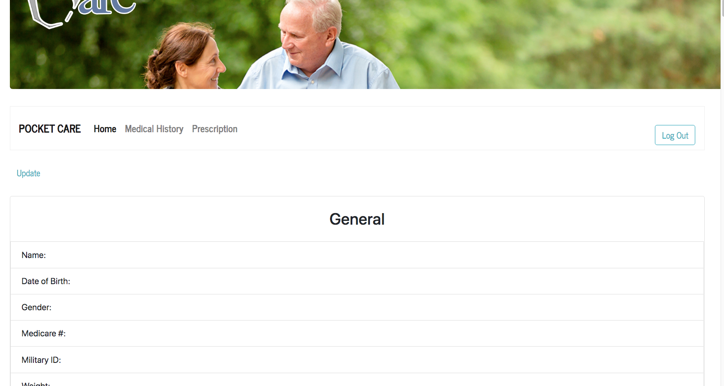

Slide 10
To Be a Better Patient (Or Caregiver)
For the patient, it helps to be informed when you go to the doctor. You can ask the right questions and feel more secure in your care.
To Help Family Members Who Are at Risk of Disease
Your medical history isn’t just for your benefit.
You can use it to alert other family members of their predisposition to getting certain diseases.
Be sure to update your family history as children are born or if family members develop illnesses. After you add them, inform your doctor of the changes.

Slide 11
Pocket-care fast tips
The best and easiest strategy is to put your medication in a weekly pillbox that has a compartment for each day. It doesn’t just visually remind you to take your medication, but also prevents double doses. Fill your pillbox with any medications, supplements or vitamins your doctor has prescribed. Use multiple boxes for AM and PM!
Take advantage of technology.
If you’re usually plugged in, set up electronic reminders, Hyland said. For instance, you can create email or text alerts to signal it’s time to take your medicine.
Combine with a daily task.
Try taking your medication with an activity you do every day, such as making coffee or brushing your teeth. This works much better than taking the medication at a free-floating time or in the midst of other variable activities [such as] mid-morning.
Create a self-care ritual.
Carve out time in the morning or evening to take your medication while practicing self-care. For instance, in the morning, drinking hot tea, reading the paper, walking around the block, meditating, stretching or writing. This doesn’t have to be a big chunk of time. It can be just 10 to 15 minutes.

Slide 12
Thank you!
CWRU – Full-Stack Bootcamp
All our invaluable instructors, and TAs, Support individuals, teammates, classmates, AND tutors for sharing their knowledge on any subject and bolstering us when we needed it most looking for syntax errors at 3:00AM!
Career Services who are just beginning their work for most of us!
All of our family and friends for their support and encouragement through an intense, empowering experience!

