Slide 1
Market Basket Analysis
Source: Brett Lantz, Chap-8

Slide 2
MARKET BASKET ANALYSIS
INPUT: list of purchases by purchaser
do not have names
identify purchase patterns
what items tend to be purchased together
obvious: steak-potatoes; beer-pretzels
what items are purchased sequentially
obvious: house-furniture; car-tires
what items tend to be purchased by season

Slide 3
Market Basket Analysis
Categorize customer purchase behavior
identify actionable information
purchase profiles
profitability of each purchase profile
use for marketing
layout or catalogs
select products for promotion
space allocation, product placement

Slide 4
Market Basket Analysis
Retail outlets
Telecommunications
Banks
Insurance
link analysis for fraud
Medical
symptom analysis

Slide 5
Purchase Profiles
beauty conscious
kids’ play
convenience food
health conscious
pet lover
women’s fashion
sports conscious
gardener
kid’ fashion
smoker
automotive
hobbyist
casual drinker
photographer
student/home office
new family \
tv/stereo enthusiast
illness (prescription)
illness over-the-counter
seasonal/traditional
personal care
casual reader
homemaker
home handyman
home comfort
men’s image conscious
fashion footwear
sentimental
men’s fashion

Slide 6
Purchase Profiles
Beauty conscious
cotton balls
hair dye
cologne
nail polish

Slide 7
Margin Profiles
Each profile has an average profit per basket
Kids’ fashion $15.24 push these
Men’s fashion $13.41
….
Smoker $2.88 don’t push
Student/home office $2.55 these

Slide 8
Market Basket Analysis
Affinity Positioning
coffee, coffee makers in close proximity
Cross-Selling
cold medicines, kleenex, orange juice
Monday Night Football kiosks on Monday p.m.

Slide 9
Market Basket Analysis
BENEFITS:
simple computations
can be undirected (don’t have to have hypotheses before analysis)
different data forms can be analyzed

Slide 10
What are Association Rules?
Study of “what goes with what”
“Customers who bought X also bought Y”
What symptoms go with what diagnosis
Transaction-based or event-based
Also called “market basket analysis” and “affinity analysis”
Originated with study of customer transactions databases to determine associations among items purchased

Slide 11
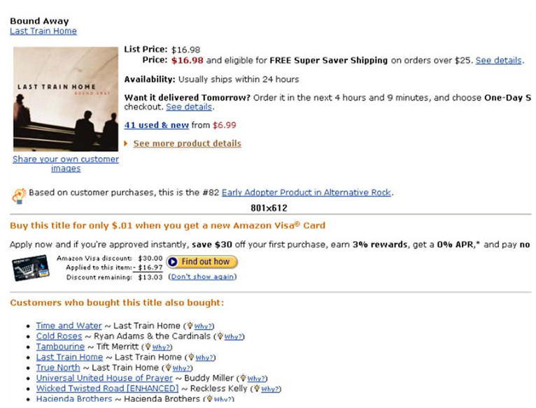
Used in many recommender systems

Slide 12
Market Basket Analysis
Given:
A database of customer transactions
Each transaction is a set of items
Goal:
Extract rules

Slide 13
Generating Rules - Terms
“IF” part = antecedent
“THEN” part = consequent
“Item set” = the items (e.g., products) comprising the antecedent or consequent
Antecedent and consequent are disjoint (i.e., have no items in common)

Slide 14
Many Rules are Possible
For example: Transaction 111 supports several rules, such as
“If pen, then milk” (“If a red faceplate is purchased, then so is a white one”)
“If pen, then juice”
“If pen and milk, then ink”
+ several more

Slide 15
Frequent Item Sets
Ideally, we want to create all possible combinations of items
Problem: computation time grows exponentially as # items increases
Solution: consider only “frequent item sets”
Criterion for frequent: support
Given k items that can appear or not appear in a set,
there are 2^k possible itemsets that could be potential rules.
the Apriori algorithm employs a simple a priori belief to reduce the
association rule search space: all subsets of a frequent itemset must also be frequent.
This heuristic is known as the Apriori property. Using this astute observation, it
is possible to dramatically limit the number of rules to be searched. For example,
the set {motor oil, lipstick} can only be frequent if both {motor oil} and {lipstick} occur
frequently as well. Consequently, if either motor oil or lipstick is infrequent, any set
containing these items can be excluded from the search.

Slide 16
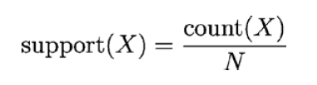

Support and Confidence
Support = % of transactions that include both the antecedent and the consequent
Confidence: the % of antecedent transactions that also have the consequent item set

Slide 17
Example
Another example: {Pen} Support: 100% Confidence: 100%
Example rule: {Pen} => {Milk} Support: 75% Confidence: 75%

Slide 18
Apriori Algorithm - Generating Frequent Item Sets
Apriori principle states that all subsets of a frequent itemset must also be frequent.
For k products…
User sets a minimum support criterion
Next, generate list of one-item sets that meet the support criterion
Use the list of one-item sets to generate list of two-item sets that meet the support criterion
Use list of two-item sets to generate list of three-item sets
Continue up through k-item sets
Apriori principle can eliminate some of them even before the next round begins. If {A}, {B}, and {C} are frequent in iteration 1 while {D} is not frequent, iteration 2 will consider only {A, B}, {A, C}, and {B, C}. Thus, the algorithm needs to evaluate only three itemsets rather than the six that would have been evaluated if the sets containing D had not been eliminated a priori.

Slide 19

Lift, to improve performance
The lift of a rule measures how much more likely one item or itemset is purchased relative to its typical rate of purchase, given that you know another item or itemset has been purchased.

Slide 20
Extensions
Imposing constraints
Only find rules involving the dairy department
Only find rules involving expensive products
Only find rules with “whiskey” on the right hand side
Only find rules with “milk” on the left hand side
Hierarchies on the items
Calendars (every Sunday, every 1st of the month)

Slide 21
Caution: The Role of Chance
Random data can generate apparently interesting association rules
The more rules you produce, the greater this danger
Rules based on large numbers of records are less subject to this danger

Slide 22
Lab:
Refer the code from Chapter 8 of Brett Lantz

