Slide 1
Linear Regression
Source: Multiple but predominantly from ISLR 7th Edition

Slide 2
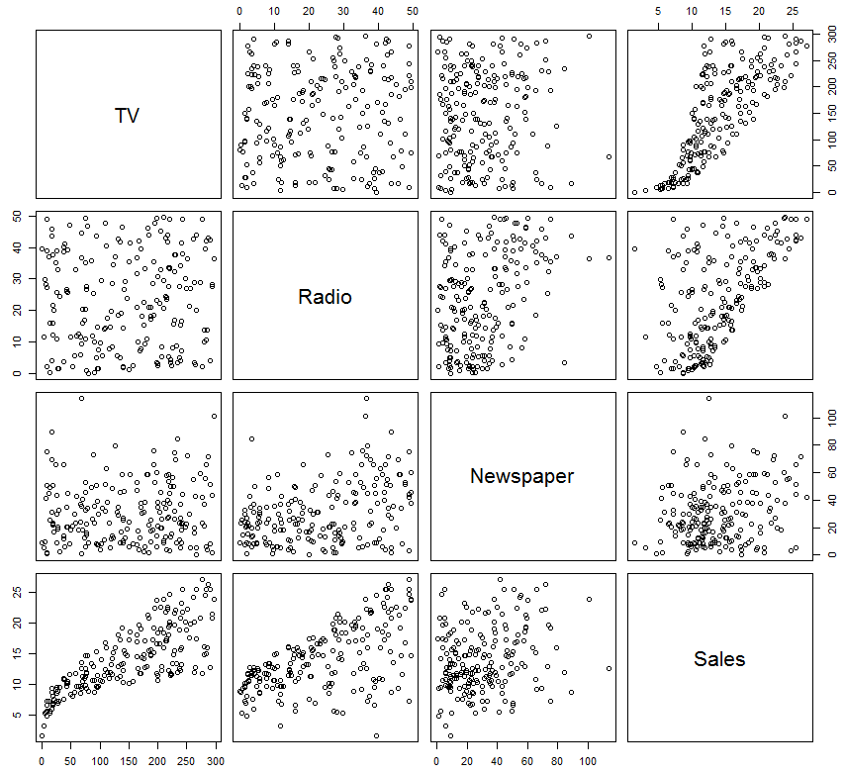
Case 1: Advertisement Data
Advertising=read.csv("http://www-bcf.usc.edu/~gareth/ISL/Advertising.csv", header=TRUE);
newdata=Advertising[,-1]
fix(newdata)
View(newdata)
names(newdata)
pairs(newdata)

Slide 3
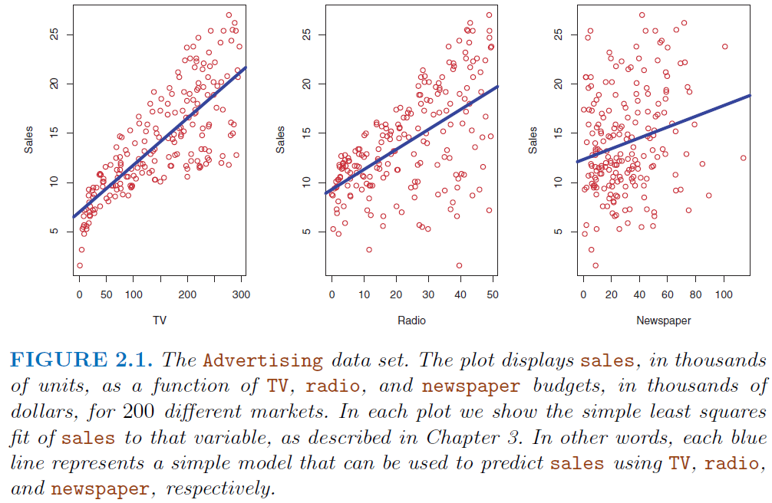
Advertisement Data: background

Slide 4
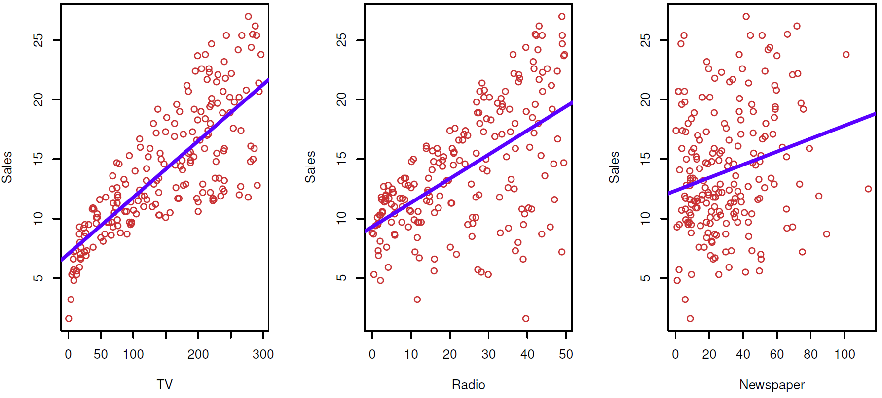
Advertisement Data:
1. Is there a relationship b/w advertising budget (TV, Radio, or Newspaper) and sales?
2. How strong is relationship b/w advertising budget (TV, Radio, or Newspaper) and sales?
3. Which media contribute to sales?

Slide 5
Advertisement Data:
4. How accurately can we estimate effect of each medium on sales?
5. How accurately can we predict future sales?
6. Is the relationship linear?
7. Is there synergy among advertising media?

Slide 6
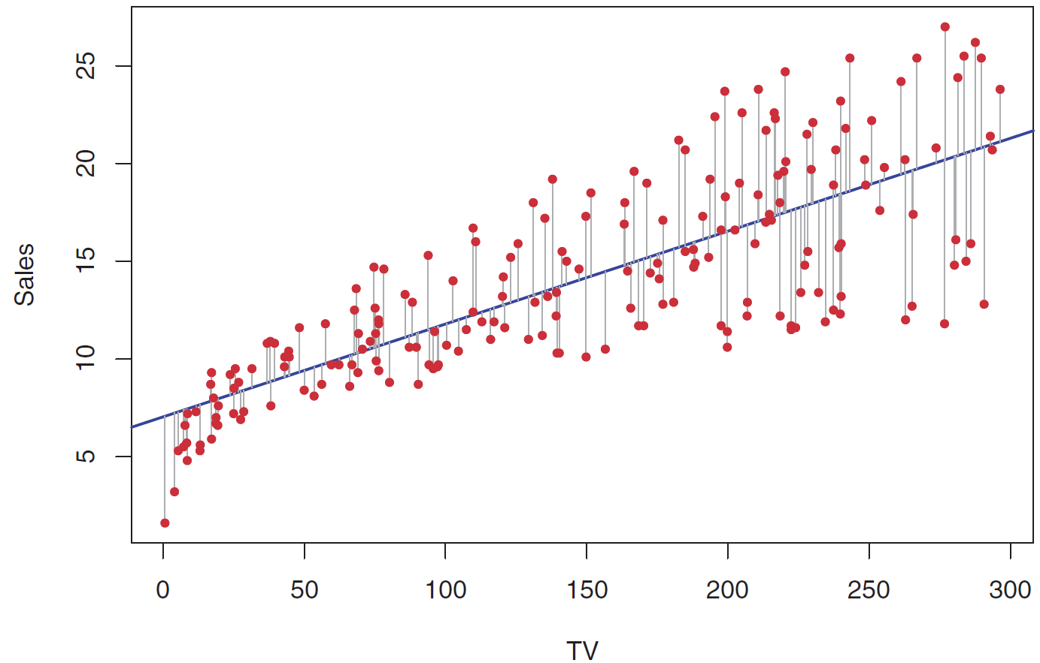
Advertisement Data: how to fit the data? ➔ LSE

Slide 7


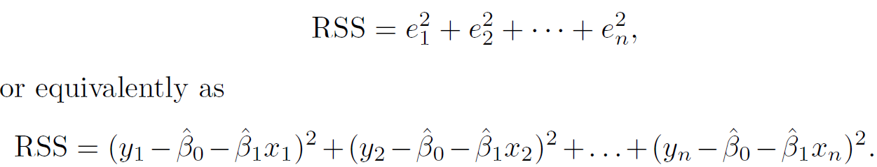
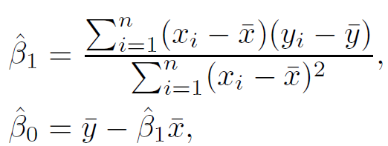
Simple Linear Regression: LSE background

Slide 8
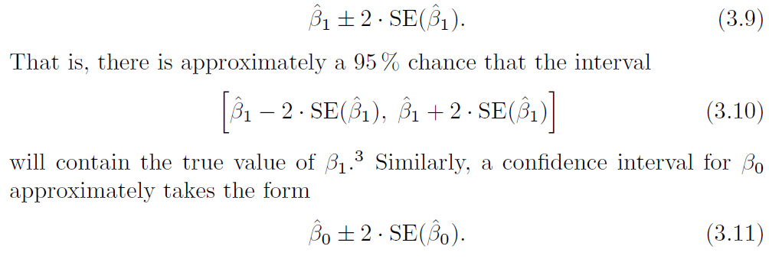
Simple Linear Regression: LSE background

Slide 9
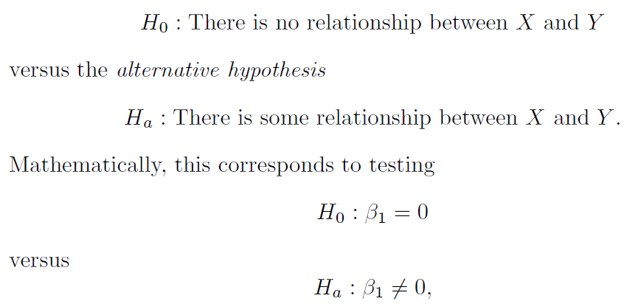

Simple Linear Regression: LSE background
t-statistic
~t(n-2)

Slide 10
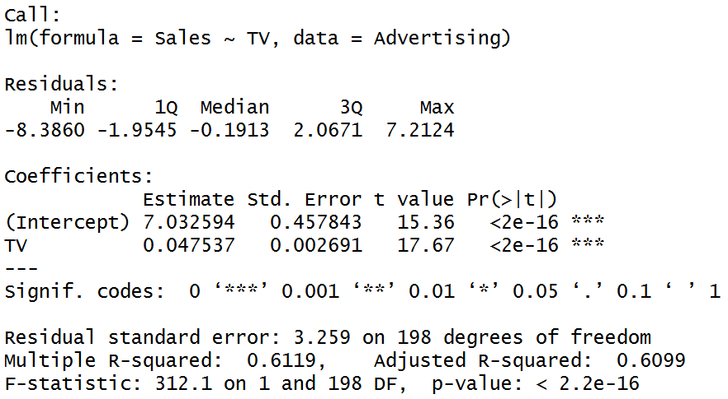
Advertisement Data for simple linear regression
lm.fit=lm(Sales~TV,data=Advertising);
summary(lm.fit)
names(lm.fit)
coef(lm.fit)
confint(lm.fit)

Slide 11
Q: Is b₁=0 i.e. is X an important variable?
We use a hypothesis test to answer this question
H₀: β₁=0 vs H_{a}: β₁≠0
Calculate
If t is large (equivalently p-value is small) we can be sure that β_{j}≠0 and that there is a relationship
Number of standard deviations away from zero.
P-value
is 17.67 SE’s from 0

Slide 12
Measures of Fit: R²
Some of the variation in Y can be explained by variation in the X’s and some cannot.
R² tells you the % of variance that can be explained by the regression on X.
R² is always between 0 and 1. Zero means no variance has been explained. One means it has all been explained (perfect fit to the data).

Slide 13
Multiple Linear Regression Model
Y: Quantitative Response; Xj: j-th predictor
The parameters in the linear regression model are very easy to interpret.
β₀ is the intercept (i.e. the average value for Y if all the X’s are zero), β_{j} is the slope for the jth variable X_{j}
β_{j} is the average increase in Y when X_{j} is increased by one unit and all other X’s are held constant.

Slide 14
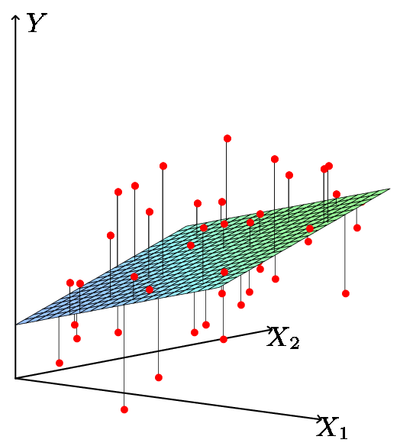
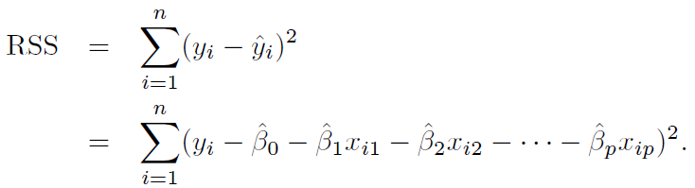
Least Squares Estimate
We estimate the parameters using least squares i.e. minimize

Slide 15
Relationship between population and least squares lines
Population line
Least Squares line
We would like to know β₀ through β_{p} i.e. the population line. Instead we know through i.e. the least squares line.
Hence we use through as guesses for β₀ through β_{p} and as a guess for Y_{i}. The guesses will not be perfect just as is not a perfect guess for μ.

Slide 16
Inference in Regression
Estimated (least squares) line.
The regression line from the sample is not the regression line from the population.
What we want to do:
Assess how well the line describes the plot.
Guess the slope of the population line.
Guess what value Y would take for a given X value
14
12
10
8
6
4
2
0
-10
-5
0
5
10
X
True (population) line. Unobserved

Slide 17
Some Relevant Questions
Is β_{j}=0 or not? We can use a hypothesis test to answer this question. If we can’t be sure that β_{j}≠0 then there is no point in using X_{j} as one of our predictors.
Can we be sure that at least one of our X variables is a useful predictor i.e. is it the case that β₁= β₂=⋅⋅⋅= β _{p}=0?

Slide 18
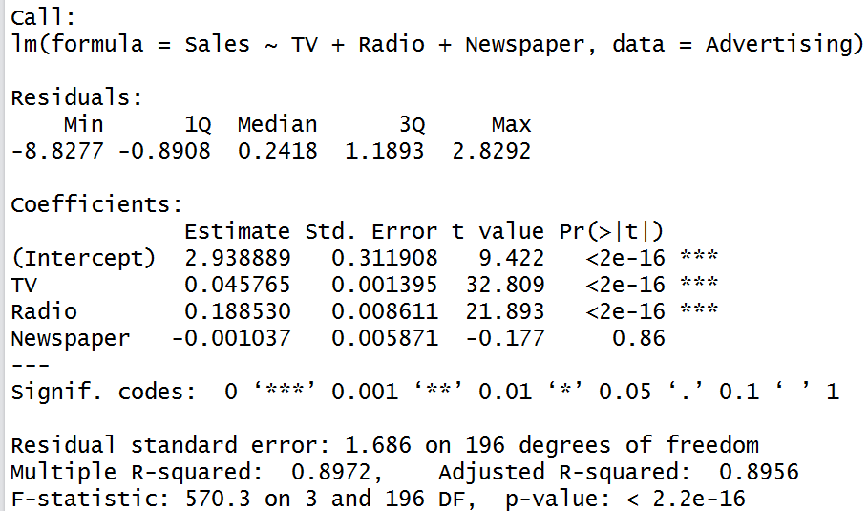
Advertisement Data for multiple linear regression
lm.fit=lm(Sales~TV+Radio+Newspaper,data=Advertising)
summary(lm.fit)
names(lm.fit)
coef(lm.fit)
confint(lm.fit)

Slide 19
1. Is b_{j}=0 i.e. is X_{j} an important variable?
We use a hypothesis test to answer this question
H₀: β_{j}=0 vs H_{a}: β_{j}≠0
Calculate
If t is large (equivalently p-value is small) we can be sure that β_{j}≠0 and that there is a relationship
Number of standard deviations away from zero.
P-value
is 17.67 SE’s from 0

Slide 20
Testing Individual Variables
Is there a (statistically detectable) linear relationship between Newspapers and Sales after all the other variables have been accounted for?
No: big p-value
Small p-value in simple regression
Almost all the explaining that Newspapers could do in simple regression has already been done by TV and Radio in multiple regression!

Slide 21
2. Is the whole regression explaining anything at all?
Test for:
H₀: all slopes = 0 (β₁=β₂=⋅⋅⋅=β_{p}=0),
H_{a}: at least one slope ≠ 0
Answer comes from the F test in the ANOVA (ANalysis Of VAriance) table.
The ANOVA table has many pieces of information. What we care about is the F Ratio and the corresponding p-value.

Slide 22
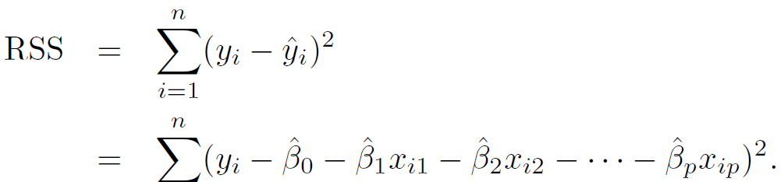
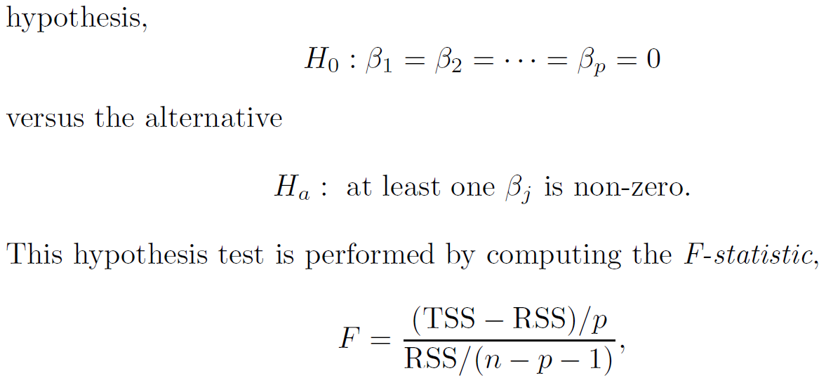
Multiple Linear Regression: LSE background

Slide 23

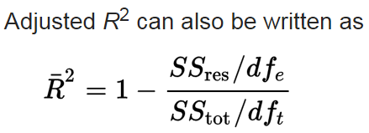
Adjusted R-Square
R-square will always increase when more variables are added to the model, even if those variables are only weakly associated with the response. This is due to the fact that adding another variable to the least squares equations must allow us to fit the training data (though not necessarily the testing data) more accurately.

Slide 24
Deciding on Important Variables: variable selection
lm.fit1=lm(Sales~Newspaper,data=Advertising)
summary(lm.fit1)
lm.fit2=lm(Sales~Newspaper+TV,data=Advertising)
summary(lm.fit2)
lm.fit3=lm(Sales~Newspaper+TV+Radio,data=Advertising)
summary(lm.fit3)
lm.fit4=lm(Sales~TV+Radio,data=Advertising)
summary(lm.fit4)

Slide 25
Qualitative Predictors
How do you stick “gender” with “men” and “women” (category listings) into a regression equation?
Code them as indicator variables (dummy variables)
For example we can “code” Males=0 and Females= 1.

Slide 26
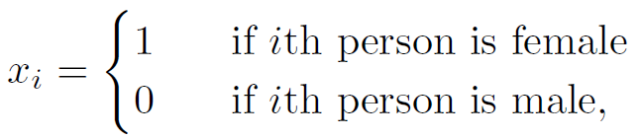
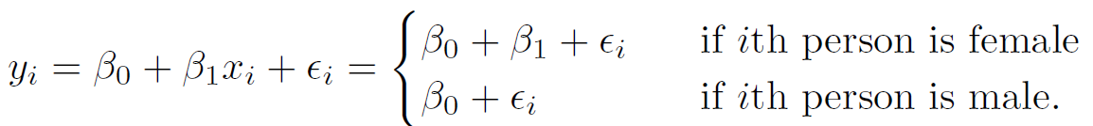
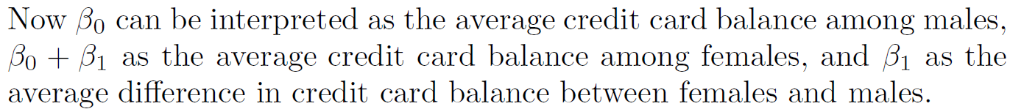
One qualitative predictor with two levels
Q: To investigate differences in credit card balance between males and females, ignoring the other variables for the moment.
Two genders (male and female). Let
then the regression equation is

Slide 27
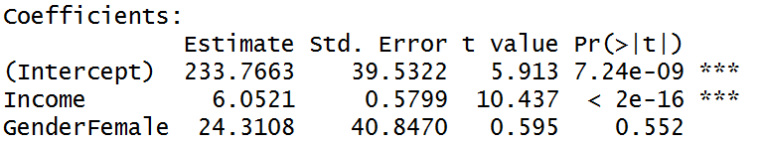
Two qualitative predictors with only two levels
Y: Balance. We want to include income and gender.
Two genders (male and female). Let
then the regression equation is
β₂ is the average extra balance each month that females have for given income level. Males are the “baseline”.

Slide 28
Other Coding Schemes
There are different ways to code categorical variables.
Two genders (male and female). Let
then the regression equation is
β₂ is the average amount that females are above the average, for any given income level. β₂ is also the average amount that males are below the average, for any given income level.

Slide 29
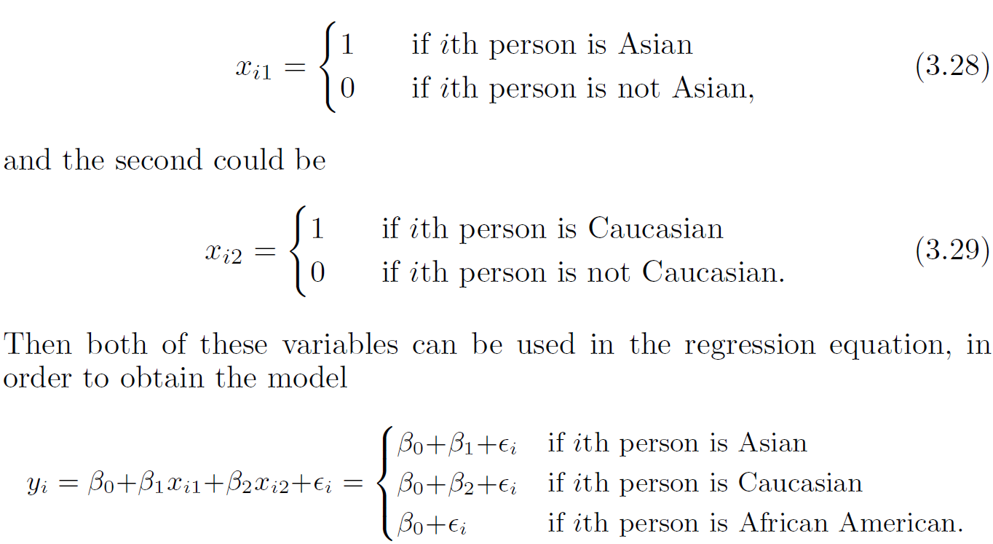
One qualitative predictor with more than two levels
Q: To investigate differences in credit card balance between Ethnicity, ignoring the other variables for the moment.
Three levels of Ethnicity
contrasts(Credit$Ethnicity)

Slide 30
Interaction
When the effect on Y of increasing X₁ depends on another X₂. [synergy effect]
Example:
Maybe the effect on Salary (Y) when increasing Position (X₁) depends on gender (X₂)?
For example maybe Male salaries go up faster (or slower) than Females as they get promoted.
Advertising example:
TV and radio advertising both increase sales.
Perhaps spending money on both of them may increase sales more than spending the same amount on one alone?

Slide 31
Interaction in advertising
Spending $1 extra on TV increases average sales by 0.0191 + 0.0011Radio
Spending $1 extra on Radio increases average sales by 0.0289 + 0.0011TV
Interaction Term

Slide 32
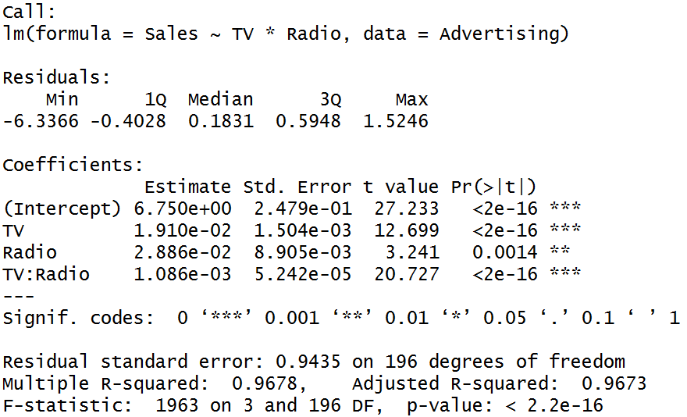
Advert Data:
Advertising=read.csv(“Advertising.csv", header=TRUE);
lm.fit=lm(Sales~TV*Radio,data=Advertising)
summary(lm.fit)

Slide 33
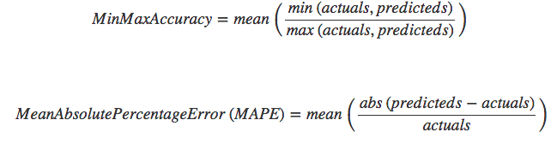
Checking accuracy of test data
Similar to other ML techniques, a part of data can be kept for testing to do further assessment

Slide 34
Summary
Try multiple lm models and use the below static to assess the model
Static | Criteria
Rsquared | Higher the better (>.70)
Adjusted Rsquared | Higher the better
F-statics | Higher the better
T-value | Should be greater than 1.96 for p-value to be less than 0.05 significance
Standard Error | Closer to zero
MSE (Mean Squared Error) | Lower the better
Minmax accuracy | Higher the better
MAPE (Mean Absolute percentage error) | Lower the better

