Slide 1
Analysis of US Diabetes Data
Hunter Lawless, Max Stevens, Zack Lasek

Slide 2
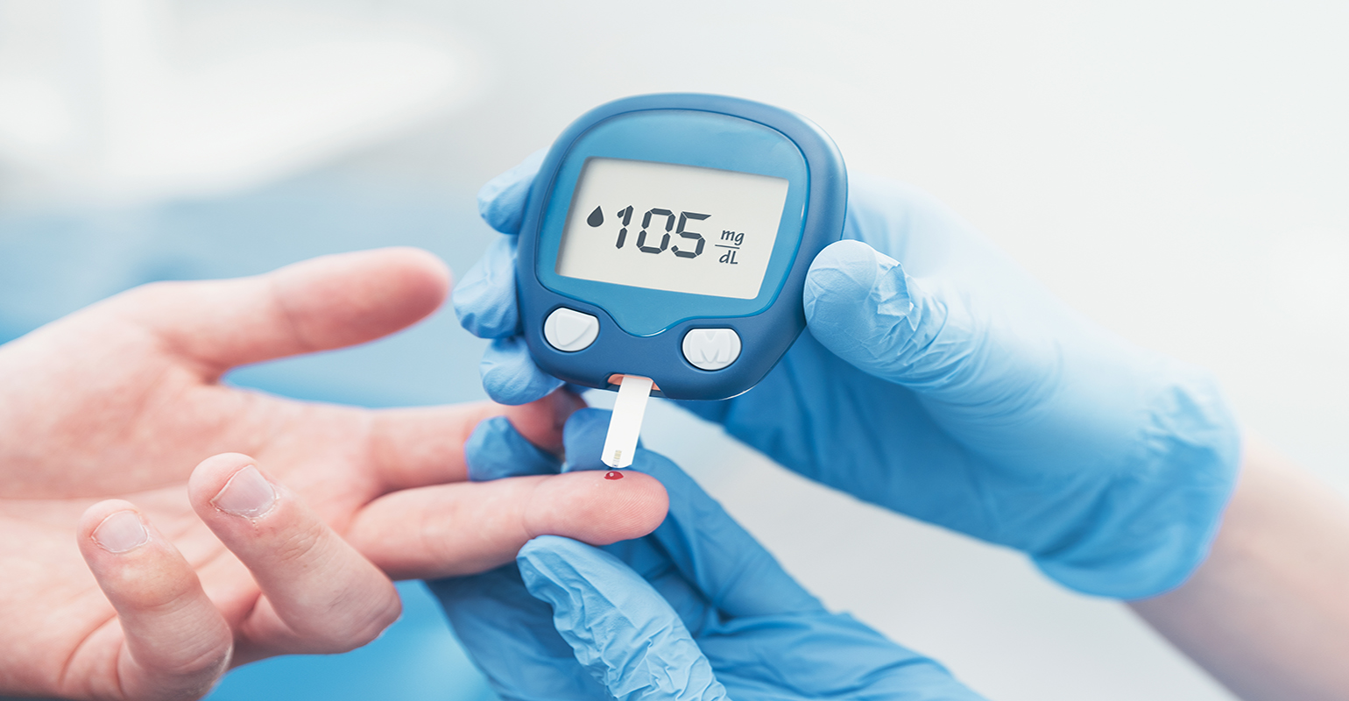
What’s the problem?
We worked to better understand the effect of diabetes on groups of people as well as what groups could be more susceptible to being diagnosed with diabetes.
What percentage of people in the data have diabetes?
What is the distribution of the age group for the diabetes data?
Which age group is more likely to be diagnosed with diabetes?
Do preexisting conditions like obesity play a factor in the likelihood of being diagnosed with diabetes?
Is there a correlation between BMI and Diabetes Pedigree Function?

Slide 3

Data
Original Data includes:
11 columns
768 rows
Columns include “Glucose”, “BloodSugar”, “BloodPressure”, etc.
Dataset uses dummy variables for “BloodSugar”, “Obesity”, and “AgeGroup”
BloodSugar - (1 = High, 0 = Normal)
Obesity - (1 = Obese, 0 = Not Obese)
AgeGroup - (1 = Adult, 0 = Young Adult)
Preprocessing Data in Python:
Dropped unnecessary columns for ease
Dropped the “SkinThickness” and “Insulin” columns
Now there are 9 columns being used

Slide 4

Libraries Used
Pandas
Matplotlib
Numpy

Slide 5
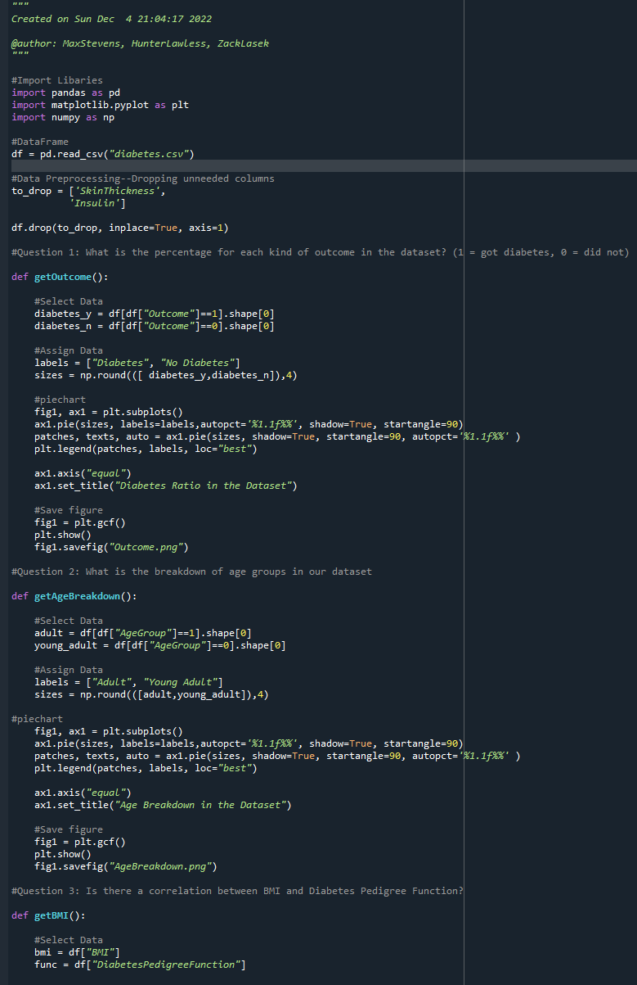


Code

Slide 6
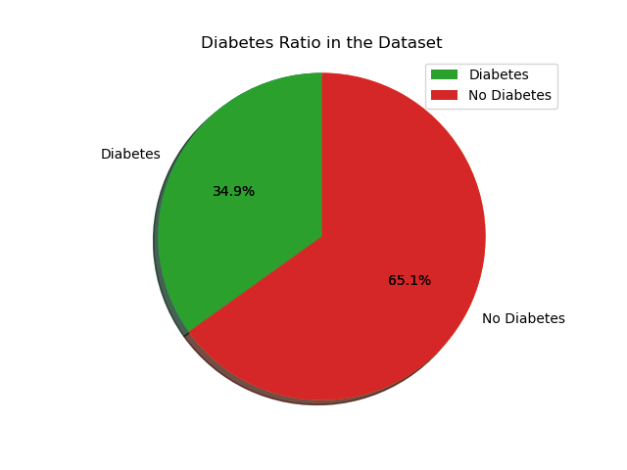
Breakdown of our data - What is the percentage of patients with diabetes?

Slide 7
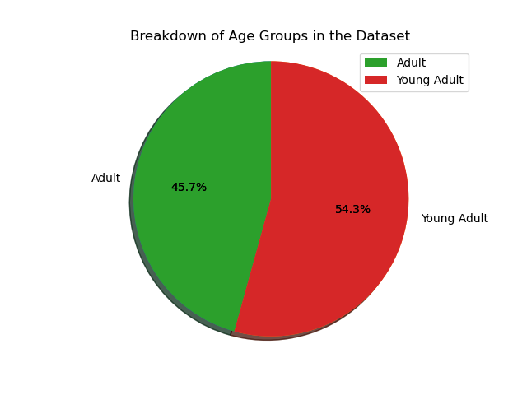
Breakdown of our Data - What are the age groups in our dataset?

Slide 8
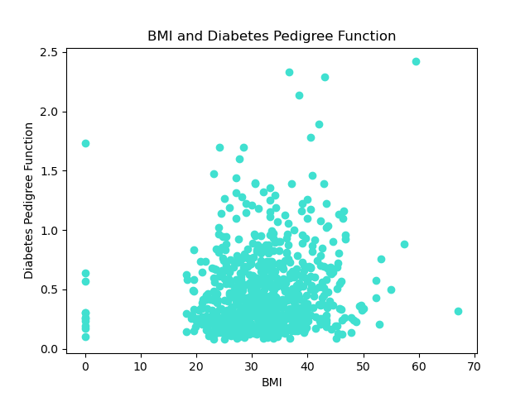
Is there a correlation between BMI and Diabetes Pedigree Function?
BMI (Body Mass Index):
Is a measure of body fatness derived from weight and height.
Diabetes Pedigree Function:
Is a measure of how likely diabetes is based on history of relatives.

Slide 9
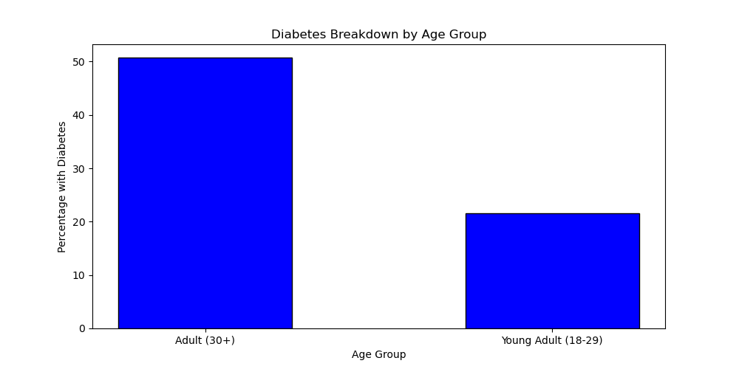
How prevalent is diabetes by age group?

Slide 10
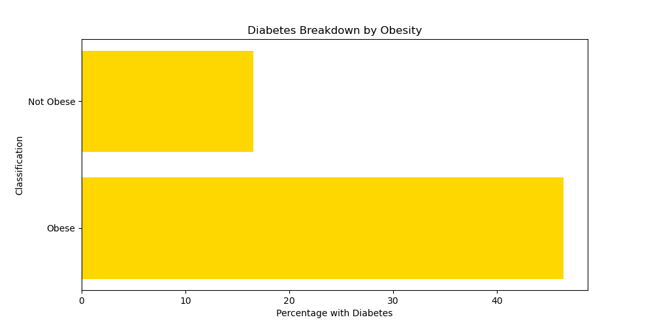
Do the obese patients experience diabetes at a higher rate?

Slide 11
Conclusion
Diabetes is a complex metabolic disorder which cannot be attributed to a sole factor. Some of these factors are age group, preexisting conditions, and health issues/factors.
As seen through this analysis, there are some commonalities between age groups, risk factors, etc.
However, not all factors have a perfect or very strong correlation, so it is hard to determine which factors are the most important and how much certain variables affect being diagnosed or not.

