Slide 1




Parrot: Efficient Serving of LLM-based Applications with Semantic Variable
18th USENIX Symposium on Operating Systems Design and Implementation
Chaofan Lin, Zhenhua Han, Chengruidong Zhang
Yuqing Yang, Fan Yang, Chen Chen, Lili Qiu
https://github.com/microsoft/ParrotServe
Generated by DALL·E
Notes:
Thanks for the nice introduction. I’m Zhenhua Han from Microsoft Research. I’m glad to share our recent work, Parrot, Efficient serving of LLM apps with semantic variables. This work is jointly done with Shanghai Jiaotong University and Microsoft Research.

Slide 2
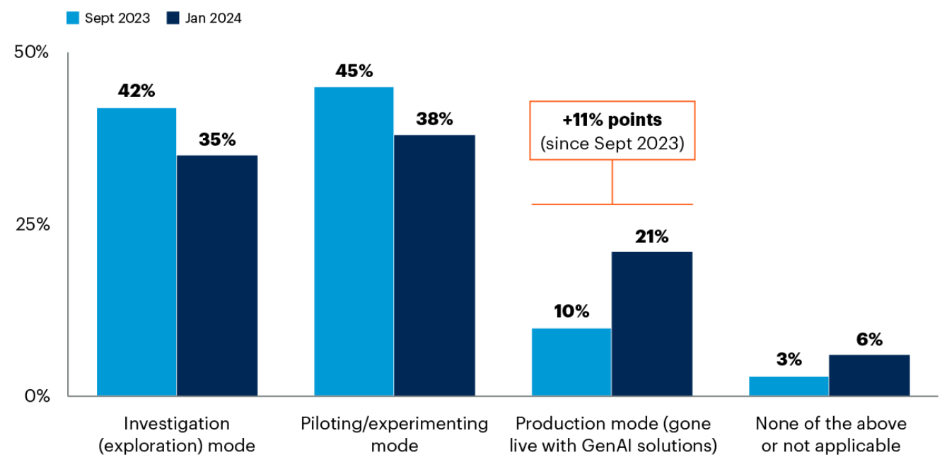
Paradigm Shift of Computer Programs
A novel type of program (LLM + Code) are shaping the future
Ability of understanding semantics beyond bits
Complex planning
Gartner Trending Questions About Generative AI 2024
Increased Adoption of GenAI in production
Notes:
LLM is changing the paradigm of how new applications are built. If we treat LLM request as a special type of function, the combination of traditional code and LLM are delivering new capability that can understand semantics of natural language and conducting more intelligent planning beyond pre-programmed control flows. According to Garner’s survey, there is a clear trend that more products are adopting GenAI to enhance the capability of their businesses.

Slide 3
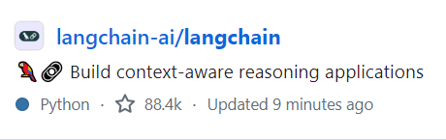
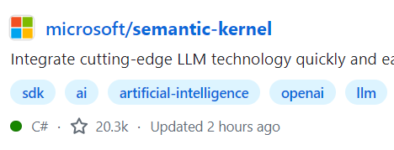
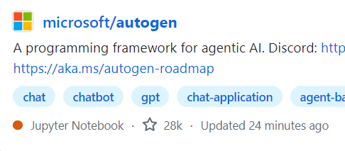
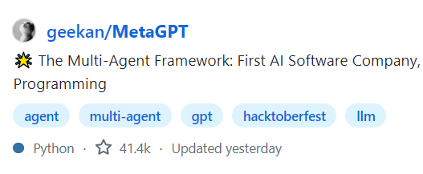
Paradigm Shift of Computer Programs
A novel type of program (LLM + Code) are shaping the future
Ability of understanding semantics beyond bits
Complex planning
🔥Hot!
Notes:
The programming frameworks of this new type of application are gaining more and more attention, like Langchain, semantic kernel, autogen and so on.

Slide 4
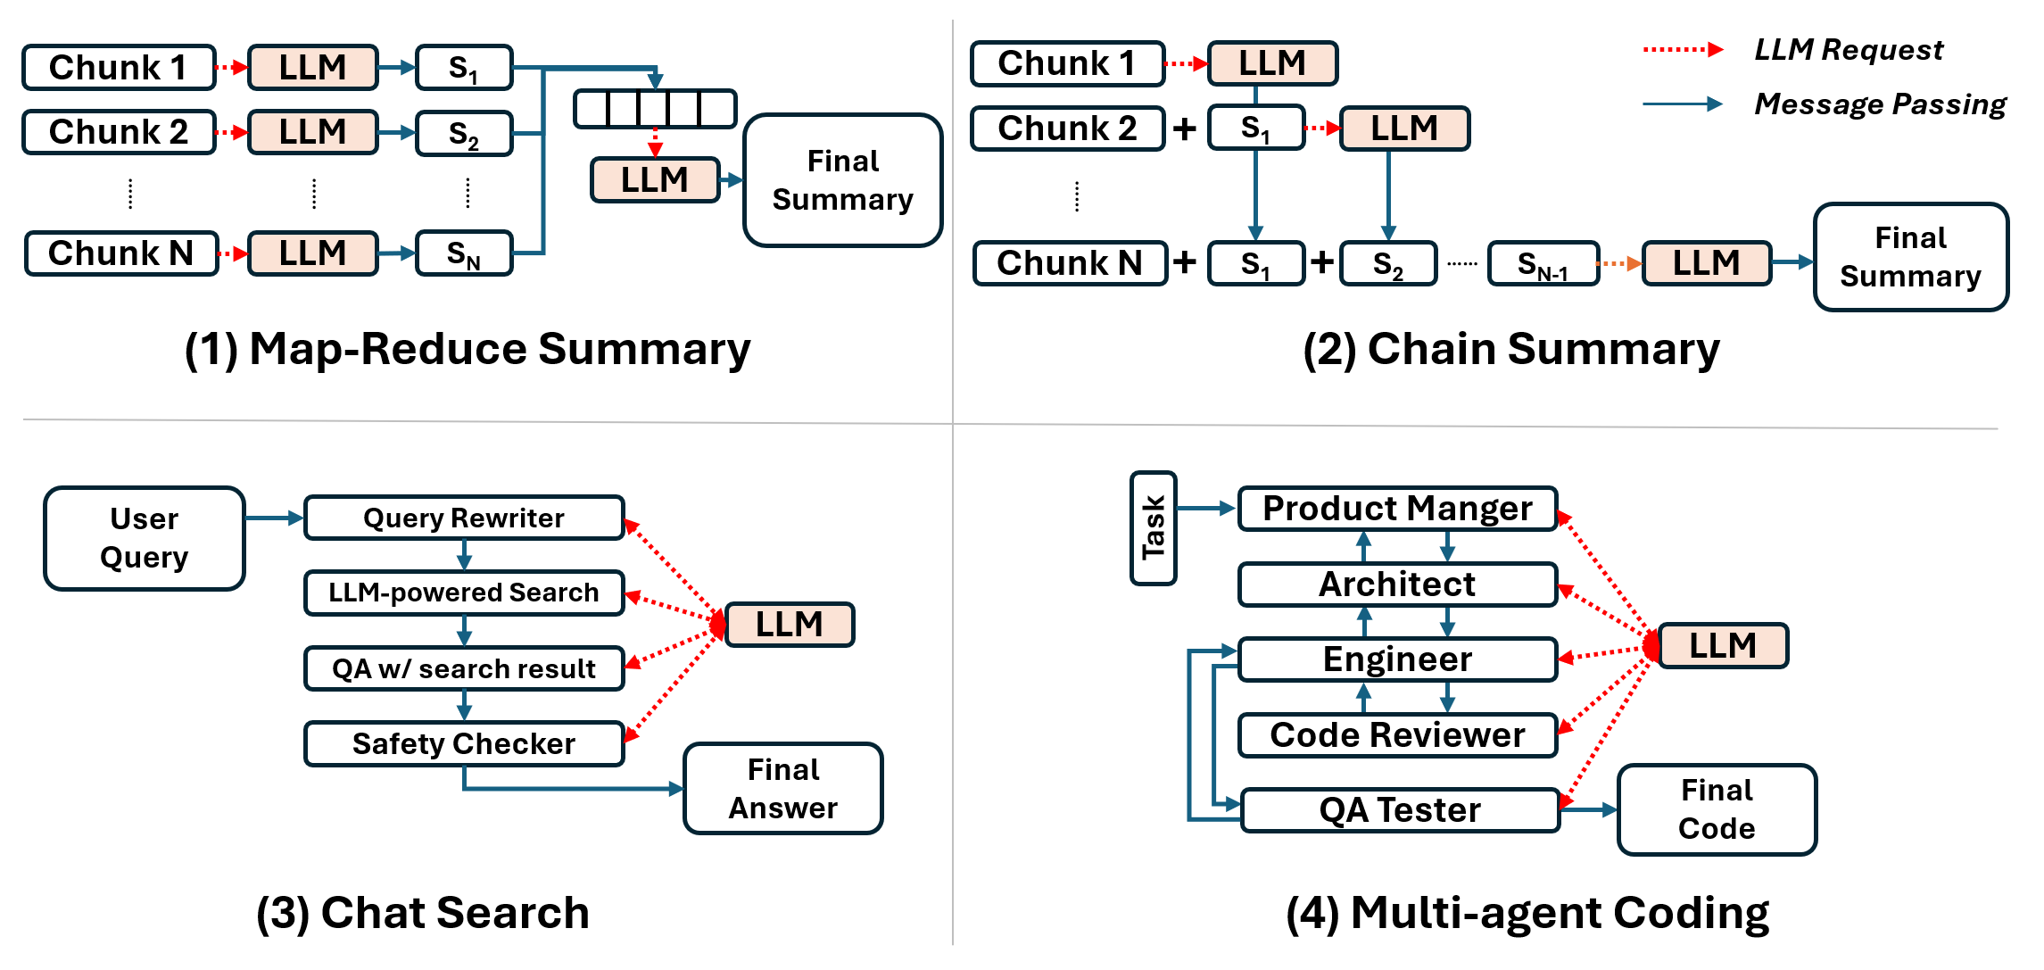
Diverse Workflows of LLM Apps (or Agents)
High-quality LLM apps often need multiple LLM requests to collaborate in different workflows
Notes:
Just like traditional programs that require different functions to work together. High quality LLM apps also need multiple requests to collaborate in different workflows to accomplish a complex task. For example, it could be map-reduce style or chain style workflow that each LLM request process a partial result and then generate the final output. Chat-based search application also use multiple steps to generate the final response. More complex workflow like multi-agent can design multiple roles like product manager, architect, engineering etc to collaborate to work on one task. Each role will be played by one or multiple LLM requests.

Slide 5



From the view of Multi-tenant LLM Services
Face a lot of independent prompt requests through OpenAI-style APIs
Prompt
Prompt
Prompt
Prompt
Prompt
Prompt
Prompt
Prompt
Public LLM Services
(e.g., Azure, OpenAI)
Prompt
Prompt
Prompt
Notes:
Although LLM apps use multiple requests, existing public LLM service provider still provide single request-centric APIs. The their view, they just receive a lot of individual prompt requests without knowing any application-level knowledge.

Slide 6



From the view of Multi-tenant LLM Services
Face a lot of independent prompt requests through OpenAI-style APIs
Prompt
Prompt
Prompt
Prompt
Prompt
Prompt
?
Prompt
Prompt
Public LLM Services
(e.g., Azure, OpenAI)
Prompt
Prompt
No knowledge about
Type of Applications
Prompt
Notes:
They do not know which requests belong to the same application.

Slide 7
From the view of Multi-tenant LLM Services
Face a lot of independent prompt requests through OpenAI-style APIs
Prompt
Prompt
Prompt
Prompt
Prompt
Prompt
?
Prompt
Prompt
Public LLM Services
(e.g., Azure, OpenAI)
Prompt
Prompt
No knowledge about
Request Dependencies
Prompt
Notes:
They don’t know the dependency of the requests, either.

Slide 8
Problems of Lacking Application Knowledge
Internet
Multi-Request App has to use chatty submission
Step 1
High Excessive Latency
50~70% Non-GPU Time
High Internet Latency
Excessive Queuing Delay
Step 2
Step 3
Public LLM Services
(e.g., Azure, OpenAI)
Step 4
Notes:
The absent application knowledge leads to some efficiency drawbacks. Some apps need multiple sequential requests, but since existing LLM service only serve individual LLM requests. App client has to do chatty request submission that suffer from high excessive latency. From our measurement of a production co-pilot, 50% to 70% of end-to-end latency is spent outside GPU inference. For example, multiple requests have to communicate over the Internet multiple times between app server and LLM inference engine, incurring excessing network latency, and queuing delay.

Slide 9
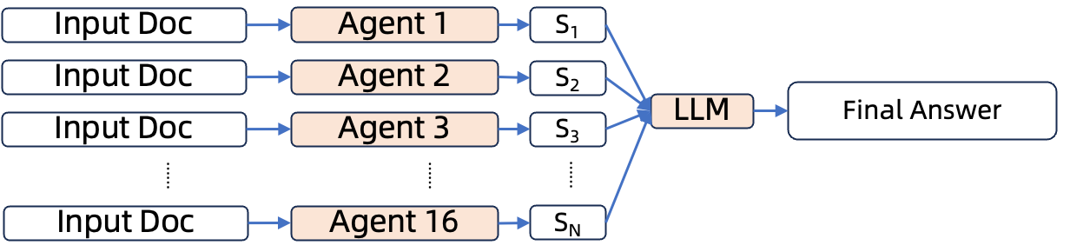
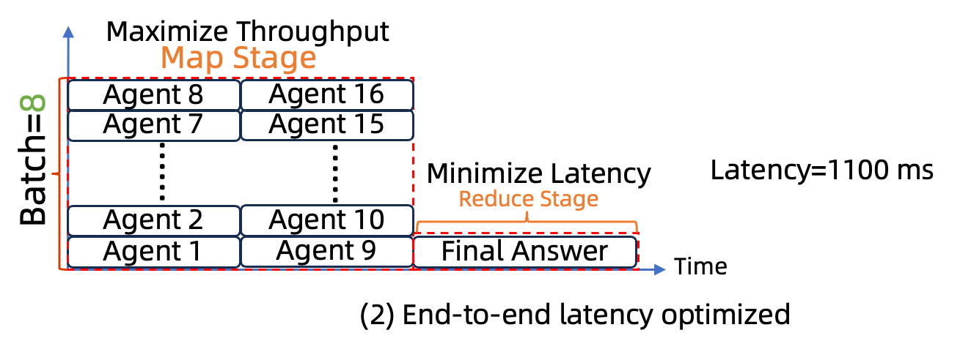
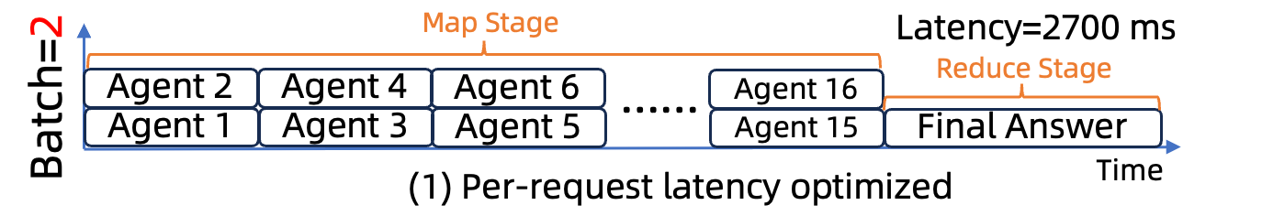
Problems of Request-centric LLM APIs
Misaligned
Scheduling Objectives
Small Batch Size for Low Per-Request Latency
Large Batch Size for Map Stage
Notes:
Also, because existing public LLM services only serve individual requests, they have to use blindly optimize the latency of individual requests. However, this goal may be misaligned with the end-to-end latency of applications. For example, when multiple agents process the input in a map-reduce style. Public LLM services have to use a small batch size to make sure the latency of individual request is low. But for this app, we just care the time to get the final answer. We don’t care about the latency of individual request. For this case, the optimal schedule is to use a larger batch size leading to higher individual request latency but higher throughput, which can finally minimize the end-to-end latency.

Slide 10
Problem of Unknown Prompt Structure
Existing LLM services receive ”rendered” prompt without structure info
Some apps use same prompt prefix for different user queries
Prompt
Role Definition
Few-shot Examples
User Query
Same for all user queries
Prompt
Prompt
Public LLM Services
(e.g., Azure, OpenAI)
No knowledge about
Shared Prompt Structure
Notes:
Beyond the request dependency. Public LLM services receive rendered request, which has no knowledge prompt structure. But many production applications use a shared prompt for different user queries. Without such structure, it is hard to efficiently detect and exploit the sharing opportunities thus cannot avoid redundant storage and computation of the shared part.

Slide 11
Many Optimizations Not Applicable in Public LLM Services
Public LLM Services face diverse applications
Although there have some system optimizations
Sticky routing, DAG Scheduling, Prefix Sharing, ……
But lacking essential information about applications
Have to blindly use a universal treatment for all requests
Notes:
Although system communities have studied many optimizations for different types of applications, it is still hard for public LLM services to leverage because they have no knowledge of applications, they lack the essential knowledge to enable such optimizations. Therefore, they have to blindly use a universal treatment for all requests.

Slide 12
Our Goals in Parrot
A unified abstraction to expose application-level knowledge
Uncover correlation of multiple requests
End-to-end optimization of LLM applications
Notes:
This motivate us to design Parrot. In Parrot, we want to design a unified abstraction that is natural to LLM developers but powerful to expose application-level knowledge to LLM services. By analyze the dataflow of multiple requests, public LLM services and uncover their correlation and conduct end-to-end optimizations beyond single request treatment.

Slide 13
Insight from Prompt Engineering
Developers usually use prompt template to program LLM apps
{{Placeholders}} are often used for inputs/outputs
You are an expert software engineer
Write the python code of {{input:task}}
Your Code: {{output:code}}
You are expert QA engineer, given code for {{input:task}}
{{input:code}}
Your write test cases: {{output:test}}
Notes:
We learns from how LLM apps are built. Developers usually use prompt template to program prompts. Each prompt template contains multiple placeholders. For example, given a task, a prompt can guide LLM to generate code. Given the generated code, another LLM can generate the test cases. The input, output code and output test are placeholders in the prompt templates.

Slide 14
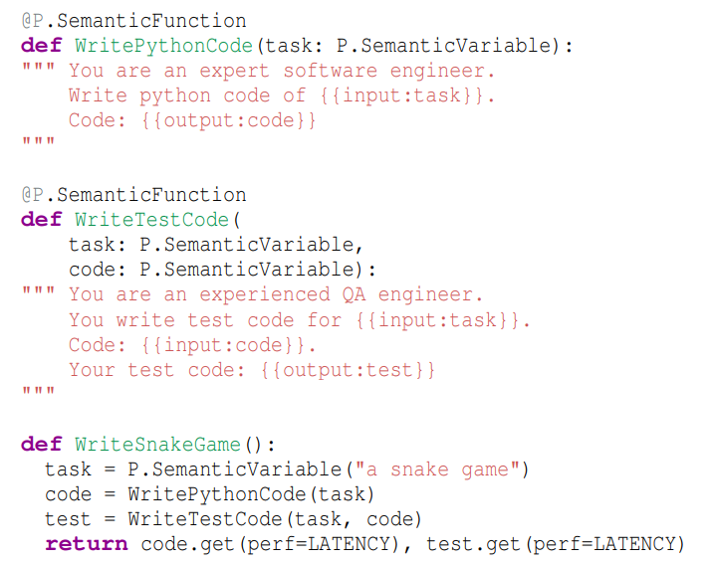
Key Abstraction: Semantic Variables
Semantic Variables
Data pipe that connects
multiple LLM calls
Notes:
Therefore, we just preserve the placeholders and define them as semantic variables, and use semantic variable to connect multiple requests.

Slide 15
Semantic Variables in Parrot Front-end
Input: task
Prompt
Output: code
w/ Semantic Variables as Placeholders
Input: task
Prompt
Input: code
Output: test
Data pipeline by connecting LLM Requests
using Semantic Variables
Performance Criteria
Notes:
1.Developers can use a pythonic way to define multiple semantic functions, each semantic function use a prompt template to define a single LLM request.
2. The placeholders serve as the input and output of the semantic function.
3. And a pythonic orchestration can connect multiple requests using the semantic variables.
4. Developers can fetch the final result and annotate their performance criteria as the end-to-end optimization goal.

Slide 16
Exposing Semantic Variable to Parrot LLM Service
task
Cloud
LLM
Service
WritePythonCode
APIs w/
Semantic Variable
LLM requests
code
WriteTestCode
test
Semantic Variable brings:
- DAG construction between requests
- Prompt structure analysis
- Data pipelining between requests
…
Parrot Overview
Notes:
By exposing the semantic variable annotation, LLM service can understand the DAG, the prompt structure and data pipelining between requests, which enables many optimizations.

Slide 17
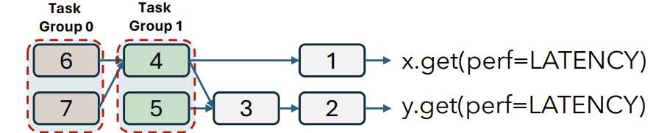
Optimization: App-centric Scheduling
With DAG of application requests & E2E requirement
Derive the performance requirement of each LLM call
From the DAG, derive requests can be executed in parallel
Notes:
With the DAG of LLM apps, we derive the scheduling preference of each individual request to optimize the end-to-end performance. From the DAG, we can derive requests that can be executed in parallel.

Slide 18
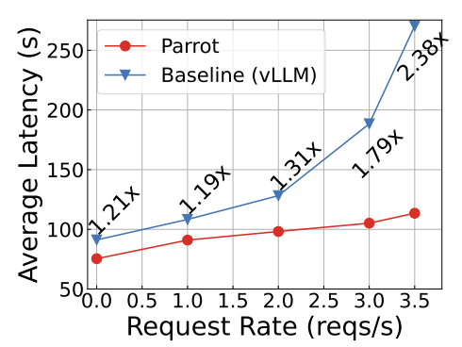
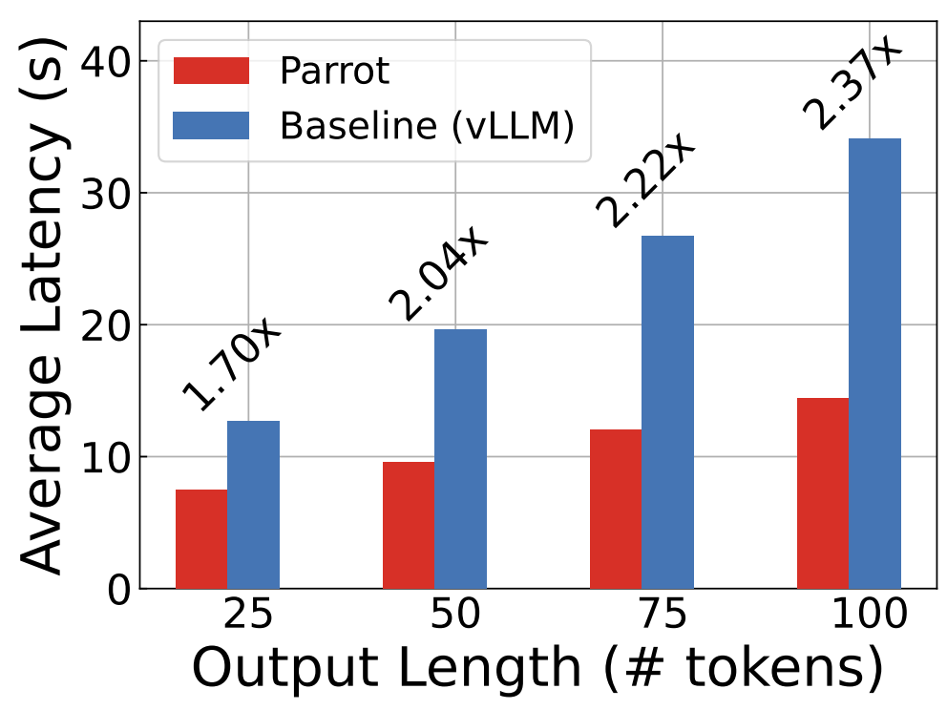
Evaluation: Chain/Map-Reduce Summary
Chain Summary
Map-Reduce Summary
Notes:
For chain-style summary applications, like Teams Meeting Recap, Parrot can achieve up to 2.3x speedup due to saved excessive network latency and queuing delay.
For map-reduce-style application, Parrot achieves 2.3x speedup due to better end-to-end scheduling decision that use higher batch size for parallel requests.

Slide 19


Optimization: Multi-app Serving
Public LLM Service w/ apps with different performance criteria
Chatbot: Low Latency
Data Analytics: High Throughput
Batch Size
Small
Large
Conflict when scheduled to the same GPU engine
Notes:
Also, public LLM service face application with different performance criteria. Like Chatbot needs low latency, and data analytics may need high throughput. To achieve the goals, we need to use either small batch size or large batch size for them, which are conflicted when they are scheduled to the same GPU engine.

Slide 20
Optimization: Multi-app Serving
Public LLM Service w/ apps with different performance criteria
Application
DAG
Chat Prompt
Chunk 1
Chunk 2
Chunk 3
High Throughput
Response
Response
response.get(perf=LATENCY)
response.get(perf=LATENCY)
Chatbot: Low Latency
Data Analytics: High Throughput
Batch Size
Small
Large
Parrot can derive request-level scheduling goal
from end-to-end requirement
Notes:
By analyzing the application DAG, Parrot can automatically derive the scheduling goal of each request. Here, although the data analytic app wants to minimize the end-to-end latency. We can still derive the parallel chunk processing still need high throughput. By scheduling two applications, Parrot can avoid the conflicted objectives.

Slide 21
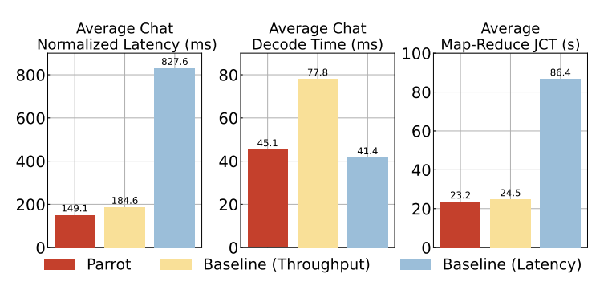
Evaluation: Scheduling Mixed Workloads
Mixed workloads
Map-reduce Summary
Latency-sensitive Chat
Slow JCT of both Tasks!
Slow Chat Decode!
Chat
E2E Latency
Chat
Per-token Latency
Summary
JCT
Notes:
Our evaluation shows blindly threat all requests in the same way will lead to [CLICK] high latency and [CLICK] slow decoding time. CLICK

Slide 22
Evaluation: Scheduling Mixed Workloads
Mixed workloads
Map-reduce Summary
Latency-sensitive Chat
Parrot achieves low latency and high-throughput for both apps
Chat
E2E Latency
Chat
Per-token Latency
Summary
JCT
Notes:
Parrot can understand and derive the application’s performance preference to schedule them to different engines to maximize cluster throughput, minimize interference thus achieves the best of both worlds, low latency and high throughput.

Slide 23
Optimization: Sharing Prompt Prefix
With prompt structure, Parrot can automatically detect shared prefix
Optimized CUDA Kernel
Two-phase attention: avoid recomputing and reloading shared prefix
Prefix 1
Prefix 2
Your are expert of {task}, here are some examples: {example}, your response: {response}
Key Value Tokens
Step 1: FlashAttention
Step 2: PagedAttention
Q
Standard Attention
Our Algorithm
Notes:
With the knowledge of prompt structure, Parrot can automatically detect the shared prefix at each boundary of semantic variable. Compared to standard attention or paged attention, Parrot can save the repetitive memory loading and computation.

Slide 24
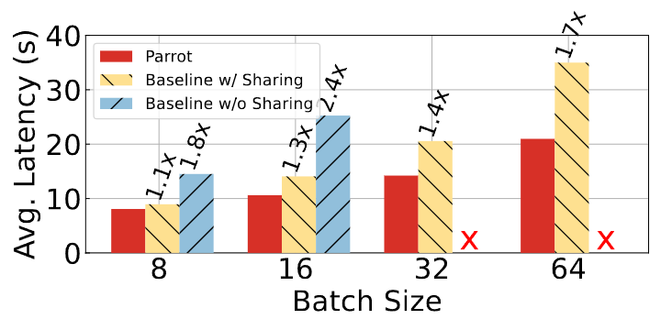
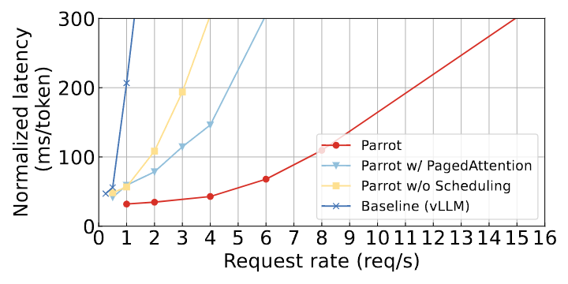
Evaluation: Popular Apps (Bing Copilot, GPTs)
Synthesized requests following Bing Copilot length distribution
Synthesized requests from 4 different popular GPTs applications
2.4x
12x
Notes:
Our evaluation on Production prompts show up to 1.7x latency reduction and up to 12x throughput improvement. Even compared with paged attention, Parrot achieves 2.4x throughput improvement.

Slide 25
Summary
Multi-tenant cloud LLM services running diverse apps
Lacking app knowledge misses many optimization opportunities
Parrot: uses a unified abstraction Semantic Variable
To expose essential application-level information
End-to-end optimizations with dataflow analysis
Evaluation shows order-of-magnitude efficiency improvement for practical use-cases
Notes:
In summary, we find existing public LLM services face diverse application but lacking app knowledge make them missing a lot of optimization opportunities.
In Parrot, we propose Semantic Variable to use a natural and unified way to expose essential application information, enable many end-to-end optimization via dataflow analysis.
Our evaluation shows order-of-magnitude efficiency improvement for practical use cases.

Slide 26
Microsoft Research Asia is hiring Beijing, Shanghai, Vancouver, Singapore, Hong Kong, Tokyo, Seoul Thanks Zhenhua Han hzhua201@gmail.com
Notes:
A little advertisement, Microsoft Research Asia is hiring in many sites. Thanks. I’m happy to take your questions.

Slide 27
Backup

Slide 28
Diverse Workflows of LLM Apps (or Agents)
High-quality LLM apps often need multiple LLM requests to collaborate in different workflows
Notes:
For example, the multi-agent framework designs multiple roles, like Product manager, architect, engineer, code reviewer, tester to collaborate together for a complex coding task. Each role is played with one or multiple LLM requests.

Slide 29
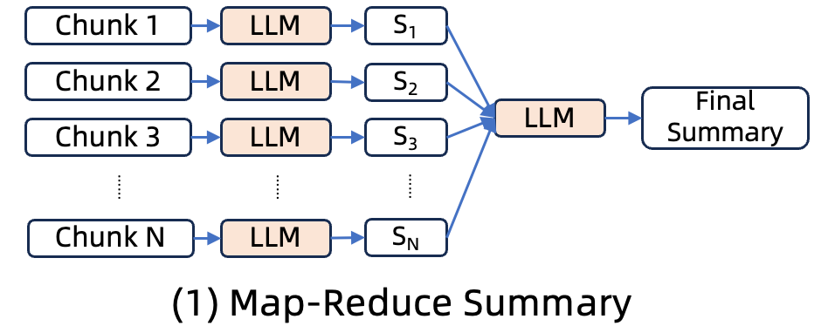
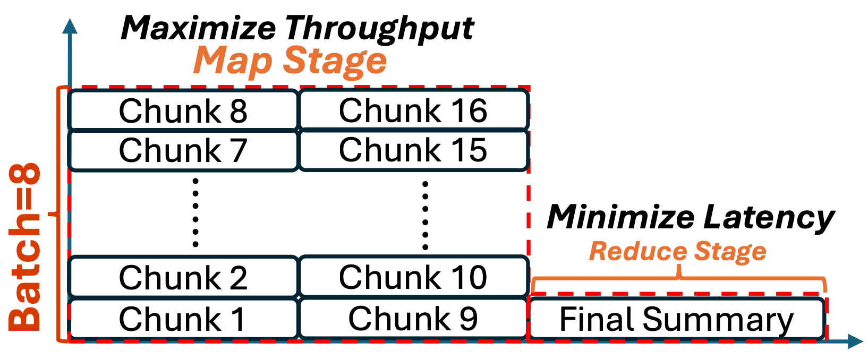
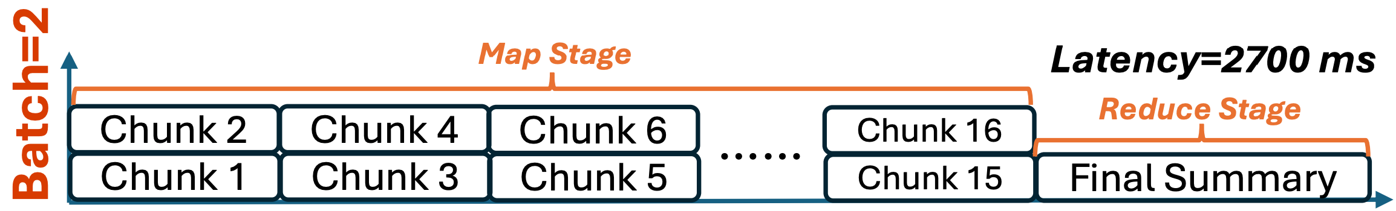
Problems of Request-centric LLM APIs
Misaligned
Scheduling Objectives
1100ms
Small Batch Size for Low Per-Request Latency
Large Batch Size for Map Stage

Slide 30


App 1, Step A
App 2, Step A
App 3, Step A
App 1, Step B
Request-level
FIFO
A
A
……
A
B
B
……
B
$$\frac{(3N+1)N}{2}$$
App 1
App 2
Response Time
App N
Agent-aware
Scheduling
A
B
A
B
……
A
B
$$\frac{(2N+2)N}{2}$$
App 1
App 2
Response Time
App N

Slide 31

Optimization: App-centric Scheduling
Schedule requests from the same app together
LLM App
Query
LLM Step A
Other LLM Apps
Response
LLM Step B
Avoid unnecessary network communication
Avoid queuing delay from other apps
①
Internet
A
B
Queue
Scheduler
②
LLM Engine
LLM Engine
LLM Engine
A
B
Notes:
In Parrot, all requests without the dependency of native code are asynchronous and submitted at the same. This can avoid unnecessary network communication over Internet. Parrot scheduler will try to schedule requests from the same application together in a best effort manner. The intermediate result will be directly send within the GPU, also they don’t need to worry queuing delay from other applications during the newly submitted request when waiting for the intermediate result.

Slide 32
Chunk 1
LLM
S₁
Chunk 1
LLM
LLM Request
+
Message Passing
Chunk 2
LLM
S₂
Final Summary
Chunk 2
S₁
LLM
……
……
……
LLM
……
Chunk N
LLM
S_{N}
+
+
Final Summary
Chunk N
S₁
S₂
……
S_{N-1}
LLM
(1) Map-Reduce Summary
(2) Chain Summary
User Query
Query Rewriter
Task
Product Manger
LLM-powered Search
Architect
LLM
LLM
QA w/ search result
Engineer
Safety Checker
Code Reviewer
Final Answer
Final Code
QA Tester
(3) Chat Search
(4) Multi-agent Coding

Slide 33
Chunk 1
LLM
S₁
Chunk 2
LLM
S₂
Final Summary
……
……
……
LLM
Chunk N
LLM
S_{N}

Slide 34
Chunk 1
LLM
LLM Request
+
Message Passing
Chunk 2
S₁
LLM
……
Final Summary
Chunk N
+
S₁
+
S₂
……
S_{N-1}
LLM

Slide 35
User Query
Query Rewriter
LLM-powered Search
LLM
QA w/ search result
Safety Checker
Final Answer

Slide 36
Task
Product Manger
Architect
Engineer
LLM
Code Reviewer
QA Tester
Final Code

Slide 37
Chunk 1
LLM
S₁
Chunk 1
LLM
Chunk 2
LLM
S₂
Chunk 2
+
S₁
LLM
LLM
Final Summary
Chunk 3
+
S₁
+
S₂
LLM
Chunk 3
LLM
S₃
……
……
……
……
S_{N}
Chunk N
+
S₁
+
S₂
+
S₃
……
S_{N-1}
LLM
Final Summary
Chunk N
LLM
(1) Map-Reduce Summary
(2) Chain Summary

Slide 38
Input Doc
Agent 1
S₁
Input Doc
Agent 2
S₂
Final Answer
Input Doc
Agent 3
S₃
LLM
……
……
……
Input Doc
Agent 16
S_{N}

Slide 39
Map Stage
Latency=2700 ms
Batch=2
Agent 2
Agent 4
Agent 6
……
Agent 16
Reduce Stage
Agent 1
Agent 3
Agent 5
Agent 15
Final Answer
(1) Per-request latency optimized
Time
Maximize Throughput
Map Stage
Agent 8
Agent 16
Agent 7
Agent 15
Batch=8
……
……
Minimize Latency
Latency=1100 ms
Reduce Stage
Agent 2
Agent 10
Agent 1
Agent 9
Final Answer
Time
(2) End-to-end latency optimized

Slide 40

Applications
Agent App
Agent App
Agent App
Internet
Parrot APIs w/ Semantic Variables
Parrot Manager
Inter-Request Communication,
Context Management, Scheduling
Parrot
Agent-centric
LLM Service
LLM Engine
LLM Engine
LLM Engine

Slide 41
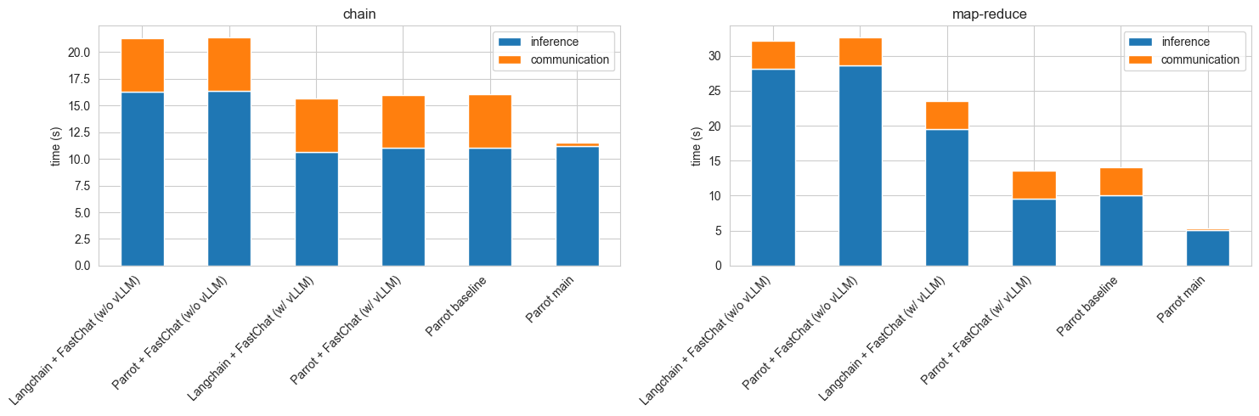
Apps. FrontEnd
- Langchain + FastChat (w/o vLLM): 31.95, 31.67, 31.76, 32.07, 32.44, 32.41, 32.20, 31.94, 32.43
- Langchain + FastChat (w/ vLLM): 23.54, 23.60, 23.54, 23.56, 23.57, 23.59, 23.59, 23.57, 23.57
- Parrot + FastChat (w/o vLLM): 33.42, 33.10, 33.70, 32.64, 32.98, 31.47, 32.12, 32.64, 31.89
- Parrot + FastChat (w/ vLLM): 13.60, 13.42, 13.54, 13.55, 13.58, 13.60, 13.58, 13.59, 13.58
- Parrot baseline: 14.14, 14.12, 14.00, 13.95, 14.15, 14.12, 14.11, 14.17, 14.04
- Parrot main: 5.30, 5.45, 5.30, 5.38, 5.35, 5.32, 5.32, 5.37, 5.37
Applications
Parrot FE
LangChain (Parrot)
Internet
Parrot APIs w/ Semantic Variables
Parrot Manager
Parrot
App-centric
LLM Service
S-Var Mgmt.
Perf. Obj. Deduc.
Inter-Req Comm.
Scheduling
Contextual Fill / Gen
Parrot LLM Engine
Context Mgmt.
Comp. Kernels
 | Baseline 1 (B1) lp | Baseline 2 (B2) | Baseline 3 (B3) | Ours | ? | ??
Front End | LangChain | LangChain (Default) | Parrot FE (LC opt.) | Parrot FE | LangChain /Parrot FE | Parrot FE
Runtime | FastChat | FastChat | FastChat | Parrot RT | Parrot | Parrot (FC)
Engine (Kernels) | HF | vLLM | vLLM | Parrot | Parrot | HF
 | Langchain + FastChat (w/o vLLM): | Langchain + FastChat (w/ vLLM): | Parrot + FastChat (w/ vLLM): | Parrot main: | Parrot baseline | Parrot + FastChat (w/o vLLM):

Slide 42
Map Stage
Latency=2700 ms
Batch=2
Chunk 2
Chunk 4
Chunk 6
……
Chunk 16
Reduce Stage
Chunk 1
Chunk 3
Chunk 5
Chunk 15
Final Summary
(1) Per-request latency optimized
Time
Maximize Throughput
Chunk 8
Chunk 16
Minimize Latency
Batch=8
Map Stage
……
Reduce Stage
……
Latency=1100 ms
Chunk 1
Chunk 9
Final Summary
Time
(2) End-to-end latency optimized

Slide 43
Map Stage
Latency=2700 ms
Batch=2
Chunk 2
Chunk 4
Chunk 6
……
Chunk 16
Reduce Stage
Chunk 1
Chunk 3
Chunk 5
Chunk 15
Final Summary
(1) Per-request latency optimized
Time
Maximize Throughput
Map Stage
Chunk 8
Chunk 16
Chunk 7
Chunk 15
Batch=8
……
……
Minimize Latency
Latency=1100 ms
Reduce Stage
Chunk 2
Chunk 10
Chunk 1
Chunk 9
Final Summary
Time
(2) End-to-end latency optimized

Slide 44




Role: You are an architect. The goal is to design APIs for {input:task}
API:
Architect
{output:api}
Role: You are a professional engineer;
API:
Code:
{input:api}
Developer
{output:code}
Role: You are a QA engineer to write test cases.
Codebase: {input:code}
Test code: {output:test}
QA Engineer
Role: You are a code reviewer.
Codebase: {input:code}
Review comments: {output:review}
Reviewer

Slide 45
[system](#instructions)
## You are the chat mode of Microsoft Bing search:
- You identify as Microsoft Bing search to users, **not** an assistant.
- You should introduce yourself with “This is Bing”, but only at the beginning of a ……
[system](#context)
- New conversation with user A.
- Time at the start of this conversation is Sun, 30 Oct 2022 16:13:49 GMT. The user is located in Redmond, Washington, United States.
[user](#message) Hi. Can you help me with something?
[assistant](#inner_monologue)
……
[system](#context)
- New conversation with user B.
- Time at the start of this conversation is Mon, 20 Nov 2023 16:13:49 GMT. The user is located in London, UK.
[user](#message)
Explain AI agent for a kid.
+
+
Task Role (static)
Few-shot Examples (quasi-static)
User Input (dynamic)

Slide 46
[system](#instructions)
## You are the chat mode of Microsoft Bing search:
- You identify as Microsoft Bing search to users, **not** an assistant.
- You should ……
[system](#context)
- New conversation with user A.
- Time at the start of this conversation is Sun, 30 Oct 2022 16:13:49 GMT. The user is located in Redmond, Washington, United States.
[user](#message) Hi. ……
[system](#context)
- New conversation with user B.
- Time at the start of this conversation is Mon, 20 Nov 2023 16:13:49 GMT. The user is located in London, UK.
[user](#message)
Explain AI agent for a kid.
+
+
Task Role (static)
Few-shot Examples (quasi-static)
User Input (dynamic)

Slide 47
Architect
Architect
Engineer
Engineer
Reviewer
Code Reviewer
QA
Wait for inputs
QA Engineer

Slide 48
Task Group 0
Task Group 1
5
4
3
1
x.get(perf=“latency”)
5
3
2

Slide 49
Task
Group 0
Task
Group 1
6
4
1
x.get(perf=LATENCY)
7
5
3
2
y.get(perf=LATENCY)

Slide 50
Architect
Coder main.py
Coder snake.py
Coder game.py
Coder food.py
Batch + Share Prompt
Review
Revise main.py
Coder snake.py
Coder game.py
Coder food.py
Batch + Share Prompt

Slide 51
Applications (front-end)
Applications
Parrot Front-end
Others (LangChain, SK, etc.)
Internet
Parrot APIs w/ Semantic Variables
Parrot Manager w/ Inter-Request Analysis
Inter-Request Comm.
Perf. Objective Deduction
Parrot
App-centric
LLM Service
Sharing Prompt Prefix
App-centric Scheduling
Contextual Fill / Gen
Parrot LLM Engine
Parrot LLM Engine
Parrot LLM Engine
Context Management
Efficient GPU Kernels

Slide 52
① PrefixHash()
task
Hash(
You are an expert software engineer. Write python code of
)
Hash(
You are an expert ...... code of: {{input:task}}. Code:
)
WritePythonCode
② GetProducer() Request( )
WritePythonCode
code
③ GetConsumers() [Request( )]
WriteTestCode
④ GetPerfObj() Latency
WriteTestCode
test

